Slide 1
“Life Abundant—Don’t waste your Life.”
John Staiger
Morningside Church of Christ
Sunday 13 December 2020
PM Sermon
Broadcast on Facebook Live from
42 Leslie Ave, Sandringham.

Slide 2
Life Abundant—
Don’t waste your Life

Slide 3

Life—
Like a Vapour
James 4:14—
Yet you do not know what your life will be like tomorrow. You are just a vapor that appears for a little while and then vanishes away. (NASB95)

Slide 4
Life—
Like a Vapour
Average life expectancy of NZ
NZer? _________

Slide 5
Life—
Like a Vapour
Average life expectancy of NZ
NZer? 82.36 years

Slide 6
Life—
Like a Vapour
Average life expectancy of NZ
Female? ________

Slide 7
Life—
Like a Vapour
Average life expectancy of NZ
Female? 83
Male? __________

Slide 8
Life—
Like a Vapour
Average life expectancy of NZ
Female? 83
Male? 79

Slide 9

Life—
Like a Vapour
Psalm 90:10—
¹⁰As for the days of our life, they contain ______ years,
Or if due to strength, ______ years,
Yet their pride is but labour and sorrow;
For soon it is gone and we fly away. (NASB95)

Slide 10
Life—
Like a Vapour
Psalm 90:10—
¹⁰As for the days of our life, they contain seventy years,
Or if due to strength, ______ years,
Yet their pride is but labour and sorrow;
For soon it is gone and we fly away. (NASB95)

Slide 11
Life—
Like a Vapour
Psalm 90:10—
¹⁰As for the days of our life, they contain seventy years,
Or if due to strength, eighty years,
Yet their pride is but labour and sorrow;
For soon it is gone and we fly away. (NASB95)

Slide 12
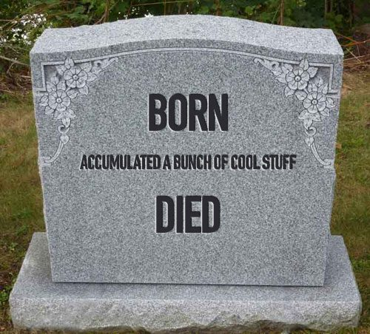
Life—
Not about stuff
Luke 12:15—
Then He said to them, “Beware, and be on your guard against every form of greed; for not even when one has an ________ does his life consist of his ___________.” (NASB95)

Slide 13
Life—
Not about stuff
Luke 12:15—
Then He said to them, “Beware, and be on your guard against every form of greed; for not even when one has an abundance does his life consist of his ___________.” (NASB95)

Slide 14
Life—
Not about stuff
Luke 12:15—
Then He said to them, “Beware, and be on your guard against every form of greed; for not even when one has an abundance does his life consist of his possessions.” (NASB95)

Slide 15
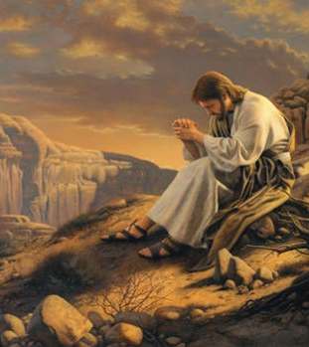
Life—
Opportunities
Luke 4:13—
When the devil had finished every temptation, he left Him until an opportune time. (NASB95)

Slide 16

Life—
Opportunities
Ephesians 4:26-28—
²⁶Be angry, and yet do not sin; do not let the sun go down on your anger, ²⁷and do not give the devil an opportunity. (NASB95)

Slide 17

Life—
Opportunities
Galatians 5:13—
For you were called to freedom, brethren; only do not turn your freedom into an opportunity for the flesh, but through love serve one another. (NASB95)

Slide 18

Life—
Opportunities
Galatians 6:10—
So then, while we have opportunity, let us do good to all people, and especially to those who are of the household of the faith. (NASB95)

Slide 19

Life—
Opportunities
Colossians 4:5—
Conduct yourselves with wisdom toward outsiders, making the most of the opportunity. (NASB95)

Slide 20

Life—
Opportunities
Lists…
Lost Souls
M.F.C

Slide 21
Life—
Opportunities
Lists…
Lost Souls
M.F.C

Slide 22
Life—
Opportunities
Lists…
Lost Souls
M_____
F______
C______

Slide 23
Life—
Opportunities
Lists…
Lost Souls
Missing
From
Church

Slide 24
Life—
Opportunities
Lists…
Lost Souls
M.F.C.

Slide 25
Life—
Opportunities
Lists…
Lost Souls
M.F.C.
  Text/Email
  Phone
  Visit
  T.A.B/S.

Slide 26
Life—
Opportunities
Lists…
Lost Souls
M.F.C.
  Text/Email
  Phone
  Visit

Slide 27
Life—
Opportunities
Lists…
Lost Souls
M.F.C.
  Text/Email
  Phone
  Visit

Slide 28
Life—
Opportunities
Lists…
Lost Souls
M.F.C.
  Text/Email
  Phone
  Visit
  T.A.B/S.

Slide 29
Life—
Opportunities
Lists…
Lost Souls
M.F.C.
  Text/Email
  Phone
  Visit
  . Tell or take
  A
  Brother/Sister

Slide 30
Life—
Opportunities
Lists…
Lost Souls
M.F.C.
  Text/Email
  Phone
  Visit
  T.A.B/S.
Sow new ground

Slide 31
Life—
Opportunities
Lists…
Lost Souls
M.F.C.
  Text/Email
  Phone
  Visit
  T.A.B/S.
Sow new ground
Work on your spiritual life

