Slide 1
His Wonders Never Cease

Slide 2

The object of our faith is the Lord our God.

Slide 3
His ‘wonders’ are a reflection of His inner thoughts towards us.

Slide 4
Wonders—Wondrous (i.e. supernaturally marvellous) deeds.

Slide 5
He is indeed beyond compare

Slide 6
His mercies

Slide 7
—the things we have already experienced—

Slide 8
Are but a fraction of what is still kept in store for us.

Slide 9
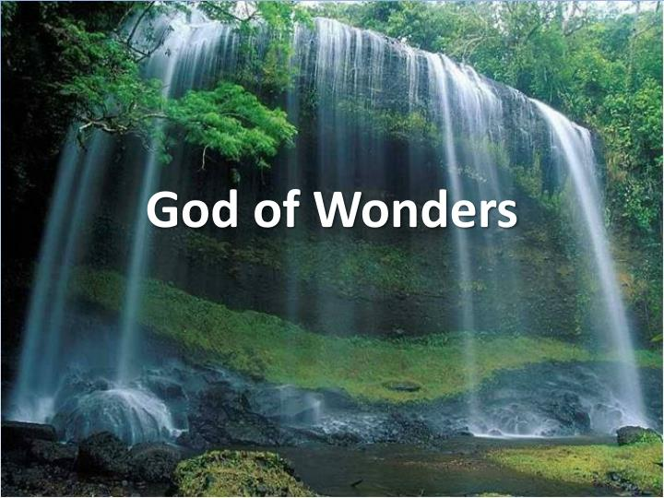
Natural Wonders Surround Us!

Slide 10
Beauty everywhere

Slide 11
Human beings are the crowning glory of His creation

Slide 12
We are made in God’s image
  Creatures of choice
  We are born Pure in Heart (Not ‘Sinful by Nature.’

Slide 13
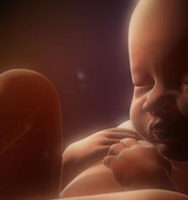
Psalm 139:13-14
¹³ For You formed my inward parts;
You wove me in my mother’s womb.
¹⁴ I will give thanks to You, for I am fearfully and wonderfully made;
Wonderful are Your works,
And my soul knows it very well. (NASB95)

Slide 14
Ecclesiastes 11:5
Just as you do not know the path of the wind and how bones are formed in the womb of the pregnant woman, so you do not know the activity of God who makes all things. (NASB95)

Slide 15
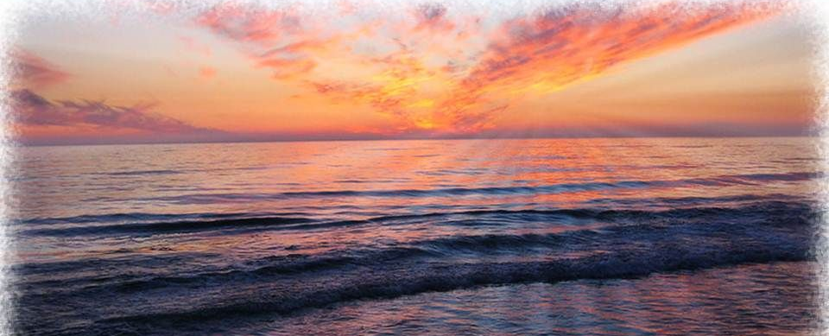
Psalm 40:5—
⁵Many, O Lord my God, are the wonders which You have done,
And Your thoughts toward us;
There is none to compare with You.
If I would declare and speak of them,
They would be too numerous to count. (NASB95)

Slide 16
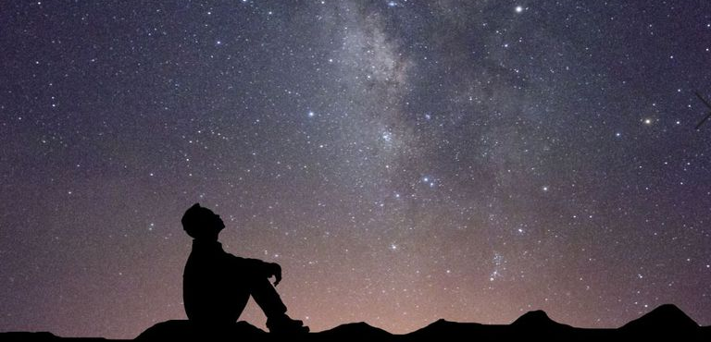
Psalm 19:1-4
¹The heavens are telling of the glory of God;
And their expanse is declaring the work of His hands.

Slide 17
Psalm 19:1-4
² Day to day pours forth speech,
And night to night reveals knowledge.

Slide 18
Psalm 19:1-4
³ There is no speech, nor are there words;
Their voice is not heard. (NASB95)

Slide 19
Psalm 19:1-4
⁴ Their line has gone out through all the earth,
And their utterances to the end of the world. (NASB95)

Slide 20
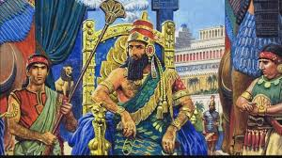
The Wonders of Babylon—short lived!
Jeremiah 51:29—The land trembles and writhed, for the Lord’s purposes against Babylon stand—to lay waste the land of Babylon so that no one will live there.

Slide 21
The Wonders of Babylon—short lived!

Slide 22
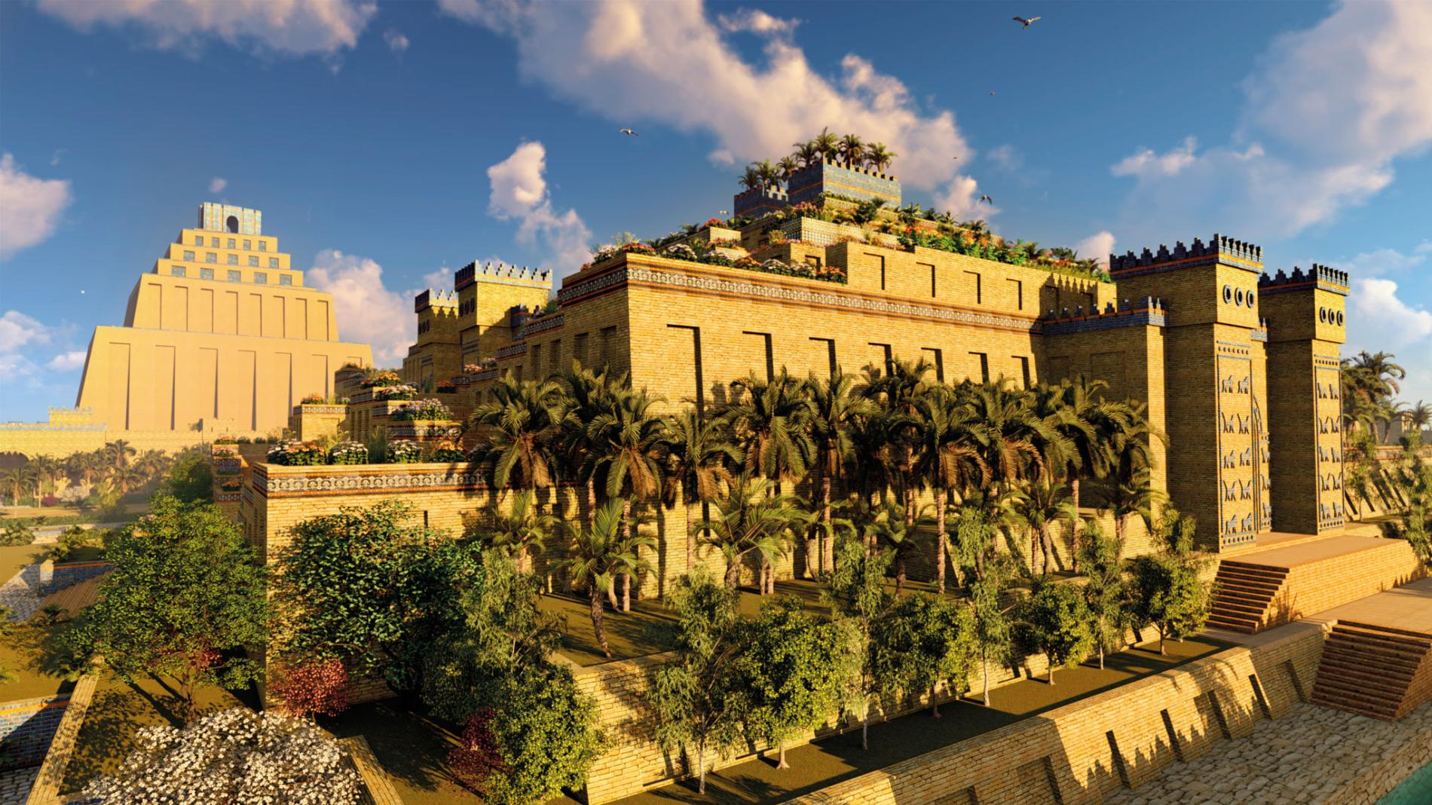
Babylon—Then…

Slide 23
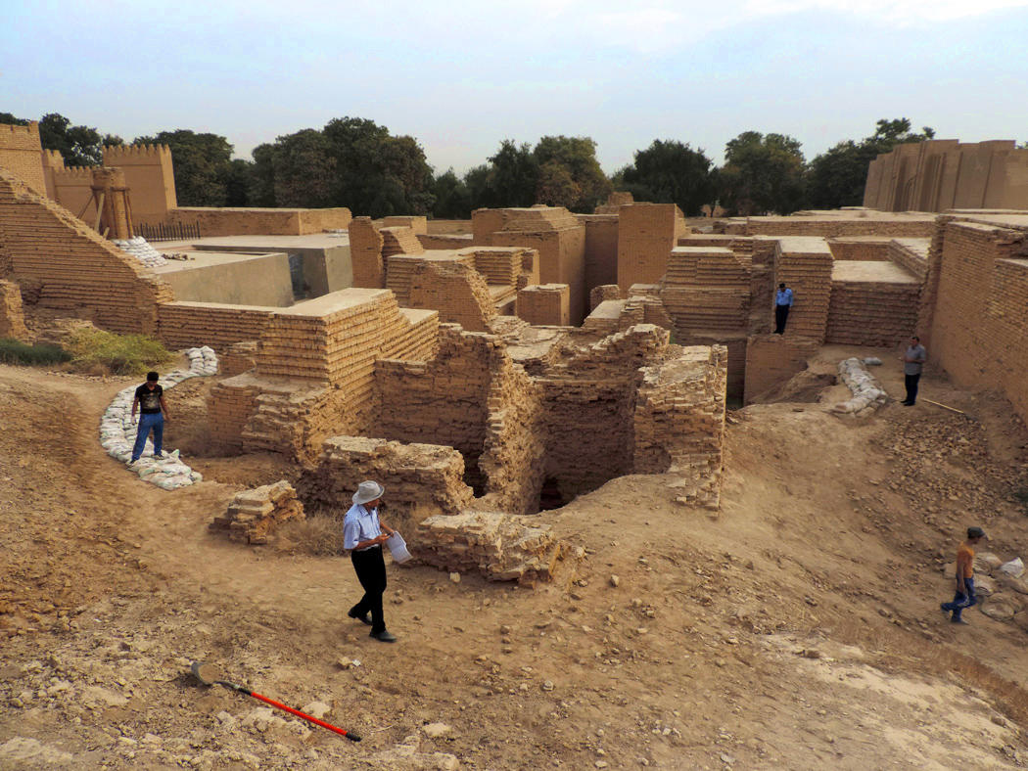
Babylon—Now!

Slide 24
Jeremiah 51:29—The land trembles and writhed, for the Lord’s purposes against Babylon stand—to lay waste the land of Babylon so that no one will live there.

Slide 25
Faith in God’s Power and Love
Psalm 62:11-12
¹¹ One thing God has spoken,
two things I have heard:
“Power belongs to you, God,
¹²and with you, Lord, is unfailing love”;
and, “You reward everyone
according to what they have done.”
Gives you power to love.
The rewards of faith and good works are blessings now and into eternity.

Slide 26
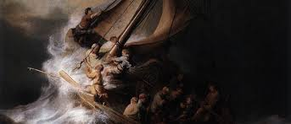
The struggles of everyday life focus our thoughts and energies on daily survival—
Away from the Wonders of an all loving and powerful God
So, take care where your thoughts are

Slide 27
Mark 4:35ff ³⁵ That day when evening came, he said to his disciples, “Let us go over to the other side.” ³⁶ Leaving the crowd behind, they took him along, just as he was, in the boat. There were also other boats with him. ³⁷ A furious squall came up, and the waves broke over the boat, so that it was nearly swamped. ³⁸ Jesus was in the stern, sleeping on a cushion. The disciples woke him and said to him, “Teacher, don’t you care if we drown?”
³⁹ He got up, rebuked the wind and said to the waves,

Slide 28
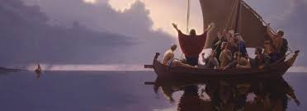
“Quiet! Be still!” Then the wind died down and it was completely calm.
⁴⁰ He said to his disciples, “Why are you so afraid? Do you still have no faith?”
⁴¹ They were terrified and asked each other, “Who is this? Even the wind and the waves obey him!”

Slide 29
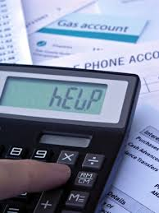
The Power of Christ brings calm to your everyday life—All you have to do is ask!
Philippians 4:4-6
⁴ Rejoice in the Lord always. I will say it again: Rejoice! ⁵ Let your gentleness be evident to all. The Lord is near. ⁶ Do not be anxious about anything, but in every situation, by prayer and petition, with thanksgiving, present your requests to God. ⁷ And the peace of God, which transcends all understanding, will guard your hearts and your minds in Christ Jesus.

Slide 30
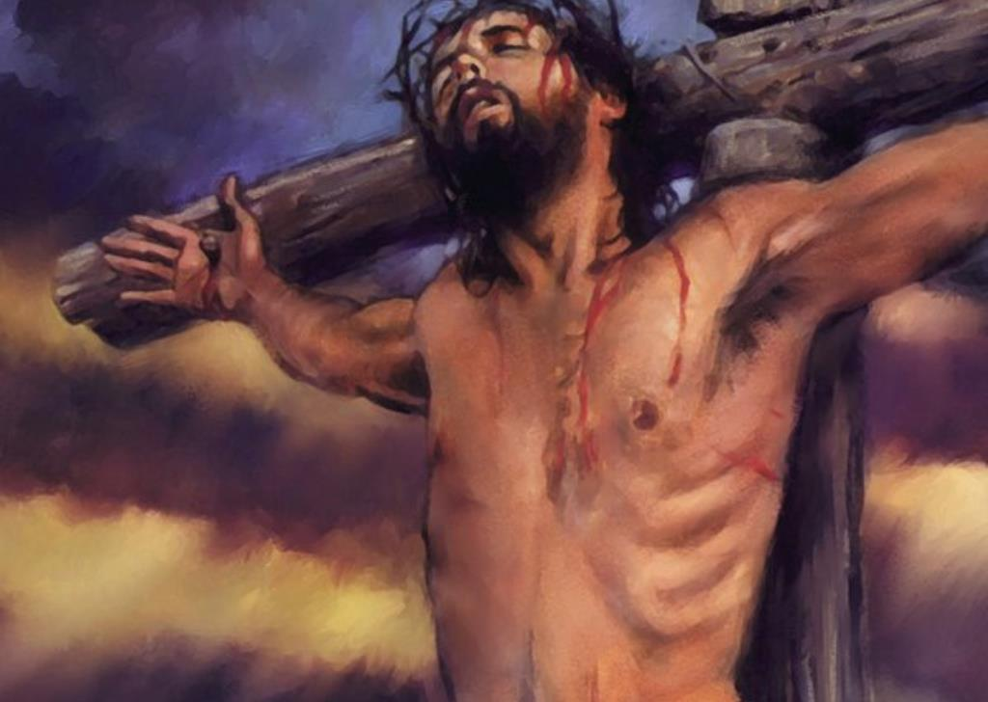
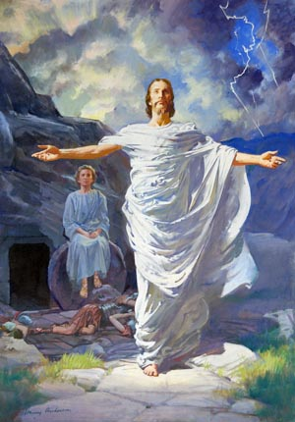
Philippians 3:10—
¹⁰ I want to know Christ—yes, to know the power of his resurrection and participation in his sufferings, becoming like him in his death,

Slide 31
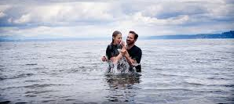
Romans 6:3-4Or don’t you know that all of us who were baptized into Christ Jesus were baptized into his death? ⁴ We were therefore buried with him through baptism into death in order that, just as Christ was raised from the dead through the glory of the Father, we too may live a new life.

