Slide 1
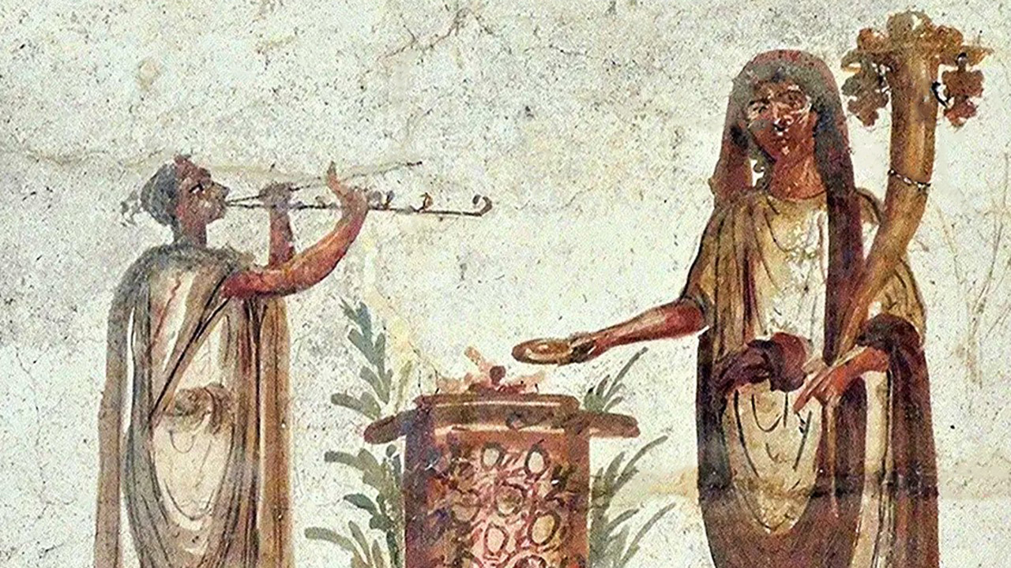
what if I think you’re crazy and you think I’m evil?
Notes:
Did not want to do this lesson
Fourth lockdown for Auckland
Third time with hotspots here in South Auckland
Then started to see discussions of prioritizing the vaccine in S Auckland → needed to look into this, perhaps write an article for the bulletin, people could read it or not, and then I would drop it
But then started to see a lot of attention in the media on South Auckland churches…

Slide 2
Efeso Collins
Sunday, 28 February
“I’ve received a number of messages today with people saying the church should excommunicate me & calling me to repent for supporting a vaccine roll out in (south) Auckland.”

Slide 3
Mike King
Monday, 1 March
“Yesterday I posted that I live in Papatoetoe and my family and I would be happily vaccinated for Covid once it was available…
“What I discovered? There are a lot of feral self-righteous zealots on BOTH sides”

Slide 4
Dan Satherley
Tuesday, 2 March
“It’s not clear what conspiracies are spreading amongst south Auckland churches, but well-known false claims include that the vaccines contain microchips (they don’t); that they can alter our DNA (they can’t); and that they contain cells from aborted babies (untrue).”

Slide 5
Hannah Tamaki
Wednesday, 3 March
“Everything in your life is a choice.. make sure you choose for yourself, not be talked into something you are not happy to do ..
“I’m not taking the vaccine.. that’s my choice..”

Slide 6
Hilary Barry
Thursday, 4 March
“$100 says Jesus would have had the jab.”
Notes:
This is what made me do this lesson
At worst, offensive – clever? funny? try replacing “Jesus” with “Muhammed” and see if anybody would have thought it was clever or funny
At best, tone-deaf – the whole problem is that they wanted people in South Auckland churches to take the vaccines, and this the social media point scoring by the media is exactly the thing that will turn people off
So, well done Hilary

Slide 7
an inconvenient truth

Slide 8
PER.C6
1990s
Janssen-
Johnson & Johnson
GROWN
AstraZeneca-Oxford
Novavax
*Pfizer-BioNTech
GROWN
HEK293
1970s
TESTED
Notes:
grown: cells filtered out, so no one is getting a syringe full of baby cells
tested: also tested on other substrates
* = currently the vaccine being used in NZ
happy to provide all the links to research – no links to pro-life sources or conspiracy videos
Janssen /yahn-sen/

Slide 9
“Sign me up. No babies were killed in order to make these vaccines.”
“No way. The mere association of abortion in this whole process is enough to put me off.”
Notes:
I’m not aware of any other reasonable objections to the vaccines other than their association with these fetal cell lines.
Given the facts, here are two reasonable responses that Christians could take.
Those two responses seem far apart, but I want to suggest that this is not unusual when dealing with controversies like this. In fact, we saw something very similar in New Testament times…

Slide 10
your intuitions may vary
Notes:
Like your mileage may vary
Read 1 Corinthians 8:1-13
Also read Romans 14:13-23
One hyper-focused on purity – mere association with pagan worship, idol sacrifice, was enough to put them off
The other side could not see purity as a problem – they had no involvement in the original offering, did not attach any special significance to the food, food was food
Talking past each other → breakdown in unity
Purity is important part of our moral thinking…

Slide 11
Put to death therefore what is earthly in you: sexual immorality, impurity, passion, evil desire, and covetousness, which is idolatry.
Colossians 3:5

Slide 12
²⁰ …why, as if you were still alive in the world, do you submit to regulations— ²¹ “Do not handle, Do not taste, Do not touch” ²² (referring to things that all perish as they are used)—according to human precepts and teachings? ²³ These have indeed an appearance of wisdom in promoting self-made religion and asceticism and severity to the body, but they are of no value in stopping the indulgence of the flesh.
Colossians 2:20-23
Notes:
But
(a) we can push purity too far, and
(b) purity is not the only sheriff in town…

Slide 13
³⁹ Now when the Pharisee who had invited Him saw this, he said to himself, “If this man were a prophet, He would have known who and what sort of woman this is who is touching Him, for she is a sinner” . . . .
⁴⁸ And He said to her, “Your sins are forgiven.” ⁴⁹ Then those who were at table with Him began to say among themselves, “Who is this, who even forgives sins?”
Luke 7:39,48-49
Notes:
For the Pharisees, the mere association with this sinful woman, let alone physical contact, would have polluted or contaminated them in someway
But for Jesus, the short-term loss of purity had to be weighed against another really important way of thinking about right and wrong, and that is, authority – here, His authority to forgive to sins
The NET Bible offers an interesting study note on “touching”: “The Pharisees believed in a form of separationism that would have prevented them from any kind of association with such a sinful woman.”

Slide 14
¹ Now concerning food offered to idols: we know that “all of us possess knowledge.” This “knowledge” puffs up, but love builds up. . . .
¹² Thus, sinning against your brothers and wounding their conscience when it is weak, you sin against Christ.
1 Corinthians 8:1,12
Notes:
Paul understood the intuitions at play in Corinth. You can’t tell a purity-focused person that his position is backward, or that he should just “get over it,” or that he should eat the free food and be grateful. To take that approach, Paul insisted, was to sin against your brother and against Christ

Slide 15
¹² For the word of God is living and active, sharper than any two-edged sword, piercing to the division of soul and of spirit, of joints and of marrow, and discerning the thoughts and intentions of the heart. ¹³ And no creature is hidden from His sight, but all are naked and exposed to the eyes of Him to whom we must give account.
Hebrews 4:12-13
Notes:
One final point
we have said purity, authority, are a couple of the really important things to consider when we a trying to make good moral choices
but intention is really important as well
these so-called stronger Christians back in Paul’s day could buy or eat any food because it was just food, and not because they had the intention of honouring or praising the Greek or Roman deity of some sort
it is one thing to intentionally kill a baby to make a vaccine, it is another to use already existing cell lines in research and development

Slide 16
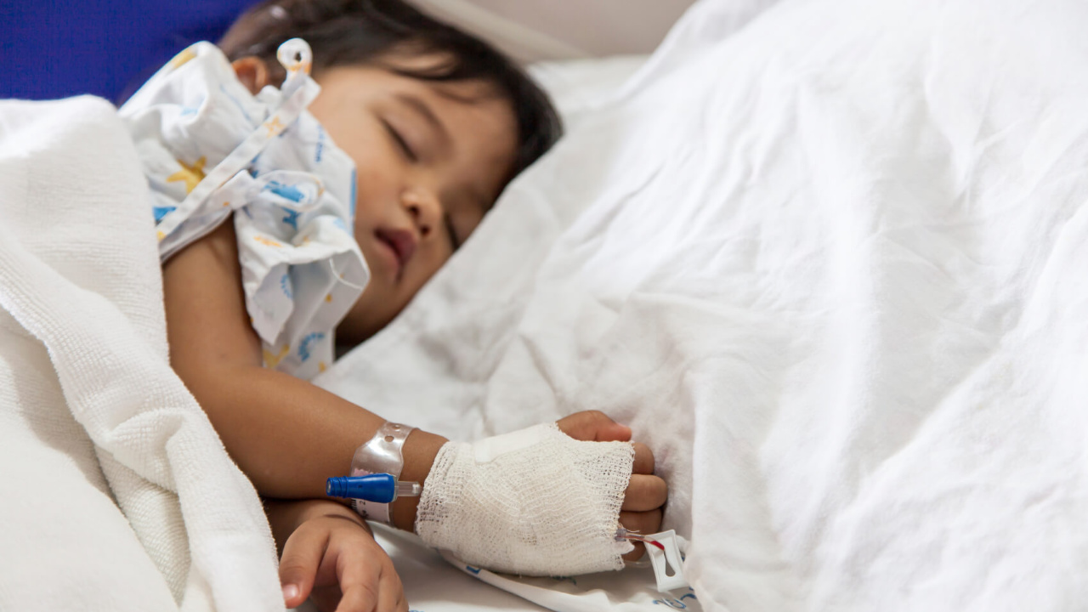
Notes:
I know we are not all going to be on the same page on this subject
Let me leave you with this thought experiment: sitting in hospital with sick child, needs heart transplant, heart becomes available from a child that was brutally murdered, would you accept that heart despite the circumstances surrounding how it became available?
I’m not trying to sway you one way or another
But I think our intuitions will go in different directions
Scripture helps us understand what that means for church unity and brotherly love

Slide 17
Notes:
One option: yep, no problem, here’s my arm, jab away
Another option: never in a million years
Third option: wait
on more information
on more options
on the pressing need

