Slide 1
Faith—Ever Growing

Slide 2

2 Thessalonians 1:3—
We ought always to give thanks to God for you, brethren, as is only fitting, because your faith is greatly enlarged, and the love of each one of you toward one another grows ever greater; (NASB95)

Slide 3
Their Faith Had Grown
2 Thessalonians 1:3—
We ought always to give thanks to God for you, brethren, as is only fitting, because your faith is greatly enlarged, and the love of each one of you toward one another grows ever greater; (NASB95)

Slide 4
Proof:
Their Love had Grown
2 Thessalonians 1:3—
We ought always to give thanks to God for you, brethren, as is only fitting, because your faith is greatly enlarged, and the love of each one of you toward one another grows ever greater; (NASB95)

Slide 5
Proof:
Their Love had Grown
Note those tell-tale signs:
Growing Faith More patience
                More Kindness
                More Generosity
                More Hospitality
                More Forgiveness

Slide 6
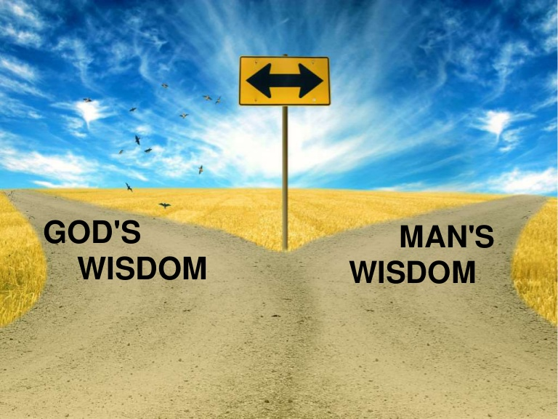
1 Corinthians 2:4-5
⁴and my message and my preaching were not in persuasive words of wisdom, but in demonstration of the Spirit and of power, ⁵so that your faith would not rest on the wisdom of men, but on the power of God. (NASB95)

Slide 7
Not Based on Man’s Wisdom
1 Corinthians 2:4-5
⁴and my message and my preaching were not in persuasive words of wisdom, but in demonstration of the Spirit and of power, ⁵so that your faith would not rest on the wisdom of men, but on the power of God. (NASB95)

Slide 8
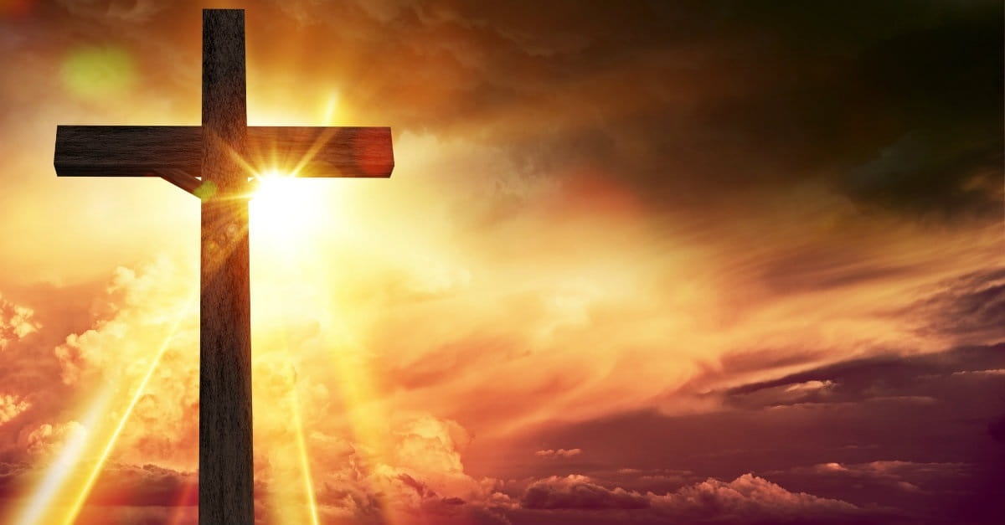
John 12:46—
I have come as Light into the world, so that everyone who believes in Me will not remain in darkness. (NASB95)
Out of Darkness

Slide 9
Colossians 1:13—
For He rescued us from the domain of darkness, and transferred us to the kingdom of His beloved Son,
(NASB95)
Out of Darkness

Slide 10
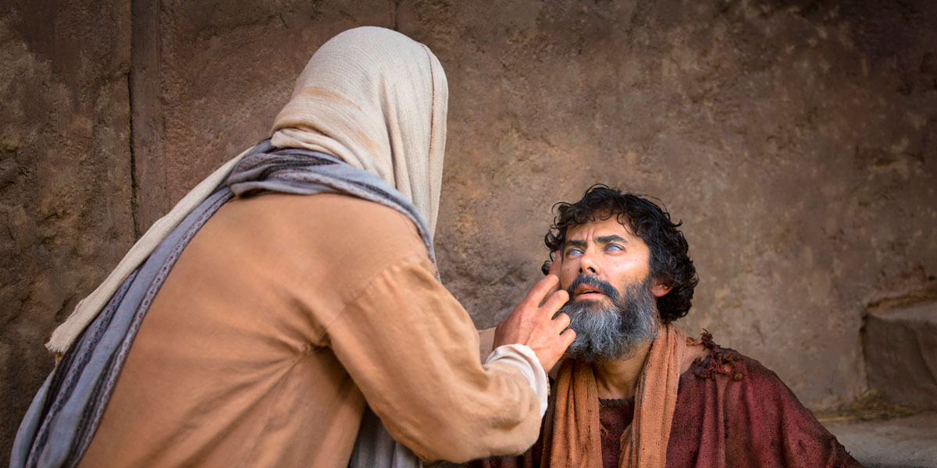
Words Backed By Action
John 10:25—Jesus answered them, “I told you, and you do not believe; the works that I do in My Father’s name, these testify of Me. (NASB95)

Slide 11
Words Backed By Action
John 20:30-31—³⁰Therefore many other signs Jesus also performed in the presence of the disciples, which are not written in this book; ³¹but these have been written so that you may believe that Jesus is the Christ, the Son of God; and that believing you may have life in His name. (NASB95)

Slide 12
Christians—Protected
1 Peter 1:5—
⁵who are protected by the power of God through faith for a salvation ready to be revealed in the last time. (NASB95)

Slide 13
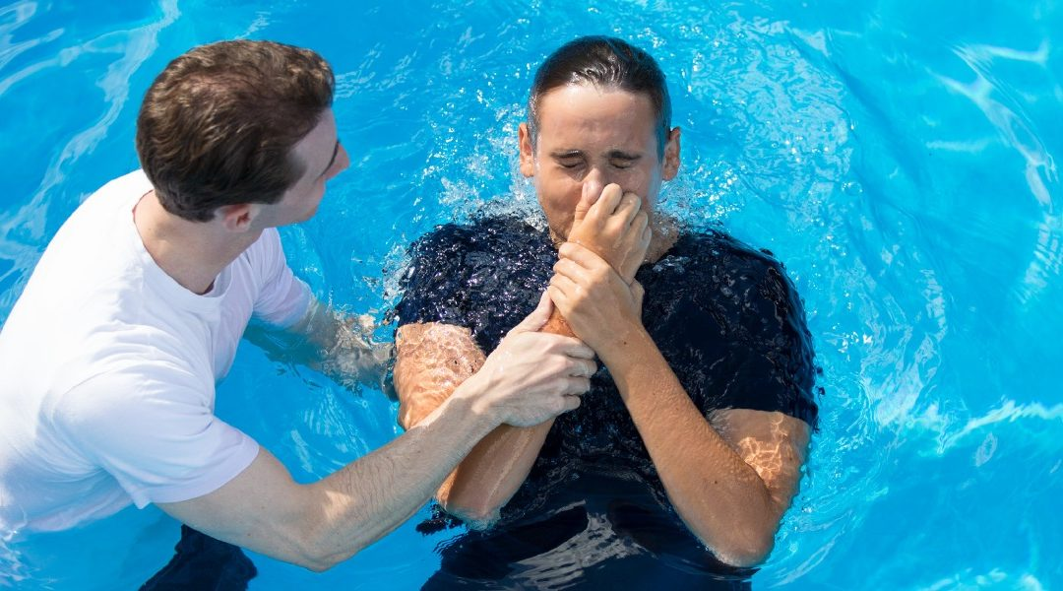
Faith brings you to Baptism

