Slide 1
“Isn't this the carpenter?
John Staiger
Morningside Church of Christ
Sunday 7 February 2021
PM Sermon
Broadcast on Facebook Live from
42 Leslie Ave, Sandringham.

Slide 2
Isn't this the carpenter?

Slide 3
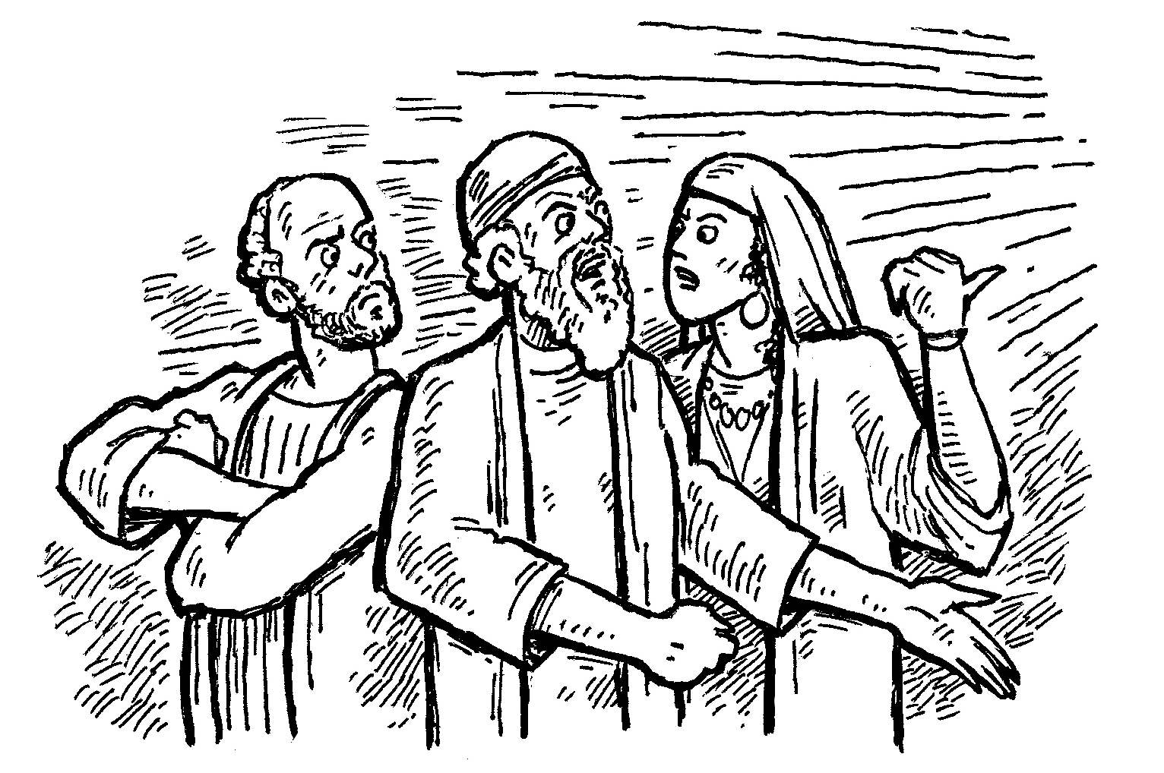
Going Home
Rejection of Jesus at Nazareth

Slide 4

Mark 6:1-6
Jesus went out from there and *came into His hometown; and His disciples *followed Him. ²When the Sabbath came, He began to teach in the synagogue; and the many listeners were astonished, saying, “Where did this man get these things, and what is this wisdom given to Him, and such miracles as these performed
by His hands? ³Is not this the
carpenter, the son of Mary,
and brother of James and
Joses and Judas and Simon?...

Slide 5
Mark 6:1-6
…Are not His sisters here with us?” And they took offense at Him. ⁴Jesus said to them, “A prophet is not without honour except in his hometown and among his own relatives and in his own household.” ⁵And He could do no miracle there except that He laid His hands on a few sick people and healed them.
⁶And He wondered at their
unbelief. And He was going
around the villages teaching.
(NASB95)

Slide 6
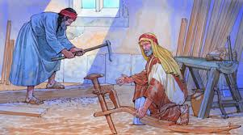
Isn't this the carpenter?
The perfect society according to one wise man of old:
Weavers
Farmers
Shoemakers
And…
Carpenters (builders).

Slide 7

Three Facts
Jesus is the Builder and a Destroyer

Slide 8

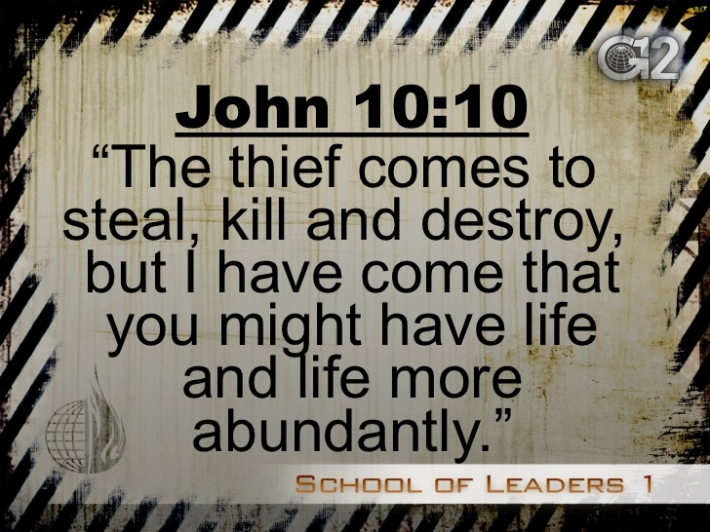
Three Facts
2. Satan is the Destroyer

Slide 9
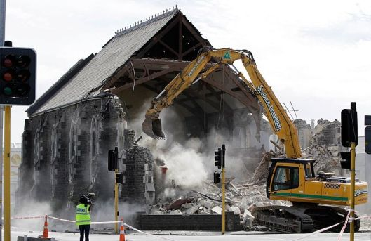
Three Facts
3. Each of us is either involved in tearing down…

Slide 10

Three Facts
3. Each of us is either involved in tearing down or building up.

Slide 11
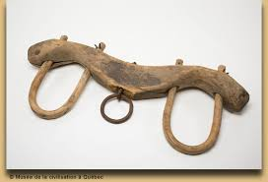
Jesus is the Master Builder
Jesus, the greatest leader, was first a working man—He made things.

Slide 12
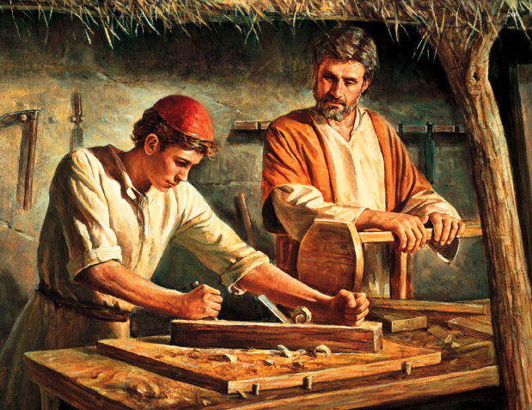
Jesus is the Master Builder
“Whosoever doesn't teach his son a trade makes him a thief.”

Slide 13
How can we be Builders?
Essential—Love
1 Corinthians 8:1b-2—…Knowledge makes arrogant, but love edifies. ²If anyone supposes that he knows anything, he has not yet known as he ought to know; (NASB95)

Slide 14

How can we be Builders?
Essential—Love
Knowledge without love becomes a weapon for tearing down!

Slide 15
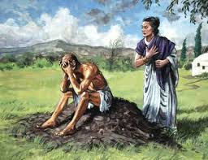
How can we be Builders?
Essential—Know your enemy
Never take Satan lightly
Two forces at work in our lives today—Jesus the Builder and Satan the Destroyer. Who determines what is done?—we do!

Slide 16
How can we be Builders?
Essential—Know your enemy
Never take Satan lightly
Two forces at work in our lives today—Jesus the Builder and Satan the Destroyer. Who determines what is done?—we do!

Slide 17
How can we be Builders?
Essential—Know your enemy
You and I must make a daily decision…
Will we allow Jesus to build us up, or Satan to tear us down?
Never take Satan lightly

Slide 18
How can we be Builders?
Essential—Know your enemy
You and I must make a daily decision…
Will we allow Jesus to build us up, or Satan to tear us down?
Never take Satan lightly

Slide 19
How can we be Builders?
Essential—Know your enemy
Even in the best run homes he can get in and destroy
He came into Eden and deceived—and Paradise was lost.
Destroyed Job’s wealth, family and body
Never take Satan lightly

Slide 20
How can we be Builders?
Essential—Purpose Built
Ephesians 4:11-12—
¹¹And He gave some as apostles, and some as prophets, and some as evangelists, and some as pastors and teachers, ¹²for the equipping of the saints for the work of service, to the building up of the body of Christ; (NASB95)

Slide 21
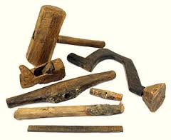
You and I are the Materials and the Tools for the building
1 Peter 2:5a
⁵you also, like living stones, are being built into a spiritual house…
When Jesus wants to build, he uses our hands…our tongues…our talents
Romans 6:13b
…and offer every part of
yourself to him as an
instrument of righteousness.

Slide 22
You and I are the Materials and the Tools for the building
1 Peter 2:5a
⁵you also, like living stones, are being built into a spiritual house…
When Jesus wants to build, he uses our hands…our tongues…our talents
Romans 6:13b
…and offer every part of
yourself to him as an
instrument of righteousness.

Slide 23
You and I are the Materials and the Tools for the building
1 Peter 2:5a
⁵you also, like living stones, are being built into a spiritual house…
When Jesus wants to build, he uses our hands…our tongues…our talents
Romans 6:13b
…and offer every part of
yourself to him as an
instrument of righteousness.

Slide 24
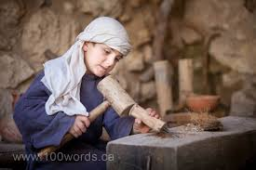
You and I are the Materials and the Tools for the building
People who say…
“Lord, here am I, use me!”
Here are my
  Hands
  Feet
  Skills
  Words
  ACTIONS…

Slide 25
You and I are the Materials and the Tools for the building
People who say…
Is there a need God can use me for?
Speaking a good word for Jesus.
Food to be delivered
A bed for the stranger
A word of encouragement
Prayers to be offered
Repairs to be made
Classes to be taught

Slide 26
You and I are the Materials and the Tools for the building
People who say…
“I want to be like Jesus, I’m ready to build.”

