Slide 1
The Narrow Road Code
Part Four
Walk Humbly with Your God.

Slide 2
Micah 6:8
⁸He has told you,
O man, what is good;
And what does the Lord
require of you
But to do justice,
to love kindness,
And to walk humbly with your God? (NASB95)

Slide 3

I Walk with the King!
Before you can speak about the
“HOW”
of Walking…

Slide 4
I Walk with the King!
You have to know
“WHO”
you are walking with.

Slide 5
I Walk with the King!
Define the
“WHO…”

Slide 6
I Walk with the King!
And you will properly
define the
“HOW.”

Slide 7
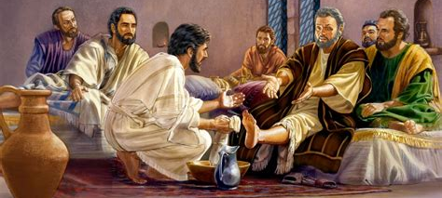
Humility Defined
Jn.13:15—For I gave you an example that you also should do as I did to you. (NASB95)

Slide 8

Humility Defined
Ex.10:3—Moses and Aaron went to Pharaoh and said to him, “Thus says the Lord, the God of the Hebrews, ‘How long will you refuse to humble yourself before Me? Let My people go, that they may serve Me. (NASB95)

Slide 9
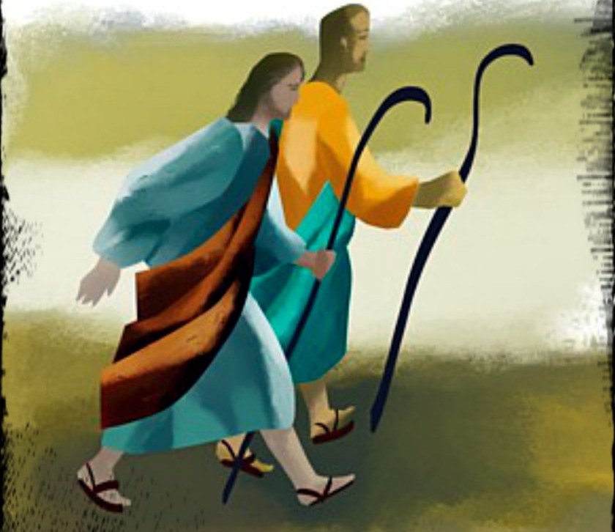

Humility Defined
Mt.10:16—“Behold, I send you out as sheep in the midst of wolves; so be shrewd as serpents and innocent as doves. (NASB95)

Slide 10
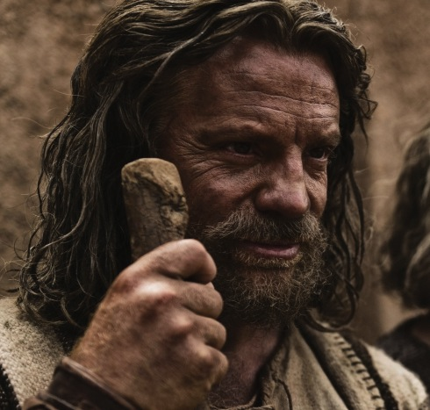
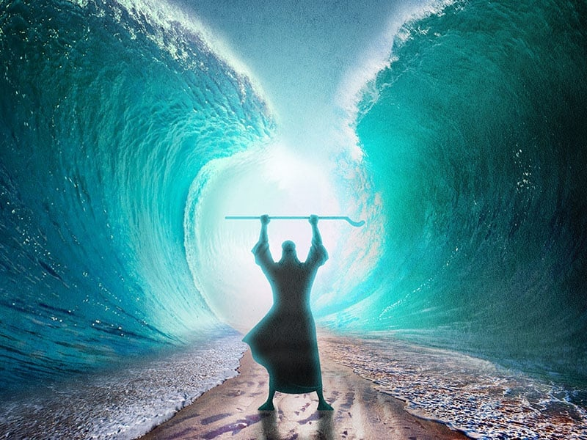
Humility Defined
Numbers 12:3—(Now the man Moses was very humble, more than any man who was on the face of the earth.) (NASB95)

Slide 11
Walking in the Opposite Direction
The closer you walk to Jesus, the more misunderstood you will be.

Slide 12
Walking in the Opposite Direction
John 15:19
¹⁹ If you were of the world, the world would love its own; but because you are not of the world, but I chose you out of the world, because of this the world hates you. (NASB95)

Slide 13
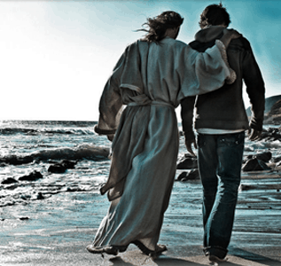
Walking in the Opposite Direction
Let’s be clear, it is impossible to remain in fellowship with the world and Christ at the same time.

Slide 14
Walking in the Opposite Direction
Romans 12:2
²And do not be conformed to this world, but be transformed by the renewing of your mind, so that you may prove what the will of God is, that which is good and acceptable and perfect. (NASB95)

Slide 15

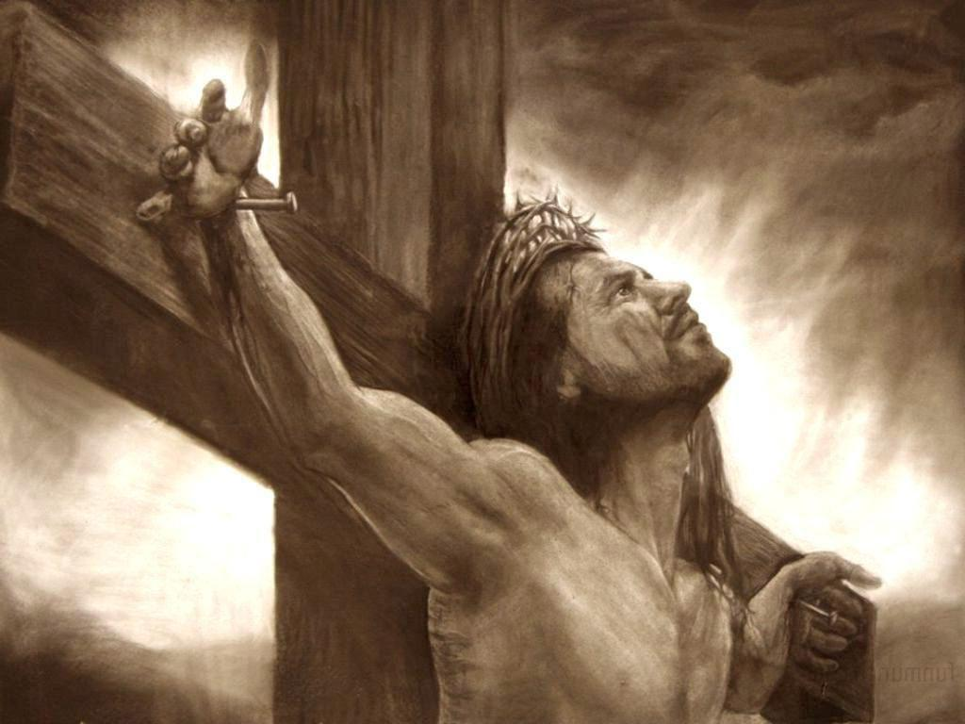
A rare commodity
Phil.2:8—Being found in appearance as a man, He humbled Himself by becoming obedient to the point of death, even death on a cross. (NASB95)

Slide 16

Acts 2:38—
Peter said to them, “Repent, and each of you be baptized in the name of Jesus Christ for the forgiveness of your sins; and you will receive the gift of the Holy Spirit. (NASB95)

