Slide 1
“On our Way Home.”
John Staiger
Morningside Church of Christ
Sunday 21 March 2021
PM Sermon
Broadcast on Facebook Live from
42 Leslie Ave, Sandringham.

Slide 3

On our Way Home

Slide 4
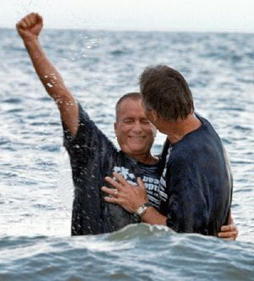
The Journey Begins…
No Day like it!

Slide 5
The Journey Begins…
No Day like it!
Begins with excitement.
Acts 8:39…

Slide 6
The Journey Begins…
No Day like it!
Acts 8:39—
³⁹When they came up out of the water, the Spirit of the Lord snatched Philip away; and the eunuch no longer saw him, but went on his way rejoicing. (NASB95)

Slide 7
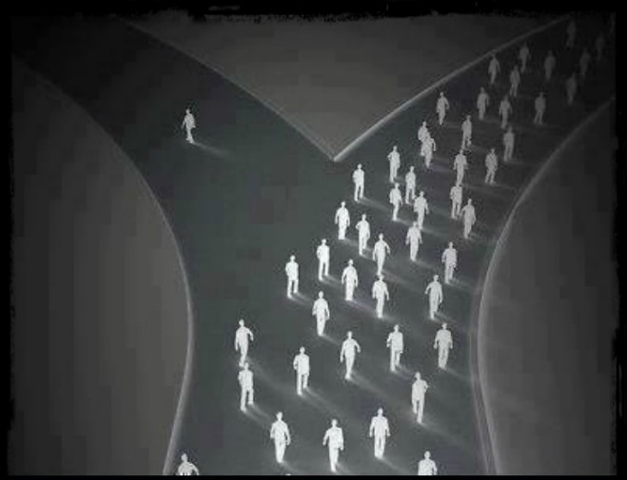
The Lay of the Land…
Things get tight and Lonely!
Mt.7:13-14—

Slide 8
The Lay of the Land…
Things get tight and Lonely!
Mt.7:13-14—
¹³ “Enter through the narrow gate; for the gate is wide and the way is broad that leads to destruction, and there are many who enter through it. ¹⁴ For the gate is small and the way is narrow that leads to life, and there are few who find it. (NASB95)

Slide 9
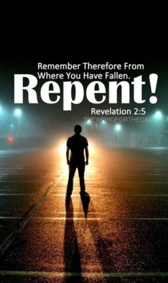
Losing your way…
Even Churches face Difficult and Dangerous times
Revelation 2:5—⁵Therefore remember from where you have fallen, and repent and do the deeds you did at first; or else I am coming to you and will remove your lampstand out of its place—unless you repent. (NASB95)

Slide 10
Losing your way…
Even Churches face Difficult and Dangerous times
Revelation 2:5—⁵Therefore remember from where you have fallen, and repent and do the deeds you did at first; or else I am coming to you and will remove your lampstand out of its place—unless you repent. (NASB95)

Slide 11
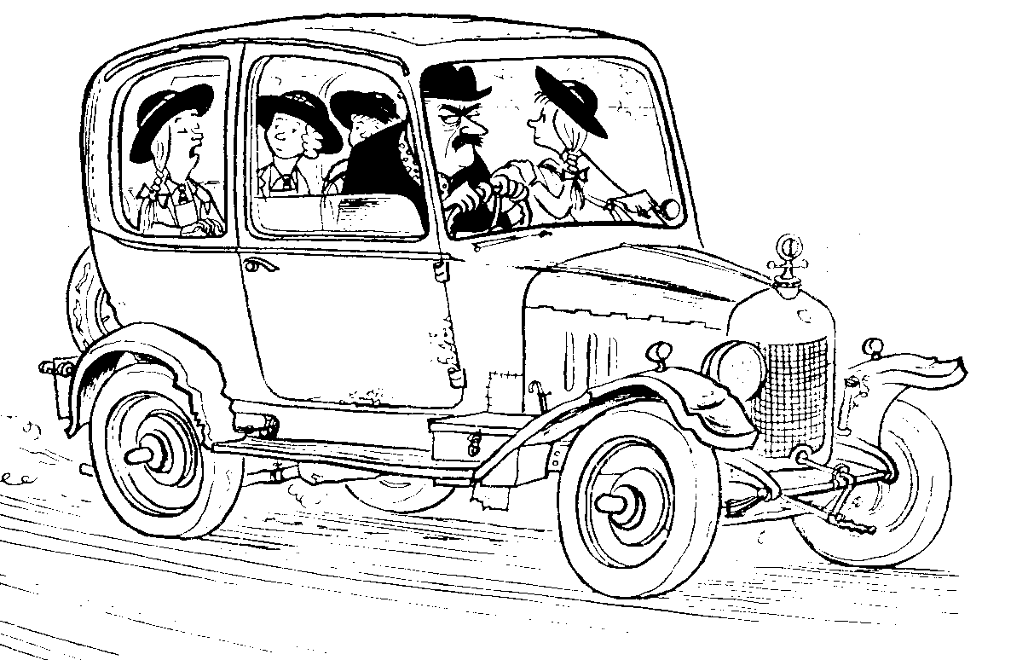
Backseat squabbles—
Philippians 2:14—
¹⁴Do all things without grumbling or disputing; (NASB95)

Slide 12
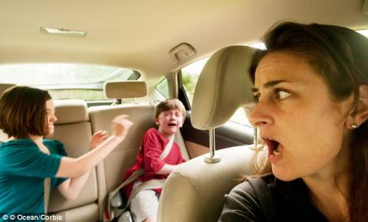
Backseat squabbles—
Ephesians 4:31—
³¹Let all bitterness and wrath and anger and clamour and slander be put away from you, along with all malice. (NASB95)

Slide 13
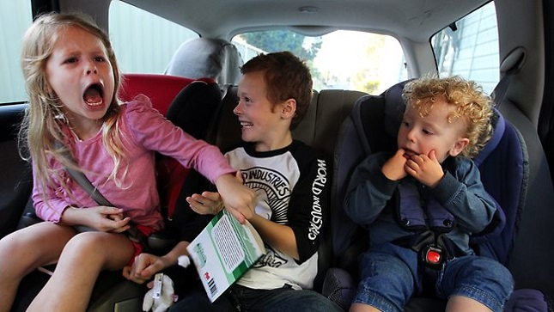
Backseat squabbles—
Galatians 5:15—
¹⁵But if you bite and devour one another, take care that you are not consumed by one another. (NASB95)

Slide 14

Losing your bearings…
Matthew 13:22—
²²And the one on whom seed was sown among the thorns, this is the man who hears the word, and the worry of the world and the deceitfulness of wealth choke the word, and it becomes unfruitful. (NASB95)

Slide 15
Losing your bearings…
Matthew 16:26—
²⁶For what will it profit a man if he gains the whole world and forfeits his soul? Or what will a man give in exchange for his soul? (NASB95)

Slide 16
Losing your bearings…
2 Timothy 4:10—
¹⁰for Demas, having loved this present world, has deserted me and gone to Thessalonica;… (NASB95)

Slide 17
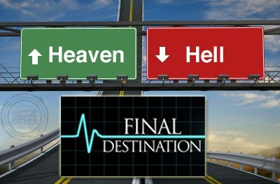
Worth the Journey…
Revelation 21:4—
⁴and He will wipe away every tear from their eyes; and there will no longer be any death; there will no longer be any mourning, or crying, or pain; the first things have passed away.” (NASB95)

Slide 18
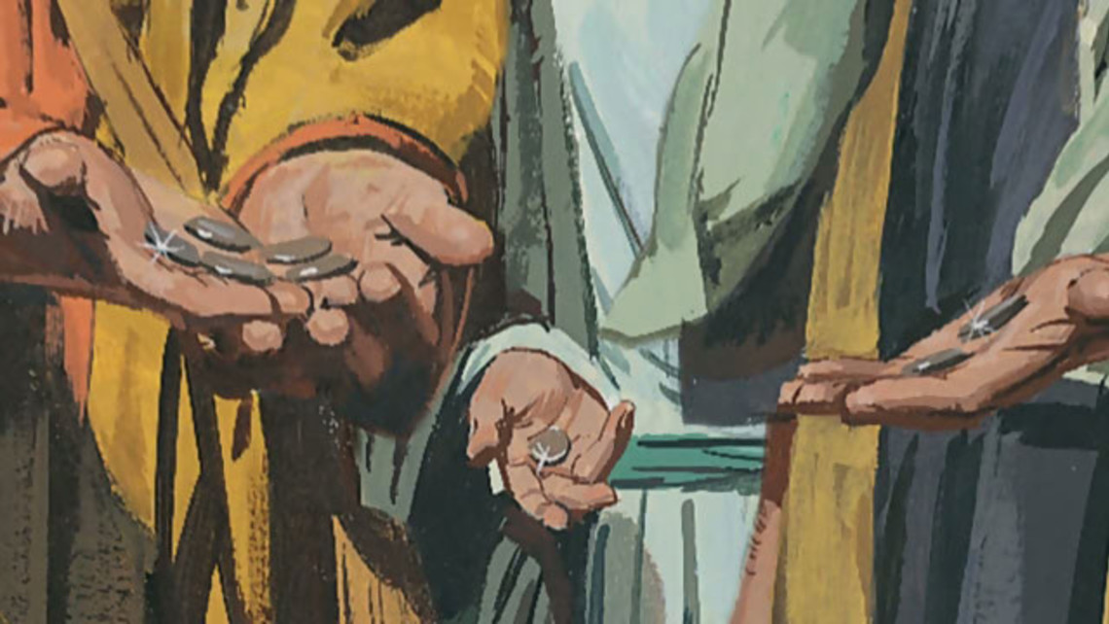
Worth the Journey…
Matthew 25:21—
²¹ His master said to him, ‘Well done, good and faithful slave. You were faithful with a few things, I will put you in charge of many things; enter into the joy of your master.’ (NASB95)

