Slide 1
The Narrow Road Code
Part Two
But to do justice

Slide 2
Micah 6:8
⁸He has told you,
O man, what is good;
And what does the Lord
require of you
But to do justice,
to love kindness,
And to walk humbly with your God? (NASB95)

Slide 3
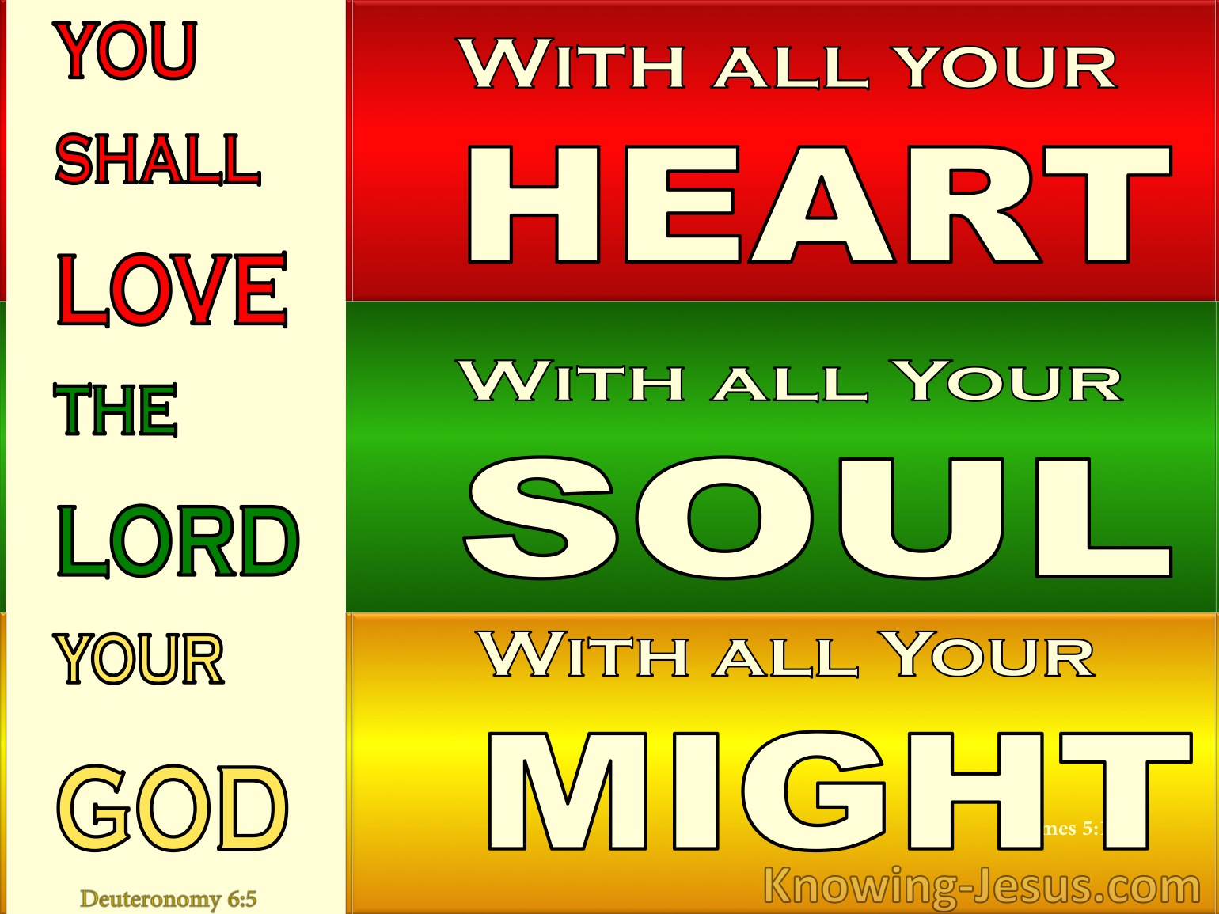
To do justly—To give to all their due.
1. To God:
Deut.6:5—
You shall love the Lord your God with all your heart and with all your soul and with all your might. (NASB95)

Slide 4
To do justly—To give to all their due.
1. To God:
We hold nothing back
All is for God to direct
Heart, body, soul, and spirit.
Your Wisdom, understanding, and judgment.

Slide 5
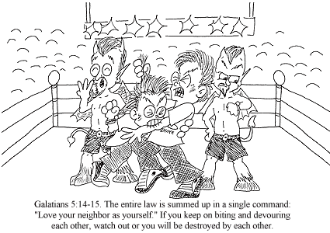
To do justly—To give to all their due.
2. Fellow Man:
Galatians 5:14
For the whole Law is fulfilled in one word, in the statement, “You shall love your neighbour as yourself.” (NASB95)
From Lev.19:18.

Slide 6
To do justly—To give to all their due.

Slide 7
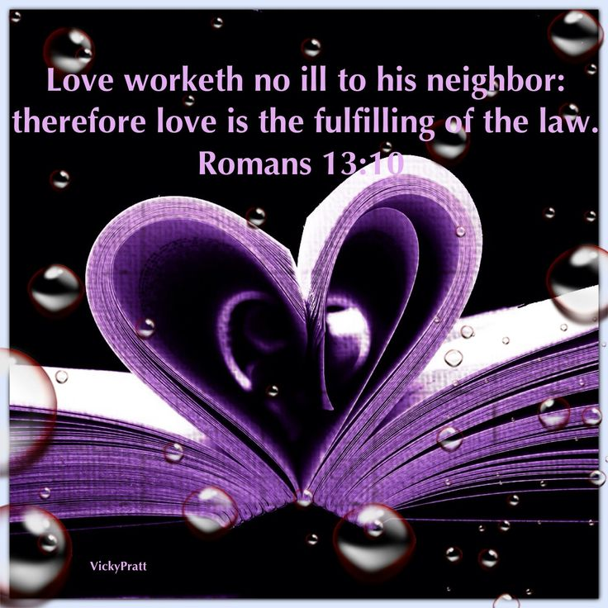
To do justly—To give to all their due.
2. Fellow Man:
Romans 13:10
Love does no wrong to a neighbour; therefore love is the fulfilment of the law. (NASB95)

Slide 8
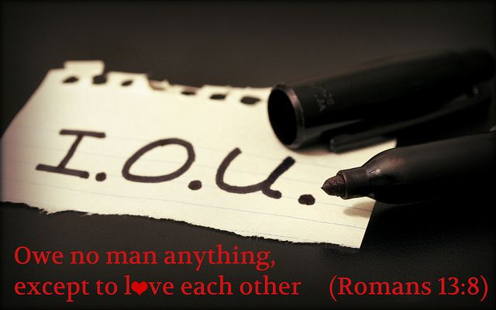
To do justly—To give to all their due.
2. Fellow Man:
Romans 13:8—
Owe nothing to anyone except to love one another; for he who loves his neighbour has fulfilled the law. (NASB95)

Slide 9
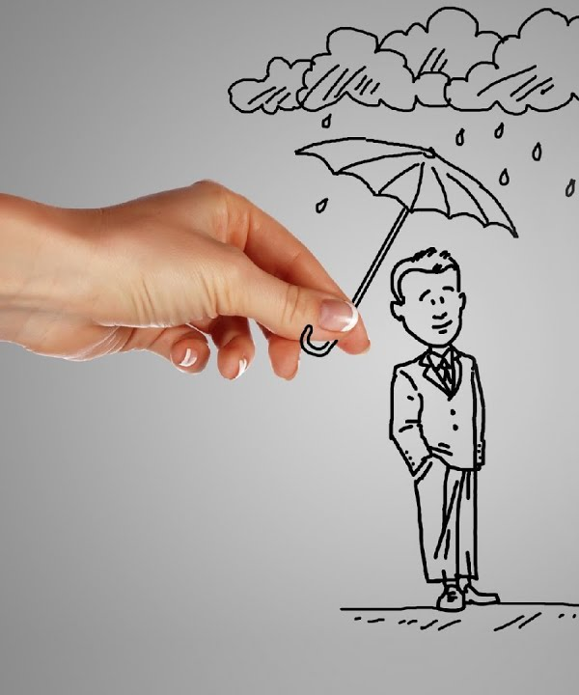
To do justly—To give to all their due.
2. Fellow Man:
Romans 15:1-3—
¹Now we who are strong ought to bear the weaknesses of those without strength and not just please ourselves. (NASB95)

Slide 10
To do justly—To give to all their due.
2. Fellow Man:
Romans 13:1-3—
²Each of us is to please his neighbour for his good, to his edification. (NASB95)

Slide 11
To do justly—To give to all their due.
2. Fellow Man:
Romans 13:1-3—
³For even Christ did not please Himself; but as it is written, “The reproaches of those who reproached You fell on Me.” (NASB95) From Psalm 69:9

Slide 12
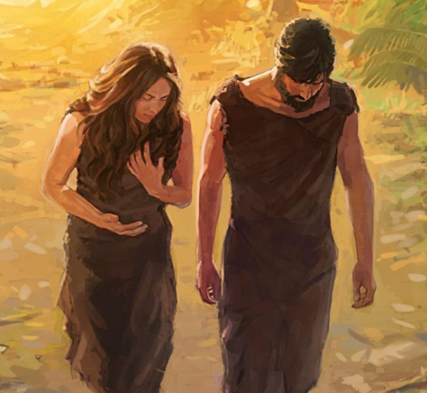
To do justly—Jesus and us:
1. Justice demands that man dies away from God:
The soul that sins dies—Adam and Eve took the sin option

Slide 13
To do justly—Jesus and us:
1. Justice demands that man dies away from God:
Sin separates man from God—Isaiah 59:2

Slide 14
To do justly—Jesus and us:
1. Justice demands that man dies away from God:
Man needed a redeemer

Slide 15
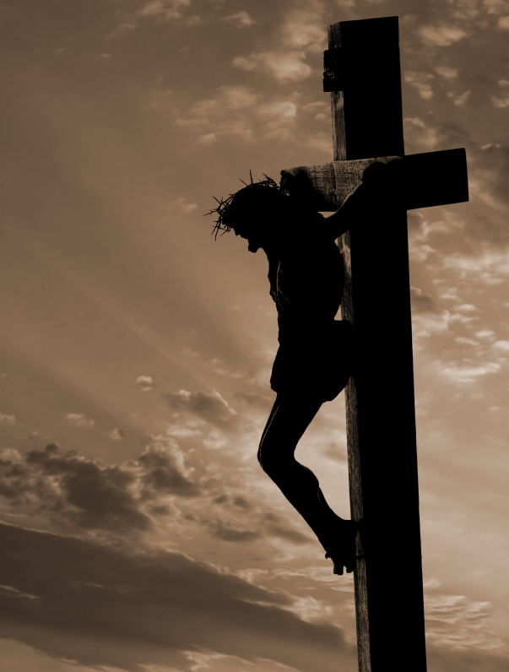
To do justly—Jesus and us:
2. Jesus took the curse:
Galatians 3:13—
Christ redeemed us from the curse of the Law, having become a curse for us—for it is written, “Cursed is everyone who hangs on a tree”— (NASB95)

Slide 16
To do justly—Jesus and us:
2. Jesus took the curse:
1 Peter 3:18—
For Christ also died for sins once for all, the just for the unjust, so that He might bring us to God, having been put to death in the flesh, but made alive in the spirit; (NASB95)

Slide 17
To do justly—Jesus and us:
2. Jesus took the curse:
2 Corinthians 5:21—
He made Him who knew no sin to be sin on our behalf, so that we might become the righteousness of God in Him. (NASB95)

Slide 18

To Do Justly:
The Church—
Love as Jesus loves you

Slide 19
To Do Justly:
The Church—
Serve as Jesus serves you

Slide 20
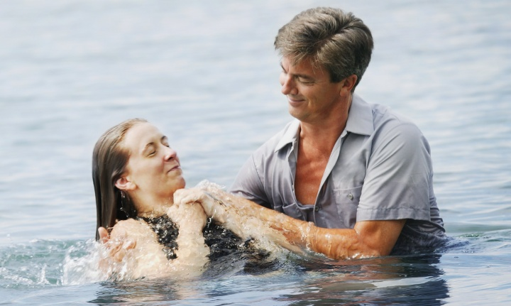
Acts 2:38—
Peter said to them, “Repent, and each of you be baptized in the name of Jesus Christ for the forgiveness of your sins; and you will receive the gift of the Holy Spirit. (NASB95)

