Slide 1


Slide 2

Always Ready…

Slide 3
My, “JUST IN CASE” Card…

Slide 4
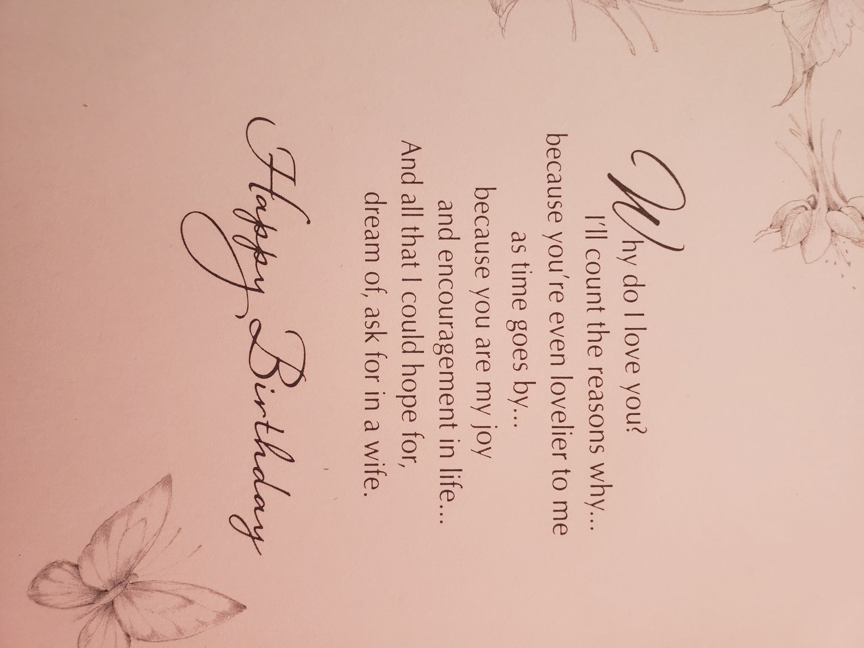
I Got Caught…TWICE!

Slide 5
The Narrow Road Code
Part Three
To Love Kindness

Slide 6
Micah 6:8
⁸He has told you,
O man, what is good;
And what does the Lord
require of you
But to do justice,
to love kindness,
And to walk humbly with your God? (NASB95)

Slide 7

To Love Kindness—
It’s hard to find anything more beautiful than kindness…

Slide 8
To Love Kindness—
It’s hard to find anything more beautiful than kindness…
And hard to find anything more ugly than cruelty.

Slide 9
To Love Kindness—
A man said: “I love to fight. It makes me feel alive!”

Slide 10
To Love Kindness—
A man said: “I love to fight. It makes me feel alive!”
I fight too.

Slide 11
To Love Kindness—
A man said: “I love to fight. It makes me feel alive!”
I fight too.
All the time…

Slide 12
To Love Kindness—
I fight temptation and sin.

Slide 13
To Love Kindness—
I fight temptation and sin.
I fight to keep my family close to God.

Slide 14
To Love Kindness—
I fight temptation and sin
I fight to keep my family close to God
I fight to help my Christian family here to walk with God.

Slide 15
To Love Kindness—
And Yes, it feels really alive to fight.

Slide 16
To Love Kindness—
And Yes, it feels really alive to fight.
But it feels better to fight the good fight for God.

Slide 17
To Love Kindness—
And Yes, it feels really alive to fight.
But it feels better to fight the good fight for God.
Instead of the squabbles of the devil.

Slide 18
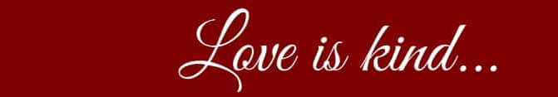
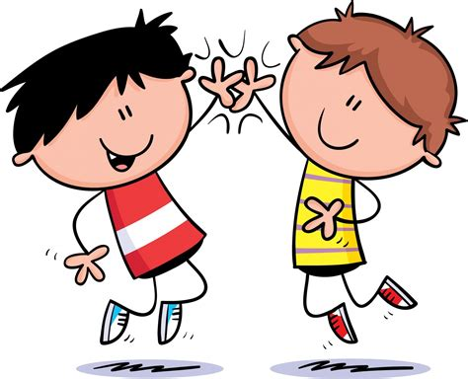
1 Cor. 13:4
Where there is kindness…

Slide 19
1 Cor. 13:4
Where there is kindness…
Happiness is usually nearby

Slide 20

The ‘Kind-Words’ Challenge…
Old saying:

Slide 21
The ‘Kind-Words’ Challenge…
Old saying:
If you can’t beat them…

Slide 22
The ‘Kind-Words’ Challenge…
Old saying:
If you can’t beat them
…kill them with kindness!
(Slightly adjusted, I know).

Slide 23
The ‘Kind-Words’ Challenge…
1 Peter 3:8-10—
⁸To sum up, all of you be…

Slide 24
The ‘Kind-Words’ Challenge…
1 Peter 3:8-10—
⁸To sum up, all of you be
harmonious,

Slide 25
The ‘Kind-Words’ Challenge…
1 Peter 3:8-10—
⁸To sum up, all of you be
harmonious,
sympathetic,

Slide 26
The ‘Kind-Words’ Challenge…
1 Peter 3:8-10—
⁸To sum up, all of you be
harmonious,
sympathetic,
brotherly,

Slide 27
The ‘Kind-Words’ Challenge…
1 Peter 3:8-10—
⁸To sum up, all of you be
harmonious,
sympathetic,
brotherly,
kind-hearted, and

Slide 28
The ‘Kind-Words’ Challenge…
1 Peter 3:8-10—
⁸To sum up, all of you be
harmonious,
sympathetic,
brotherly,
kind-hearted, and
humble in spirit;…

Slide 29
The ‘Kind-Words’ Challenge…
1 Peter 3:8-10—
⁹not returning…

Slide 30
The ‘Kind-Words’ Challenge…
1 Peter 3:8-10—
⁹not returning
evil for evil

Slide 31
The ‘Kind-Words’ Challenge…
1 Peter 3:8-10—
⁹not returning
evil for evil
or insult for insult,

Slide 32
The ‘Kind-Words’ Challenge…
1 Peter 3:8-10—
⁹not returning
evil for evil
or insult for insult, but giving a blessing instead;

Slide 33
The ‘Kind-Words’ Challenge…
1 Peter 3:8-10—
⁹…for you were called for the very purpose…

Slide 34
The ‘Kind-Words’ Challenge…
1 Peter 3:8-10—
⁹…for you were called for the very purpose that you might inherit a blessing…

Slide 35
The ‘Kind-Words’ Challenge…
1 Peter 3:8-10—
¹⁰ For,…

Slide 36
The ‘Kind-Words’ Challenge…
1 Peter 3:8-10—
¹⁰ For,
“The one who desires life,

Slide 37
The ‘Kind-Words’ Challenge…
1 Peter 3:8-10—
¹⁰ For,
“The one who desires life,
to love and see good days,

Slide 38
The ‘Kind-Words’ Challenge…
1 Peter 3:8-10—
¹⁰ For,
“The one who desires life,
to love and see good days,
Must keep his tongue from evil

Slide 39
The ‘Kind-Words’ Challenge…
1 Peter 3:8-10—
¹⁰ For,
“The one who desires life,
to love and see good days,
Must keep his tongue from evil and his lips from speaking deceit. (NASB95)

Slide 40
Some Love Their Evil Ways
John 3:20—
For everyone who does evil hates the Light, and does not come to the Light for fear that his deeds will be exposed. (NASB95)

Slide 41
Some Love Their Evil Ways
John 3:20—
For everyone who does evil hates the Light, and does not come to the Light for fear that his deeds will be exposed. (NASB95)

Slide 42
Some Love Their Evil Ways
Luke 6:22—
Blessed are you when men hate you, and ostracize you, and insult you, and scorn your name as evil, for the sake of the Son of Man. (NASB95)

Slide 43
Some Love Their Evil Ways
Luke 6:22—
Blessed are you when men hate you, and ostracize you, and insult you, and scorn your name as evil, for the sake of the Son of Man. (NASB95)

Slide 44
Some Love Their Evil Ways
Luke 6:22—
Blessed are you when men hate you, and ostracize you, and insult you, and scorn your name as evil, for the sake of the Son of Man. (NASB95)

Slide 45
Some Love Their Evil Ways
Luke 6:22—
Blessed are you when men hate you, and ostracize you, and insult you, and scorn your name as evil, for the sake of the Son of Man. (NASB95)

Slide 46
Some Love Their Evil Ways
Luke 6:22—
Blessed are you when men hate you, and ostracize you, and insult you, and scorn your name as evil, for the sake of the Son of Man. (NASB95)

Slide 47
Some Love Their Evil Ways
Luke 6:22—
Blessed are you when men hate you, and ostracize you, and insult you, and scorn your name as evil, for the sake of the Son of Man. (NASB95)

Slide 48
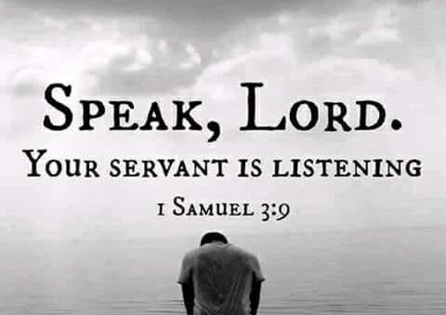

Slide 49
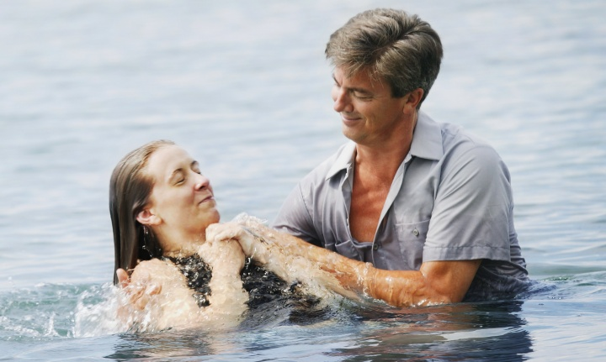
Acts 2:38—
Peter said to them, “Repent, and each of you be baptized in the name of Jesus Christ for the forgiveness of your sins; and you will receive the gift of the Holy Spirit. (NASB95)

