Slide 1
“ ’Tis so sweet to trust in Jesus”
John Staiger
Morningside Church of Christ
Sunday 31 January 2021
PM Sermon
Broadcast on Facebook Live from
42 Leslie Ave, Sandringham.

Slide 2


Slide 3
Who can you trust?
There are a lot of good people around.

Slide 4
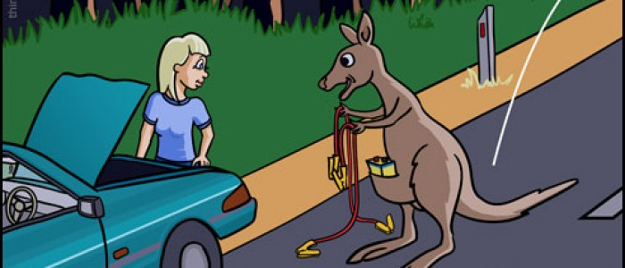
Who can you trust?
There are a lot of good people around.
                Try asking for a jump start.

Slide 5

Who can you trust?
There are a lot of good people around.
                School teachers

Slide 6

Who can you trust?
There are a lot of good people around.
                Health professionals

Slide 7

Who can you trust?
There are a lot of good people around.
Neighbours

Slide 8
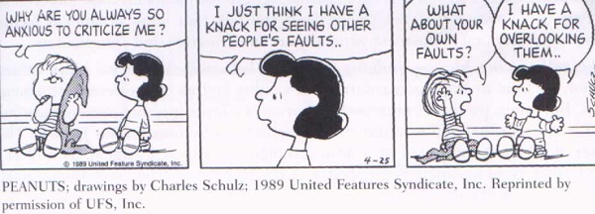
Who can you trust?
We take people as they come and assume the best.

Slide 9
Who can you trust?
We take people as they come and assume the best.

Slide 10
Who can you trust?
We take people as they come and assume the best.

Slide 11
Who can you trust?
We take people as they come and assume the best.

Slide 12

Spiritual Matters—Who can you trust?
We start by assuming the best of those who speak about Jesus

Slide 13
Spiritual Matters—Who can you trust?
We start by assuming the best of those who speak about Jesus
                Preachers
                Teachers
                __________________________________________________________________

Slide 14
Spiritual Matters—Who can you trust?
We start by assuming the best of those who speak about Jesus
                __________________________________________________________________
                Learn to discern

Slide 15
Spiritual Matters—Who can you trust?
Learn to discern
1 Corinthians 2:14—The person without the Spirit does not accept the things that come from the Spirit of God but considers them foolishness, and cannot understand them because they are discerned only through the Spirit.

Slide 16
Spiritual Matters—Who can you trust?
We start by assuming the best of those who speak about Jesus
                Rightly divide

Slide 17
Spiritual Matters—Who can you trust?
Rightly divide
2 Timothy 2:15—
¹⁵Be diligent to present yourself approved to God as a workman who does not need to be ashamed, accurately handling the word of truth. (NASB95)

Slide 18
Spiritual Matters—Who can you trust?
We start by assuming the best of those who speak about Jesus
                Growing

Slide 19
Spiritual Matters—Who can you trust?
Growing
2 Peter 3:17-18—¹⁷You therefore, beloved, knowing this beforehand, be on your guard so that you are not carried away by the error of unprincipled men and fall from your own steadfastness, ¹⁸ but grow in the grace and knowledge of our Lord and Savior Jesus Christ. To Him be the glory, both now and to the day of eternity. Amen. (NASB95)

