Slide 1



Part 1.

Slide 2
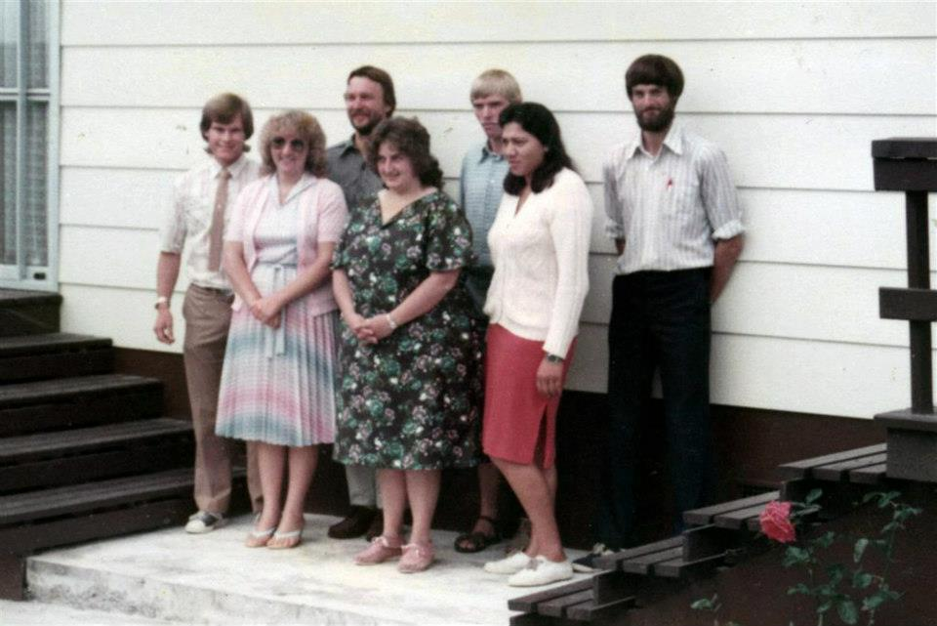
Yesterday—I know that Place…

Slide 3
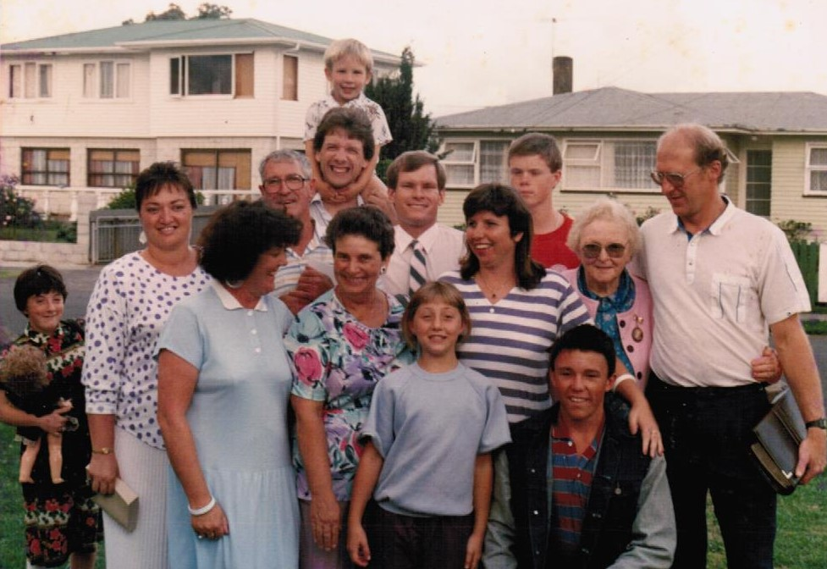
Yesterday—I know that Place…

Slide 4
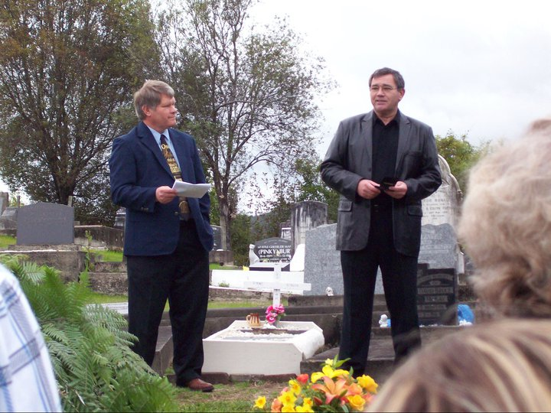
Yesterday—I know that Place…

Slide 5
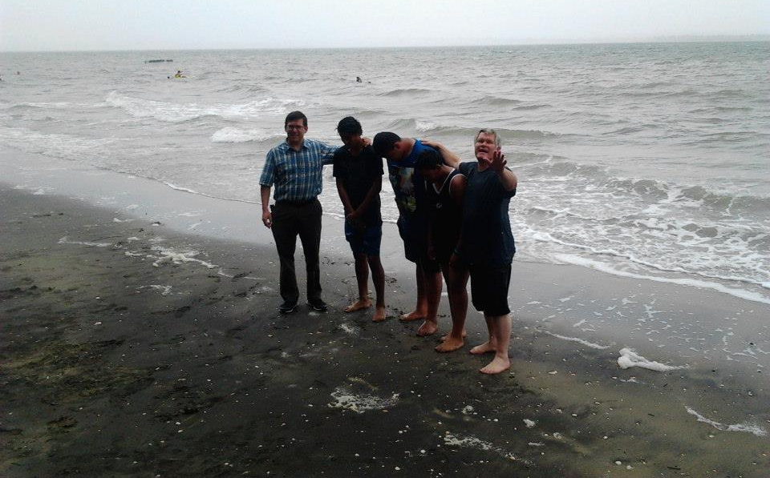
Yesterday—I know that Place…

Slide 6
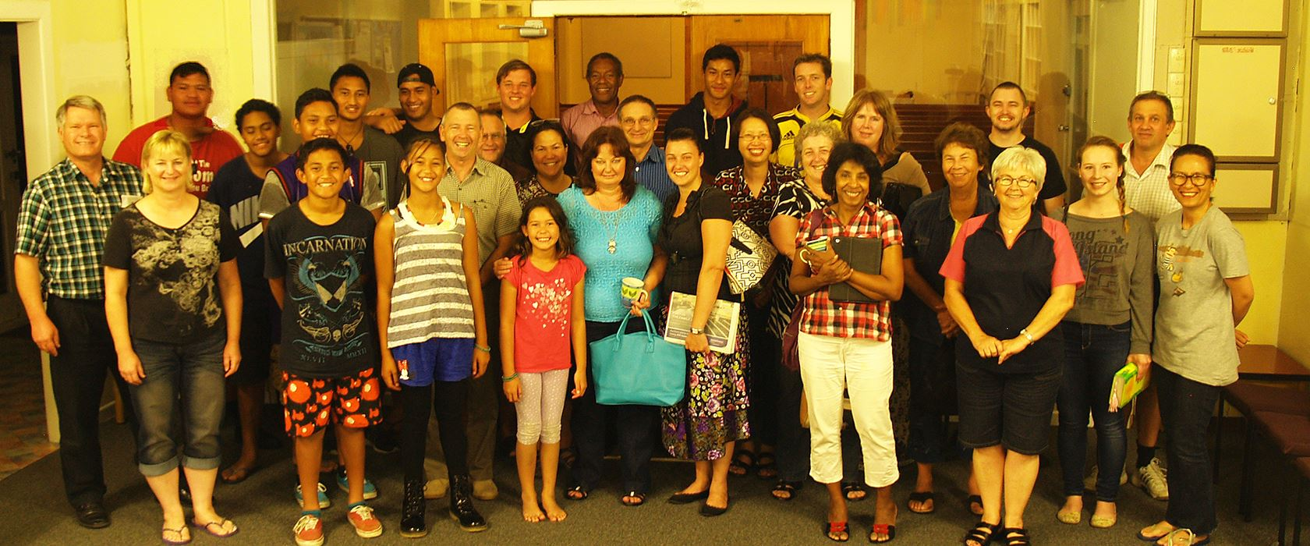

Yesterday—I know that Place…

Slide 7
Buried in the Past…
No place to Live:
  God did not design us to live there.

Slide 8
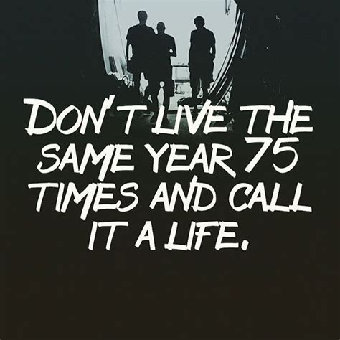
Buried in the Past…
No place to Live:
  God did not design us to live there.

Slide 9
Buried in the Past…
2 Corinthians 6:2—
for He says, “At the acceptable time I listened to you, And on the day of salvation I helped you.” Behold, now is “the acceptable time,” behold, now is “the day of salvation”—
No place to Live:
  God did not design us to live there.

Slide 10
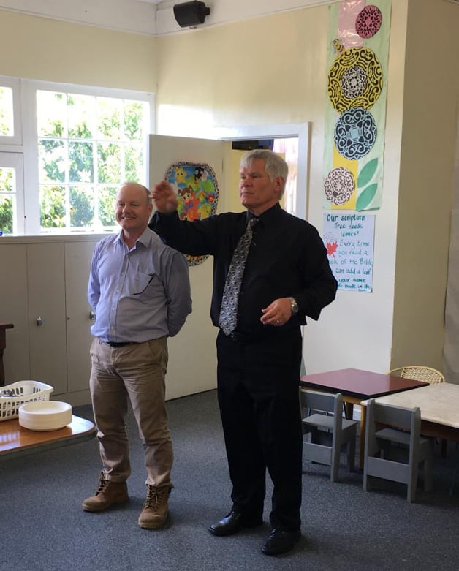
Buried in the Past…
No place to Live:
  Yes, a lot of good memories and stories that thrill…

Slide 11
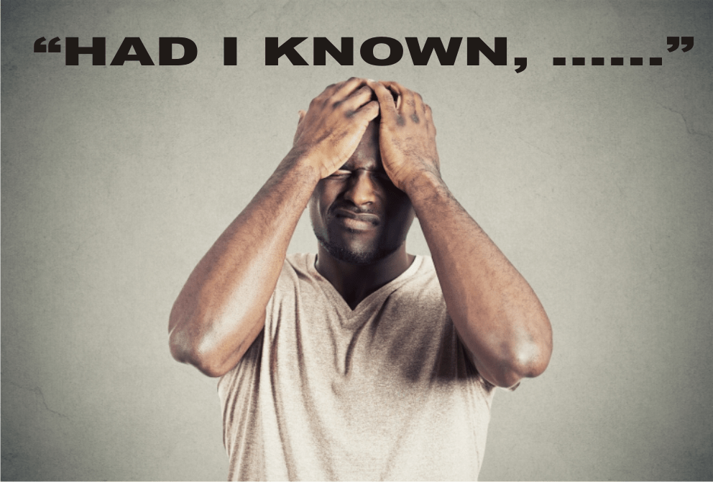
Buried in the Past…
No place to Live:
  But also, a place of regrets and…

Slide 12

Buried in the Past…
No place to Live:
  …Re-
    Constructing
    of facts

Slide 13
Buried in the Past…
No place to Live:
Rewriting history—

Slide 14
Buried in the Past…
No place to Live:
God already knows everything.

Slide 15
Buried in the Past…
No place to Live:
Mis-remembering.

Slide 16

Doing something about it…
I won’t do that again—

Slide 17

Doing something about it…
I won’t do that again—
Repent if it was sin.

Slide 18
Doing something about it…
I won’t do that again—
Repent if it was sin.
2 Corinthians 7:10—
For the sorrow that is according to the will of God produces a repentance without regret, leading to salvation, but the sorrow of the world produces death. (NASB95)

Slide 19
Doing something about it…
I won’t do that again—
Apologise if it was stupid.

Slide 20
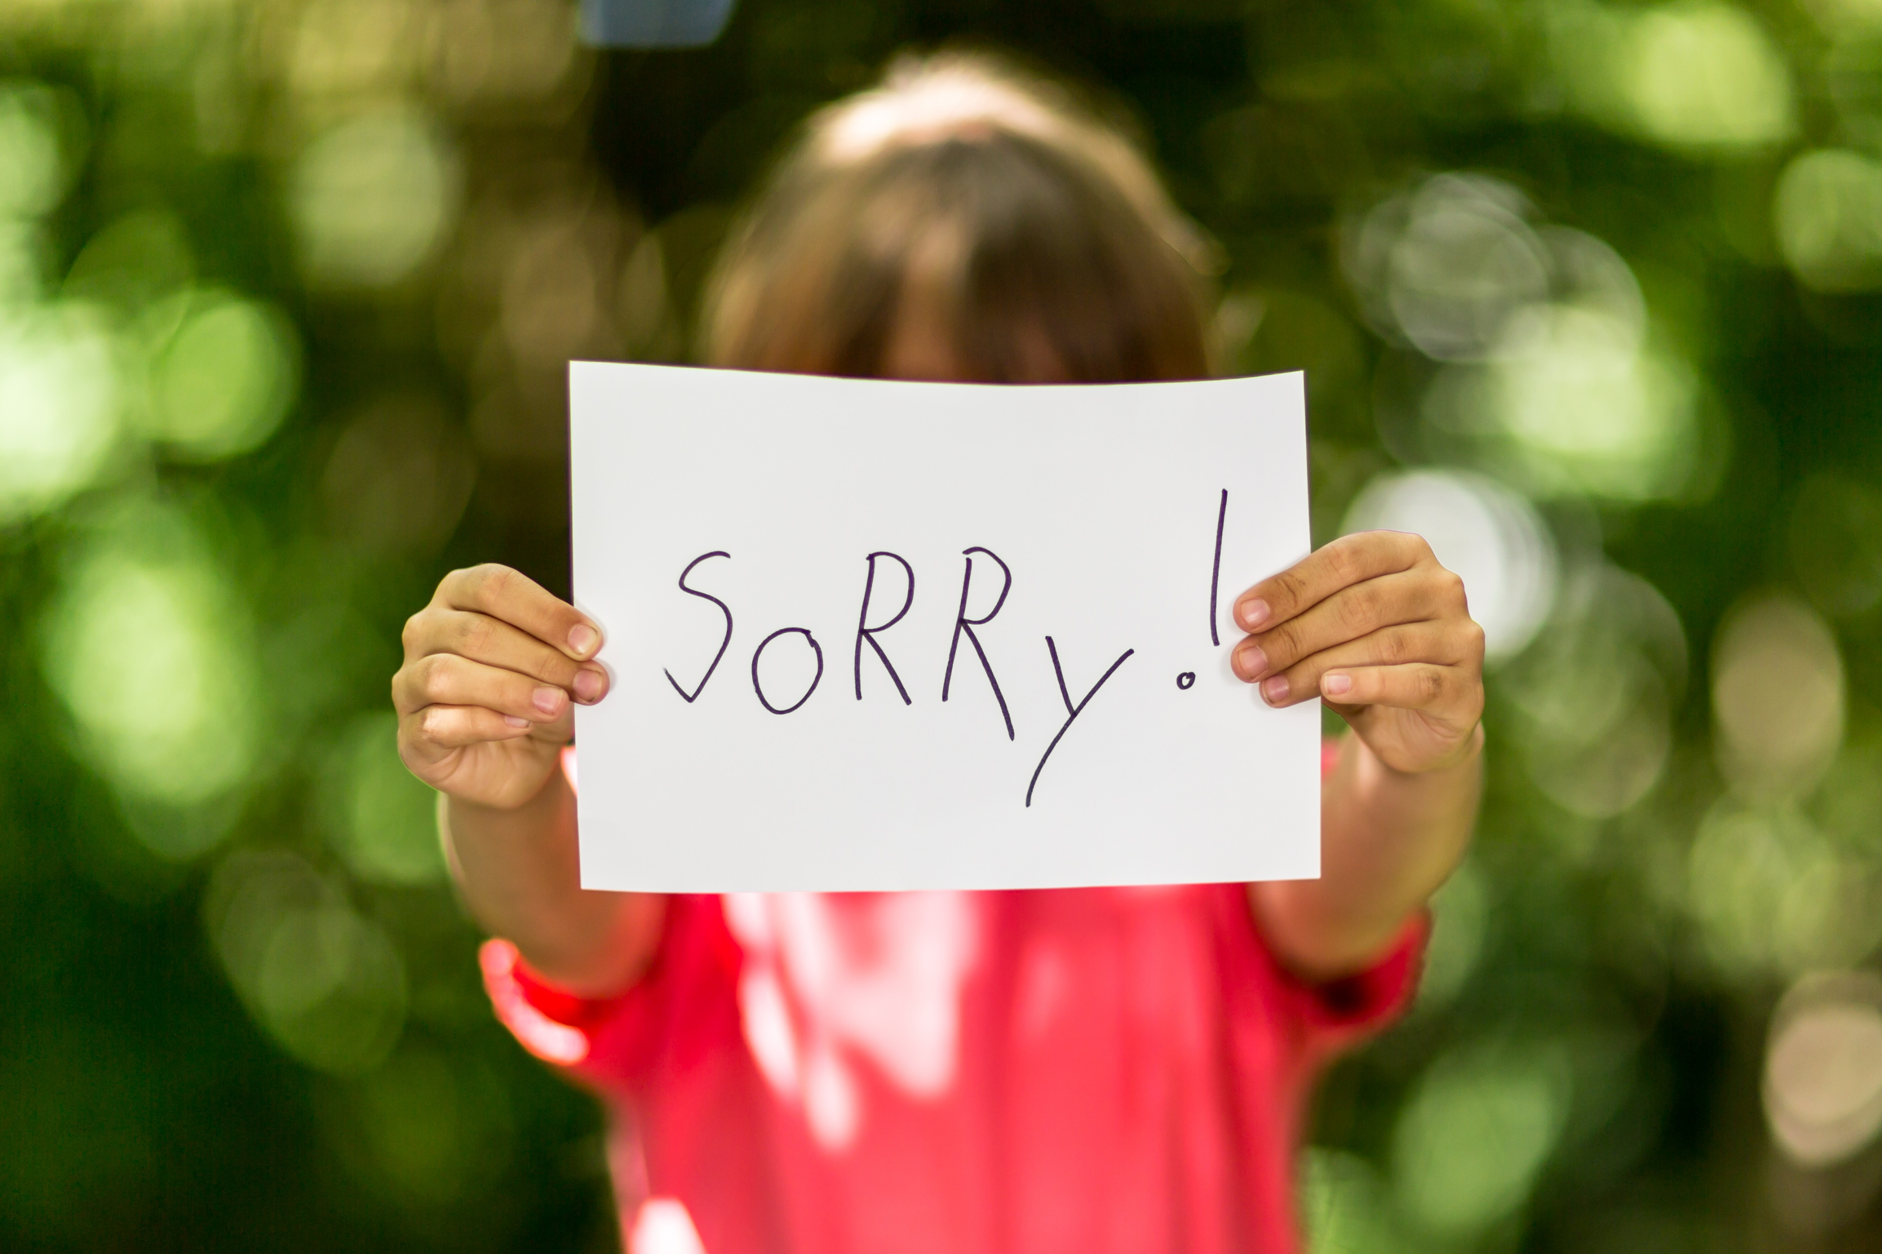
Doing something about it…
I won’t do that again—
Apologise if it was stupid.

Slide 21
Doing something about it…
I won’t do that again—
Forget it like God does.

Slide 22
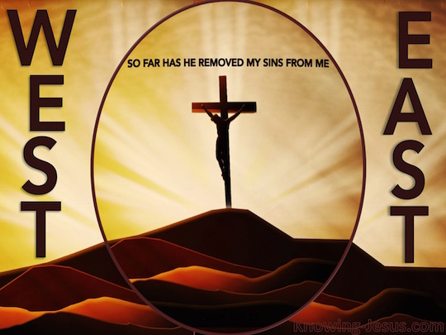
Doing something about it…
Psalm 103:12—
As far as the east is from the west,
So far has He removed our transgressions from us. (NASB95)
I won’t do that again—
Forget it like God does.

Slide 23
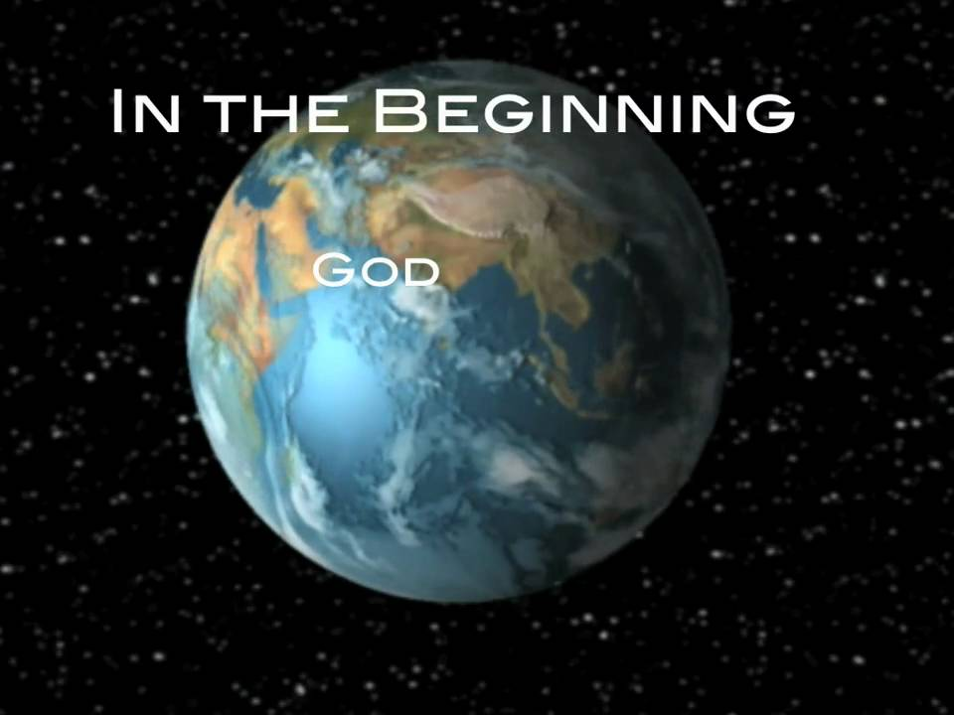
Vital to our cause…
Defines our cause—
The Bible contains our Faith History
    Creation
    Fall
    Flood
    Babel
    Abraham
    The Law of Moses
    Christ

Slide 24
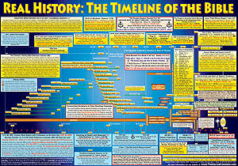
Vital to our cause…
Defines our cause—
      Historians:
        Moses
        Prophets
        Matthew
        Mark
        Luke
        John
        Stephen (Acts 7)

Slide 25
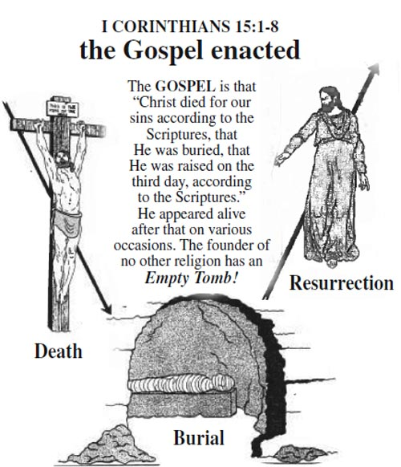
Vital to our cause…
Defines our cause—
Death, burial and resurrection—
  An Historical event that changed the world.
  Witnesses proclaim it.
  We remember it.
  We live because of it

Slide 26

Galatians 3:27
²⁷For as many of you as were baptized into Christ have put on Christ. (ESV)

