Slide 1


Part 2.

Slide 2


Slide 3
True to a point…
We live in the moment,
but…

Slide 4
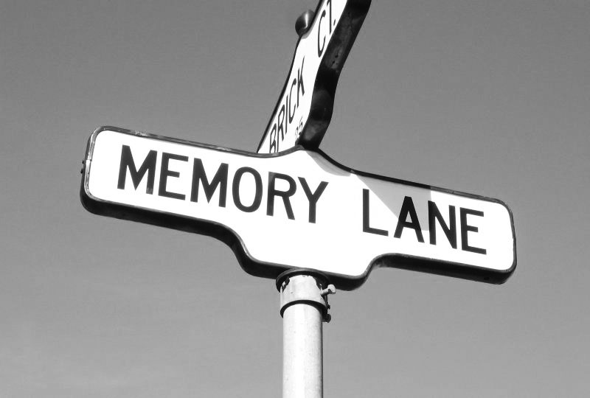
True to a point…
We carry
“Yesterday”
along with us,
and…

Slide 5

True to a point…
The
possibilities
of the
future
are always on our minds.

Slide 6
True to a point…
God made us to consider all three states…

Slide 7
True to a point…
God made us to consider all three states…
Then

Slide 8
True to a point…
God made us to consider all three states…
Then
Now

Slide 9
True to a point…
God made us to consider all three states…
Then
Now
When

Slide 10

True to a point…
God made us to consider all three states…
Then
Now
When

Slide 11
True to a point…
Focus on
God’s will
brings sense and meaning

Slide 12
True to a point…
Crushing
today
with
‘Yesterday’
is messy,
and…

Slide 13
True to a point…
Crushing
today
with
‘Tomorrow’
is adding to the Mess!

Slide 14

Today—
Every good deed is rewarded

Slide 15
Today—
Every good deed is rewarded
  Your past good deeds—the fruit of your service for the Lord—have been couriered ahead.

Slide 16
Today—
Every good deed is rewarded
  Your past good deeds—the fruit of your service for the Lord—have been couriered ahead.
  Send some more!

Slide 17
Today—
    Everyday works of service done in the name of Jesus…

Slide 18
Today—
    Everyday works of service done in the name of Jesus.
    Seeking the welfare of the lost and saved alike.

Slide 19
Today—
    Everyday works of service done in the name of Jesus.
    Seeking the welfare of the lost and saved alike.
    The needs of the widow and orphan go on.

Slide 20
Today—
James 1:27—
Pure and undefiled religion in the sight of our God and Father is this: to visit orphans and widows in their distress, and to keep oneself unstained by the world. (NASB95)

Slide 21
Today—
Is welcomed.
Will be used for the opportunity it is—
To impact lives for Jesus:

Slide 22
Today—
As a Christian, you are called upon to: factually inform the misinformed.
Not everybody is receptive.
Perspective clouds the truth.
This can be no fun.
However, it must be done!
But how…?

Slide 23
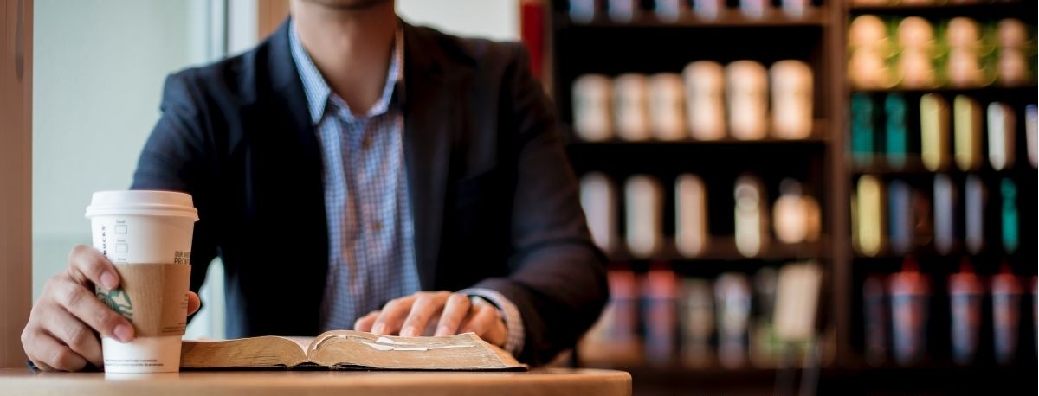
Today—
Colossians 4:5-6—⁵Conduct yourselves with wisdom toward outsiders, making the most of the opportunity. ⁶Let your speech always be with grace, as though seasoned with salt, so that you will know how you should respond to each person. (NASB95)

Slide 24
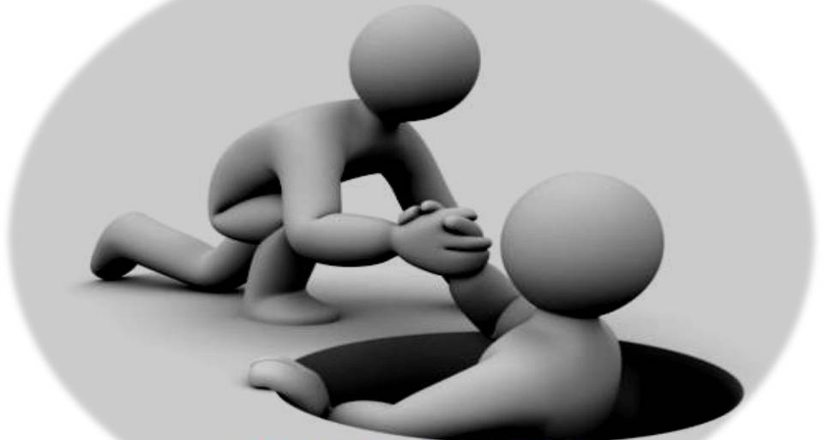
Today—
Galatians 6:10—So then, while we have opportunity, let us do good to all people, and especially to those who are of the household of the faith. (NASB95)

Slide 25

Today we have a job to do…

Slide 26
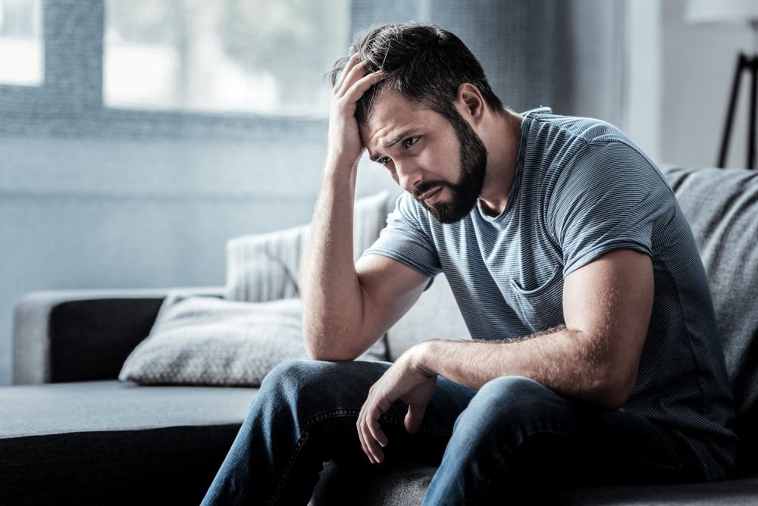
Today we have a job to do…
Yes,
there are
REGRETS
of
“Yesterday,”
And…

Slide 27
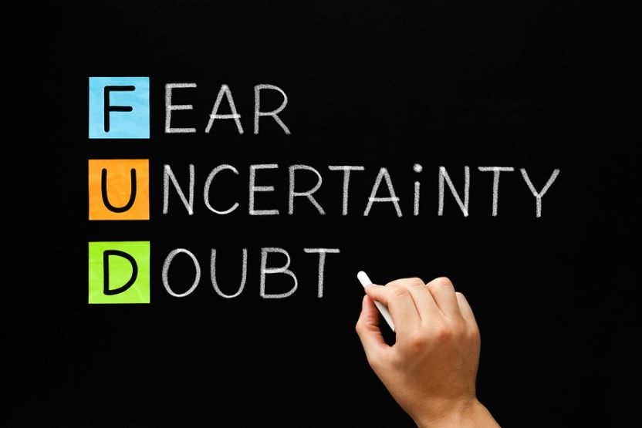
Today we have a job to do…
Yes,
there are
APREHENSIONS
about “Tomorrow,”
But, Praise God…!

Slide 28
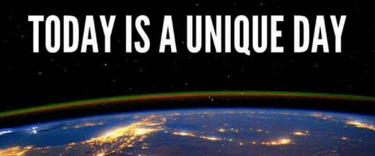
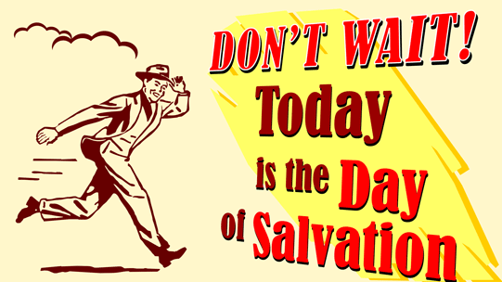
Today we have a job to do…
“Today”
is
about
SALVATION!

Slide 29
Today we have a job to do…
2 Corinthians 6:1-3—
And working together with Him, we also urge you not to receive the grace of God in vain— ²for He says,
“At the acceptable time I listened to you,
And on the day of salvation I helped you.”
Behold, now is “the acceptable time,” behold, now is “the day of salvation” (NASB95)

Slide 30
Today we have a job to do…
“Today”
is
about
SALVATION!

Slide 31
Today we have a job to do…
“Today”
You
SET
your
heart
on the LOST.

Slide 32
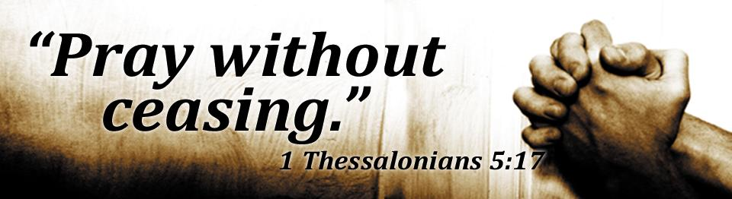
Today we have a job to do…
“Today”
you
PRAY
for the souls of
ALL PEOPLE

Slide 33

Today we have a job to do…
“Today”
You
EQUIP
yourself for the fight

Slide 34
Today we have a job to do…
“Today”
You
SPEAK
a good word for Jesus

Slide 35
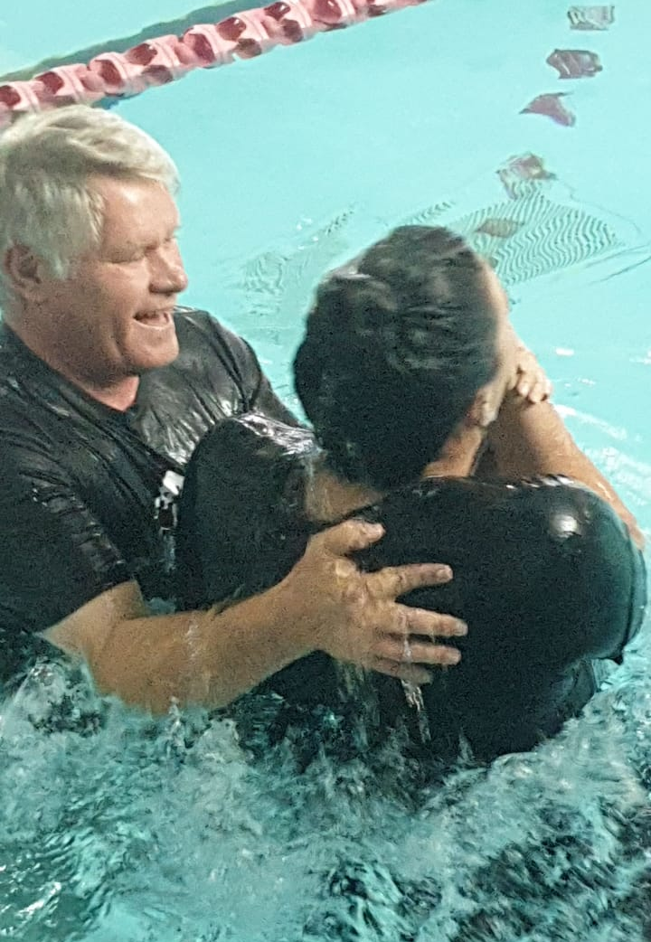
Galatians 3:27
²⁷For as many of you as were baptized into Christ have put on Christ. (ESV)

