Slide 1



Part 3.

Slide 2

Today is Yesterday’s Tomorrow
Psalm 118:24
²⁴This is the day which the Lord has made;
Let us rejoice and be glad in it.

Slide 3

The problem with
TOMORROW-LAND:
Not this one at Disneyland

Slide 4

The problem with
TOMORROW-LAND:
The one that too
much time is spent
in today.

Slide 5
The problem with
TOMORROW-LAND:
It doesn’t Exist.

Slide 6
The problem with
TOMORROW-LAND:
Real people
do not live there.

Slide 7
The problem with
TOMORROW-LAND:
Real things
do not happen
there.

Slide 8
The problem with
TOMORROW-LAND:
But, there are…

Slide 9
The problem with
TOMORROW-LAND:
But, there are…
  TOMORROW-LAND
  PEOPLE
  everywhere around us
  TODAY.

Slide 10
The problems for
TOMORROW
PEOPLE:
Their ‘Today’ is transferred into a void.
Today is not enjoyed for itself.
Today becomes a slave to the future

Slide 11
The problems for
TOMORROW
PEOPLE:
Their ‘Today’ is transferred into a void.

Slide 12
The problems for
TOMORROW
PEOPLE:
Today is not enjoyed for itself.

Slide 13
The problems for
TOMORROW
PEOPLE:
Today becomes a slave to the future

Slide 14
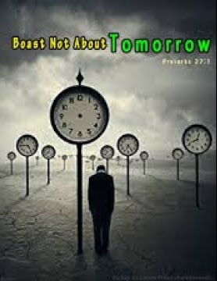

Proverbs 27:1—
Do not boast about tomorrow,
For you do not know what a day may bring forth. (NASB95)

Slide 15
“But surely,” you say,
“Isn’t today yesterday’s tomorrow that I planned for?”

Slide 16
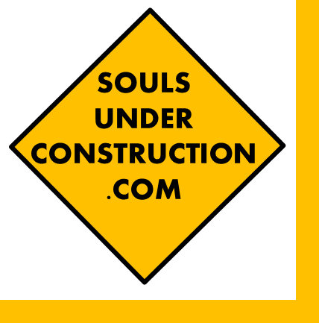
James give us the spiritual perspective:
James 4:13-14

Slide 17
James 4:13-14—
¹³Come now, you who say, “Today or tomorrow we will go to such and such a city, and spend a year there and engage in business and make a profit.” ^{14[a]}Yet you do not know ^{[b]}what your life will be like tomorrow. You are just a vapor that appears for a little while and then vanishes away. (NASB95)
[a]Lit Who do not [b]Or what will happen tomorrow. What kind of life is yours?

Slide 18
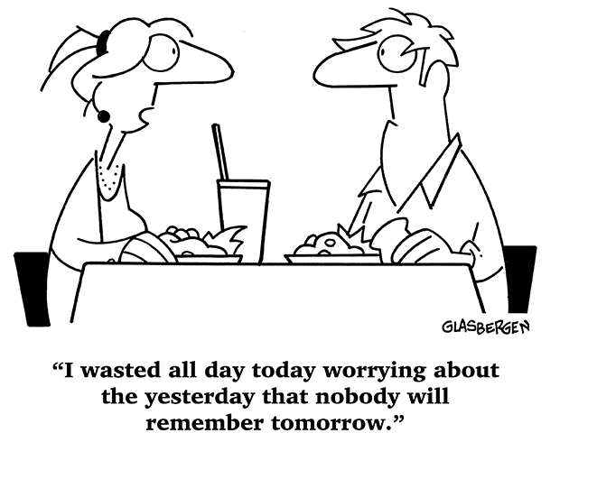
Assuming there is a Tomorrow:
Bless it by…
  Resolving
  yesterday’s
  issues

Slide 19
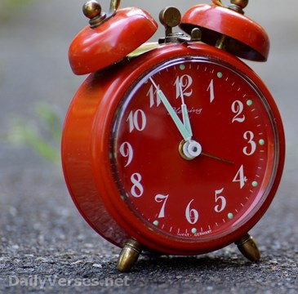
Matthew 6:34—
³⁴“So do not worry about tomorrow; for tomorrow will ^{[a]}care for itself. ^{[b]}Each day has enough trouble of its own. (NASB95)
[a]Lit worry about itself [b]Lit Sufficient for the day is its evils

Slide 20

Assuming there is a Tomorrow:
Bless it by…
  Resolve today’s
  issues:
    Anger
    Regret
    Blame

Slide 21
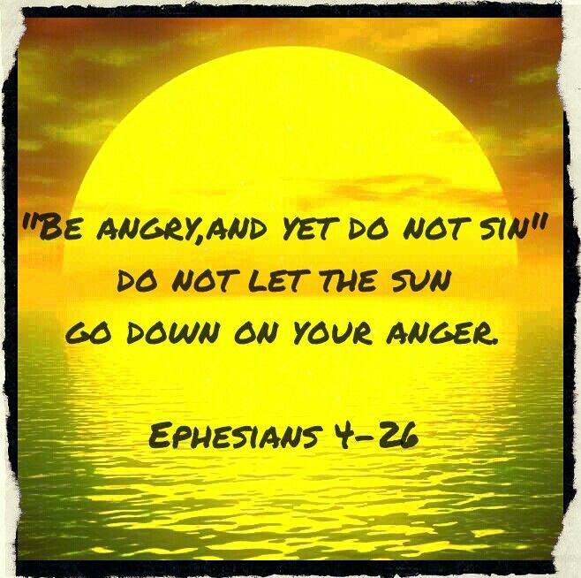

Slide 22
Assuming there is a Tomorrow:
Bless it by…
  Honouring today’s commitments:
    Complete them.
    Don’t put them off.
    Procrastination intensifies anxiety.
    Tomorrow is not a dumping ground for today’s excuses.

Slide 23

Assuming there is a Tomorrow:
Bless it by..
  Being ready:
    Weighed up

Slide 24

Assuming there is a Tomorrow:
Bless it by…
  Being ready
    Paid up

Slide 25

Assuming there is a Tomorrow:
Bless it by…
  Being ready
    Prayed up

Slide 26

Assuming there is a Tomorrow:
Bless it by…
  Being ready
    Made up

Slide 27
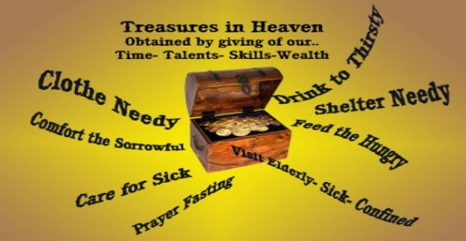
Assuming there is a Tomorrow:
Bless it by…
  Being ready
    Laid up

Slide 28
1 Corinthians 15:32—
³²If ^{[a]}from human motives I fought with wild beasts at Ephesus, what does it profit me? If the dead are not raised, let us eat and drink, for tomorrow we die. (NASB95) [a]Lit according to man

Slide 29

Galatians 3:27
²⁷For as many of you as were baptized into Christ have put on Christ. (ESV)

