Slide 2
The Resurrection

Slide 3
What other message on earth has been:

Slide 4
What other message on earth has been:
More Repeated?

Slide 5
What other message on earth has been:
More Repeated?
More Persistent?

Slide 6
What other message on earth has been:
More Repeated?
More Persistent?
More Reviled?

Slide 7
What other message on earth has been:
More Repeated?
More Persistent?
More Reviled?
More Revered?

Slide 8
What other message on earth has been:
More Repeated?
More Persistent?
More Reviled?
More Revered?
Than that message that says of Jesus of Nazareth…

Slide 9


Slide 10
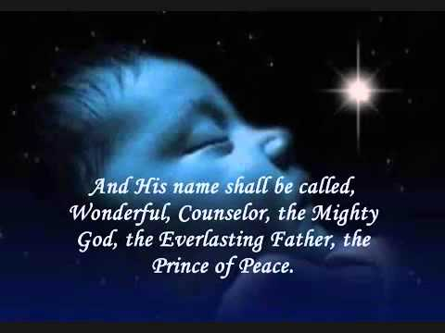
33 years earlier…
Luke 2:11
¹¹for today in the city of David there has been born for you a Saviour, who is Christ the Lord.
Isaiah 9:6

Slide 11
1. Central to the gospel.
The message of the resurrection
1 Corinthians 15:1-2
Now I make known to you, brethren, the gospel which I preached to you, which also you received, in which also you stand, ²by which also you are saved, if you hold fast the word which I preached to you, unless you believed in vain. (NASB)

Slide 12
1. Central to the gospel.
The message of the resurrection
It is the event that gives power to salvation.

Slide 13
1. Central to the gospel.
The message of the resurrection
It is the event that gives power to salvation.
“By which also you are saved”

Slide 14
1. Central to the gospel.
The message of the resurrection
It is the event that gives power to salvation.
“By which also you are saved”
Saving faith rests on this fact.

Slide 15
2. Predicted, expected, and done in the presence of others.
The message of the resurrection

Slide 16
2. Predicted, expected, and done in the presence of others.
The message of the resurrection
1 Corinthians 15:3-4
³For I delivered to you as of first importance what I also received, that Christ died for our sins according to the Scriptures,
⁴and that He was buried, and that He was raised on the third day according to the Scriptures, (NASB)

Slide 17

2. Predicted, expected, and done in the presence of others.
The message of the resurrection
You can oppose it, but you can’t ignore it!

Slide 18
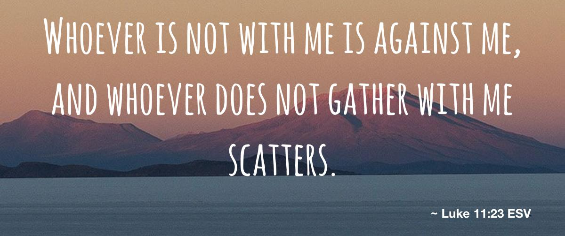
2. Predicted, expected, and done in the presence of others.
The message of the resurrection
You can oppose it, but you can’t ignore it!
  No fence-sitting

Slide 19
2. Predicted, expected, and done in the presence of others.
The message of the resurrection
You can oppose it, but you can’t ignore it!
  No fence-sitting
  No one stays neutral

Slide 20

2. Predicted, expected, and done in the presence of others.
The message of the resurrection
You can oppose it, but you can’t ignore it!
  No fence-sitting
  No one stays neutral
Either it’s a lie

Slide 21
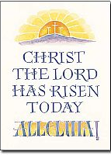
2. Predicted, expected, and done in the presence of others.
The message of the resurrection
You can oppose it, but you can’t ignore it!
  No fence-sitting
  No one stays neutral
Either it’s a lie
Or it’s the fact of history that marks the love of God among us.

Slide 22
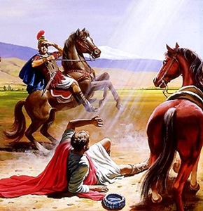
2. Predicted, expected, and done in the presence of others.
The message of the resurrection
1 Corinthians 15:5-11
⁵and that He appeared to Cephas, then to the twelve. ⁶After that He appeared to more than five hundred brethren at one time, most of whom remain until now, but some have fallen asleep; ⁷then He appeared to James, then to all the apostles; ⁸and last of all, as to one untimely born, He appeared to me also. (NASB95)

Slide 23
2. Predicted, expected, and done in the presence of others.
The message of the resurrection
1 Corinthians 15:5-11
⁵and that He appeared to Cephas, then to the twelve. ⁶After that He appeared to more than five hundred brethren at one time, most of whom remain until now, but some have fallen asleep; ⁷then He appeared to James, then to all the apostles; ⁸and last of all, as to one untimely born, He appeared to me also. (NASB95)

Slide 24
2. Predicted, expected, and done in the presence of others.
The message of the resurrection
1 Corinthians 15:5-11
⁵and that He appeared to Cephas, then to the twelve. ⁶After that He appeared to more than five hundred brethren at one time, most of whom remain until now, but some have fallen asleep; ⁷then He appeared to James, then to all the apostles; ⁸and last of all, as to one untimely born, He appeared to me also. (NASB95)

Slide 25
2. Predicted, expected, and done in the presence of others.
The message of the resurrection
1 Corinthians 15:5-11
⁵and that He appeared to Cephas, then to the twelve. ⁶After that He appeared to more than five hundred brethren at one time, most of whom remain until now, but some have fallen asleep; ⁷then He appeared to James, then to all the apostles; ⁸and last of all, as to one untimely born, He appeared to me also. (NASB95)

Slide 26
2. Predicted, expected, and done in the presence of others.
The message of the resurrection
1 Corinthians 15:5-11
⁵and that He appeared to Cephas, then to the twelve. ⁶After that He appeared to more than five hundred brethren at one time, most of whom remain until now, but some have fallen asleep; ⁷then He appeared to James, then to all the apostles; ⁸and last of all, as to one untimely born, He appeared to me also. (NASB95)

Slide 27
2. Predicted, expected, and done in the presence of others.
The message of the resurrection
1 Corinthians 15:5-11
⁵and that He appeared to Cephas, then to the twelve. ⁶After that He appeared to more than five hundred brethren at one time, most of whom remain until now, but some have fallen asleep; ⁷then He appeared to James, then to all the apostles; ⁸and last of all, as to one untimely born, He appeared to me also. (NASB95)

Slide 28
2. Predicted, expected, and done in the presence of others.
The message of the resurrection
1 Corinthians 15:5-11
⁵and that He appeared to Cephas, then to the twelve. ⁶After that He appeared to more than five hundred brethren at one time, most of whom remain until now, but some have fallen asleep; ⁷then He appeared to James, then to all the apostles; ⁸and last of all, as to one untimely born, He appeared to me also. (NASB95)

Slide 29
3. People have always been skeptical.
The message of the resurrection

Slide 30
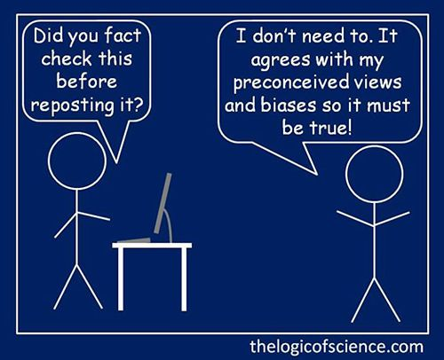
3. People have always been skeptical.
The message of the resurrection

Slide 31
1 Corinthians 15:12-17(NASB)
¹²Now if Christ is preached, that He has been raised from the dead, how do some among you say that there is no resurrection of the dead?
¹³But if there is no resurrection of the dead, not even Christ has been raised;
¹⁴and if Christ has not been raised, then our preaching is vain, your faith also is vain.
¹⁵Moreover we are even found to be false witnesses of God, because we testified against God that He raised Christ, whom He did not raise, if in fact the dead are not raised. ¹⁶For if the dead are not raised, not even Christ has been raised;
¹⁷and if Christ has not been raised, your faith is worthless; you are still in your sins.

Slide 32

3. People have always been skeptical.
The message of the resurrection
Not even Christ was raised.

Slide 33
3. People have always been skeptical.
The message of the resurrection
Not even Christ was raised.
Preaching is a waste of time.

Slide 34
3. People have always been skeptical.
The message of the resurrection
Not even Christ was raised.
Preaching is a waste of time.
Faith is meaningless.

Slide 35
3. People have always been skeptical.
The message of the resurrection
Not even Christ was raised.
Preaching is a waste of time.
Faith is meaningless.
All the people who claimed to see Jesus raised are liars.

Slide 36
3. People have always been skeptical.
The message of the resurrection
Not even Christ was raised.
Preaching is a waste of time.
Faith is meaningless.
All the people who claimed to see Jesus raised are liars.
Everyone is still in their sins.

Slide 37
3. People have always been skeptical.
The message of the resurrection
Not even Christ was raised.
Preaching is a waste of time.
Faith is meaningless.
All the people who claimed to see Jesus raised are liars.
Everyone is still in their sins.
The dead have perished.

Slide 38
3. People have always been skeptical.
The message of the resurrection
Not even Christ was raised.
Preaching is a waste of time.
Faith is meaningless.
All the people who claimed to see Jesus raised are liars.
Everyone is still in their sins.
The dead have perished.
Christians are to be pitied.

Slide 39

3. People have always been skeptical.
The message of the resurrection

Slide 40
3. People have always been skeptical.
The message of the resurrection
Paul is laying down a challenge:

Slide 41
3. People have always been skeptical.
The message of the resurrection
Paul is laying down a challenge:
Check the facts

Slide 42
3. People have always been skeptical.
The message of the resurrection
Paul is laying down a challenge:
Check the facts
Does it stand up to scrutiny?

Slide 43
3. People have always been skeptical.
The message of the resurrection
Paul is laying down a challenge:
Check the facts
Does it stand up to scrutiny?
Pity or Promote

Slide 44
3. People have always been skeptical.
The message of the resurrection
Paul is laying down a challenge:
Check the facts
Does it stand up to scrutiny?
Pity or Promote
Lord or lunatic

Slide 45
3. People have always been skeptical.
The message of the resurrection
Paul is laying down a challenge:
Check the facts
Does it stand up to scrutiny?
Pity or Promote
Lord or lunatic
Deliverance or delusion

Slide 46
3. People have always been skeptical.
The message of the resurrection
Paul is laying down a challenge:
Check the facts
Does it stand up to scrutiny?
Pity or Promote
Lord or lunatic
Deliverance or delusion
If its not true, it’s worse than useless—it’s a deception to be opposed.

Slide 47
3. People have always been skeptical.
The message of the resurrection
Paul is laying down a challenge:
Check the facts
Does it stand up to scrutiny?
Pity or Promote
Lord or lunatic
Deliverance or delusion
If its not true, it’s worse than useless—it’s a deception to be opposed.
If it is true—it’s a call to believe, repent, confess and be baptised

Slide 48
