Slide 1
Series: Fight for the Mind
Part 1. “Challenge Your Thoughts.”
John Staiger
Morningside Church of Christ
Sunday 16 May 2021
PM Sermon
Broadcast on Facebook Live from
42 Leslie Ave, Sandringham, Auckland, NZ.

Slide 3

FOR THE

Slide 4

How to Win the War for Your Mind

Slide 5
Romans 8:5-9—
How to Win the War for Your Mind

Slide 6
Romans 8:5-9
⁵For those who are according to the flesh set their minds on the things of the flesh, but those who are according to the Spirit, the things of the Spirit…
Flesh or Spirit?

Slide 7
Romans 8:5-9
⁶For the mind set on the flesh is death, but the mind set on the Spirit is life and peace,…
Death or Life?

Slide 8
Romans 8:5-9
⁷ because the mind set on the flesh is hostile toward God; for it does not subject itself to the law of God, for it is not even able to do so,…
A Hostile State
to be in.

Slide 9
Romans 8:5-9
⁸and those who are in the flesh cannot please God…
Impossible way to please God!

Slide 10
Romans 8:5-9
⁹However, you are not in the flesh but in the Spirit, if indeed the Spirit of God dwells in you. But if anyone does not have the Spirit of Christ, he does not belong to Him. (NASB95)
Walking in the Spirit.
Make sure He is there.

Slide 11

Challenge Your Thoughts

Slide 12

Challenge Your Thoughts

Slide 13
Challenge Your Thoughts
Slow down!

Slide 14
Challenge Your Thoughts
Slow down!
Pay attention to what is going on in your mind.

Slide 15

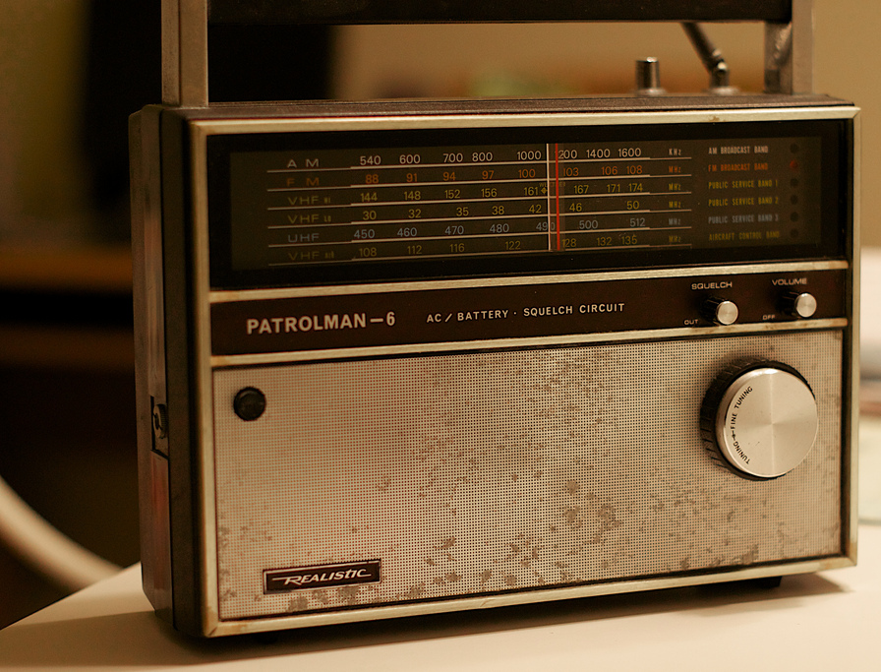

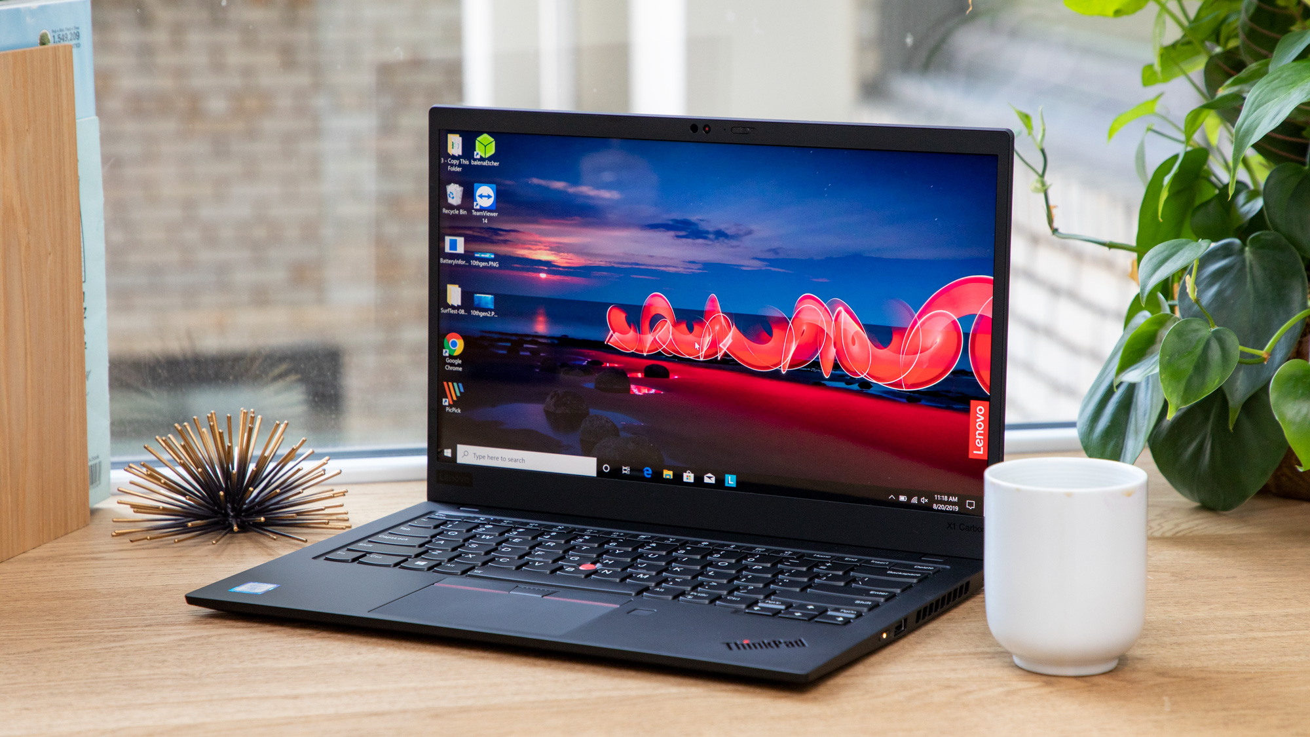
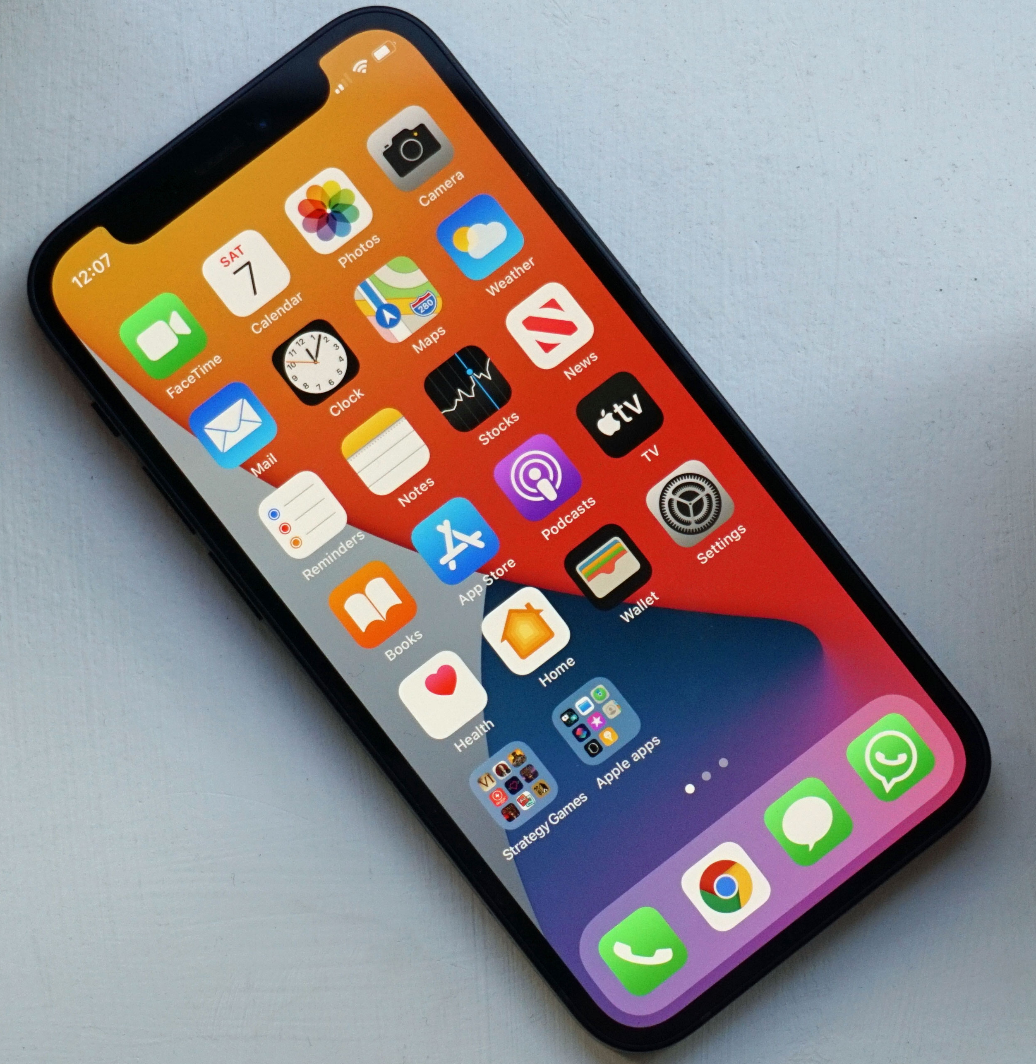
Challenge Your Thoughts
What are you hearing?

Slide 16
Challenge Your Thoughts
What are you hearing?
Constantly bombarded by:
  Words
  Ideas
  Worldviews
  Philosophies

Slide 17
Challenge Your Thoughts
What are you hearing?
Constantly bombarded by:
  Words
  Ideas
  Worldviews
  Philosophies
John 10:20—Many of them were saying, “He has a demon and is insane. Why do you listen to Him?” (NASB)

Slide 18
Challenge Your Thoughts
What are you hearing?
Constantly bombarded by:
  Words
  Ideas
  Worldviews
  Philosophies
John 10:20—Many of them were saying, “He has a demon and is insane. Why do you listen to Him?” (NASB)
Luke 9:35—Then a voice came out of the cloud, saying, “This is My Son, My Chosen One; listen to Him!” (NASB)

Slide 19
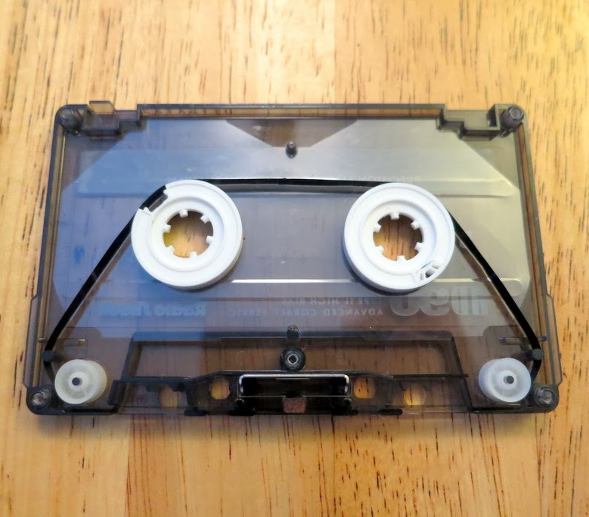
Challenge Your Thoughts
What are you thinking?
When your personal stories are filled with
  Disappointment
  Brokenness
  Pain

Slide 20
Challenge Your Thoughts
What are you thinking?
When your personal stories are filled with
  Disappointment
  Brokenness
  Pain
Thinking in a loop.

Slide 21
Challenge Your Thoughts
What are you thinking?
When your personal stories are filled with:
Thinking in a loop.

Slide 22
Challenge Your Thoughts
What are you thinking?
When your personal stories are filled with:
  Disappointment
Thinking in a loop.

Slide 23
Challenge Your Thoughts
What are you thinking?
When your personal stories are filled with:
  Brokenness
Thinking in a loop.

Slide 24
Challenge Your Thoughts
What are you thinking?
When your personal stories are filled with:
  Pain
Thinking in a loop.

Slide 25
Challenge Your Thoughts
What are you thinking?
When your personal stories are filled with:
  Sinful regrets
Thinking in a loop.

Slide 26
Challenge Your Thoughts
What are you thinking?
When your personal stories are filled with:
  Broken promises
Thinking in a loop.

Slide 27
Challenge Your Thoughts
What are you thinking?
When your personal stories are filled with:
  What you think will be controlled by what you believe!
Thinking in a loop.

Slide 28
Challenge Your Thoughts
What are you believing?
Our hearts and heads are
easily informed by
  Lies
    Deceit
Accusations from the
  world,
    the flesh,
      and the devil.
That you might believe!

Slide 29

Challenge Your Thoughts
What are you believing?
Our hearts and heads are
easily informed by
  Lies
    Deceit
Accusations from the
  world,
    the flesh,
      and the devil.
That you might believe!

Slide 30
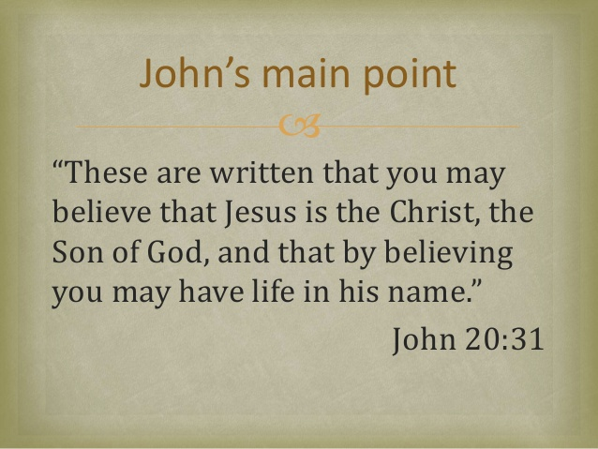
Challenge Your Thoughts
What are you believing?
Our hearts and heads are
easily informed by
  Lies
    Deceit
Accusations from the
  world,
    the flesh,
      and the devil.
That you might believe!

Slide 31
Challenge Your Thoughts
What are you believing?
Our hearts and heads are
easily filled up with:
That you might believe!

Slide 32
Challenge Your Thoughts
What are you believing?
Our hearts and heads are
easily filled up with:
  Lies
That you might believe!

Slide 33
Challenge Your Thoughts
What are you believing?
Our hearts and heads are
easily filled up with:
  Deception
That you might believe!

Slide 34
Challenge Your Thoughts
What are you believing?
Our hearts and heads are
easily filled up with:
  Accusations from the world and Satan
That you might believe!

Slide 35
Challenge Your Thoughts
What are you believing?
1 John 4:5—They are from the world; therefore they speak as from the world, and the world listens to them. (NASB)
That you might believe!

Slide 36
Challenge Your Thoughts
What are you believing?
John 14:1
“Do not let your hearts be troubled.
You believe in God;
believe also in me.
That you might believe!

Slide 37
Challenge Your Thoughts
What are you believing?
Colossians 3:1
Since, then, you have been raised with Christ, set your hearts on things above, where Christ is, seated at the right hand of God.
That you might believe!

Slide 38
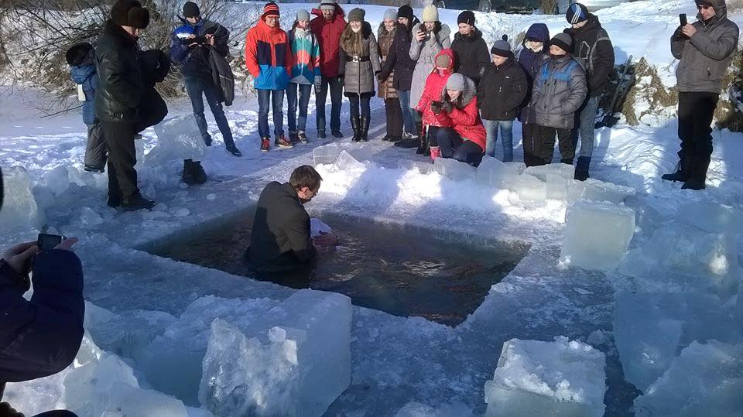
Matthew 28:19-20—¹⁹ Therefore go and make disciples of all nations, baptizing them in the name of the Father and of the Son and of the Holy Spirit, ²⁰ and teaching them to obey everything I have commanded you. And surely I am with you always, to the very end of the age.” (NIV)

