Slide 1
“Through many tribulations!”
Acts 14:22

Slide 2
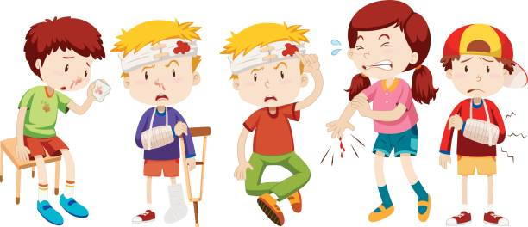
Things that are common to all
Life
Can
Hurt…

Slide 3
Things that are common to all
Life
Can
Hurt…
We are born into a troubled world.
Pain, sickness and death cannot be avoided.
Trust in people gets thin sometimes.
Setbacks: Home, School, Work…
can put our dreams far into the distant future.

Slide 4

Things that are common to all—
The Blessings
Acts 14:16-17—¹⁶In the generations gone by He permitted all the nations to go their own ways; ¹⁷and yet He did not leave Himself without witness, in that He did good and gave you rains from heaven and fruitful seasons, satisfying your hearts with food and gladness.” (NASB)

Slide 5
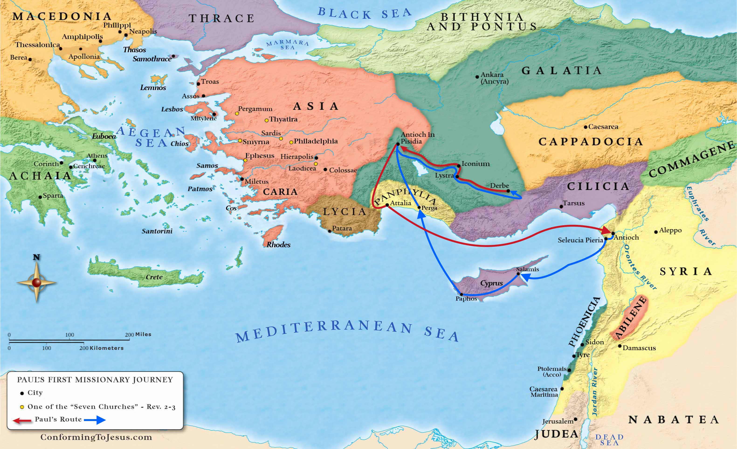
Paul’s first Missionary Journey (Acts 13-14)

Slide 6
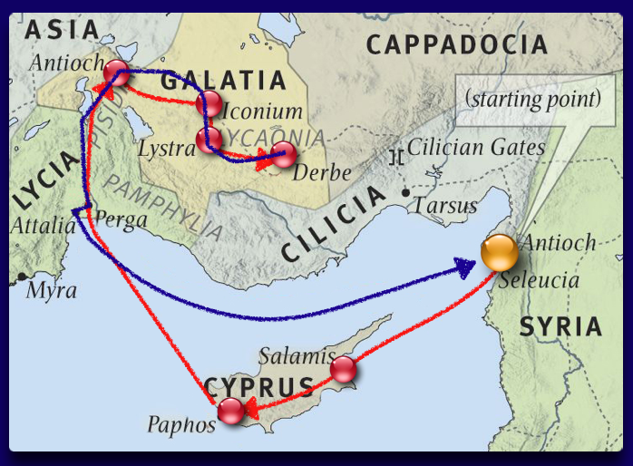

Slide 7
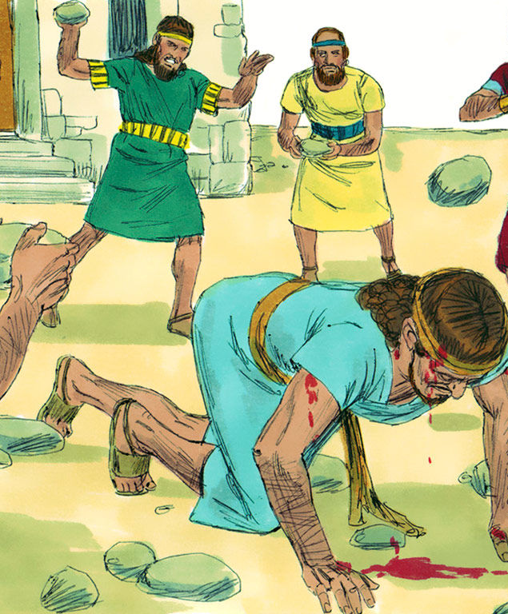
Opposition to preaching
Acts 14:19-20
¹⁹But Jews came from Antioch and Iconium, and having won over the crowds, they stoned Paul and dragged him out of the city, supposing him to be dead. ²⁰But while the disciples stood around him, he got up and entered the city. The next day he went away with Barnabas to Derbe. (NASB)

Slide 8
No Retreat—The Gospel goes on…

Slide 9
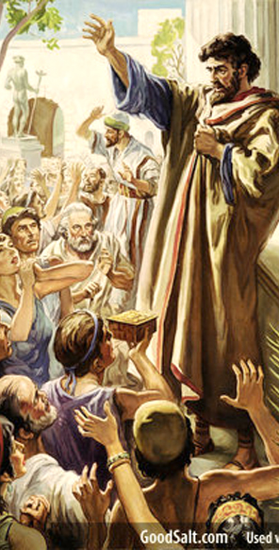
“Through many tribulations!”
Acts 14:21-22
²¹After they had preached the gospel to that city and had made many disciples, they returned to Lystra and to Iconium and to Antioch, ²²strengthening the souls of the disciples, encouraging them to continue in the faith, and saying, “Through many tribulations we must enter the kingdom of God.” (NASB)

Slide 10
“Through many tribulations!”
What this wasn’t:
What this was:

Slide 11
“Through many tribulations!”
What this wasn’t:
Not Paul’s resignation to the possible miseries of preaching the gospel.
What this was:

Slide 12
“Through many tribulations!”
What this wasn’t:
Not Paul’s resignation to the possible miseries of preaching the gospel.
Not a warning to the unsuspecting who might think that is all rosy out there on the mission field.
What this was:

Slide 13
“Through many tribulations!”
What this wasn’t:
Not Paul’s resignation to the possible miseries of preaching the gospel.
Not a warning to the unsuspecting who might think that is all rosy out there on the mission field.
Not a heads-up to future Christians that being a disciple is going from one set of struggles to another for nothing.
What this was:

Slide 14
“Through many tribulations!”
What this wasn’t:
Not Paul’s resignation to the possible miseries of preaching the gospel.
Not a warning to the unsuspecting who might think that is all rosy out there on the mission field.
Not a heads-up to future Christians that being a disciple is going from one set of struggles to another for nothing.
Not Paul’s lament.
What this was:

Slide 15
“Through many tribulations!”
What this wasn’t:
Not Paul’s resignation to the possible miseries of preaching the gospel
Not a warning to the unsuspecting who might think that is all rosy out there on the mission field
Not a heads-up to future Christians that being a disciple is going from one set of struggles to another for nothing.
Not Paul’s lament
What this was:
Paul’s dedication to the probable miseries of preaching the gospel—They are worth it!

Slide 16
“Through many tribulations!”
What this wasn’t:
Not Paul’s resignation to the possible miseries of preaching the gospel.
Not a warning to the unsuspecting who might think that is all rosy out there on the mission field.
Not a heads-up to future Christians that being a disciple is going from one set of struggles to another for nothing.
Not Paul’s lament
What this was:
Paul’s dedication to the probable miseries of preaching the gospel—They are worth it!
A warning to the unprepared who might think that is all rosy out there on the mission field.

Slide 17
“Through many tribulations!”
What this wasn’t:
Not Paul’s resignation to the possible miseries of preaching the gospel.
Not a warning to the unsuspecting who might think that is all rosy out there on the mission field.
Not a heads-up to future Christians that being a disciple is going from one set of struggles to another for nothing.
Not Paul’s lament.
What this was:
Paul’s dedication to the probable miseries of preaching the gospel—They are worth it!
A warning to the unprepared who might think that is all rosy out there on the mission field.
A heads-up to future Christians that being a disciple is going from one set of struggles to another—FOR EVERYTHING!

Slide 18
“Through many tribulations!”
What this wasn’t:
Not Paul’s resignation to the possible miseries of preaching the gospel.
Not a warning to the unsuspecting who might think that is all rosy out there on the mission field.
Not a heads-up to future Christians that being a disciple is going from one set of struggles to another for nothing.
Not Paul’s lament.
What this was:
Paul dedication to the probable miseries of preaching the gospel—They are worth it!
A warning to the unprepared who might think that is all rosy out there on the mission field.
A heads-up to future Christians that being a disciple is going from one set of struggles to another for everything.
Paul’s Battle Cry!

Slide 19

Paul made a choice—Discernment is everything!

Slide 20
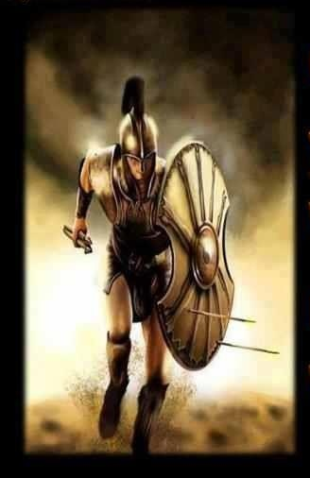
This is War!
Ephesians 6:12-13
¹²For our struggle is not against flesh and blood, but against the rulers, against the powers, against the world forces of this darkness, against the spiritual forces of wickedness in the heavenly places.
¹³Therefore, take up the full armour of God, so that you will be able to resist in the evil day, and having done everything, to stand firm. (NASB)

Slide 21

Soldiers…Marching as to war.
Philippians 4:3—³Indeed, true companion, I ask you also to help these women who have shared my struggle in the cause of the gospel, together with Clement also and the rest of my fellow workers, whose names are in the book of life. (NASB)

Slide 22
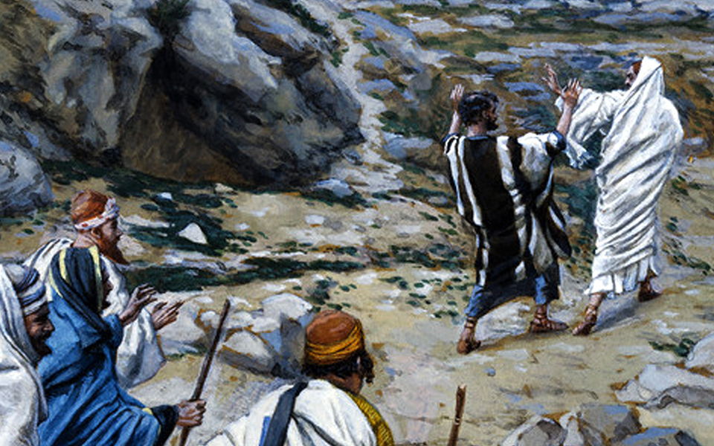
Satan at work—At the sowing.
Luke 8:12—¹²Those beside the road are those who have heard; then the devil comes and takes away the word from their heart, so that they will not believe and be saved. (NASB)
Satan at work—Using anyone.
Thus, we too cry, “Get behind me, Satan!”

Slide 23
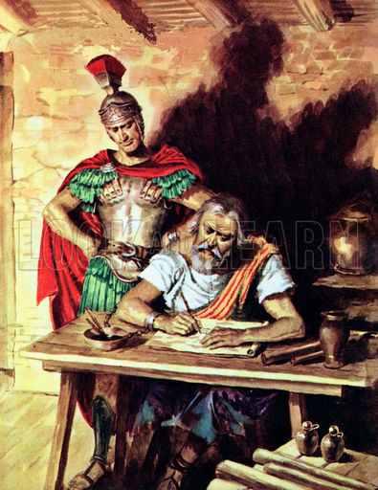
Life didn’t get easier
Colossians 2:1
For I want you to know how great a struggle I have on your behalf and for those who are at Laodicea, and for all those who have not personally seen my face, (NASB)

Slide 24

From this point on…
Ecclesiastes 12:13-14—
¹³The conclusion, when all has been heard, is: fear God and keep His commandments, because this applies to every person. ¹⁴For God will bring every act to judgment, everything which is hidden, whether it is good or evil. (NASB)

Slide 25

John 16:33
³³These things I have spoken to you, so that in Me you may have peace.
In the world you have tribulation, but take courage;
I have overcome the world.” (NASB)
Notes:
θλῖψιν

Slide 26
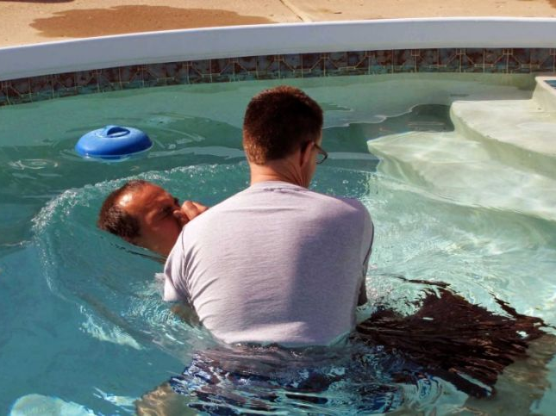
Galatians 3:27—²⁷For all of you who were baptized into Christ have clothed yourselves with Christ. (NASB)

