Slide 1


Slide 2

The Gospel
Part 1.
The Power of God

Slide 3
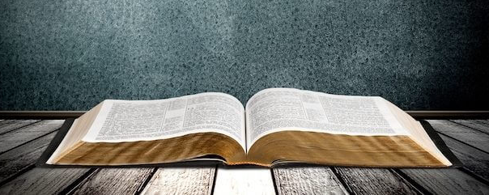
Hebrews 4:12—¹²For the word of God is living and active and sharper than any two-edged sword, and piercing as far as the division of soul and spirit, of both joints and marrow, and able to judge the thoughts and intentions of the heart.

Slide 4
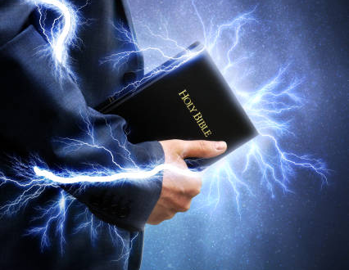
The Power of God unto Salvation
Romans 1:16-17—
¹⁶ For I am not ashamed of the gospel of Christ: for it is the power of God unto salvation to everyone that believeth; to the Jew first, and also to the Greek.
¹⁷ For therein is the righteousness of God revealed from faith to faith: as it is written, The just shall live by faith. (KJV)

Slide 5

The Power to change You!
Freedom—
From Sin.
From condemnation.
To eternal salvation.
Free to serve the Lord.
Sanctification…

Slide 6
The Power to change You!
The ongoing work of God making us more holy.
Lifetime process.
Not overnight, even though I wish it were so.
Becoming more and more like our Lord.
You learn you have a new nature and you realize that you don’t have to say yes to sin any longer!

Slide 7
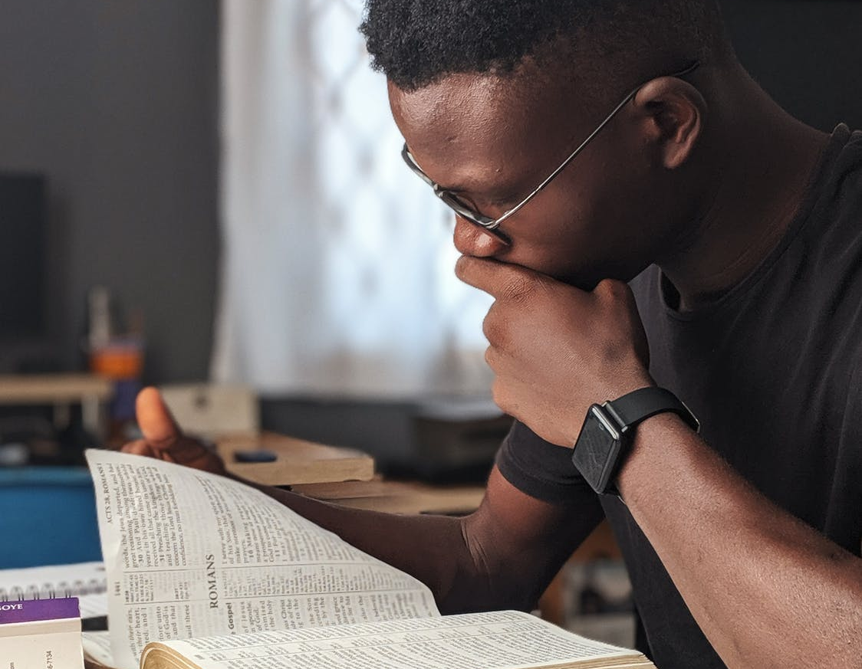
The Power to change the world.
Notice:
• It’s the POWER OF GOD inherently…
• Whenever you share the gospel
• God’s power is unleashed!
• Its not you making the change.

Slide 8
The Power to change the world.
Matthew 16:18- And I also say to you that you are Peter, and on this rock I will build My church, and the gates of Hades shall not prevail against it. (NKJV)

Slide 9

Power to the unbeliever
1 Corinthians 1:18
¹⁸For the word of the cross is foolishness to those who are perishing, but to us who are being saved it is the power of God. (NASB95)

Slide 10
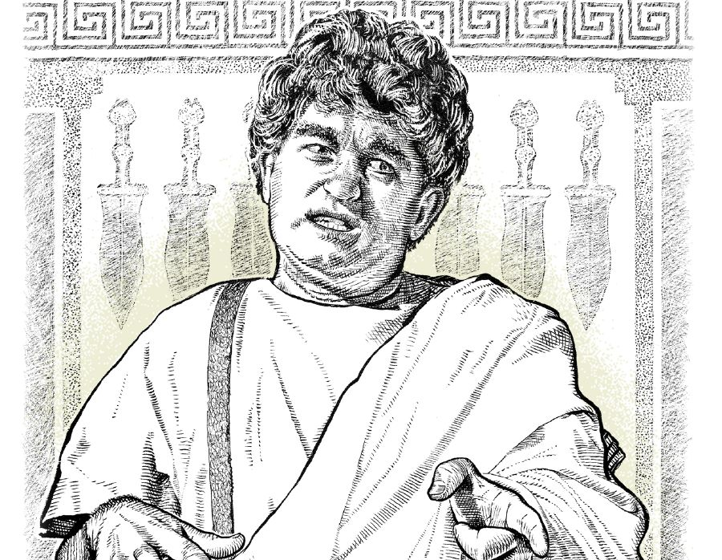
Felix’s Response to the Gospel
Acts 24:24-25
²⁴But some days later Felix arrived with Drusilla, his wife who was a Jewess, and sent for Paul and heard him speak about faith in Christ Jesus.

Slide 11
Felix’s Response to the Gospel
Acts 24:24-25
²⁵But as he was discussing righteousness, self-control and the judgment to come, Felix became frightened and said, “Go away for the present, and when I find time I will summon you.” (NASB95)

Slide 12
Felix’s Response to the Gospel
Frightened
When convenient –
At his leisure.
Finding time.
‘More important things’ come first.
When his conscience was pricked.
When he had power to resist.

Slide 13
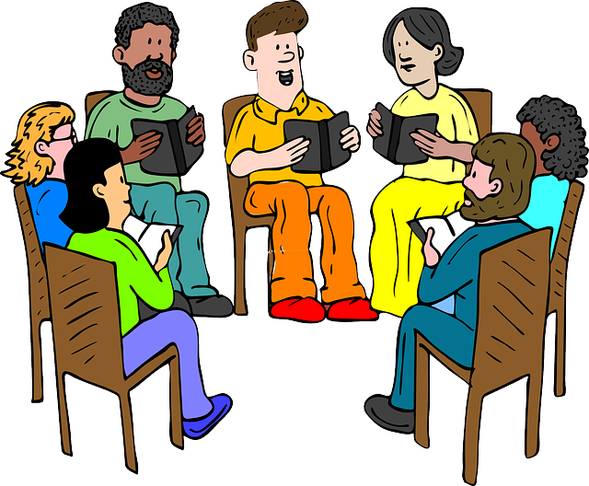
The Power that brings us together
United by a common faith in Christ
Bible is our only guide:
Love
Doctrines
Worship
Fellowship
Home
Friends
Work
Evangelism

Slide 14
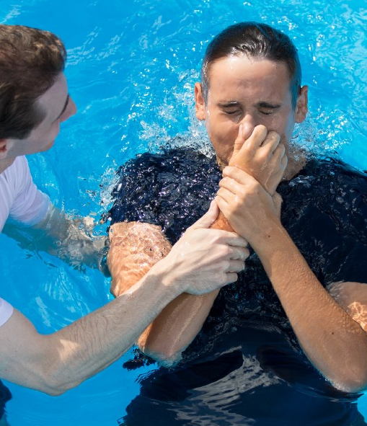
¹⁶Now why do you delay? Get up and be baptized, and wash away your sins, calling on His name.’ (NASB95)
Acts 22:16

