Slide 2
The Gospel
Part 2.
I am Debtor

Slide 3
Romans 1:14—¹⁴ I am debtor both to the Greeks, and to the Barbarians; both to the wise, and to the unwise. (KJV)

Slide 4
Romans 1:14—¹⁴For I have a great sense of obligation to people in both the civilized world and the rest of the world, to the educated and uneducated alike. (NLB)

Slide 5
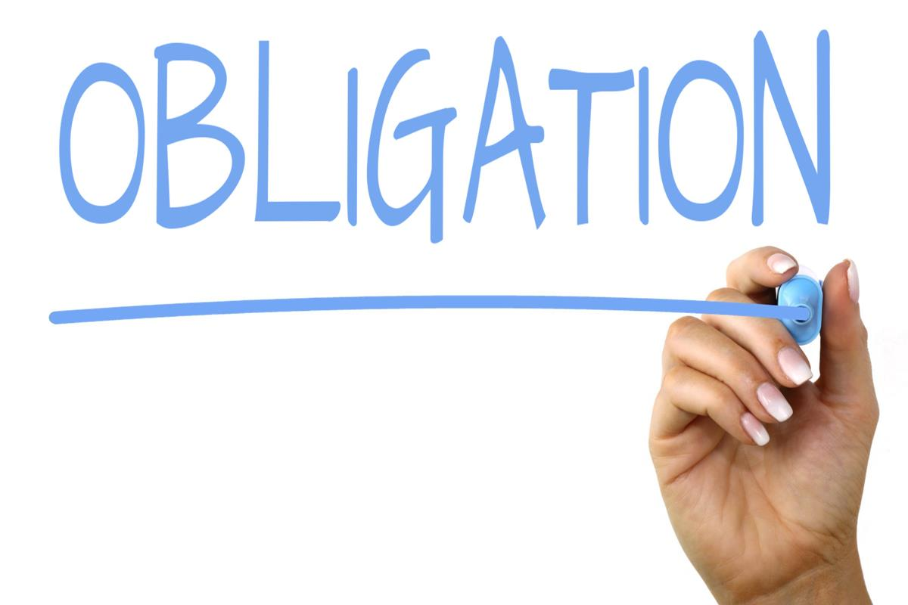
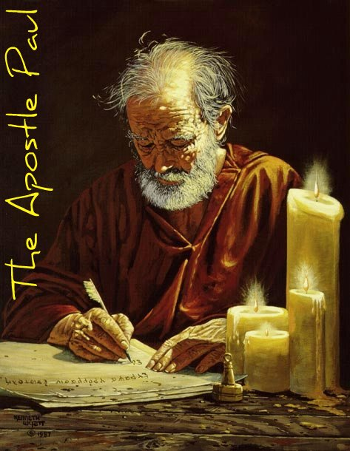
A burden of debt was laid upon Paul's heart:
No person could do this to Paul…

Slide 6
A burden of debt was laid upon Paul's heart:
No man
inspired
Him to do this.
No person could do this to Paul…

Slide 7
A burden of debt was laid upon Paul's heart:
No one could
bind
him to do this.
No person could do this to Paul…

Slide 8
A burden of debt was laid upon Paul's heart:
No one could
Bribe him.
Bully him.
Manipulate him.
Deceive him.
No person could do this to Paul…

Slide 9
Overwhelmed.

Slide 10
Overwhelmed.
Such a mighty weight of blessing had produced Paul's feeling of indebtedness.

Slide 11
Overwhelmed.
Christians have the same sense of indebtedness.

Slide 12
Overwhelmed.
No amount of:
Talents / Resources
Time / Energy
Limited his desire to preach.

Slide 13
Hebrews
Jews and Gentiles.
Greeks
Greeks and Barbarians.
Romans
Romans and pagans

Slide 14
Everyone—Without exception!
Hebrews
Jews and Gentiles.
Greeks
Greeks and Barbarians.
Romans
Romans and pagans

Slide 15
I must serve all people—those who share in Greek culture and those who are less civilized, the educated as well as the ignorant.
Hebrews
Jews and Gentiles.
Greeks
Greeks and Barbarians.
Romans
Romans and pagans

Slide 16
Romans 11:13— ¹³But I am speaking to you who are Gentiles. Inasmuch then as I am an apostle of Gentiles, I magnify my ministry (NASB95)
Hebrews
Jews and Gentiles.
Greeks
Greeks and Barbarians.
Romans
Romans and pagans

Slide 17
Acts 9:15— ¹⁵But the Lord said to him, “Go, for he is a chosen instrument of Mine, to bear My name before the Gentiles and kings and the sons of Israel; (NASB95)
Hebrews
Jews and Gentiles.
Greeks
Greeks and Barbarians.
Romans
Romans and pagans

Slide 18
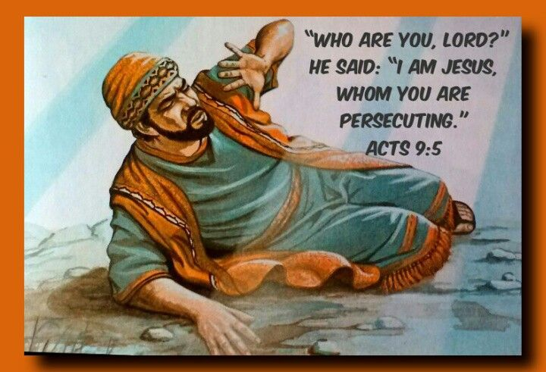
Christ paid a Debt He did not owe…
Christ had:
Died for Paul.
Appeared to him.
Commissioned him as an apostle.
Saved his soul from sin.
Made him an heir of everlasting life.

Slide 19
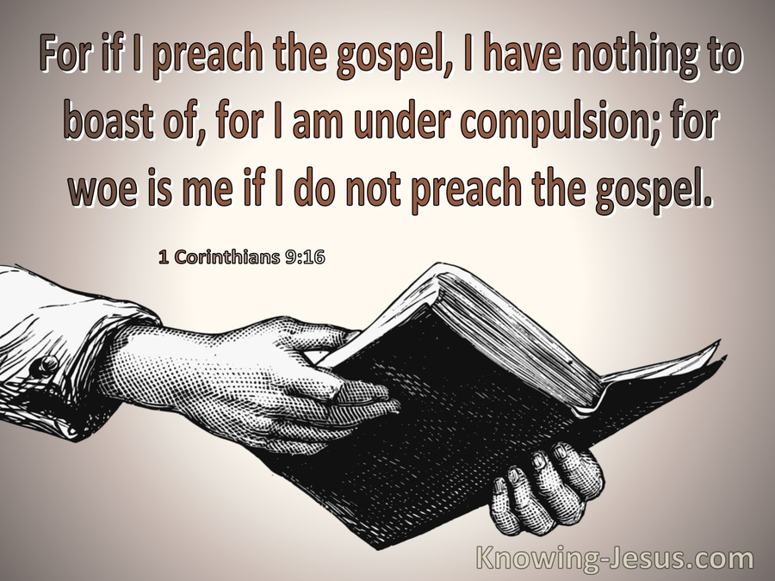
Paul felt a Debt of Gratitude
Owed God:
Gloried in God’s mercy
1 Timothy 1:13—¹³even though I was formerly a blasphemer and a persecutor and a violent aggressor. Yet I was shown mercy because I acted ignorantly in unbelief; (NASB95)

Slide 20
Paul felt a Debt of Gratitude
Owed God:
Praised God’s grace
1 Corinthians 15:10—¹⁰ But by the grace of God I am what I am, and His grace toward me did not prove vain; but I laboured even more than all of them, yet not I, but the grace of God with me. (NASB95)

Slide 21
Paul felt a Debt of Gratitude
Owed God:
Thanks for putting him into service
Apostolic commission

Slide 22
You and Me…!
The spirit of our Mission
Out of a sense of debt.
Bound to the teachings of Christ.
Continually a debtor.
Cannot do enough for our Lord.
Never unbind myself from Jesus and his mission.

Slide 23
¹⁶Now why do you delay? Get up and be baptized, and wash away your sins, calling on His name.’ (NASB95)
Acts 22:16

