Slide 1
For the Purpose of Godliness
Living and Thinking As Jesus Did
Titus 2:11-13

Slide 2

Titus 2:11-13—
¹¹For the grace of God has appeared, bringing salvation to all men, ¹²instructing us to deny ungodliness and worldly desires and to live sensibly, righteously and godly in the present age, ¹³looking for the blessed hope and the appearing of the glory of our great God and Saviour, Christ Jesus,

Slide 3
Jesus—Our Great Example of Godliness (1 Timothy 3:16)
He who was revealed in the flesh – A Life lived in the flesh – no cheating – God lived right here, among us, and under His own rules
Was vindicated in the Spirit – Jesus was Proven by the Holy Spirit – empowered, and honoured by the Holy Spirit of God
Seen by angels – Watched from heaven – Jesus had heaven’s attention the whole time (cf 1Pet.1:12) – glued to their “I-phones”
Proclaimed among the nations – He preached to the uttermost person – those most unlike Him – Gentiles, lost, ignorant, no rights
Believed on in the world – He was and is believed on and trusted around he world – not just by a select few, but by young and old, smart and dumb, rich and poor
Taken up in glory – He is now in heaven, seated in glory and is King of kings and Lord of lords!
Godliness is to have your life lined up with Christ’s life – to be living God-ward, instead of world-ward.

Slide 4

Facts About Godliness
Godliness is a source of Real Power in Your Life.
  Paul warned about those with a form of godliness, but denying its power - 2 Tim 3:5
  True godliness contains "power"
  If your conduct pleases God, He empowers you!

Slide 5

Facts About Godliness
Godliness is a great thing – not for wimps and cowards. Profitable for all things (1 Tim 4:7-8; 6:6)
Godliness is only learned – it is not automatic, nor naturally occurring in your life:
  Learned through right instruction (1Tim 6:3-11)
  And learned through patiently going through trials – godliness is Built Upon Patience – no short-cuts

Slide 6

Growing in
Godliness
Requires Exercise...effort on your part (1Tim 4:7,8; 12-16) - "giving all diligence" (cf. 2Pet 1:5)
Requires Abstinence...
  Staying away from disputes and arguments that lead to false doctrine (1Tim 6:3-4).
  From influences of those men who fight to get what they can out of the church (1Tim 6:5).
  From materialism and the love of money (1Tim 6:6-10)
Flee these things, and pursue godliness (1Tim 6:11)

Slide 7
Making it Work…
It is God's desire that you live godly lives – A ‘God-ward’ life.
Satan wants your focus on this world. On the failures and frustrations of this life, away from Jesus.
Godliness has an enemy – self-righteousness.
Godliness is Great – It is ADDED to your life, one experience at a time – not automatic.
Godliness Shows its Fruit – In every area of your life that is seen by those around you
Godliness Grows in your Life by:
  Spiritual Exercise... strenuous effort on our part.
  Abstinence from things that are “of the world.”
  Fleeing those things, while hotly pursuing godliness.

Slide 8
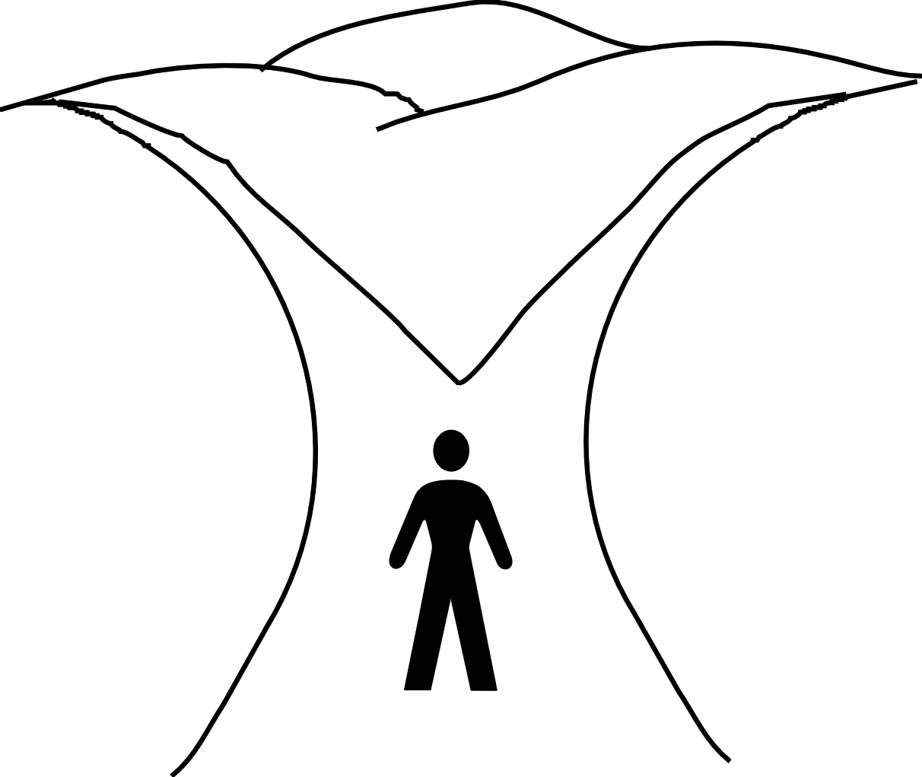
The Christian’s Choice
Life
Two directions
Two sets of desires in us all
Two choices to make every moment of every day
Two results
Death
My Way
God’s Way
Worldliness
Godliness
Proverbs 14:12
¹² There is a way which seems right to a man,
But its end is the way of death.
Romans 6:22
²² But now that you have been set free from sin and have become slaves of God, the fruit you get leads to sanctification and its end, eternal life.
Matthew 7:13-14

Slide 9
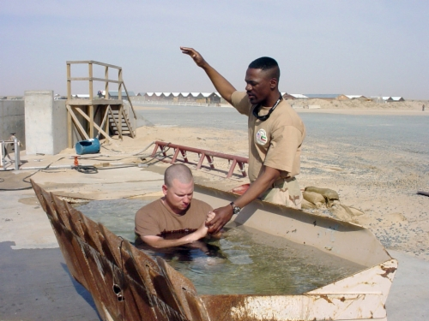
Matthew 7:13-14—
¹³“Enter through the narrow gate; for the gate is wide and the way is broad that leads to destruction, and there are many who enter through it. ¹⁴ For the gate is small and the way is narrow that leads to life, and there are few who find it. (NASB95)

