Slide 1
“Advice of the Ages…Again?”
John Staiger
Morningside Church of Christ
Sunday 29 August 2021
PM Sermon
Broadcast on Facebook Live from Massey, Auckland, NZ.

Slide 2

Advice of the Ages…Again?

Slide 3
Proverbs 3:1-3—
¹My son, do not forget my teaching,
But let your heart keep my commandments;
² For length of days and years of life
And peace they will add to you.
³ Do not let kindness and truth leave you;
Bind them around your neck,
Write them on the tablet of your heart. (NASB95)

Slide 4

Parent’s Advice—How did you do?

Slide 5
Parent’s Advice—How did you do?
A famous man once said, “Older people love to give advice, because it saves them the trouble of being a good example.”

Slide 6
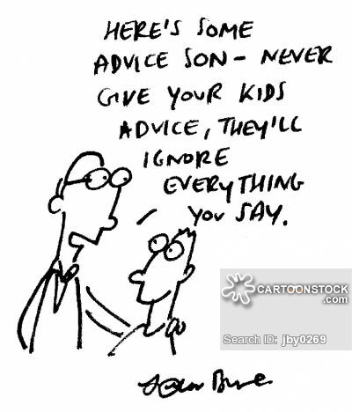

Slide 7
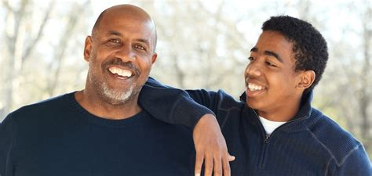
My son…
27 times in the Book of Proverbs he says, “My son(s)…”
1:10—My son, if sinful men entice you, do not give in to them.
3:11—My son, do not despise the Lord’s discipline…
3:31—My son, do not let wisdom and understanding out of your sight…

Slide 8

Going off to seek his fortune—Just 10 minutes is all you have…

Slide 9
Going off to seek his fortune—Just 10 minutes is all you have…
What ‘last words of wisdom’ would you impart?
What would come to mind?
How important would it be?

Slide 10

Just 10 minutes is all you have…
Today…?
How much time do you have left and what can you impart?

Slide 11
Wise counsel brings a full life
Why waste?
Time..?
Opportunities?
Friendships?
Souls…?

Slide 12

Learn God’s word.
Proverbs 3:1—¹My son, do not forget my teaching, but keep my commands in your heart,

Slide 13
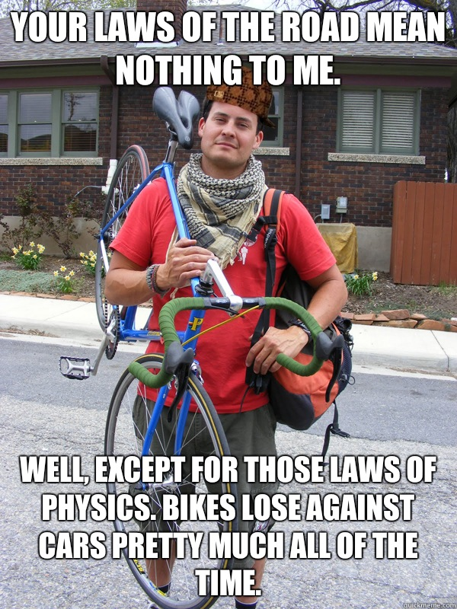
Learn God’s word—Don’t fight the Law.

Slide 14
Learn God’s word—Don’t fight the Law.

Slide 15
Learn God’s word—Don’t fight the Law.
Notes to my son…

Slide 16
Learn God’s word—Don’t fight the Law.
Notes to my son…
Nothing at all would work if God didn’t build His laws into this universe.

Slide 17
Learn God’s word—Don’t fight the Law.
Notes to my son…
All that scientists do is think God’s thoughts after Him—whether they know it or not.

Slide 18
Learn God’s word—Don’t fight the Law.
Notes to my son…
They discover laws that God has built into His universe and cooperate with them.

Slide 19
Learn God’s word—Don’t fight the Law.
Notes to my son…
If we cooperate—there is power and progress.

Slide 20
Learn God’s word—Don’t fight the Law.
Notes to my son…
If we fight against them—there is weakness and defeat.

Slide 21
Learn God’s word—Don’t fight the Law.
Notes to my son…
Fight against the laws of Nature or Health and see what happens.

Slide 22
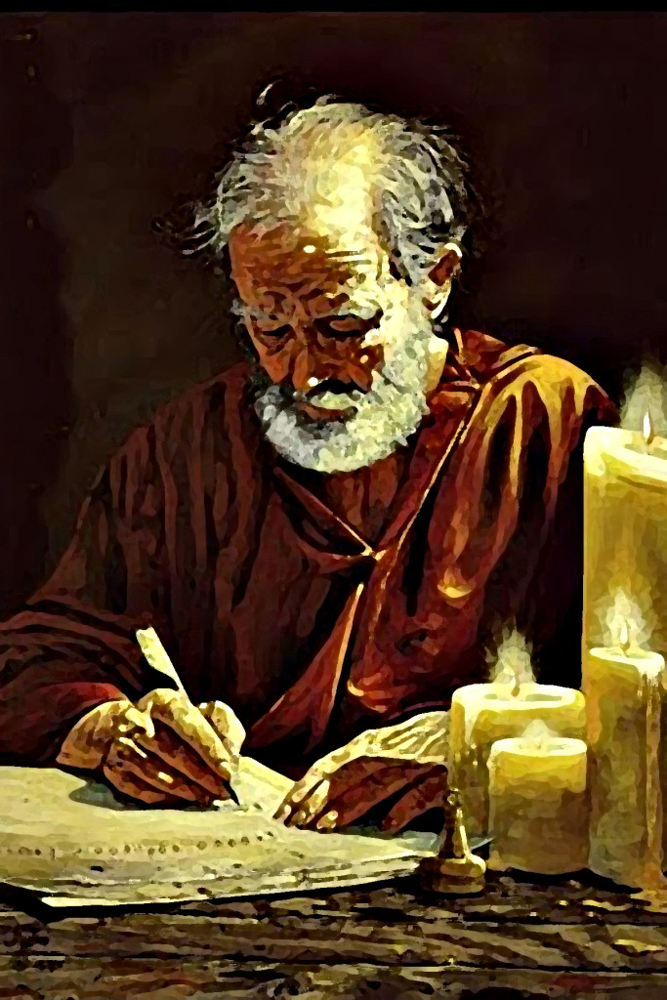
Learn God’s word—From the Heart.
Proverbs 3:3—
³ Do not let kindness and truth leave you;
Bind them around your neck,
Write them on the tablet of your heart. (NASB95)

Slide 23
Learn God’s word—From the Heart.
Co-operate with God’s principles, and God will co-operate with you.

Slide 24
Learn God’s word—From the Heart.
The most important thing for us to do is learn God’s word…

Slide 25
Learn God’s word—From the Heart.
Into your mind
  v.1. ‘Do not forget my teaching.’

Slide 26
Learn God’s word—From the Heart.
X2 into your heart
  v.1. ‘But keep my commands in your heart.’
  v.3. ‘Write them on the tablet of your heart.’

Slide 27

Learn God’s word—Beyond Theory.
We are not just a technical Bible student.
We begin with an end in mind (2Pet.3:18).
What is in the heart controls the life.
¹⁸ but grow in the grace and knowledge of our Lord and Saviour Jesus Christ. To Him be the glory, both now and to the day of eternity. Amen.

Slide 28
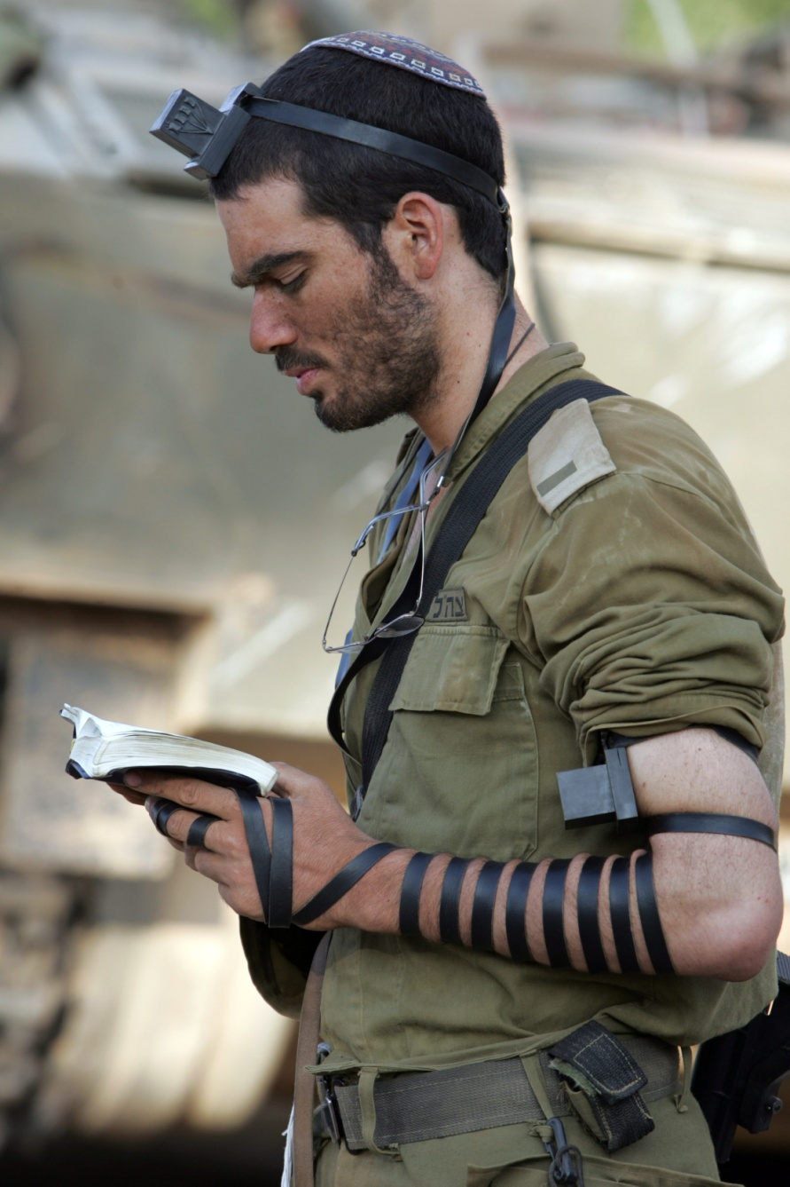
Learn God’s word —Tied Down.
Deuteronomy 11:18
Fix these words of mine in your hearts and minds; tie them as symbols on your hands and bind them on your foreheads.

Slide 29

Learn God’s word—The Consequences…
Proverbs 3:2a—“For they will prolong your life many years,…”

Slide 30
Learn God’s word—The Consequences…
Proverbs 3:2a—“For they will prolong your life many years,…”
Some good people die young.
Some wicked people live long healthy lives.
The point isn’t found in ‘Calendar Years.’
This is a life well lived despite circumstances.

Slide 31
Learn God’s word—The Consequences…
Proverbs 3:2a—“For they will prolong your life many years,…”
All of God’s Commands are designed to bring Spiritual, Mental and Physical wellbeing:
Worship / Bible instruction / Brotherhood / Diet / Family / Work

Slide 32
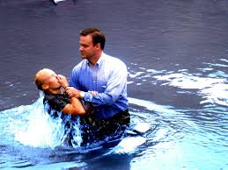
God’s Word—Saves.
Acts 2:38
³⁸Peter said to them, “Repent, and each of you be baptized in the name of Jesus Christ for the forgiveness of your sins; and you will receive the gift of the Holy Spirit.

