Slide 1

^{for the}
Part 2. “Taking Captive Every Thought.”

Slide 2


Slide 3
The enemy of our soul tells lies about God…

Slide 4
The enemy of our soul tells lies about God…
John 8:44—⁴⁴You belong to your father, the devil, and you want to carry out your father’s desires. He was a murderer from the beginning, not holding to the truth, for there is no truth in him. When he lies, he speaks his native language, for he is a liar and the father of lies. (NIV)

Slide 5
The enemy of our soul tells lies about God…
  To tempt us.
John 8:44—⁴⁴You belong to your father, the devil, and you want to carry out your father’s desires. He was a murderer from the beginning, not holding to the truth, for there is no truth in him. When he lies, he speaks his native language, for he is a liar and the father of lies. (NIV)

Slide 6

The enemy of our soul tells lies about God…
  To breed distrust in relationships.

Slide 7

The enemy of our soul tells lies about God…
  To divide us.

Slide 8

The enemy of our soul tells lies about God
  To ‘Loop’ accusing words in our minds to destroy us.

Slide 9


Slide 10
Take captive your thoughts and examine them…

Slide 11

Take captive your thoughts and examine them…

Slide 12
Take captive your thoughts and examine them…
1. Capture:
  Control them.
  Sort them.
  ‘Slow to speak.’
  ‘Slow to become angry.’
  Lust.
  Envy.
  Spite.

Slide 13
Take captive your thoughts and examine them...
2. Examine:
A closer look—
  “Where did THAT come from?”
  “What are these thoughts saying about my claim to faith in Jesus?”

Slide 14


Slide 15
Consider the evidence…

Slide 16

Consider the evidence…
Jesus asked His disciples…
Matthew 16:15

Slide 17
Consider the evidence…
‘Has Jesus changed me?’
Jesus asked His disciples…
Matthew 16:15

Slide 18
Consider the evidence…
‘Who am I ‘NOW’ because of what Jesus means to me?’
Jesus asked His disciples…
Matthew 16:15

Slide 19
Consider the evidence…
‘How do I come across?’
Jesus asked His disciples…
Matthew 16:15

Slide 20
Consider the evidence…
‘What does everyone
  ‘See in me,’
  and
  ‘see happening around me?’
Jesus asked His disciples…
Matthew 16:15

Slide 21
Questions to ask God to address:

Slide 22

Questions to ask God to address:
Will this thinking produce qualities that reflect the presence of the Holy Spirit in me?

Slide 23

Questions to ask God to address:
Does this kind of thinking sound like:
  The devil’s accusations,
  or the Spirit’s conviction?
  Despair or Victory
“Where, O death, is your victory?
Where, O death, is your sting?” ^{(1Cor.15:55)}

Slide 24

Questions to ask God to address:
What am I putting my hope in now:
  God’s Word and work,
  myself,
  or someone else’s ideas?

Slide 25

Questions to ask God to address:
How can I grasp the full impact of the Jesus’
life
death
burial and
resurrection?

Slide 26

Questions to ask God to address:
What things about Jesus do I need to know right now to…?
Mature
Serve
Teach

Slide 27

Pray:
“Lord, I submit my thoughts and beliefs to you...
I will obey you in order to be renewed in my mind by Your truths…
Teach me in the reading of Your Bible.”

Slide 28
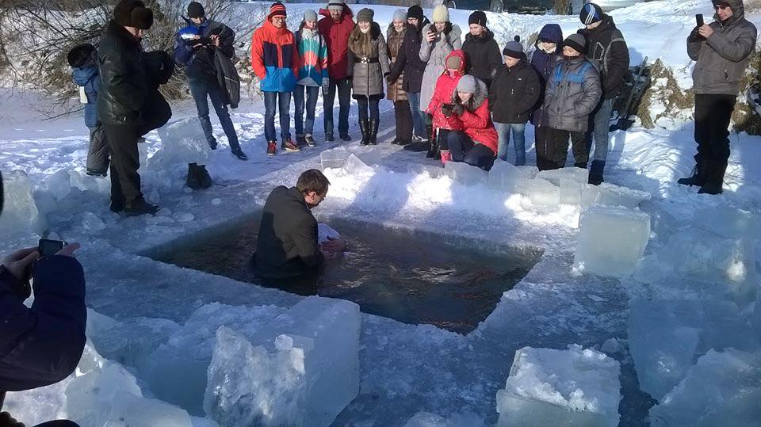
Matthew 28:19-20—¹⁹ Therefore go and make disciples of all nations, baptizing them in the name of the Father and of the Son and of the Holy Spirit, ²⁰ and teaching them to obey everything I have commanded you. And surely I am with you always, to the very end of the age.” (NIV)

