Slide 2
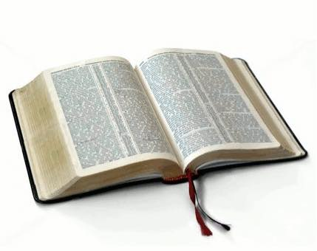
What am I doing here?
Bible

Slide 3
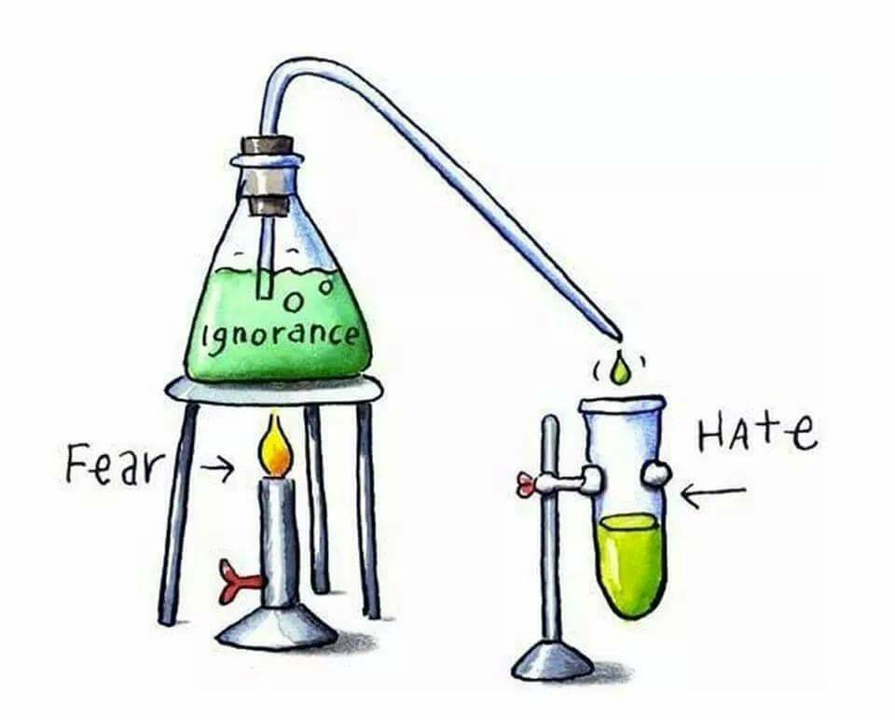
How Satan works!

Slide 4
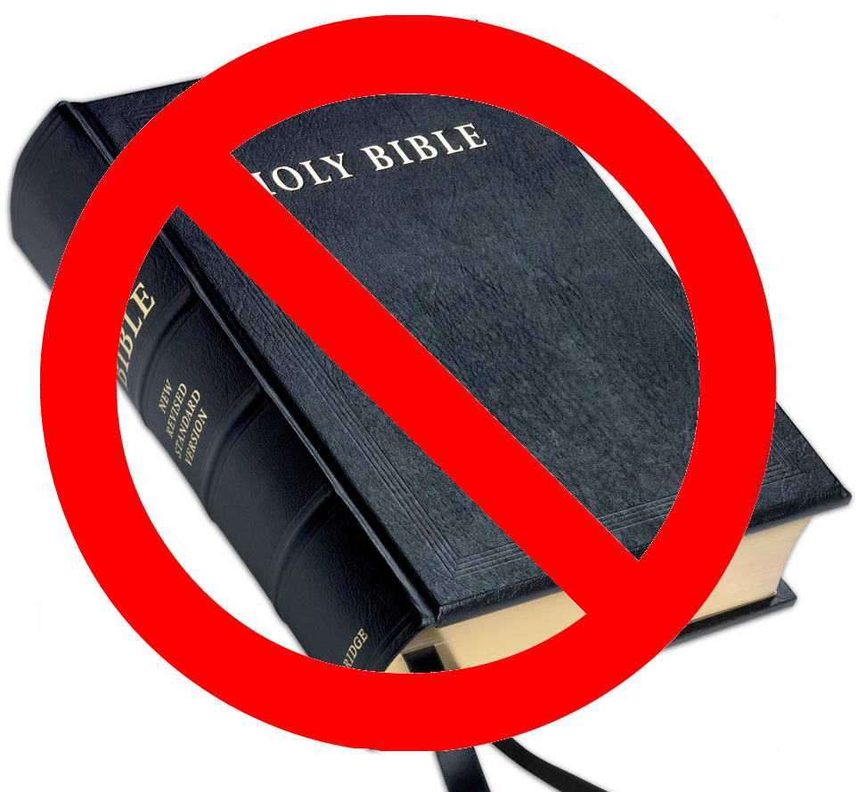
What are they afraid of..?
In some, mostly Muslim states, censorship of the Bible exists today, such as in Saudi Arabia where the distribution of non-Muslim religious materials such as Bibles is illegal, although non-Muslims are permitted to own their own Bibles.

Slide 5
What are they afraid of..?
China
The state-owned Amity Press is the only publisher allowed to print Bibles in China that are not for export. The quantity printed is restricted, and the sale or distribution of Bibles is limited to officially sanctioned churches, with online sales having been recently cracked down upon.

Slide 6

How we work!
John 13:35—
³⁵By this all men will know that you are My disciples, if you have love for one another.” (NASB95)

Slide 7

Why only me?—
Not so…
Elijah felt alone…
Romans 11:4—
⁴But what is the divine response to him? “I have kept for Myself seven thousand men who have not bowed the knee to Baal.” (NASB95)

Slide 8

It takes work…
Bill Such lamented that he would find personal Bibles left behind in church for weeks.

Slide 9
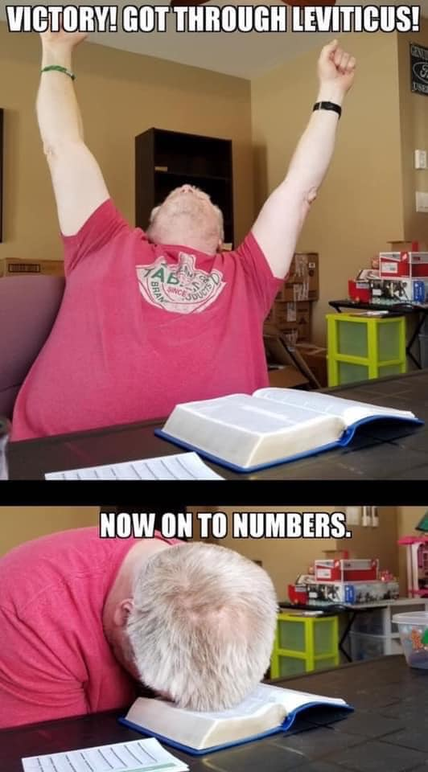
It takes work!
2 Peter 3:15-16—
¹⁵…just as also our beloved brother Paul, according to the wisdom given him, wrote to you, ¹⁶as also in all his letters, speaking in them of these things, in which are some things hard to understand, which the untaught and unstable distort, as they do also the rest of the Scriptures, to their own destruction. (NASB95)

Slide 10
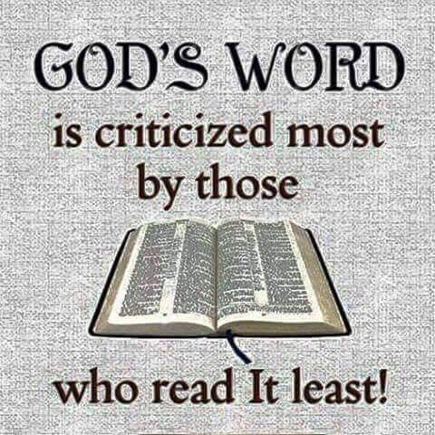
It pays to not prove yourself a hypocrite…!
I have heard and read men who have heard and read men criticise the Bible—Their ignorance of the Bible exposed itself in every sentence.

Slide 11
It pays to not prove yourself a hypocrite…!
We have churches and universities that have teach things not found in scripture.
They deny:
  Inspiration.
  Creation.
  The deity of Christ.

Slide 12
It pays to not prove yourself a hypocrite…!
The goodness that we are surrounded by today is because of the Bible.
The Bible commands love through:
  Hope—Evangelism.
  Kindness— Benevolence.
  Hard work—Usefulness.

Slide 13
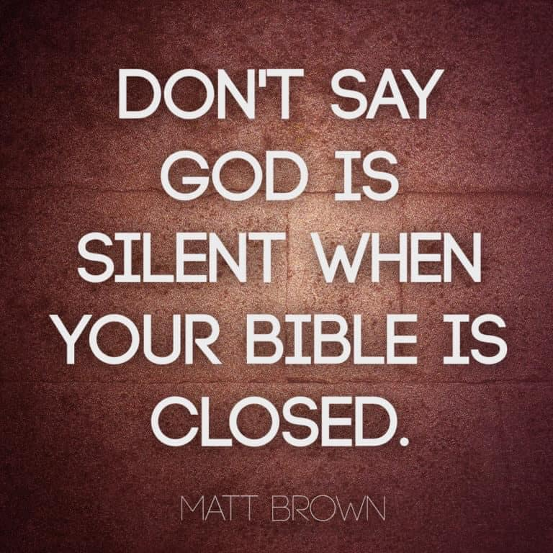
God is always speaking…!
John 17:17
¹⁷ Sanctify them in the truth; Your word is truth.

Slide 14
God is always speaking…!
2 Timothy 3:16-17
¹⁶All Scripture is inspired by God and profitable for teaching, for reproof, for correction, for training in righteousness; ¹⁷ so that the man of God may be adequate, equipped for every good work.

Slide 15
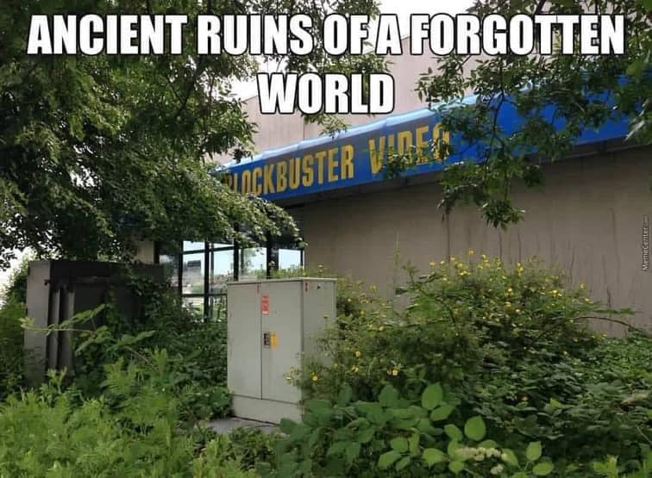
Things don’t stay as they are in your life!
The Bible:
Tells you of changes to come.
Warns you of consequences.
Guides you through life.
Helps you to overcome.
Warning—Life will blindside you.
Hope—God ever guides His children.

Slide 16
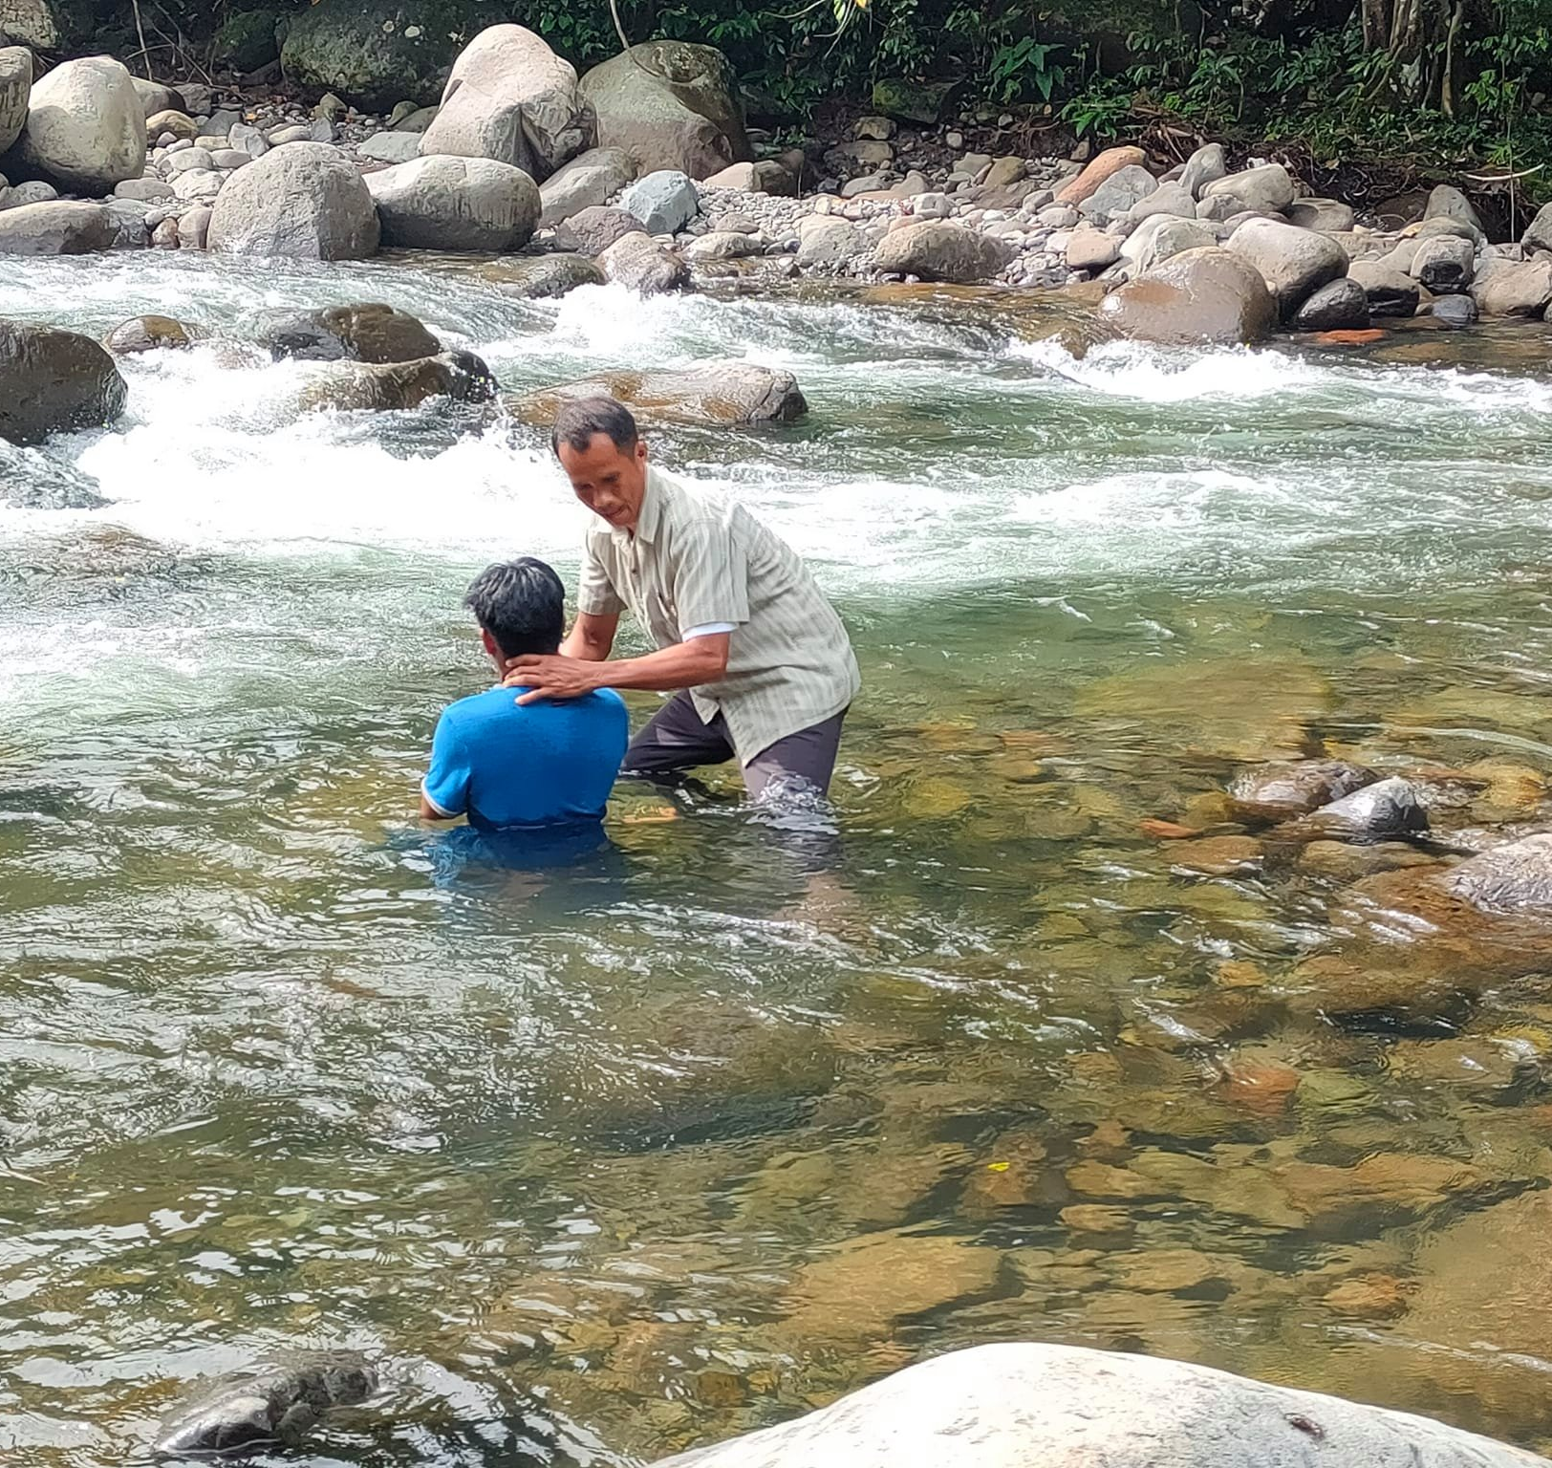
“Baptism now saves you” (1Pet.3:21).
Matthew 28:19-20—¹⁹Go therefore and make disciples of all the nations, baptizing them in the name of the Father and the Son and the Holy Spirit, ²⁰teaching them to observe all that I commanded you; and lo, I am with you always, even to the end of the age.” (NASB95)

