Slide 2

What am I doing here?
Working together.”

Slide 3
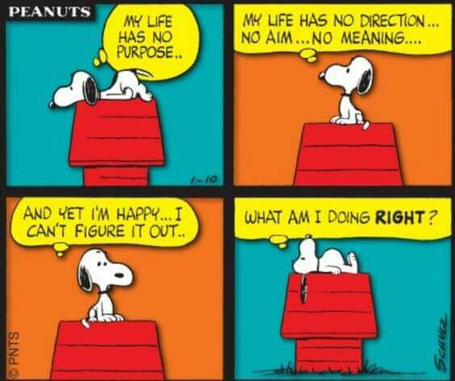

Slide 7
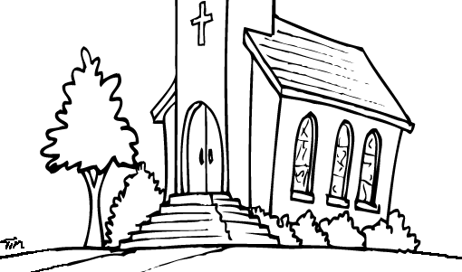
The church I grew up in…
Had a profound impact FOR GOOD—
Embodied Faith, Hope and Love.
A lifetime of Godly Friends and Mentors.
Taught Sound Reasoning—Bible.
Great memories…

Slide 8
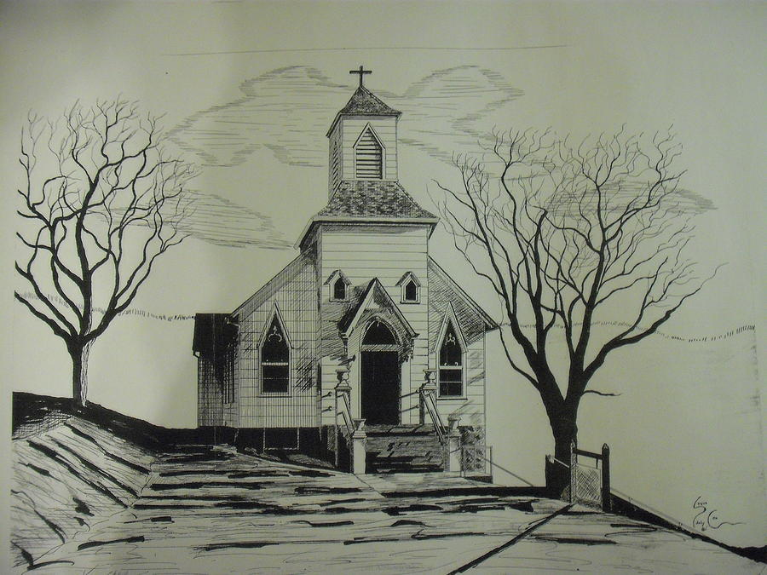
The church I grew up in…
Had a profound impact FOR EVIL—
No Faith, No Hope and No Love.
A lifetime of godless ‘Friends’ and ‘Mentors.’
Unsound Reasoning—Bible was distorted.
I’d rather forget them…

Slide 9
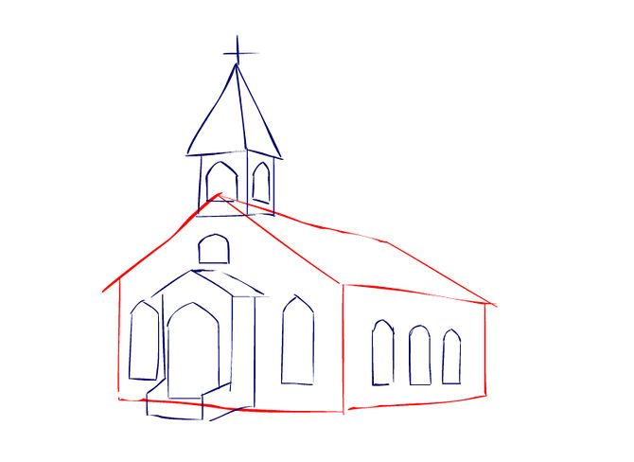
The church I grew up in…
Had a profound impact…FOR SOMEBODY ELSE—I guess…
It’s all a bit sketchy.
I was there…in body.
I still have some good friends who go there.
I gave up religion…I still have my thoughts on it all.
My wife goes somewhere.
I wish them well.

Slide 10
What am I doing here…
Today?

Slide 11
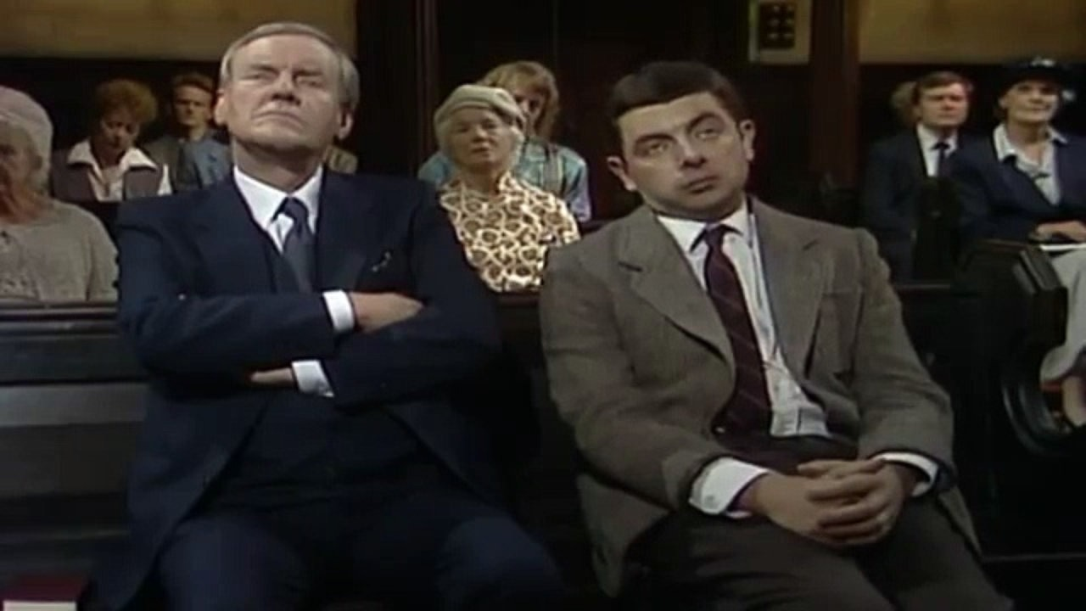
What am I doing here…?
Going…

Slide 12
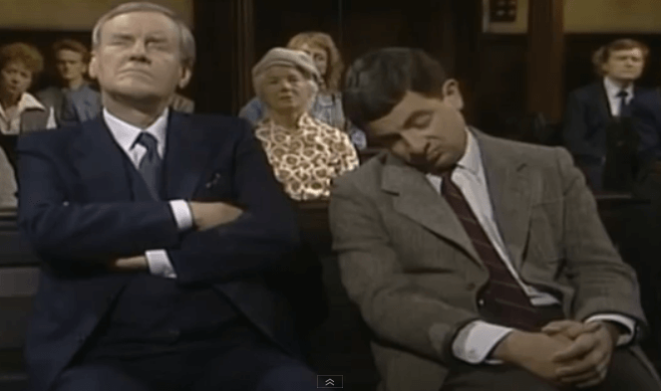
What am I doing here…?
Gone!

Slide 13
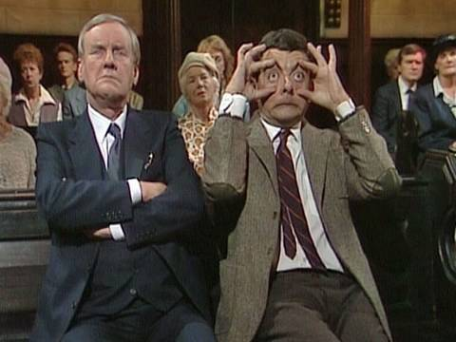
What am I doing here…?
Doing my best, preacher!

Slide 14
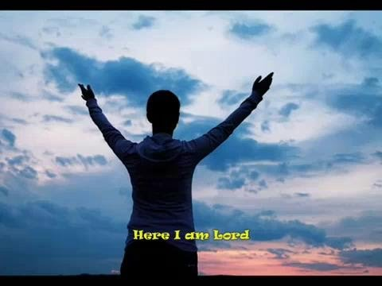
When you know why…!

Slide 15
When you know why…!
Hebrews 13:15-16—
God-pleasing Sacrifices
¹⁵Through Him then, let us continually offer up a sacrifice of praise to God, that is, the fruit of lips that give thanks to His name. (NASB95)

Slide 16
When you know why…!
Hebrews 13:15-16—
God-pleasing Sacrifices
¹⁶And do not neglect doing good and sharing, for with such sacrifices God is pleased. (NASB95)
What life pleases God? One spend doing good and sharing for Jesus’ church.

Slide 17

Missing the obvious..
1 Peter 4:7-11—
⁷The end of all things is near; therefore, be of sound judgment and sober spirit for the purpose of prayer. (NASB95)
The End—Our starting point.
Set your compass.
Who are you talking to about sound judgment?
No prayer—No progress.

Slide 18
Missing the obvious..
1 Peter 4:7-11—
⁸Above all, keep fervent in your love for one another, because love covers a multitude of sins. (NASB95)
Lacklustre love kills churches.
Christ’s love defines everything good about this world.
Unlimited!

Slide 19
Missing the obvious..
1 Peter 4:7-11—
⁹Be hospitable to one another without complaint. (NASB95)
We draw people as close as we can.
What place is closer than the home?
Hospitality costs!
Those who don’t do it know no burdens—or blessings!

Slide 20
Missing the obvious..
1 Peter 4:7-11—
¹⁰As each one has received a special gift, employ it in serving one another as good stewards of the manifold grace of God. (NASB95)
Given to give away.
Steward is a servant.
Serving—The Grace of God
Manifold—Multi-faceted. It meets all needs.

Slide 21
Missing the obvious..
1 Peter 4:7-11—
¹¹Whoever speaks, is to do so as one who is speaking the utterances of God;… (NASB95)
Biblical
Spiritual
Humble
Teachable
Correctable

Slide 22
Missing the obvious..
1 Peter 4:7-11—
¹¹…whoever serves is to do so as one who is serving by the strength which God supplies;… (NASB95)
Requires wisdom from above.
The devil turns up too.
Results are for God’s work—not ours.

Slide 23
Missing the obvious..
1 Peter 4:7-11—
¹¹…so that in all things God may be glorified through Jesus Christ, to whom belongs the glory and dominion forever and ever. Amen. (NASB95)
God is glorified through His church.
God has all and for Him is all worship.

Slide 24


This is Home…
Being in Christ is being in a member of Christ’s body—The church.
Jesus is not ashamed to call us brothers and sisters (Heb.2:11).

Slide 25
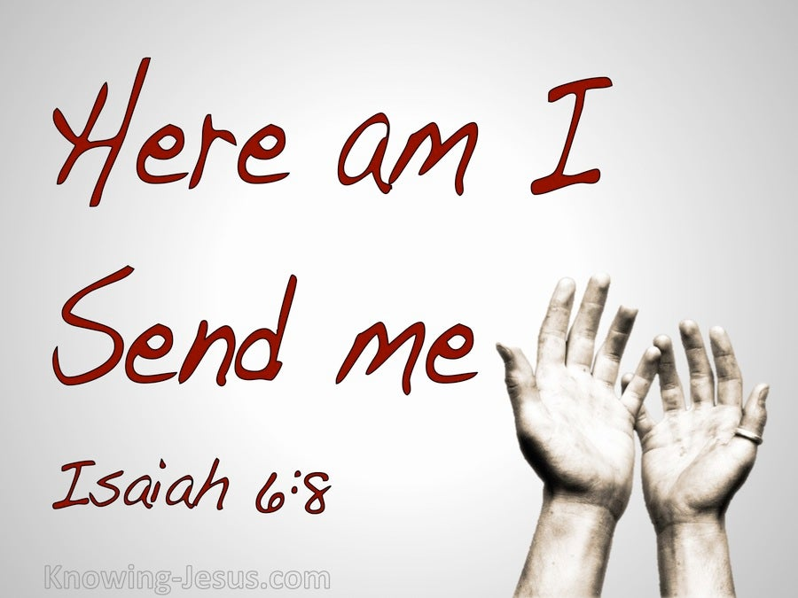

Slide 26
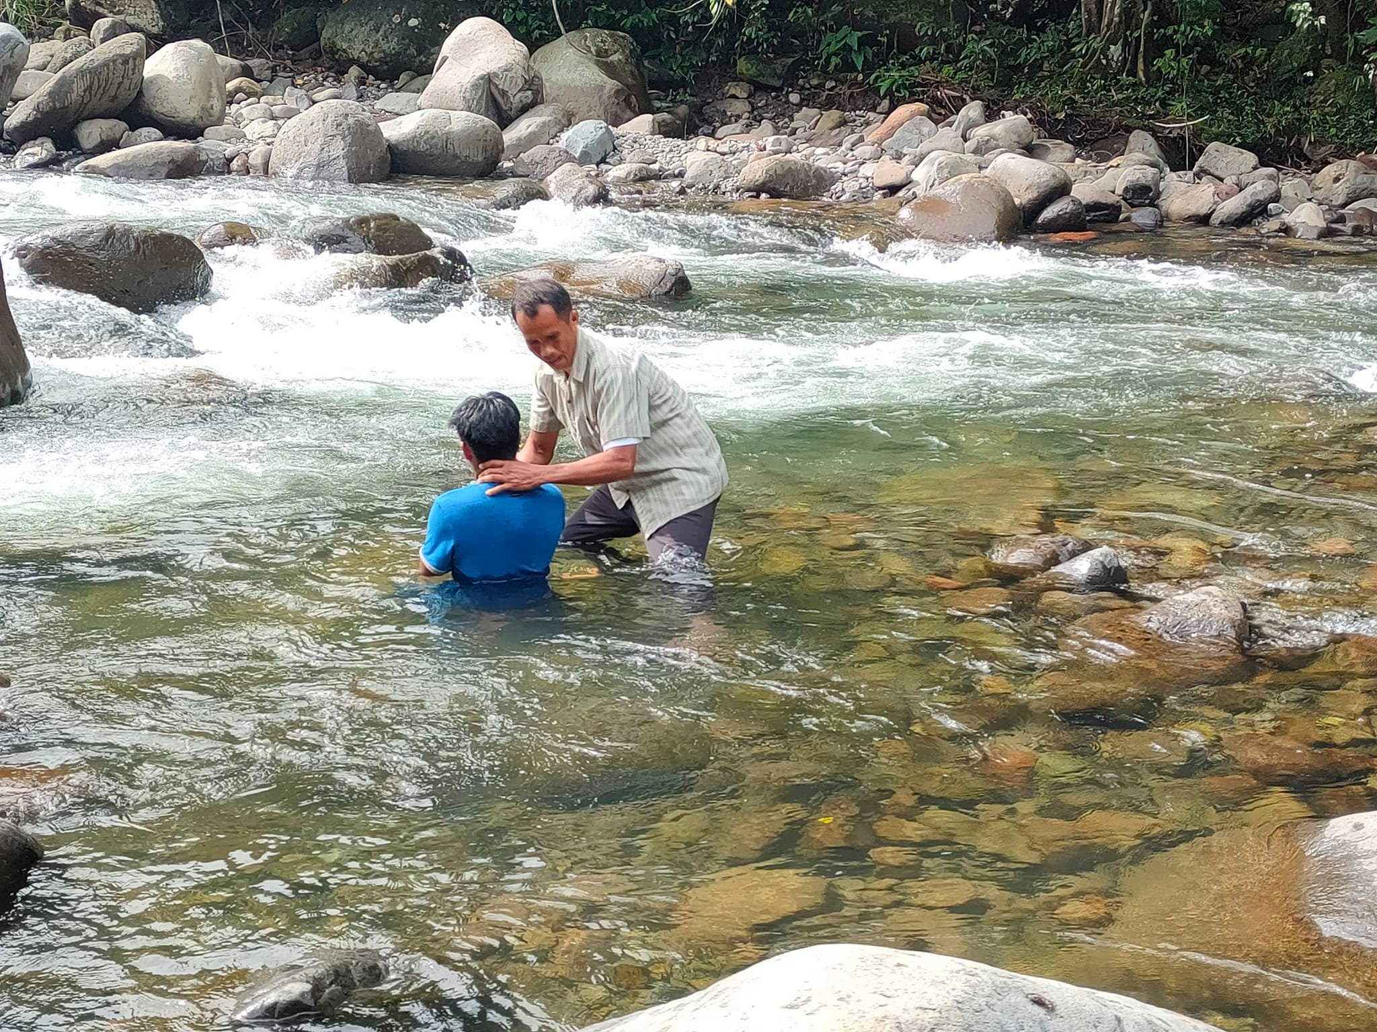
“Baptism now saves you” (1Pet.3:21).
Matthew 28:19-20—¹⁹Go therefore and make disciples of all the nations, baptizing them in the name of the Father and the Son and the Holy Spirit, ²⁰teaching them to observe all that I commanded you; and lo, I am with you always, even to the end of the age.” (NASB95)

