Slide 2
For the Purpose of Godliness
Living and Thinking As Jesus Does
Titus 2:11-13

Slide 3
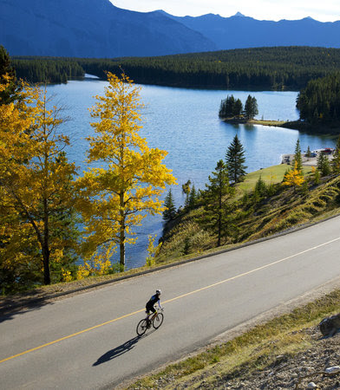
1 Timothy 4:7-8 --⁷But ^{[a]}have nothing to do with worldly fables fit only for old women. On the other hand, discipline yourself for the purpose of godliness…

Slide 4
1 Timothy 4:7-8 --⁷But ^{[a]}have nothing to do with worldly fables fit only for old women. On the other hand, discipline yourself for the purpose of godliness…
Ordering your life.

Slide 5
1 Timothy 4:7-8 --⁷But ^{[a]}have nothing to do with worldly fables fit only for old women. On the other hand, discipline yourself for the purpose of godliness…
Ordering your life.
Spiritual ends.

Slide 6
1 Timothy 4:7-8 --⁷But ^{[a]}have nothing to do with worldly fables fit only for old women. On the other hand, discipline yourself for the purpose of godliness…
Ordering your life.
Spiritual ends.
Hold up the mirror.

Slide 7
1 Timothy 4:7-8 --⁷But ^{[a]}have nothing to do with worldly fables fit only for old women. On the other hand, discipline yourself for the purpose of godliness…
Ordering your life.
Spiritual ends.
Hold up the mirror.
Godliness is the purpose

Slide 8
1 Timothy 4:7-8 --⁸for bodily discipline is only of little profit, but godliness is profitable for all things, since it holds promise for the present life and also for the life to come. (NASB95) [a]Or reject

Slide 9
1 Timothy 4:7-8 --⁸for bodily discipline is only of little profit, but godliness is profitable for all things, since it holds promise for the present life and also for the life to come. (NASB95) [a]Or reject
Physical health is important.

Slide 10
1 Timothy 4:7-8 --⁸for bodily discipline is only of little profit, but godliness is profitable for all things, since it holds promise for the present life and also for the life to come. (NASB95) [a]Or reject
Physical health is important.
Godliness is at the centre of that, too.

Slide 11
1 Timothy 4:7-8 --⁸for bodily discipline is only of little profit, but godliness is profitable for all things, since it holds promise for the present life and also for the life to come. (NASB95) [a]Or reject
Physical health is important.
Godliness is at the centre of that, too.
Heaven is our desired destination.

Slide 12
True Success
It is facing every aspect of life
With the power of Jesus Christ in you.
God
Everyone
Sin
Faith
Virtue
Charity
Jesus
in Me
Believers
Brotherly
Kindness
Knowledge
Uncertainty
Godliness
Temperance
Patience
World
Self
Promises of God

Slide 13
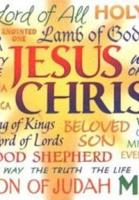
Practical Godliness
What does it do?
Teaches us to live and think as Jesus does.

Slide 14
Practical Godliness
What does it do?
Teaches us to live and think as Jesus does.

Slide 15
Practical Godliness
What does it do?
Teaches us to live and think as Jesus does.

Slide 16
Practical Godliness
What does it do?
Teaches us to live and think as Jesus does.
Titus 2:11-12—

Slide 17
Titus 2:11-12—

Slide 18
Titus 2:11-12—
¹¹For the grace of God has appeared,

Slide 19
Titus 2:11-12—
¹¹For the grace of God has appeared,
bringing salvation for all people,

Slide 20
Titus 2:11-12—
¹¹For the grace of God has appeared,
bringing salvation for all people,
¹²training us to renounce ungodliness

Slide 21
Titus 2:11-12—
¹¹For the grace of God has appeared,
bringing salvation for all people,
¹²training us to renounce ungodliness
and worldly passions,

Slide 22
Titus 2:11-12—
¹¹For the grace of God has appeared,
bringing salvation for all people,
¹²training us to renounce ungodliness
and worldly passions,
and to live self-controlled,

Slide 23
Titus 2:11-12—
¹¹For the grace of God has appeared,
bringing salvation for all people,
¹²training us to renounce ungodliness
and worldly passions,
and to live self-controlled,
upright,

Slide 24
Titus 2:11-12—
¹¹For the grace of God has appeared,
bringing salvation for all people,
¹²training us to renounce ungodliness
and worldly passions,
and to live self-controlled,
upright,
and godly lives in the present age, (ESV)

Slide 25

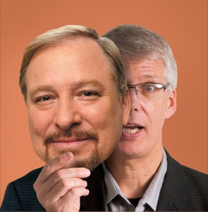
2 Timothy 3:1-5—¹But understand this, that in the last days there will come times of difficulty.
²For people will be lovers of self,
lovers of money,
proud,
arrogant,
abusive,
disobedient to their parents,
ungrateful,
unholy,
³heartless,
unappeasable,

Slide 26
2 Timothy 3:1-5—¹But understand this, that in the last days there will come times of difficulty.
²For people will be lovers of self,
lovers of money,
proud,
arrogant,
abusive,
disobedient to their parents,
ungrateful,
unholy,
³heartless,
unappeasable,

Slide 27
2 Timothy 3:1-5—¹But understand this, that in the last days there will come times of difficulty.
²For people will be lovers of self,
lovers of money,
proud,
arrogant,
abusive,
disobedient to their parents,
ungrateful,
unholy,
³heartless,
unappeasable,

Slide 28
2 Timothy 3:1-5—¹But understand this, that in the last days there will come times of difficulty.
²For people will be lovers of self,
lovers of money,
proud,
arrogant,
abusive,
disobedient to their parents,
ungrateful,
unholy,
³heartless,
unappeasable,

Slide 29
2 Timothy 3:1-5—¹But understand this, that in the last days there will come times of difficulty.
²For people will be lovers of self,
lovers of money,
proud,
arrogant,
abusive,
disobedient to their parents,
ungrateful,
unholy,
³heartless,
unappeasable,

Slide 30
2 Timothy 3:1-5—¹But understand this, that in the last days there will come times of difficulty.
²For people will be lovers of self,
lovers of money,
proud,
arrogant,
abusive,
disobedient to their parents,
ungrateful,
unholy,
³heartless,
unappeasable,

Slide 31
2 Timothy 3:1-5—¹But understand this, that in the last days there will come times of difficulty.
²For people will be lovers of self,
lovers of money,
proud,
arrogant,
abusive,
disobedient to their parents,
ungrateful,
unholy,
³heartless,
unappeasable,

Slide 32
2 Timothy 3:1-5—¹But understand this, that in the last days there will come times of difficulty.
²For people will be lovers of self,
lovers of money,
proud,
arrogant,
abusive,
disobedient to their parents,
ungrateful,
unholy,
³heartless,
unappeasable,

Slide 33
2 Timothy 3:1-5—¹But understand this, that in the last days there will come times of difficulty.
²For people will be lovers of self,
lovers of money,
proud,
arrogant,
abusive,
disobedient to their parents,
ungrateful,
unholy,
³heartless,
unappeasable,

Slide 34
2 Timothy 3:1-5—¹But understand this, that in the last days there will come times of difficulty.
²For people will be lovers of self,
lovers of money,
proud,
arrogant,
abusive,
disobedient to their parents,
ungrateful,
unholy,
³heartless,
unappeasable,

Slide 35
2 Timothy 3:1-5—¹But understand this, that in the last days there will come times of difficulty.
²For people will be lovers of self,
lovers of money,
proud,
arrogant,
abusive,
disobedient to their parents,
ungrateful,
unholy,
³heartless,
unappeasable,

Slide 36
2 Timothy 3:1-5—¹But understand this, that in the last days there will come times of difficulty.
²For people will be lovers of self,
lovers of money,
proud,
arrogant,
abusive,
disobedient to their parents,
ungrateful,
unholy,
³heartless,
unappeasable,
slanderous,
without self-control,
brutal,
not loving good,
⁴treacherous,
reckless,
swollen with conceit,
lovers of pleasure rather than lovers of God,
⁵having the appearance of godliness,
but denying its power.
Avoid such people. (ESV)

Slide 37
2 Timothy 3:1-5—¹But understand this, that in the last days there will come times of difficulty.
²For people will be lovers of self,
lovers of money,
proud,
arrogant,
abusive,
disobedient to their parents,
ungrateful,
unholy,
³heartless,
unappeasable,
slanderous,
without self-control,
brutal,
not loving good,
⁴treacherous,
reckless,
swollen with conceit,
lovers of pleasure rather than lovers of God,
⁵having the appearance of godliness,
but denying its power.
Avoid such people. (ESV)

Slide 38
2 Timothy 3:1-5—¹But understand this, that in the last days there will come times of difficulty.
²For people will be lovers of self,
lovers of money,
proud,
arrogant,
abusive,
disobedient to their parents,
ungrateful,
unholy,
³heartless,
unappeasable,
slanderous,
without self-control,
brutal,
not loving good,
⁴treacherous,
reckless,
swollen with conceit,
lovers of pleasure rather than lovers of God,
⁵having the appearance of godliness,
but denying its power.
Avoid such people. (ESV)

Slide 39
2 Timothy 3:1-5—¹But understand this, that in the last days there will come times of difficulty.
²For people will be lovers of self,
lovers of money,
proud,
arrogant,
abusive,
disobedient to their parents,
ungrateful,
unholy,
³heartless,
unappeasable,
slanderous,
without self-control,
brutal,
not loving good,
⁴treacherous,
reckless,
swollen with conceit,
lovers of pleasure rather than lovers of God,
⁵having the appearance of godliness,
but denying its power.
Avoid such people. (ESV)

Slide 40
2 Timothy 3:1-5—¹But understand this, that in the last days there will come times of difficulty.
²For people will be lovers of self,
lovers of money,
proud,
arrogant,
abusive,
disobedient to their parents,
ungrateful,
unholy,
³heartless,
unappeasable,
slanderous,
without self-control,
brutal,
not loving good,
⁴treacherous,
reckless,
swollen with conceit,
lovers of pleasure rather than lovers of God,
⁵having the appearance of godliness,
but denying its power.
Avoid such people. (ESV)

Slide 41
2 Timothy 3:1-5—¹But understand this, that in the last days there will come times of difficulty.
²For people will be lovers of self,
lovers of money,
proud,
arrogant,
abusive,
disobedient to their parents,
ungrateful,
unholy,
³heartless,
unappeasable,
slanderous,
without self-control,
brutal,
not loving good,
⁴treacherous,
reckless,
swollen with conceit,
lovers of pleasure rather than lovers of God,
⁵having the appearance of godliness,
but denying its power.
Avoid such people. (ESV)

Slide 42
2 Timothy 3:1-5—¹But understand this, that in the last days there will come times of difficulty.
²For people will be lovers of self,
lovers of money,
proud,
arrogant,
abusive,
disobedient to their parents,
ungrateful,
unholy,
³heartless,
unappeasable,
slanderous,
without self-control,
brutal,
not loving good,
⁴treacherous,
reckless,
swollen with conceit,
lovers of pleasure rather than lovers of God,
⁵having the appearance of godliness,
but denying its power.
Avoid such people. (ESV)

Slide 43
2 Timothy 3:1-5—¹But understand this, that in the last days there will come times of difficulty.
²For people will be lovers of self,
lovers of money,
proud,
arrogant,
abusive,
disobedient to their parents,
ungrateful,
unholy,
³heartless,
unappeasable,
slanderous,
without self-control,
brutal,
not loving good,
⁴treacherous,
reckless,
swollen with conceit,
lovers of pleasure rather than lovers of God,
⁵having the appearance of godliness,
but denying its power.
Avoid such people. (ESV)

Slide 44
2 Timothy 3:1-5—¹But understand this, that in the last days there will come times of difficulty.
²For people will be lovers of self,
lovers of money,
proud,
arrogant,
abusive,
disobedient to their parents,
ungrateful,
unholy,
³heartless,
unappeasable,
slanderous,
without self-control,
brutal,
not loving good,
⁴treacherous,
reckless,
swollen with conceit,
lovers of pleasure rather than lovers of God,
⁵having the appearance of godliness,
but denying its power.
Avoid such people. (ESV)

Slide 45
2 Timothy 3:1-5—¹But understand this, that in the last days there will come times of difficulty.
²For people will be lovers of self,
lovers of money,
proud,
arrogant,
abusive,
disobedient to their parents,
ungrateful,
unholy,
³heartless,
unappeasable,
slanderous,
without self-control,
brutal,
not loving good,
⁴treacherous,
reckless,
swollen with conceit,
lovers of pleasure rather than lovers of God,
⁵having the appearance of godliness,
but denying its power.
Avoid such people. (ESV)

Slide 46
2 Timothy 3:1-5—¹But understand this, that in the last days there will come times of difficulty.
²For people will be lovers of self,
lovers of money,
proud,
arrogant,
abusive,
disobedient to their parents,
ungrateful,
unholy,
³heartless,
unappeasable,
slanderous,
without self-control,
brutal,
not loving good,
⁴treacherous,
reckless,
swollen with conceit,
lovers of pleasure rather than lovers of God,
⁵having the appearance of godliness,
but denying its power.
Avoid such people. (ESV)

Slide 47

A Life without godliness is…?
Worldly – like the world.
False Godliness (2Tim 3:1-5)
  Displayed by those who are
  "lovers of pleasure"
  rather than
  "lovers of God“ (v.4)
  Such ‘godliness’ is just an act:
    Only to be seen by others.
    To impress them.
    For the purpose of self-glorification.

Slide 48
A Life without godliness is…?
Worldly – like the world.
True Godliness
  True godliness is characterized by:
  Seeking to be approved by God, not man.
  Devoted to the will of God.
  Desiring to please Him.
  Anything else is simply hypocrisy!

Slide 49
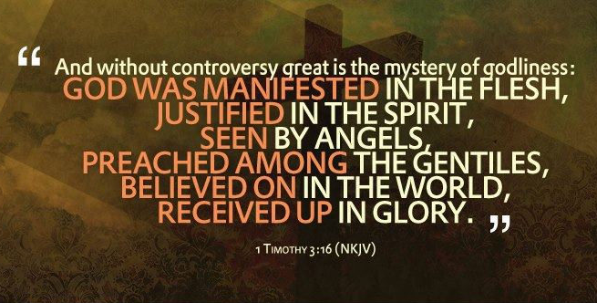

Slide 50
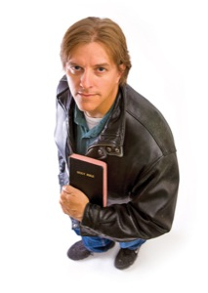
Godliness Shows…

Slide 51
Godliness Shows…
The way we talk – godly or worldly

Slide 52
Godliness Shows…
The way we talk – godly or worldly
The way we give – liberally or selfishly

Slide 53
Godliness Shows…
The way we talk – godly or worldly
The way we give – liberally or selfishly
The way we dress – modestly or worldly

Slide 54
Godliness Shows…
The way we talk – godly or worldly
The way we give – liberally or selfishly
The way we dress – modestly or worldly
The way we love – selflessly or greedily

Slide 55
Godliness Shows…
The way we talk – godly or worldly
The way we give – liberally or selfishly
The way we dress – modestly or worldly
The way we love – selflessly or greedily
The way we think and feel – about others, or only about ourselves

Slide 56
Godliness Shows…
The way we talk – godly or worldly
The way we give – liberally or selfishly
The way we dress – modestly or worldly
The way we love – selflessly or greedily
The way we think and feel – about others, or only about ourselves
The way we die – expectantly and restfully – only falling asleep, or fearfully, and lost!

