Slide 1

Forewarned
Notes:
Lesson 1
Usual policy:
focus on preaching what the Bible says, rather than what the Bible doesn’t say
focus on you and I getting it right before God, and not on whether our friends and neighbors across the road or around the corner are doing it wrong
But (and you knew there was going to be a “but”)…

Slide 2
Has Christ already come?
Forewarned
Notes:
My personal “Rule of Twos”
if I hear something weird once, I raise my eyebrows and move on
if I hear something weird twice, it makes me think I better say something about it
in this case, I heard about the AD 70 doctrine still being relevant on my trip to Singapore in 2016, and then again in Australia in 2019
It’s not here in NZ, as far as I know, so I want to forewarn, to inoculate against it
Most influential proponent in the brotherhood: King, Max R. The Spirit of Prophecy. Warren, OH: self published, 1971. His work continued on into the 1980s and 1990s. Spent 12 years in Ohio (2000-2012), the epicenter of this doctrine, and yet I hardly ever heard about it. Nonetheless, the view has spread far and wide.
Fra Angelico [attributed], Christ Glorified in the Court of Heaven [1428-1430], detail

Slide 3
¹ Now concerning the coming of our Lord Jesus Christ and our being gathered together to Him, we ask you, brothers, ² not to be quickly shaken in mind or alarmed, either by a spirit or a spoken word, or a letter seeming to be from us, to the effect that the day of the Lord has come.
  2 Thessalonians 2:1–2
Notes:
A warning about the second coming having already happened

Slide 4
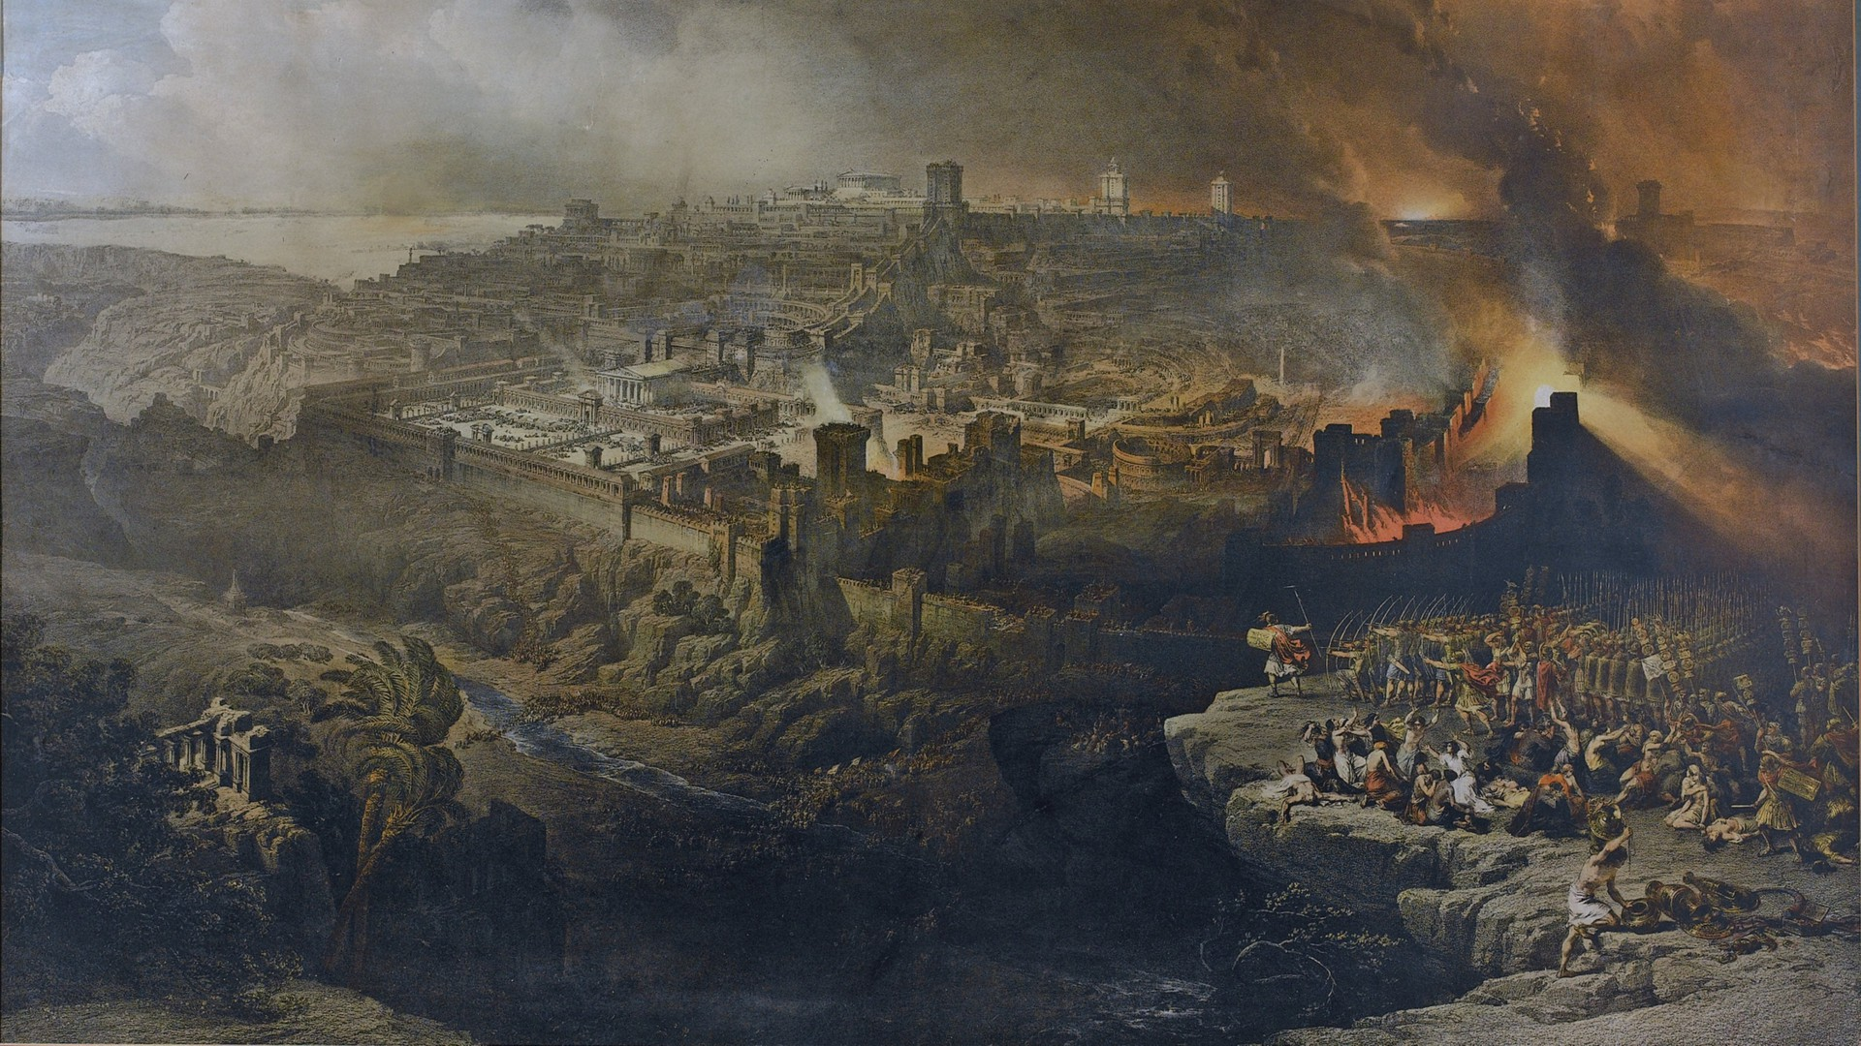
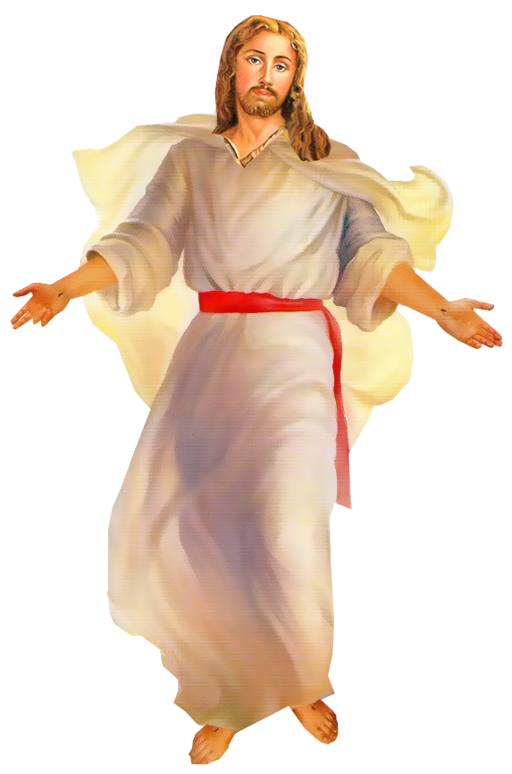
Notes:
Christ came in AD 70 with the siege of Jerusalem and the destruction of the Temple
Everything happened at this time…

Slide 5
On 10 August AD 70…
Church/kingdom established
Final judgment
Resurrection
End of the world
Second coming of Christ
Notes:
And so, as the dust settles, there are zero prophecies to be fulfilled
Warnings, consequences…
Suggested dates in the Gregorian Calendar
Si Sheppard gives it as 10 August, The Jewish Revolt AD 66–74 (Osprey, 2013)
most Hebrew to Gregorian converters will calculate 9th of Av, 3830 as Saturday, 2nd of August, AD 70, although there may be a 10 day discrepancy because of the Gregorian Reformation https://www.hebcal.com/converter/?gd=2&gm=8&gy=70

Slide 6
²⁶ For as often as you eat this bread and drink the cup, you proclaim the Lord’s death until He comes.
  1 Corinthians 11:26
Notes:
Practical consequences
I have heard of some churches who hold to this view giving up on the Lord’s Supper – at least they’re consistent
But you can understand how this would upset the faith and cause division
What do want to say about this idea? A lot.
we could get into the nitty gritty of Matthew 24, but I’ve already done that for our Wednesday night series on Premilliennialism, so I don’t want to get into that
for this Sunday morning lesson, I really want to focus on some really obvious problems – skip to problem #3…

Slide 7
judgment on the temple did not require a literal return of Jesus
Notes:
1. The Lord’s coming on the clouds is not about a literal return
The destruction of the Temple in AD 70 does not represent the coming of Jesus in His kingdom, it represents the coming of Jesus in judgment – it’s not the same thing

Slide 8
³⁰ …they will see the Son of Man coming on the clouds of heaven with power and great glory. ³¹ And he will send out his angels with a loud trumpet call, and they will gather his elect from the four winds, from one end of heaven to the other. *
  Matthew 24:30–31
* Matthew 26:64; Daniel 7:13
Notes:
We agree that this is about the destruction of the Temple in AD 70
Used twice by Jesus, clearly referring back to Daniel
“I saw in the night visions, and behold, with the clouds of heaven there came one like a son of man, and he came to the Ancient of Days and was presented before him. – Daniel 7:13
The point is how Jesus is using it
1. Over in Mt. 26:64, Jesus is already here, prophecy is already fulfilled
2. Here in Mt. 24:30, Jesus coming in judgment
Radical Preterists:
this is the second coming (“coming on the clouds”)
this is when the resurrection happens (“gather His elect”)

Slide 9
⁷ Then the LORD said, “I have surely seen the affliction of my people who are in Egypt and have heard their cry because of their taskmasters. I know their sufferings, ⁸ and I have come down to deliver them out of the hand of the Egyptians…
  Exodus 3:7–8
Notes:
e.g., Exo 3 is about the power of God working through Moses, without literally coming down from heaven
Have to say more about Mt. 24; given that it is so abused (AD 70 folks, premillennialists, etc.), simply recommend that you get as comfortable working your way through that passage as possible

Slide 10
there is yet to be a literal, bodily resurrection
Notes:
2. There will be a bodily resurrection
On the face of it, seems crazy
we know that Judaism continued
we know that the church began c. AD 30, Day of Pentecost – it had already been going for 40 years
Radical preterists
the general resurrection has already happened, but this was figurative
"Thus, out of the decay of Judaism arose the spiritual body of Christianity that became fully developed or resurrected by the end-time. Hence, this is the primary meaning of Paul's statement, ‘It is sown a natural body; it is raised a spiritual body. There is a natural body and there is a spiritual body.’ ” – Max King, The Spirit of Prophecy, pp. 199-200.
upshot: we will keep living and dying and this world forever

Slide 11
¹² Now if Christ is proclaimed as raised from the dead, how can some of you say that there is no resurrection of the dead?
  1 Corinthians 15:12
Notes:
this is one of those many warnings

Slide 12
⁴² So is it with the resurrection of the dead. What is sown is perishable; what is raised is imperishable. ⁴³ It is sown in dishonor; it is raised in glory. It is sown in weakness; it is raised in power. ⁴⁴ It is sown a natural body; it is raised a spiritual body. If there is a natural body, there is also a spiritual body.
  1 Corinthians 15:42–44
Notes:
(a) This is a literal bodily resurrection

Slide 13
⁵¹ Behold! I tell you a mystery. We shall not all sleep, but we shall all be changed, ⁵² in a moment, in the twinkling of an eye, at the last trumpet. For the trumpet will sound, and the dead will be raised imperishable, and we shall be changed.
  1 Corinthians 15:51–52
Notes:
(b) This is personal, literal, bodily resurrection – we shall all be changed
(c) It shall happen at the end, the last trumpet, there is a finality to it – it’s not ongoing, it’s not something that goes on forever

Slide 14
²⁶ The last enemy to be destroyed is death….
⁵⁴ When the perishable puts on the imperishable, and the mortal puts on immortality, then shall come to pass the saying that is written: “Death is swallowed up in victory.” ⁵⁵ “O death, where is your victory? O death, where is your sting?”
  1 Corinthians 15:26, 54–55
Notes:
(d) This personal, literal, bodily resurrection represents a final victory over death
But clearly there has been a lot of death in the last 2,000 years
Physical death will have passed away, because the physical world will have passed away…

Slide 15
the literal end of the world is yet to come
Notes:
3. The earth will be destroyed and will not last forever
Their belief: when the old Jerusalem was destroyed, the new Jerusalem came, a world without the Temple is a new heaven, a new earth
Radical preterists
believe the new heavens and the new earth came when the Jewish faith passed away
“The New Testament saints, born of Abrahams spiritual seed, looked for this new world (2 Pet. 3:13), in anticipation of the time Ishmael would be cast out, or the old heaven and earth would pass away. The time was drawing near when the Hebrew letter was written. Now that which decayeth and waxeth old is ready to vanish away. (Heb. 8:13)." – Max King, The Spirit of Prophecy, p. 35
so, just as the resurrection is not literal, so the destruction of the earth is not literal
we will keep living and dying on this earth forever

Slide 16
¹⁰ But the day of the Lord will come like a thief, and then the heavens will pass away with a roar, and the heavenly bodies will be burned up and dissolved, and the earth and the works that are done on it will be exposed. ¹¹ Since all these things are thus to be dissolved, what sort of people ought you to be in lives of holiness and godliness…
  2 Peter 3:10-11

Slide 17
¹² waiting for and hastening the coming of the day of God, because of which the heavens will be set on fire and dissolved, and the heavenly bodies will melt as they burn! ¹³ But according to his promise we are waiting for new heavens and a new earth in which righteousness dwells.
  2 Peter 3:12-13
Notes:
There will be a new heavens and new earth in which righteousness dwells, not this same old world in which we just keep living and suffering and dying

Slide 18
what’s the real significance of AD 70?
Notes:
Here is the true significance of AD 70…

Slide 19
³⁷ “O Jerusalem, Jerusalem, the city that kills the prophets and stones those who are sent to it! How often would I have gathered your children together as a hen gathers her brood under her wings, and you were not willing! ³⁸ See, your house is left to you desolate.
  Matthew 23:37–38
Notes:
That’s depressing in many ways, but there is hope…

Slide 20
¹⁶ For the Lord himself will descend from heaven with a cry of command, with the voice of an archangel, and with the sound of the trumpet of God. And the dead in Christ will rise first. ¹⁷ Then we who are alive, who are left, will be caught up together with them in the clouds to meet the Lord in the air, and so we will always be with the Lord.
  1 Thessalonians 4:15–17
Notes:
A message of hope

