Slide 1

Part 1.
There’s a Great Day Coming

Slide 2
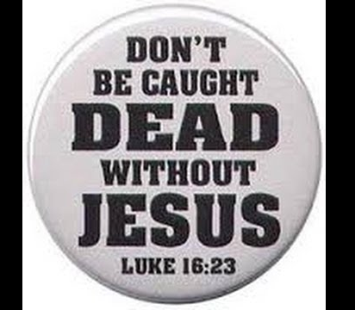
Hebrews 9:27-28—
²⁷And just as it is appointed for man to die once, and after that comes judgment,
²⁸so Christ, having been offered once to bear the sins of many, will appear a second time, not to deal with sin but to save those who are eagerly waiting for him. (ESV)

Slide 3

No Third Option Available

Slide 4

Ecclesiastes 7:20—
“²⁰ Indeed, there is not a righteous man on earth who continually does good and who never sins. (NASB95)

Slide 5

.
.
Hebrews 4:13—
Nothing in all the world can be hidden from God. He can clearly see all things. Everything is open before him. And to him we must explain the way we have lived. (ERV)

Slide 6
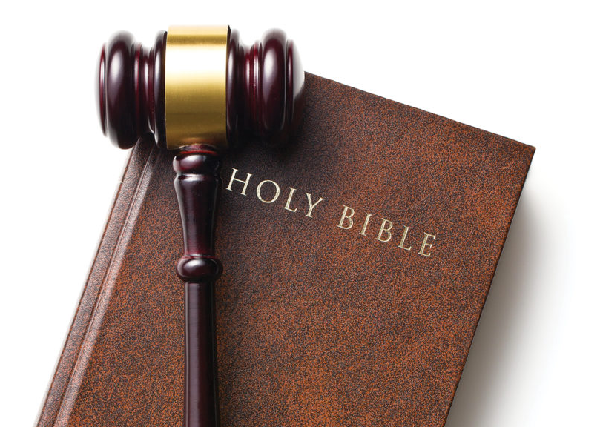
Jesus:
Prophet
Saviour
Judge
John 12:47-48—
⁴⁷If anyone hears My sayings and does not keep them, I do not judge him; for I did not come to judge the world, but to save the world. ⁴⁸He who rejects Me and does not receive My sayings, has one who judges him; the word I spoke is what will judge him at the last day. (NASB95)

Slide 7

How not to worry and be happy…
Ecclesiastes 11:9—
⁹Rejoice, young man, during your childhood, and let your heart be pleasant during the days of young manhood. And follow the impulses of your heart and the desires of your eyes. Yet know that God will bring you to judgment for all these things. (NASB95)

Slide 8
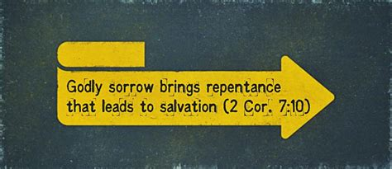

The sorrow that leads to Heaven

Slide 9
The sorrow that leads to Heaven

Slide 10
The sorrow that leads to Heaven
Everyone regrets bad outcomes.
Sin ultimately ends in regret.
But, regret isn’t always repentance.
The angry blame God.
The humble see their sin.
No regrets…Heaven bound.

Slide 11
The sorrow that leads to Heaven
Everyone regrets bad outcomes.
Sin ultimately ends in regret.
But, regret isn’t always repentance.
The angry blame God.
The humble see their sin.
No regrets…Heaven bound.

Slide 12
The sorrow that leads to Heaven
Everyone regrets bad outcomes.
Sin ultimately ends in regret.
But, regret isn’t always repentance.
The angry blame God.
The humble see their sin.
No regrets…Heaven bound.

Slide 13
The sorrow that leads to Heaven
Everyone regrets bad outcomes.
Sin ultimately ends in regret.
But, regret isn’t always repentance.
The angry blame God.
The humble see their sin.
No regrets…Heaven bound.

Slide 14
The sorrow that leads to Heaven
Everyone regrets bad outcomes.
Sin ultimately ends in regret.
But, regret isn’t always repentance.
The angry blame God.
The humble see their sin.
No regrets…Heaven bound.

Slide 15
The sorrow that leads to Heaven
Everyone regrets bad outcomes.
Sin ultimately ends in regret.
But, regret isn’t always repentance.
The angry blame God.
The humble see their sin.
No regrets…Heaven bound.

Slide 16

No Safer Place
1 Peter 2:5—you yourselves like living stones are being built up as a spiritual house, to be a holy priesthood, to offer spiritual sacrifices acceptable to God through Jesus Christ. (ESV)

Slide 17

No warning of arrival…
2 Peter 3:10—
¹⁰But the day of the Lord will come like a thief, and then the heavens will pass away with a roar, and the heavenly bodies will be burned up and dissolved, and the earth and the works that are done on it will be exposed. ^{(ESV)}

Slide 18


1 John 5:20—²⁰ And we know that the Son of God has come and has given us understanding, so that we may know him who is true; and we are in him who is true, in his Son Jesus Christ. He is the true God and eternal life. (ESV)

Slide 19


Slide 20

Matthew 28:19-20—¹⁹Go therefore and make disciples of all the nations, baptizing them in the name of the Father and the Son and the Holy Spirit, ²⁰teaching them to observe all that I commanded you; and lo, I am with you always, even to the end of the age.” (NASB95)

