Slide 2

Part 2.
Well done!

Slide 3

Parable of the Talents
Matthew 25:21—²¹His master said to him, ‘Well done, good and faithful slave. You were faithful with a few things, I will put you in charge of many things; enter into the joy of your master.’ (NASB95)

Slide 4
Judgement—Sheep and Goats
Matthew 25:34—³⁴“Then the King will say to those on His right, ‘Come, you who are blessed of My Father, inherit the kingdom prepared for you from the foundation of the world. (NASB95)

Slide 5
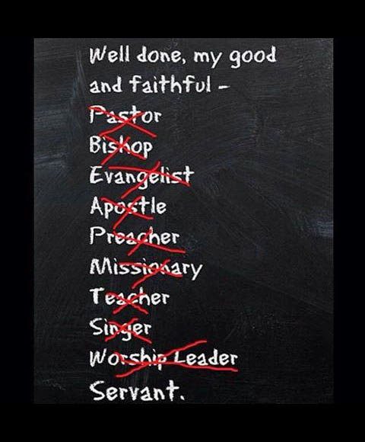


Slide 6
Matthew 7:21-23—
²¹“Not everyone who says to Me, ‘Lord, Lord,’ will enter the kingdom of heaven, but he who does the will of My Father who is in heaven will enter. ²² Many will say to Me on that day, ‘Lord, Lord, did we not prophesy in Your name, and in Your name cast out demons, and in Your name perform many miracles?’ ²³And then I will declare to them, ‘I never knew you; depart from Me, you who practice lawlessness.’ (NASB95)

Slide 7
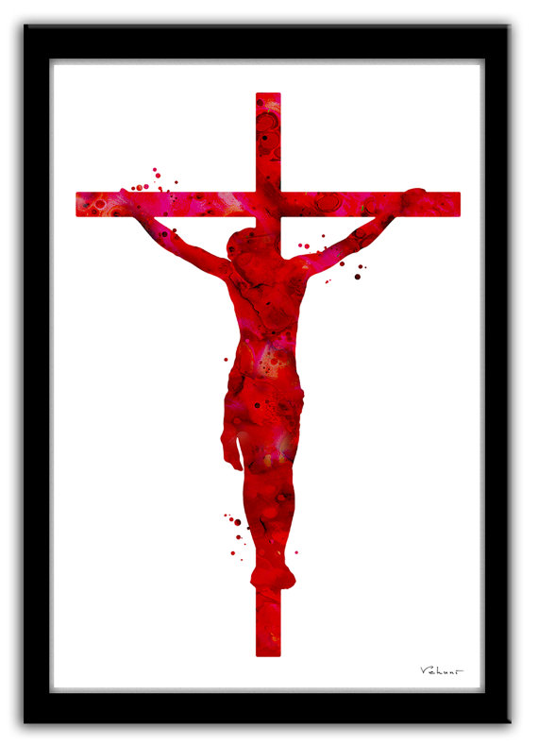
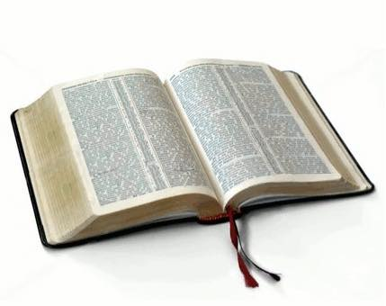
Ephesians 1:13-14—¹³In Him, you also, after listening to the message of truth, the gospel of your salvation—having also believed, you were sealed in Him with the Holy Spirit of promise, ¹⁴who is given as a pledge of our inheritance, with a view to the redemption of God’s own possession, to the praise of His glory. (NASB95)

Slide 8
1 John 5:11-12—¹¹And the testimony is this, that God has given us eternal life, and this life is in His Son. ¹²He who has the Son has the life; he who does not have the Son of God does not have the life. (NASB95)

Slide 9

2 Thessalonians 2:16-17—
¹⁶ Now may our Lord Jesus Christ Himself and God our Father, who has loved us and given us eternal comfort and good hope by grace, ¹⁷comfort and strengthen your hearts in every good work and word. (NASB95)

Slide 10
Philippians 1:6—⁶For I am confident of this very thing, that He who began a good work in you will perfect it until the day of Christ Jesus. (NASB95)

Slide 11

Hebrews 11:6—
⁶ And without faith it is impossible to please Him, for he who comes to God must believe that He is and that He is a rewarder of those who seek Him. (NASB95)

Slide 12
Hebrews 11:39-40—³⁹These were all commended for their faith, yet none of them received what had been promised, ⁴⁰since God had planned something better for us so that only together with us would they be made perfect. (NIV)

Slide 13
Matthew 6:19-21—¹⁹“Do not store up for yourselves treasures on earth, where moth and rust destroy, and where thieves break in and steal. ²⁰But store up for yourselves treasures in heaven, where neither moth nor rust destroys, and where thieves do not break in or steal; ²¹for where your treasure is, there your heart will be also. (NASB95)

Slide 14

Colossians 3:25—
²⁵For he who does wrong will receive the consequences of the wrong which he has done, and that without partiality. (NASB95)

Slide 15
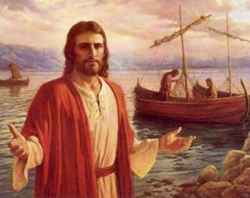
Mark 10:28-30—²⁸Peter began to say to Him, “Behold, we have left everything and followed You.” ²⁹Jesus said, “Truly I say to you, there is no one who has left house or brothers or sisters or mother or father or children or farms, for My sake and for the gospel’s sake, ³⁰but that he will receive a hundred times as much now in the present age, houses and brothers and sisters and mothers and children and farms, along with persecutions; and in the age to come, eternal life. (NASB95)

Slide 16


Slide 17
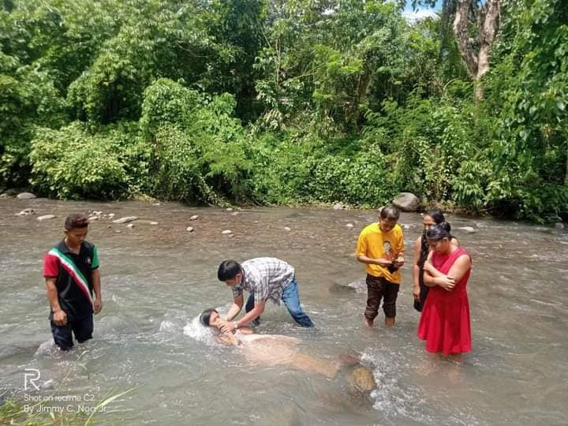
Matthew 28:19-20—¹⁹Go therefore and make disciples of all the nations, baptizing them in the name of the Father and the Son and the Holy Spirit, ²⁰teaching them to observe all that I commanded you; and lo, I am with you always, even to the end of the age.” (NASB95)

