Slide 2
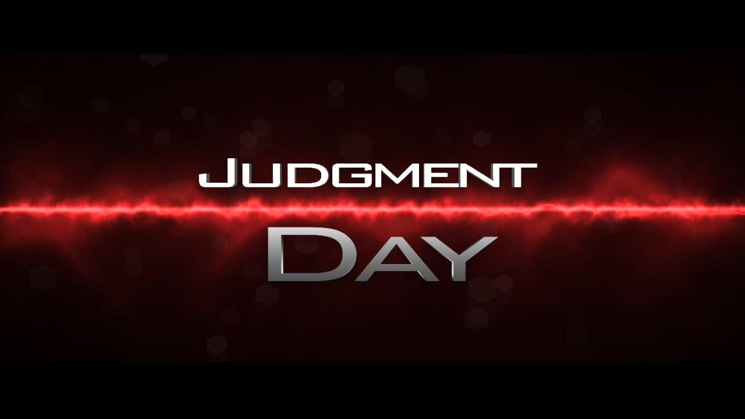
Part 3.
Fear not…!

Slide 3

Judgement—
Fear God.
Matthew 10:28
  ²⁸Do not fear
  those who kill the body
  but are unable
  to kill the soul;
  but rather fear Him
  who is able to destroy
  both soul and body
  in hell. (NASB95)

Slide 4
Judgement—
Fear God.
Too much fear of man:

Slide 5
Judgement—
Fear God.
Too much fear of man:
  Understandable from man’s perspective only.

Slide 6
Judgement—
Fear God.
Too much fear of man:
  Understandable from man’s perspective only.
  But never necessary.

Slide 7
Judgement—
Fear God.
Too much fear of man.
  Understandable from man’s perspective only.
  But never necessary.
  They are but 70+ years of flesh.

Slide 8
Judgement—
Fear God.
Too much fear of man.
  Understandable from man’s perspective only.
  But never necessary.
  They are but 70+ years of flesh.
  Kill the body only.

Slide 9
Judgement—
Fear God.
Too much fear of man.
  Understandable from man’s perspective only.
  But never necessary.
  They are but 70+ years of flesh.
  Kill the body only.
  The Church advances.

Slide 10
Judgement—
Fear God.
Too much fear of man.
  Understandable from man’s perspective only.
  But never necessary.
  They are but 70+ years of flesh.
  Kill the body only.
  The Church advances.
  They can’t stop God.

Slide 11
Judgement—
Fear God.
Too much fear of man.
  Understandable from man’s perspective only.
  But never necessary.
  They are but 70+ years of flesh.
  Kill the body only.
  The Church advances.
  They can’t stop God.
  Don’t play their devil’s game.

Slide 12
Judgement—
Fear God.
Too much fear of man.
  Understandable from man’s perspective only.
  But never necessary.
  They are but 70+ years of flesh.
  Kill the body only.
  The Church advances.
  They can’t stop God.
  Don’t play their devil’s game.
  God rules…

Slide 13
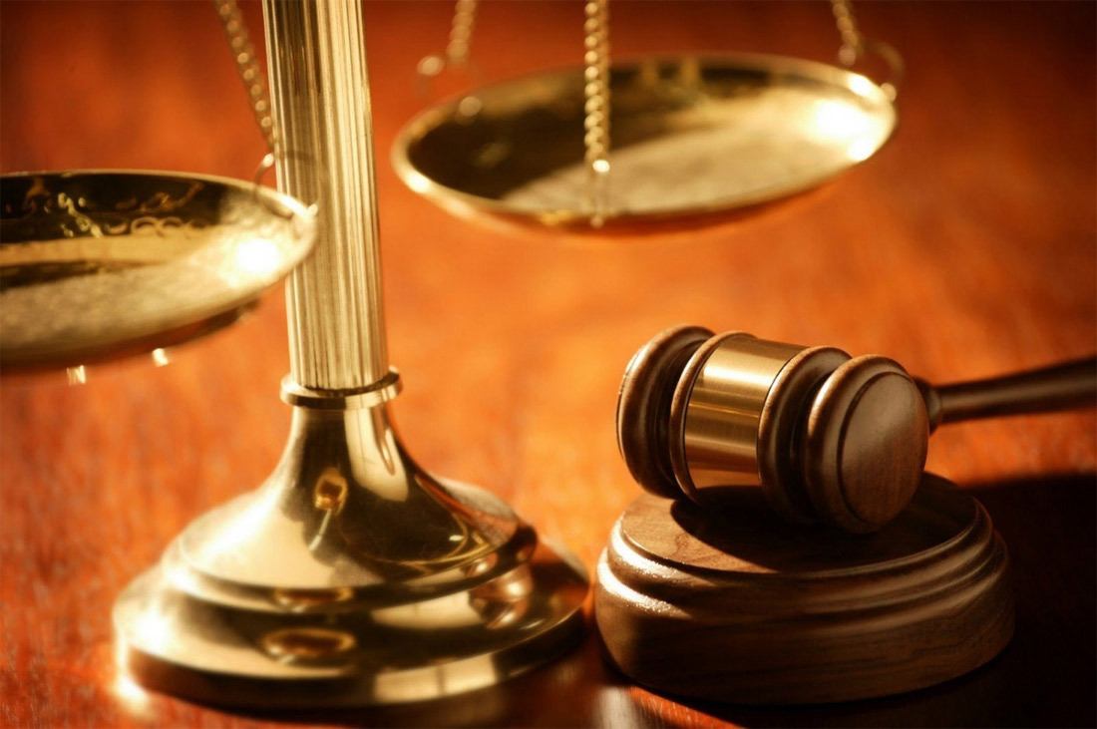
Judgement—
Power over Demons
2 Peter 2:4—
  ⁴…God did not spare
  angels when they sinned,
  but cast them into hell
  and committed them to
  pits of darkness,
  reserved for judgment; (NASB95)

Slide 14
Judgement—
Power over Demons
God is Judge of all:
  No exceptions in heaven and on earth.
  Satan has no ‘Master Plan’ that god doesn’t know about.
  All things will be judged by God.
  You need not fear…

Slide 15
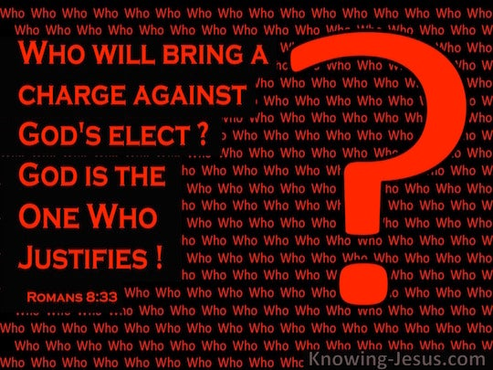
Judgement—
Confidence
Romans 8:33-34
  ³³Who will bring a charge against God’s elect?
  God is the one who justifies;
  ³⁴who is the one who condemns?
  Christ Jesus is
  He who died,
  yes, rather who was raised, who is at the
  right hand of God,
  who also intercedes for us. (NASB95)

Slide 16
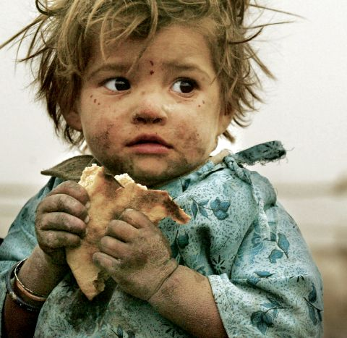
Judgement—
Good deeds remembered
Hebrews 6:10—
¹⁰For God is not unjust so as to forget your work and the love which you have shown toward His name, in having ministered and in still ministering to the saints. (NASB95)
Matthew 25:40—⁴⁰The King will answer and say to them, ‘Truly I say to you, to the extent that you did it to one of these brothers of Mine, even the least of them, you did it to Me.’ (NASB95)

Slide 17
Judgement—
Good deeds remembered
Hebrews 6:10—
¹⁰For God is not unjust so as to forget your work and the love which you have shown toward His name, in having ministered and in still ministering to the saints. (NASB95)
Matthew 25:40—⁴⁰The King will answer and say to them, ‘Truly I say to you, to the extent that you did it to one of these brothers of Mine, even the least of them, you did it to Me.’ (NASB95)

Slide 18
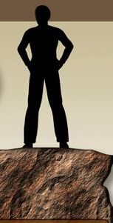
Judgement—
To Stand
Jude 24-25—
  ²⁴Now to Him who is able to keep you from stumbling, and to make you stand in the presence of His glory blameless with great joy,
  ²⁵to the only God our Saviour, through Jesus Christ our Lord, be glory, majesty, dominion and authority, before all time and now and forever. Amen. (NASB95)

Slide 19
Judgement—
To Stand
1 John 2:28
  ²⁸Now, little children,
  abide in Him,
  so that when
  He appears,
  we may
  have confidence
  and not shrink away
  from Him
  in shame
  at His coming. (NASB95)

Slide 20
Judgement—
To Stand
1 John 4:17
  ¹⁷By this,
  love is perfected with us,
  so that we may
  have confidence
  in the day of judgment;
  because as He is,
  so also are we
  in this world. (NASB95)
  As he is —
  Made like Jesus;
  Pure, holy, and loving;
  Washed clean.

Slide 21

Judgement—
Those who Love His Appearing
2 Timothy 4:8—
  ⁸in the future
  there is laid up for me
  the crown of
  righteousness,
  which the Lord,
  the righteous Judge,
  will award to me
  on that day;
  and not only to me,
  but also to all who have
  loved His appearing. (NASB95)

Slide 22
Judgement—
Those who Love His Appearing
We think it strange to talk of welcoming dead.
It can be.
Christians see the end.
Reaching the Goal.
Apostle’s perspective...?

Slide 23
Judgement—
Those who Love His Appearing
We think it strange to talk of welcoming dead.
It can be.
Christians see the end.
Reaching the Goal.
Apostle’s perspective...?
Philippians 1:21—
²¹For to me, to live is Christ and to die is gain. (NASB95)

Slide 24


Slide 25
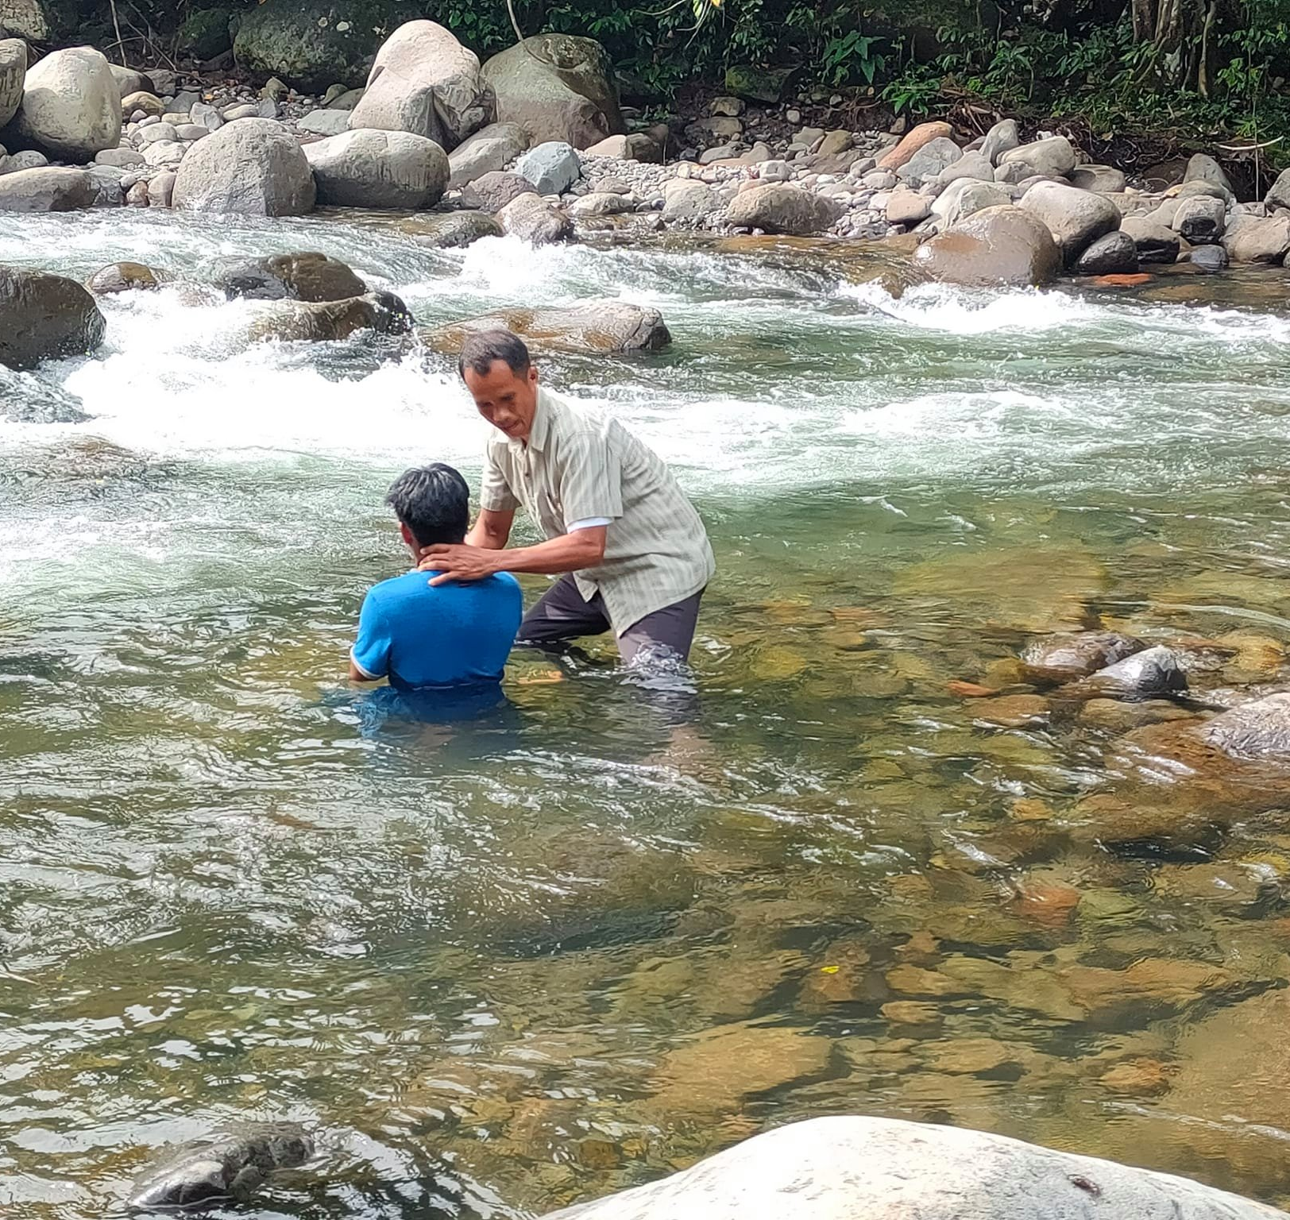
“Baptism now saves you” (1Pet.3:21).
Matthew 28:19-20—¹⁹Go therefore and make disciples of all the nations, baptizing them in the name of the Father and the Son and the Holy Spirit, ²⁰teaching them to observe all that I commanded you; and lo, I am with you always, even to the end of the age.” (NASB95)

