Slide 1
My Fair Share

Slide 2
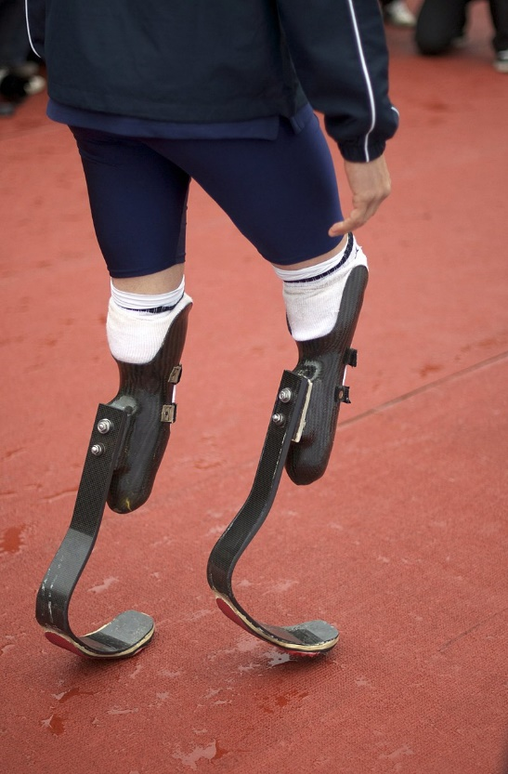
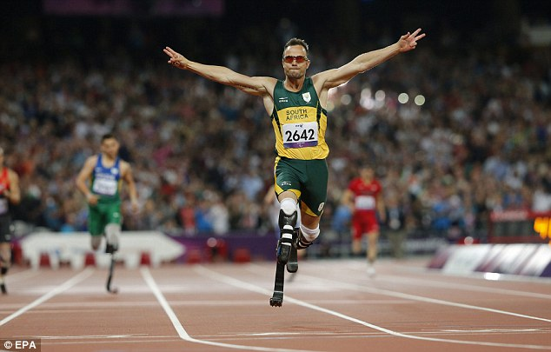
Remember Oscar…?

Slide 3
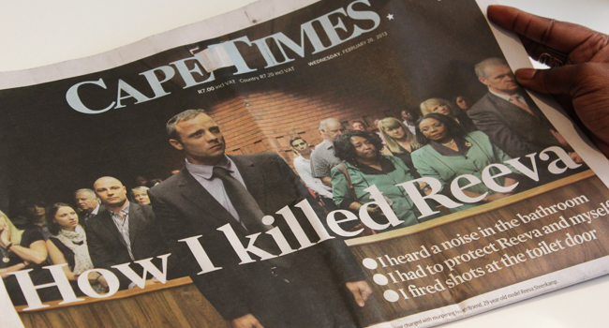

Slide 4
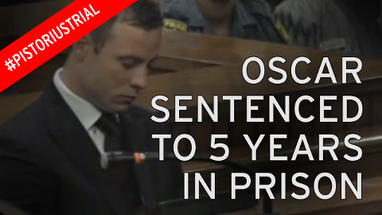
Just deserts…?
Increased to 15 years in 2017.

Slide 5
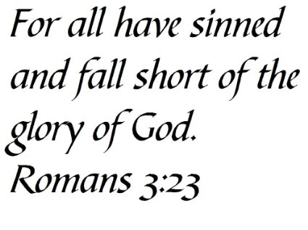
A contrast indeed!
Where we are…

Slide 6
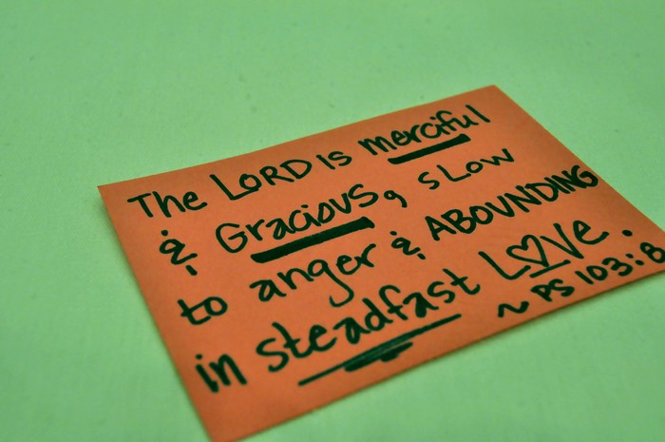
A contrast indeed!
Where we are…
God’s Starting Point, anyway!

Slide 7
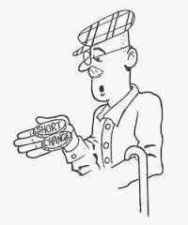
But we are easily distracted

Slide 8
But we are easily distracted
No one likes to be short- changed.

Slide 9
But we are easily distracted
No one likes to be short- changed
“All I want is my fair share”
We all want the proper change back when we buy something.
Ever been short-changed?
Become angry?
Demand your rights?
Much focus on: “human rights”
Emphasis on what’s right for the individual.

Slide 10
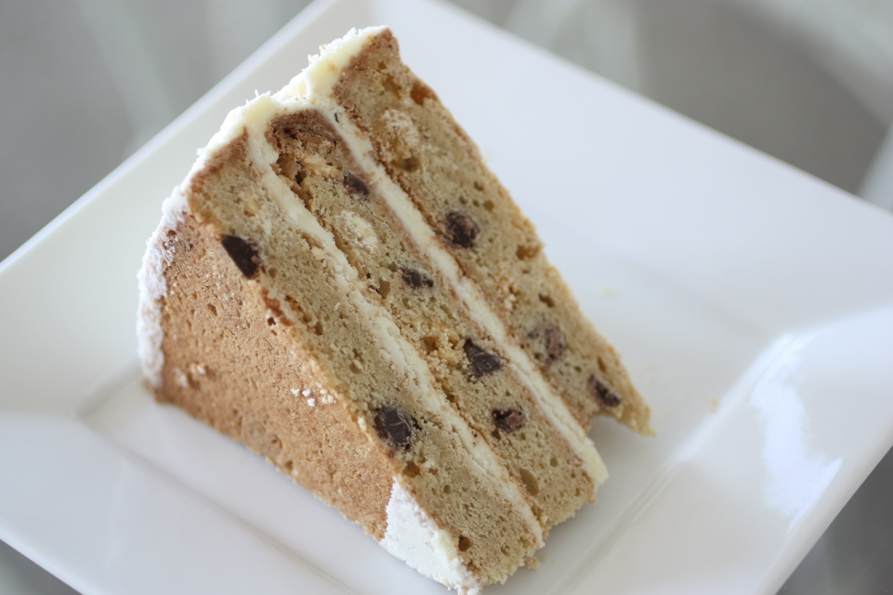
The story of the two preachers and the cake

Slide 11

Matthew 20:1-16

Slide 12
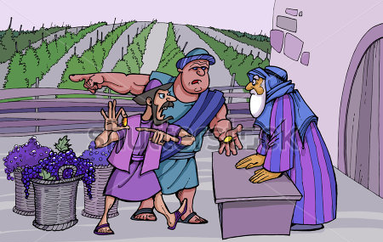

Slide 13
Then and…Now
Matthew 20:13-15—¹³ “But he answered one of them, ‘I am not being unfair to you, friend. Didn’t you agree to work for a denarius? ¹⁴ Take your pay and go. I want to give the one who was hired last the same as I gave you. ¹⁵ Don’t I have the right to do what I want with my own money? Or are you envious because I am generous?’

Slide 14
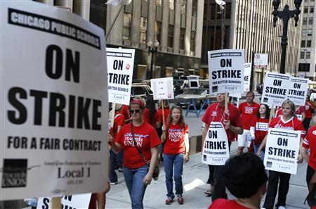
Then and Now

Slide 15
Not given what we deserve.

Slide 16
Not given what we deserve.
This one area—I am glad that I did not get a fair deal.
Here I will never demand my rights.
I will not insist on what should be coming to me.
I will remain forever silent.
I will simply be thankful that I got ‘short-changed.’

Slide 17
Not given what we deserve.
This one area—I am glad that I did not get a fair deal.
Here I will never demand my rights.
I will not insist on what should be coming to me.
I will remain forever silent.
I will simply be thankful that I got ‘short-changed.’

Slide 18
Not given what we deserve.
This one area—I am glad that I did not get a fair deal.
Here I will never demand my rights.
I will not insist on what should be coming to me.
I will remain forever silent.
I will simply be thankful that I got ‘short-changed.’

Slide 19
Not given what we deserve.
This one area—I am glad that I did not get a fair deal.
Here I will never demand my rights.
I will not insist on what should be coming to me.
I will remain forever silent.
I will simply be thankful that I got ‘short-changed.’

Slide 20
Not given what we deserve.
This one area—I am glad that I did not get a fair deal.
Here I will never demand my rights.
I will not insist on what should be coming to me.
I will remain forever silent.
I will simply be thankful that I got ‘short-changed.’

Slide 21
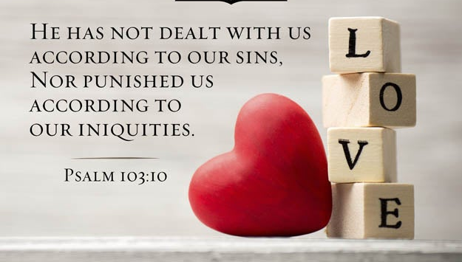
Not given what we deserve.
This one area—I am glad that I did not get a fair deal.
Here I will never demand my rights.
I will not insist on what should be coming to me.
I will remain forever silent.
I will simply be thankful that I got ‘short-changed.’

Slide 22
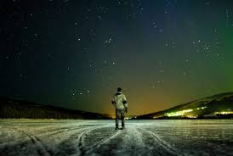
Motivated by love
Psalm 103:11
11 For as high as the heavens are above the earth, so great is his love for those who fear him;

Slide 23
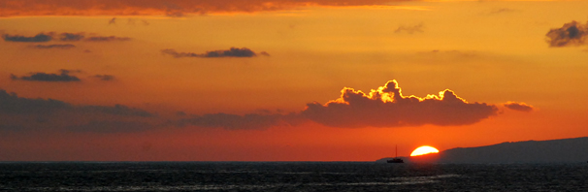
East and West—
Never the twain shall meet.

Slide 24
Do you believe in Jesus Christ as Lord and Saviour? Then…
Your sins are gone!
Never to be remembered again.
East and West—
Never the twain shall meet.

Slide 25
Do you believe in Jesus Christ as Lord and Saviour? Then…
Your sins are gone!
Never to be remembered again.
East and West—
Never the twain shall meet.

Slide 26
Do you believe in Jesus Christ as Lord and Saviour? Then…
Your sins are gone!
Never to be remembered again.
East and West—
Never the twain shall meet.

Slide 27
Psalm 103:12—as far as the east is from the west, so far has he removed our transgressions from us.
Do you believe in Jesus Christ as Lord and Saviour? Then…
Your sins are gone!
Never to be remembered again.
East and West—
Never the twain shall meet.

Slide 28
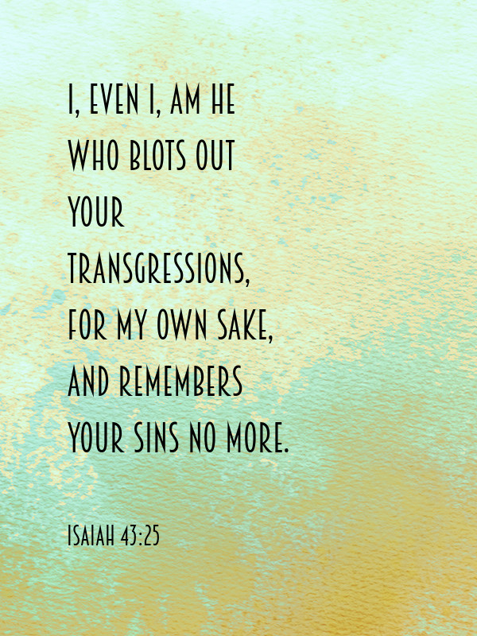

Slide 29
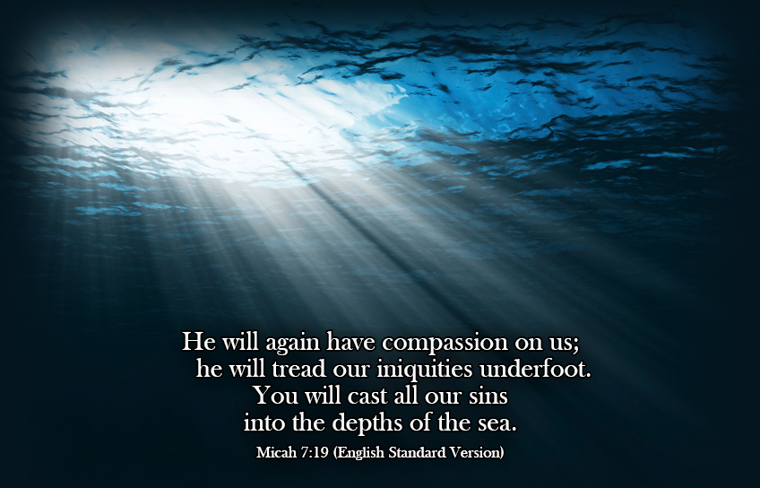

Slide 30
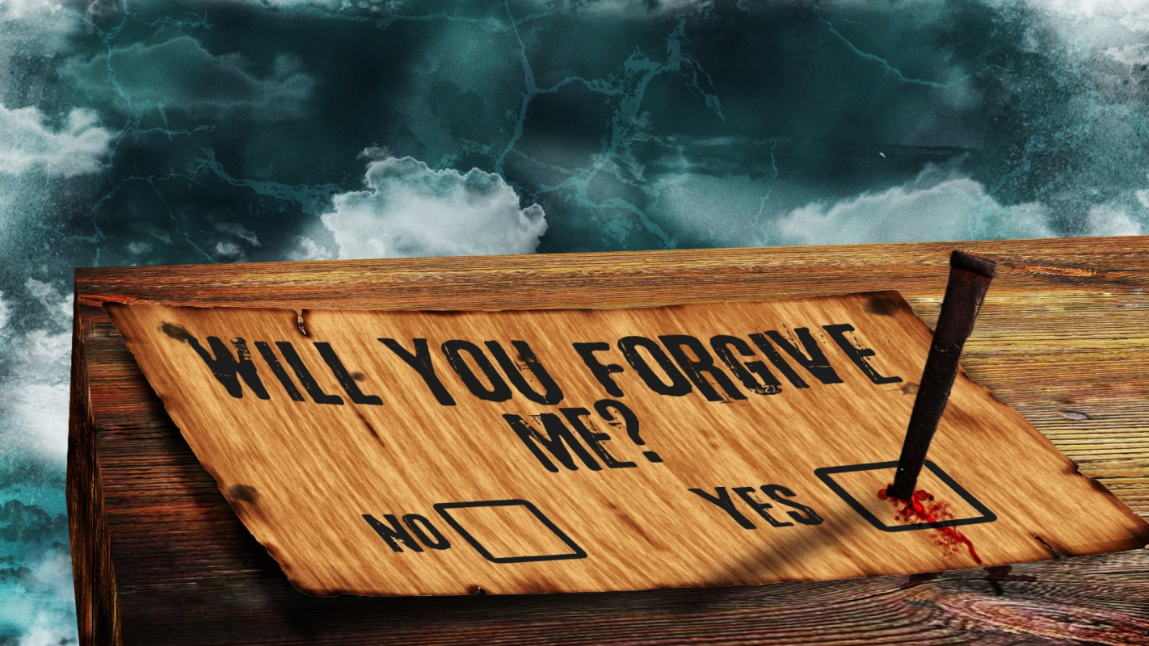
1 John 1:9—
“If we confess our sins, he is faithful and just and will forgive us our sins and purify us from all unrighteousness”.

Slide 31
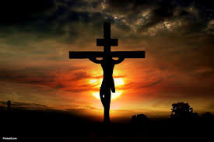
2 Corinthians 5:21—
God made him who had no sin to be sin for us, so that in him we might become the righteousness of God.

Slide 32
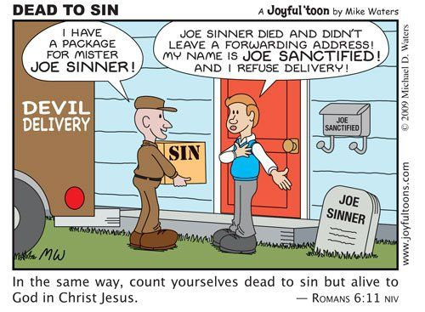
Dead to sin
Romans 6:1-2—What shall we say, then? Shall we go on sinning so that grace may increase? ² By no means! We are those who have died to sin; how can we live in it any longer?

Slide 33
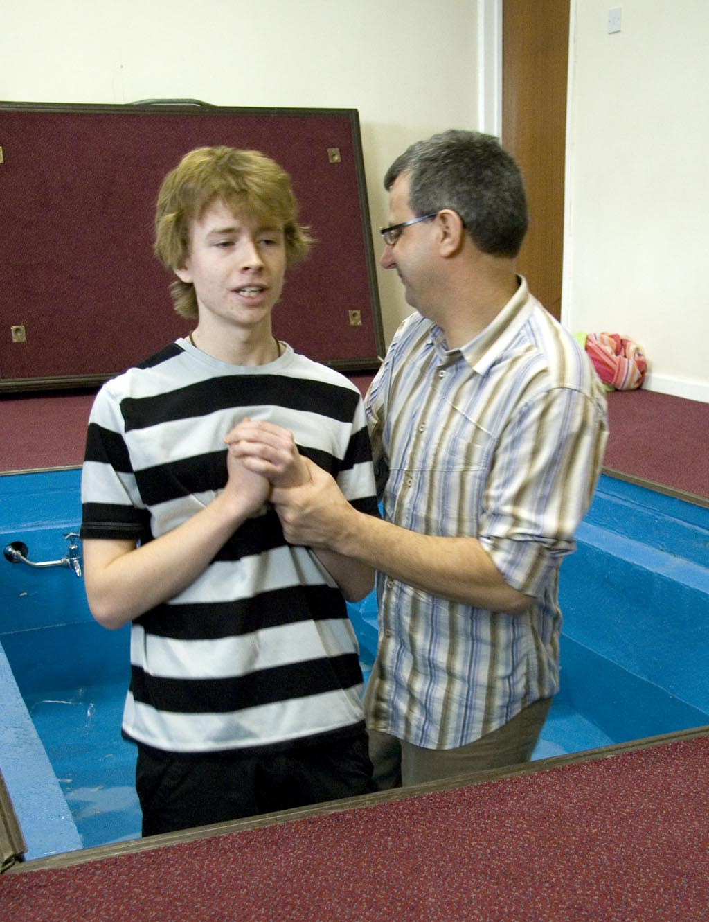
Romans 6:3-4
³ Or don’t you know that all of us who were baptized into Christ Jesus were baptized into his death? ⁴ We were therefore buried with him through baptism into death in order that, just as Christ was raised from the dead through the glory of the Father, we too may live a new life.

