Slide 1


Slide 2
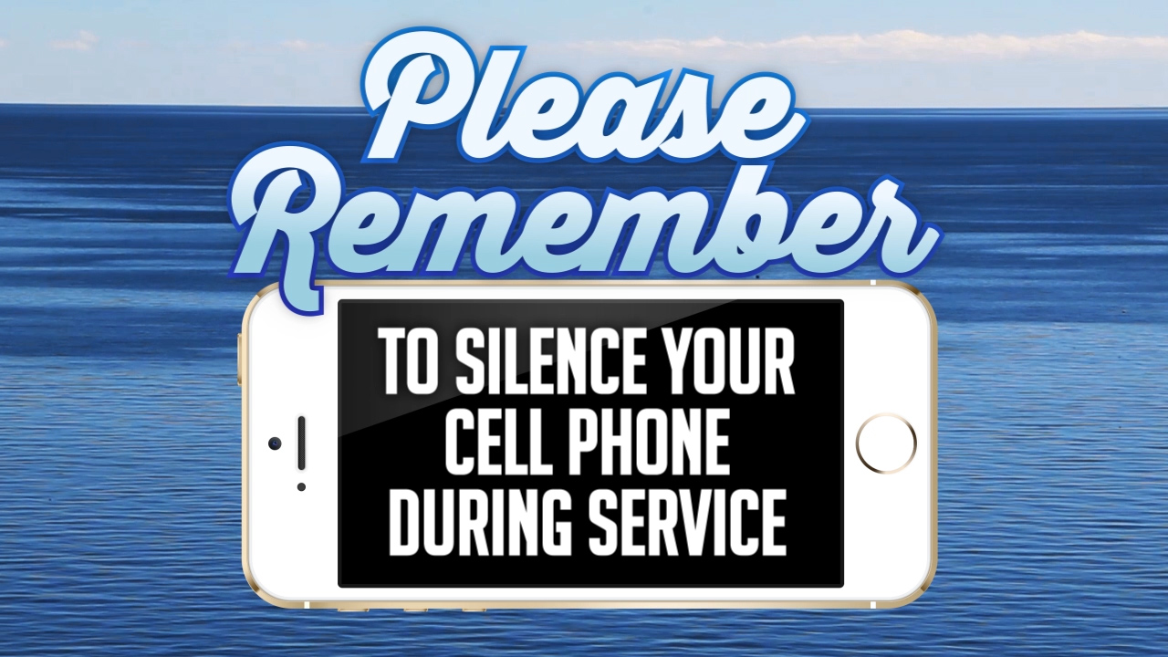

Slide 3
Overlook an Offense
For the
Sake of Glory.

Slide 4


Proverbs 19:11
A person's wisdom yields patience; it is to one's glory to overlook an offense. (NIV)

Slide 5
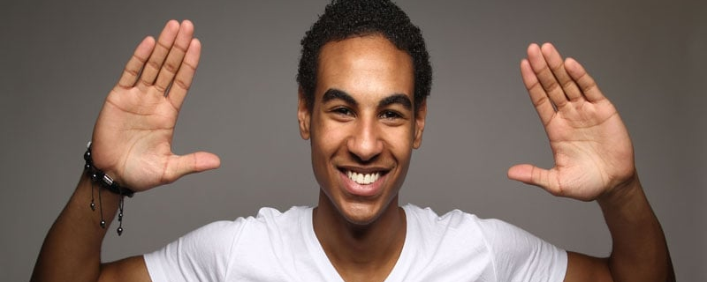
Proverbs 19:11
Good sense makes one slow to anger, and it is his glory to overlook an offense. (ESV)

Slide 6

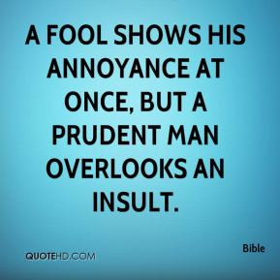
Proverbs 12:16

Slide 7
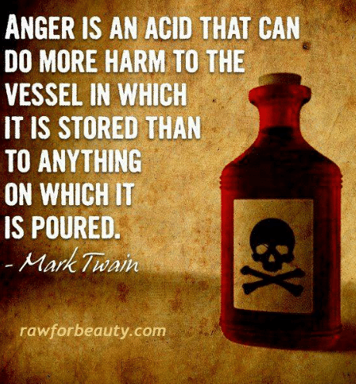
James 1:19-20
¹⁹My dear brothers, take note of this: Everyone should be quick to listen, slow to speak and slow to become angry, ²⁰for man's anger does not bring about the righteous life that God desires. (NIV)

Slide 8
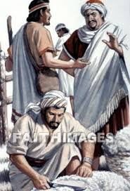
David, Nabal and Abigail (1Samuel 25).
The Incident at Carmel
David is on the run from King Saul (1Sam.21f).
600 men (1Sam.23:13).
Nabal—a Calebite, was surly and mean.
Abigail—Intelligent and beautiful.

Slide 9
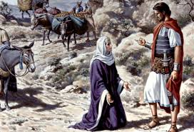
1 Samuel 25:30-32
30 When the LORD has done for my master every good thing he promised concerning him and has appointed him leader over Israel, 31 my master will not have on his conscience the staggering burden of needless bloodshed or of having avenged himself.
And when the LORD
has brought my
master success,
remember your
servant."

Slide 10
The Depth of God’s Forgiveness
Micah 7:18-19
18 Who is a God like you, who pardons sin and forgives the transgression of the remnant of his inheritance? You do not stay angry forever but delight to show mercy. 19 You will again have compassion on us; you will tread our sins underfoot and hurl all our iniquities into the depths of the sea.

Slide 11
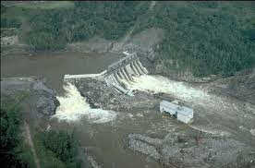
How we react will determine the outcome...
Proverbs 17:14 “Starting a
quarrel is like
breaching a
dam;
so drop the
matter before
a dispute
breaks out.” (NIV)

Slide 12
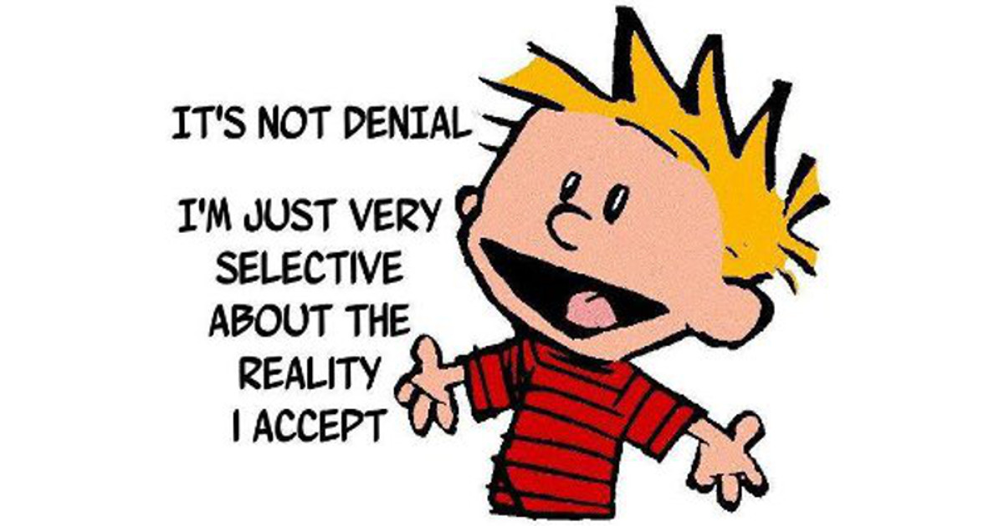
Forgiveness is not...
Forgiveness is not excusing—
Forgiveness is not denying that the one who has caused the hurt is responsible for their actions.

Slide 13
Forgiveness is not...
Forgiveness is not avoidance—
Forgiveness is not making light of something we find hurtful by saying, “It doesn’t matter.”

Slide 14

Forgiveness is not Simply trying to forget...
"Forgiveness means that we are not going to allow the experiences of the past to dominate our future."

Slide 15
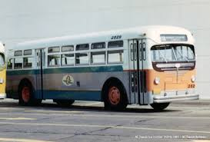
Pre-Select your Response
1 Peter 3:9
Do not repay evil with evil or insult with insult, but with blessing, because to this you were called so that you may inherit a blessing.

Slide 16

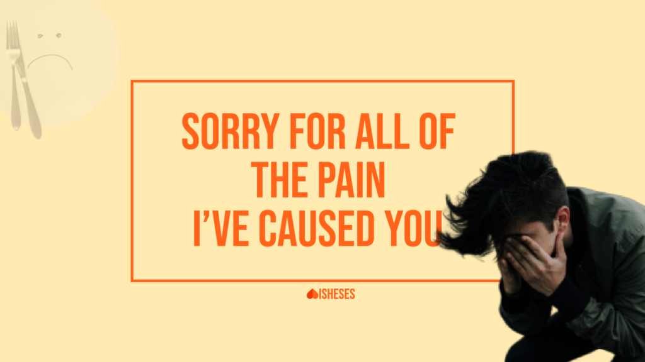
Pre-Select your Response
Matthew 6:14-15
¹⁴For if you forgive others for their transgressions, your heavenly Father will also forgive you. ¹⁵But if you do not forgive others, then your Father will not forgive your transgressions.

Slide 17
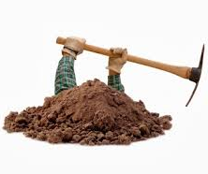
You will probably find in people what you’re digging for...
Proverbs 11:27 “He who seeks good finds goodwill,
but evil comes to him who searches for it.” (NIV)

Slide 18
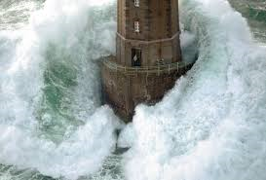
First place to go—Psalm 46:1 (NIV)
“God is our refuge and strength, an ever-present help in trouble.

Slide 19
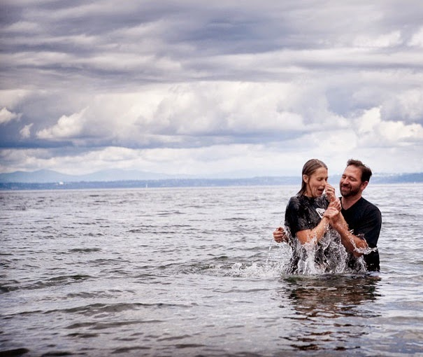
Mark 16:15-16—
¹⁵ And He said to them, “Go into all the world and preach the gospel to all creation. ¹⁶ He who has believed and has been baptized shall be saved; but he who has disbelieved shall be condemned. (NASB95)

