Slide 1
Series: Promises
Part 1.
John Staiger
Morningside Church of Christ
Sunday 6 June 2021
AM Sermon
Broadcast on Facebook Live from
42 Leslie Ave, Sandringham, Auckland, NZ.

Slide 2
Promises
Part 1.

Slide 3


Slide 4

Beware the empty promises.
A Christian’s word is his bond.
Because God’s word is His bond!

Slide 5
Beware the empty promises.
A Christian’s word is his bond.
Because God’s word is His bond!

Slide 6
Beware the empty promises.
Man may disappoint us, but…
It is impossible for God to lie (Heb.6:18).

Slide 7
Beware the empty promises.
Man may disappoint us, but…
It is impossible for God to lie (Heb.6:18).

Slide 8

John 14:1-2
“Do not let your heart be troubled; believe in God, believe also in Me. ²In My Father’s house are many dwelling places; if it were not so, I would have told you; for I go to prepare a place for you. (NASB95)

Slide 9

Heaven is
THE PROMISE.
It is toward Heaven that I have set my compass.

Slide 10
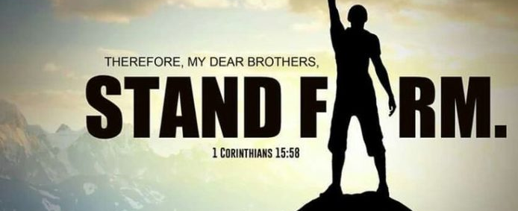
Jude 24—
²⁴Now to Him who is able to keep you from stumbling, and to make you stand in the presence of His glory blameless with great joy, (NASB95)
Can I stand?

Slide 11
Jude 24—
²⁴Now to Him who is able to keep you from stumbling, and to make you stand in the presence of His glory blameless with great joy, (NASB95)
Can I stand?
Jesus makes standing possible.

Slide 12
Jude 24—
²⁴Now to Him who is able to keep you from stumbling, and to make you stand in the presence of His glory blameless with great joy, (NASB95)
Can I stand?
Jesus makes standing possible.
…against the devil.

Slide 13
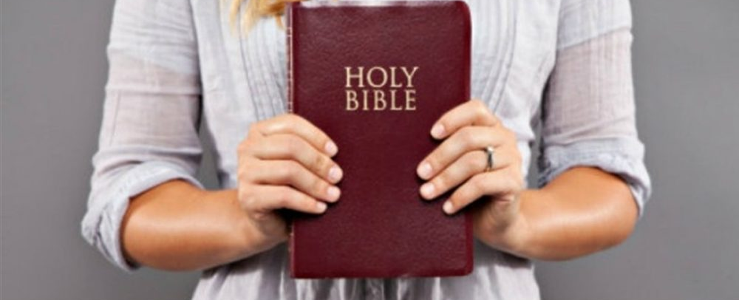
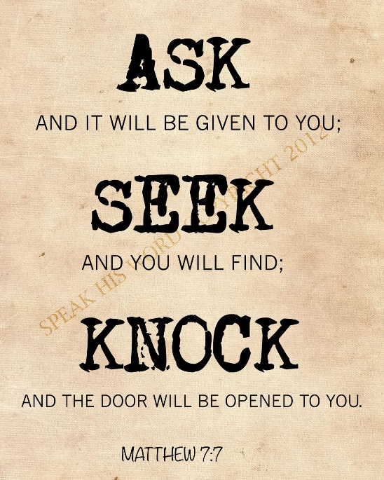
1 John 5:14-15—
¹⁴This is the confidence which we have before Him, that, if we ask anything according to His will, He hears us. ¹⁵And if we know that He hears us in whatever we ask, we know that we have the requests which we have asked from Him. (NASB95)

Slide 14
1 John 5:14-15—
¹⁴This is the confidence which we have before Him, that, if we ask anything according to His will, He hears us. ¹⁵And if we know that He hears us in whatever we ask, we know that we have the requests which we have asked from Him. (NASB95)
Approach with boldness.

Slide 15
1 John 5:14-15—
¹⁴This is the confidence which we have before Him, that, if we ask anything according to His will, He hears us. ¹⁵And if we know that He hears us in whatever we ask, we know that we have the requests which we have asked from Him. (NASB95)
Guaranteed success:

Slide 16

1 John 5:14-15—
¹⁴This is the confidence which we have before Him, that, if we ask anything according to His will, He hears us. ¹⁵And if we know that He hears us in whatever we ask, we know that we have the requests which we have asked from Him. (NASB95)
Guaranteed success:

Slide 17
1 John 5:14-15—
¹⁴This is the confidence which we have before Him, that, if we ask anything according to His will, He hears us. ¹⁵And if we know that He hears us in whatever we ask, we know that we have the requests which we have asked from Him. (NASB95)
Guaranteed success:
“Thy will be done!”

Slide 18

2 Peter 3:9—
⁹The Lord is not slow about His promise, as some count slowness, but is patient toward you, not wishing for any to perish but for all to come to repentance. (NASB95)

Slide 19
God’s promises stand:
In Christ.
Today is the day of salvation.
Time is finite.
Die expecting an eternal inheritance.

Slide 20

2 Corinthians 1:19-20—
¹⁹For the Son of God, Christ Jesus, who was preached among you by us—by me and Silvanus and Timothy—was not yes and no, but is yes in Him. ²⁰For as many as are the promises of God, in Him they are yes; therefore also through Him is our Amen to the glory of God through us. (NASB95)
Always “YES!”

Slide 21

Romans 6:4—
⁴ We were therefore buried with him through baptism into death in order that, just as Christ was raised from the dead through the glory of the Father, we too may live a new life.

