Slide 1
Series: Promises
Part 2. “What of the Future?”
John Staiger
Morningside Church of Christ
Sunday 13 June 2021
AM Sermon
Broadcast on Facebook Live from
42 Leslie Ave, Sandringham, Auckland, NZ.

Slide 2

Promises
Part 2.
“What of the Future?”

Slide 3

Jeremiah 29:11—
¹¹For I know the plans that I have for you,’ declares the Lord, ‘plans for welfare and not for calamity to give you a future and a hope” (NASB95)

Slide 4
Jeremiah 29:13—
¹³You will seek Me and find Me when you search for Me with all your heart. (NASB95)

Slide 5

Future—Lots of thoughts and Questions:
Dream big for Jesus!

Slide 6
Future—Lots of thoughts and Questions:
Dream big for Jesus!
God wants the best for your life in the Son.

Slide 7
Future—Lots of thoughts and Questions:
Dream big for Jesus!
God wants the best for your life in the Son.
What does that mean?

Slide 8
Future—Lots of thoughts and Questions:
Dream big for Jesus!
God wants the best for your life in the Son.
What does that mean?
I have no idea—Praise the Lord!

Slide 9
Future—Lots of thoughts and Questions:
Dream big for Jesus!
God wants the best for your life in the Son.
What does that mean?
I have no idea—Praise the Lord!
But God knows.

Slide 10
Future—Lots of thoughts and Questions:
Dream big for Jesus!
God wants the best for your life in the Son.
What does that mean?
I have no idea—Praise the Lord!
But God knows.
Ask…seek…knock (Mt.7:7).

Slide 11
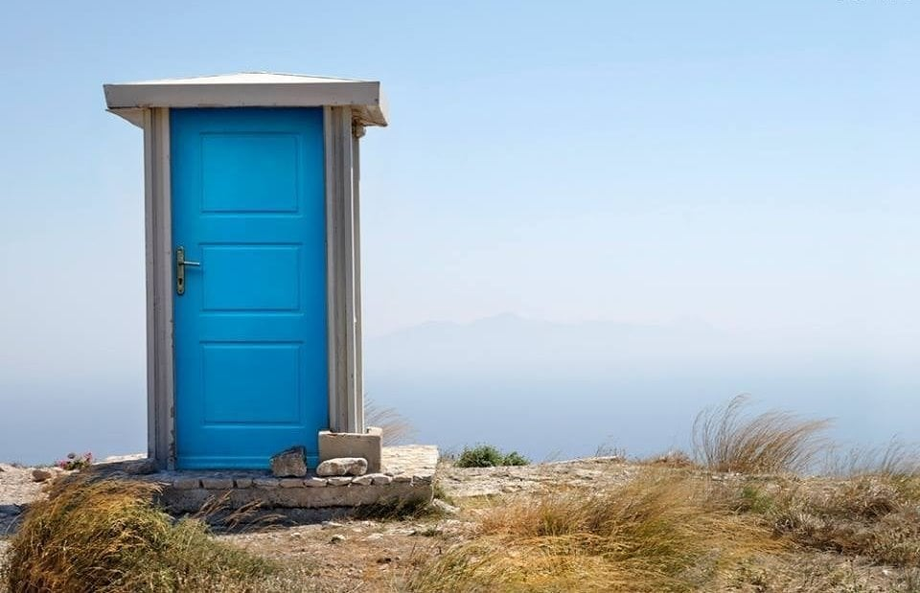
Future—Dreams for Sale
But beware the doors to nowhere.

Slide 12
Future—Dreams for Sale
But beware the doors to nowhere.
The world is a big place.

Slide 13
Future—Dreams for Sale
But beware the doors to nowhere.
The world is a big place.
Lots of places and people.

Slide 14
Future—Dreams for Sale
But beware the doors to nowhere.
The world is a big place.
Lots of places and people.
Go!

Slide 15
Future—Dreams for Sale
But beware the doors to nowhere.
The world is a big place.
Lots of places and people.
Go!
But—Take the Name of Jesus with you.

Slide 16
Future—Dreams for Sale
But beware the doors to nowhere.
The world is a big place.
Lots of places and people.
Go!
But—Take the Name of Jesus with you.
Let God lead you to souls.

Slide 17
Future—Dreams for Sale
But beware the doors to nowhere.
The world is a big place.
Lots of places and people.
Go!
But—Take the Name of Jesus with you.
Let God lead you to souls.
You will literally change the world.

Slide 18

It only looks like this on the inside.
Phil.4:11 “…I have learned to be content in whatever circumstances I am.”
Paul “Learned contentment.”
Future—Contentment

Slide 19

Future contentment starts now
Phil.4:13—
“I can do all things through Him who strengthens me.”
ALL THINGS pertaining to contentment in present ministry.
NOT horrible situations that we refuse to change.

Slide 20

Today is the tomorrow you worried about yesterday.

Slide 21
Don’t waste today:
Seek true riches (Luke 16:11)

Slide 22
Don’t waste today:
Seek true riches (Luke 16:11)
Hebrews 13:5—⁵Make sure that your character is free from the love of money, being content with what you have; for He Himself has said, “I will never desert you, nor will I ever forsake you,” (NASB95)

Slide 23

Future—Before your very eyes.
Where to start?
Invest in the next generation.
Know their names.
Pray for them.
Be there for them.
Live lives worthy of copying.
Live in hope!

Slide 24

Speaking Promise into the Future
Legacy of faithfulness.
“By faith Abel…better sacrifice… though he is dead, he still speaks (Heb.11:4).
Your voice can be heard into the future, also.

Slide 25

Romans 6:4—
⁴ We were therefore buried with him through baptism into death in order that, just as Christ was raised from the dead through the glory of the Father, we too may live a new life.

