Slide 1

Promises
Part 3.
“Promise of Life”

Slide 2
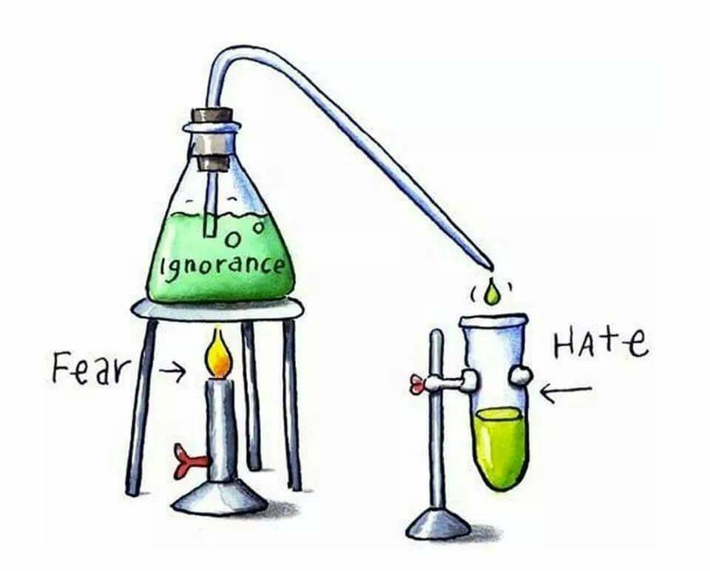
Paul’s starting point—Before…!
Before Paul stood in that Promised Life in Jesus…

Slide 3
Paul’s starting point—Before…!
Before Paul stood in that Promised Life in Jesus,
His potential future was unseeable.

Slide 4
Paul’s starting point—Before…!
Before Paul stood in that Promised Life in Jesus…
His potential future was unseeable.
He saw his work against the church as righteous…
1Tim.1:12-13…

Slide 5
Paul’s starting point—Before…!
Before Paul stood in that Promised Life in Jesus…
His potential future was unseeable.
He saw his work against the church as righteous.
He was blind to what was coming:
1Tim.1:12-13…

Slide 6
Paul’s starting point—Before…!
1Tim.1:12-13—
¹² I thank Christ Jesus our Lord, who has given me strength, that he considered me trustworthy, appointing me to his service. ¹³Even though I was once a blasphemer and a persecutor and a violent man, I was shown mercy because I acted in ignorance and unbelief.

Slide 7
Looking Back…
When now standing in that Promised Life in Jesus…

Slide 8
Looking Back…
When now standing in that Promised Life in Jesus…
He would have preferred his past offenses were blacked out.

Slide 9
Looking Back…
When now standing in that Promised Life in Jesus…
He would have preferred his past offenses were blacked out.
They were!
1Tim.1:12-13…

Slide 10
Paul’s starting point—After…!
1Tim.1:12-13—
¹² I thank Christ Jesus our Lord, who has given me strength, that he considered me trustworthy, appointing me to his service. ¹³Even though I was once a blasphemer and a persecutor and a violent man, I was shown mercy because I acted in ignorance and unbelief.

Slide 11
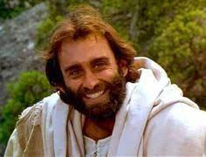
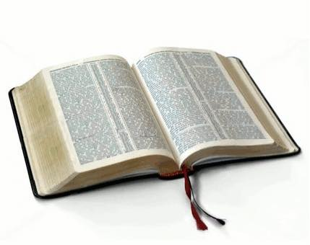
Promise of Life
2 Timothy 1:1—
¹Paul, an apostle of Christ Jesus by the will of God, according to the promise of life in Christ Jesus, (NASB95)

Slide 12
Promise of Life
The apostles were sent to deliver a promise.

Slide 13
Promise of Life
The apostles were sent to deliver a promise.
Delivering the abundant life that Jesus promised…(John 10:10)

Slide 14
Promise of Life
John 10:10—
¹⁰The thief comes only to steal and kill and destroy; I came that they may have life, and have it abundantly. (NASB95)

Slide 15
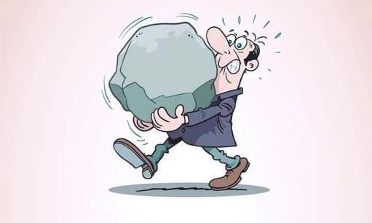

Choose Wisely
Quality of Life…
Psalm 28:7

Slide 16
Choose Wisely
Quality of Life…
Still carrying Burdens:
  Suffocating Guilt
  Draining judgmentalism
  Tiring Temptations
How you see God’s place for you in life is going to determine its quality:
  Burdens are lifted at Calvary
  Choose life
  Rejoice
Psalm 28:7

Slide 17
Choose Wisely
Quality of Life…
Still carrying Burdens:
  Suffocating Guilt
  Draining judgmentalism
  Tiring Temptations
How you see God’s place for you in life is going to determine its quality:
  Burdens are lifted at Calvary
  Choose life
  Rejoice
Psalm 28:7

Slide 18
Choose Wisely
Quality of Life…
Still carrying Burdens:
  Suffocating Guilt
  Draining judgmentalism
  Tiring Temptations
How you see God’s place for you in life is going to determine its quality:
  Burdens are lifted at Calvary
  Choose life
  Rejoice
Psalm 28:7

Slide 19
Choose Wisely
Quality of Life…
Still carrying Burdens:
  Suffocating Guilt
  Draining judgmentalism
  Tiring Temptations
How you see God’s place for you in life is going to determine its quality:
  Burdens are lifted at Calvary
  Choose life
  Rejoice
Psalm 28:7

Slide 20
Choose Wisely
Quality of Life…
Still carrying Burdens:
  Suffocating Guilt
  Draining judgmentalism
  Tiring Temptations
How you see God’s place for you in life is going to determine its quality:
  Burdens are lifted at Calvary
  Choose life
  Rejoice
Psalm 28:7

Slide 21
Choose Wisely
Quality of Life…
Still carrying Burdens:
  Suffocating Guilt
  Draining judgmentalism
  Tiring Temptations
How you see God’s place for you in life is going to determine its quality:
  Burdens are lifted at Calvary
  Choose life
  Rejoice
Psalm 28:7

Slide 22
Choose Wisely
Quality of Life…
Still carrying Burdens:
  Suffocating Guilt
  Draining judgmentalism
  Tiring Temptations
How you see God’s place for you in life is going to determine its quality:
  Burdens are lifted at Calvary
  Choose life
  Rejoice
Psalm 28:7

Slide 23
Choose Wisely
Quality of Life…
Still carrying Burdens:
  Suffocating Guilt
  Draining judgmentalism
  Tiring Temptations
How you see God’s place for you in life is going to determine its quality:
  Burdens are lifted at Calvary
  Choose life
  Rejoice
Psalm 28:7

Slide 24
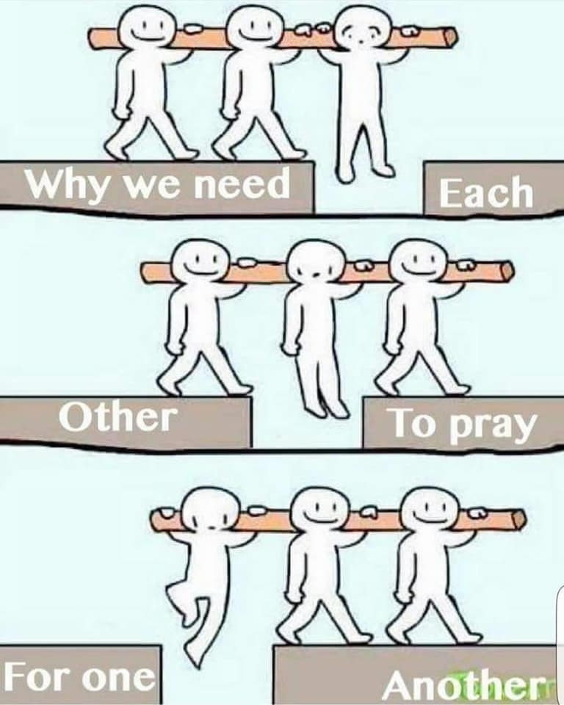
An Easy-to-do ‘Alive?’ or ‘Dead?’ Test
1 John 3:14—
¹⁴We know that we have passed out of death into life, because we love the brethren. He who does not love abides in death. (NASB95)

Slide 25

2Pet.1:4—For by these He has granted to us His precious and magnificent promises, so that by them you may become partakers of the divine nature, having escaped the corruption that is in the world by lust.
(NASB95)
John 8:36—So if the Son makes you free, you will be free indeed.

Slide 26

Children of Promise
Acts 2:39—
For the promise is for you and your children and for all who are far off, as many as the Lord our God will call to Himself.” (NASB95)

Slide 27
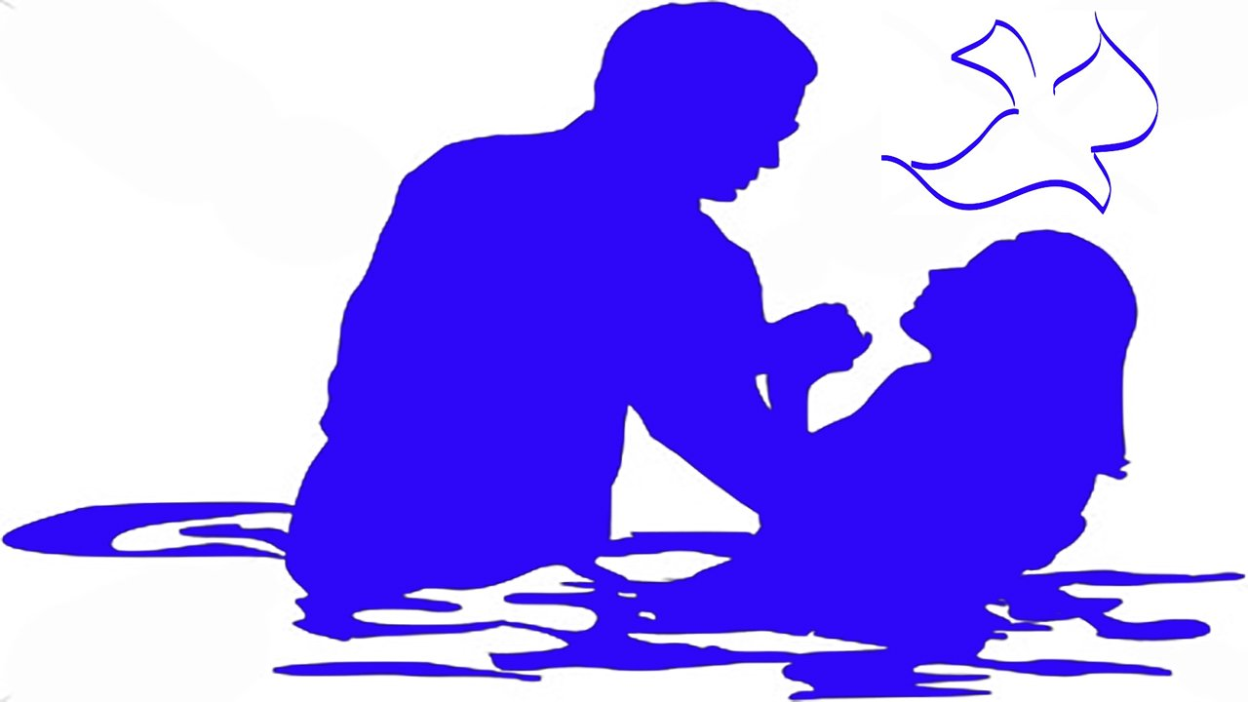
Acts 2:38—
³⁸ Peter said to them, “Repent, and each of you be baptized in the name of Jesus Christ for the forgiveness of your sins; and you will receive the gift of the Holy Spirit. (NASB95)

