Slide 1
Purpose
Part 1.
According to His Purpose

Slide 2
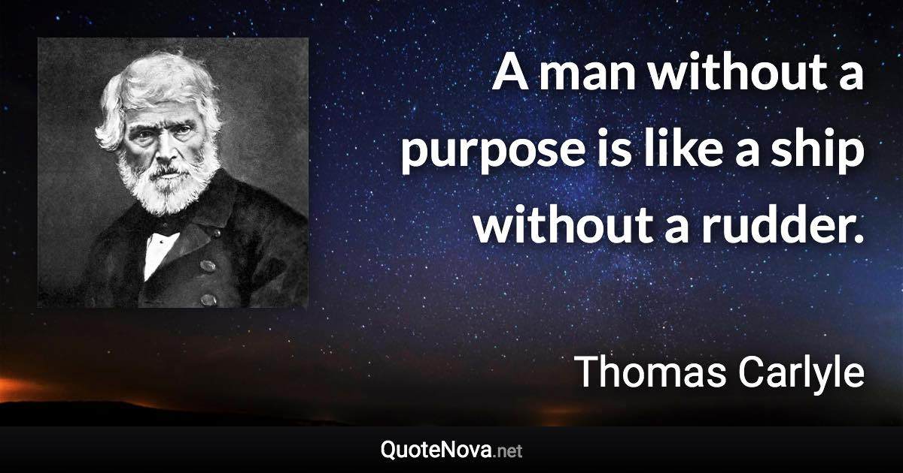


Slide 3
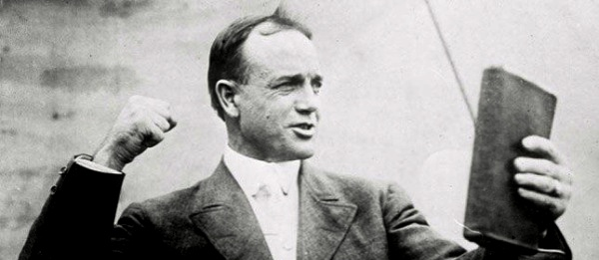

Billy Sunday
"More men fail through lack of purpose than lack of talent."

Slide 4

Romans 8:28—
And we know that God causes all things to work together for good to those who love God, to those who are called according to His purpose. (NASB95)

Slide 5

Psalm 33:10-11—
¹⁰The Lord frustrates the
purposes of the nations;
he keeps them from
carrying out their plans.
¹¹ But his plans endure forever;
his purposes last eternally.
(TEV)

Slide 6
God has promised to make everything beneficial to His people.
This is God’s gracious providence at work.
So, can I sin and let God pick up the bill?
“Shall we go on sinning so that grace may increase?
By no means!
We died to sin; how can we live in it any longer?” (Rom.6:1-2)

Slide 7
God has promised to make everything beneficial to His people.
This is God’s gracious providence at work.
So, can I sin and let God pick up the bill?
“Shall we go on sinning so that grace may increase?
By no means!
We died to sin; how can we live in it any longer?” (Rom.6:1-2)

Slide 8
God has promised to make everything beneficial to His people.
This is God’s gracious providence at work.
So, can you sin and let God pick up the bill?
“Shall we go on sinning so that grace may increase?
By no means!
We died to sin; how can we live in it any longer?” (Rom.6:1-2)

Slide 9
God has promised to make everything beneficial to His people.
This is God’s gracious providence at work.
So, can you sin and let God pick up the bill?
“Shall we go on sinning so that grace may increase?
By no means!
We died to sin; how can we live in it any longer?” (Rom.6:1-2)

Slide 10
God has promised to make everything beneficial to His people.
This is God’s gracious providence at work.
So, can you sin and let God pick up the bill?
“Shall we go on sinning so that grace may increase?
By no means!
We died to sin; how can we live in it any longer?” (Rom.6:1-2)

Slide 11
God has promised to make everything beneficial to His people.
This is God’s gracious providence at work.
So, can you sin and let God pick up the bill?
“Shall we go on sinning so that grace may increase?
By no means!
We died to sin; how can we live in it any longer?” (Rom.6:1-2)

Slide 12
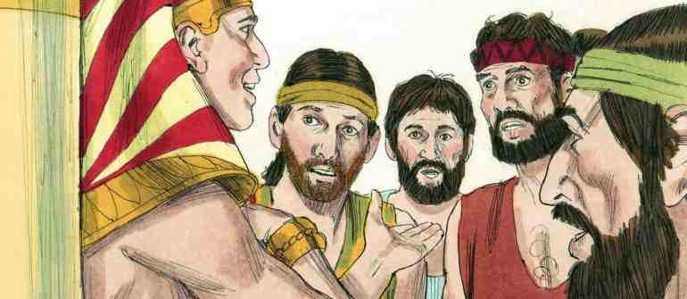
Joseph—An instrument in the hand of God
Genesis 50:20—²⁰As for you, you meant evil against me, but God meant it for good in order to bring about this present result, to preserve many people alive. (NASB95)

Slide 13
Joseph—An instrument in the hand of God
Dreams of greatness.
Thrown into a well.
Enslaved in Egypt.
Thrown into prison.
Second in charge of Egypt.

Slide 14

God’s purpose is that we take Christ’s joy to the nations.
It is not that we will escape Satan’s miseries.
But that God will make every one of our hardships an instrument to do us good.

Slide 15
God’s purpose is that we take Christ’s joy to the nations.
It is not that we will escape Satan’s miseries.
But that God will make every one of our hardships an instrument to do us good.

Slide 16
God’s purpose is that we take Christ’s joy to the nations.
It is not that we will escape Satan’s miseries.
But that God will make every one of our hardships an instrument to do us good.

Slide 17

2 Timothy 1:9-10—⁹who has saved us and called us with a holy calling, not according to our works, but according to His own purpose and grace which was granted us in Christ Jesus from all eternity,…
(NASB95)

Slide 18
2 Timothy 1:9-10—
…¹⁰but now has been revealed by the appearing of our Saviour Christ Jesus, who abolished death and brought life and immortality to light through the gospel, (NASB95)

Slide 19
1 Timothy 2:3-4
³This is good and acceptable in the sight of God our Saviour, ⁴who desires all men to be saved and to come to the knowledge of the truth. (NASB95)

Slide 20

Acts 2:38—
³⁸Peter said to them, “Repent, and each of you be baptized in the name of Jesus Christ for the forgiveness of your sins; and you will receive the gift of the Holy Spirit. (NASB95)

