Slide 1

Purpose
Part 2.
What is my Purpose?

Slide 2
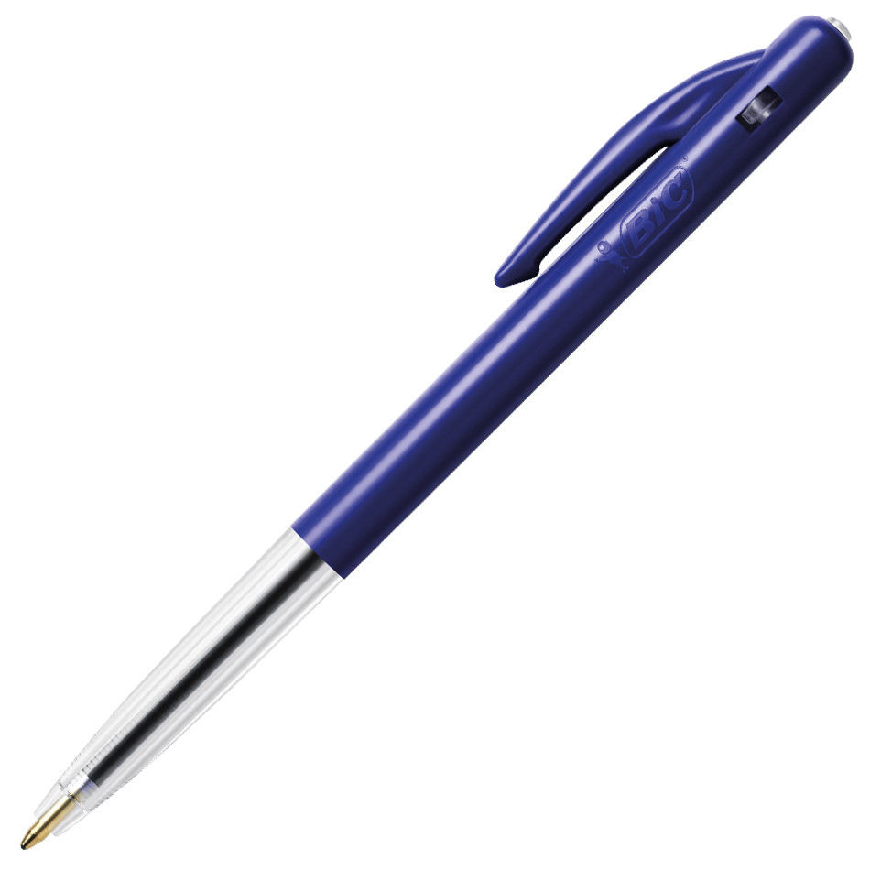
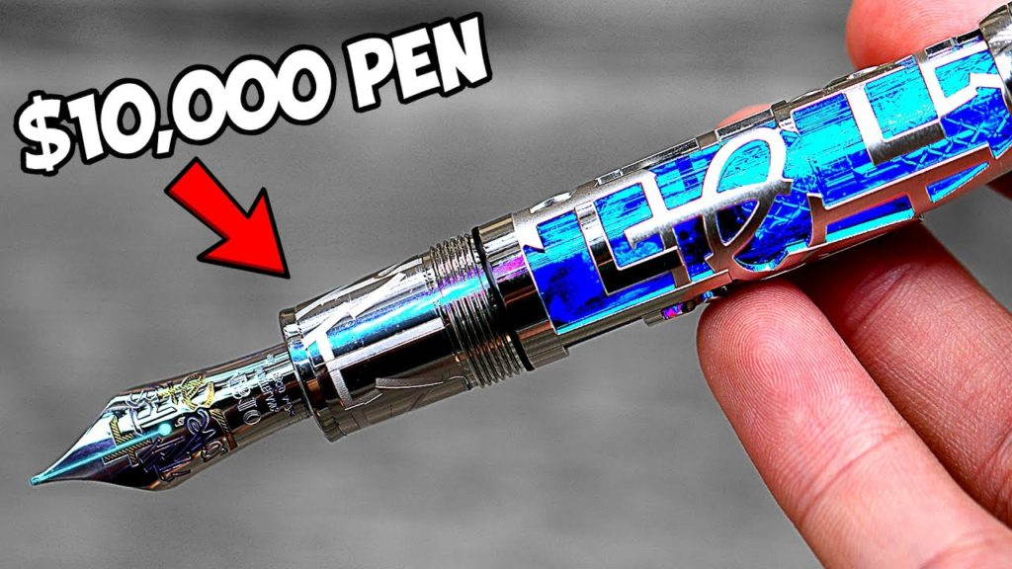
What makes one of these pens worth 10,000 times more than the other?

Slide 3

What makes one of these pens worth 10,000 times more than the other?

Slide 4

After patiently watching a Scotsman swing and miss the golf ball six times President Grant was heard to say…

Slide 5
“There seems to be a fair amount of exercise in this game, but I fail to see...”

Slide 6
“There seems to be a fair amount of exercise in this game, but I fail to see the purpose of the ball.”

Slide 7

Driven by design or default?
Either:
You live for the purpose that God designed for you for.
Or…

Slide 8
Driven by design or default?
Or according to the
  demands of your schedule
  Or expectations of others.

Slide 9
Driven by design or default?
Your Purpose?:
Making money.
Being the boss.
Having Fun.
Being popular.
Not necessarily bad…for a while!
But…

Slide 10
Driven by design or default?
Your Purpose?:
Making money.
Being the boss.
Having Fun.
Being popular.
Not necessarily bad…for a while!
But…

Slide 11
Driven by design or default?
Your Purpose?:
Making money.
Being the boss.
Having Fun.
Being popular.
Not necessarily bad…for a while!
But…

Slide 12
Driven by design or default?
Without Christ there is always a sense of emptiness in our pursuits…

Slide 13
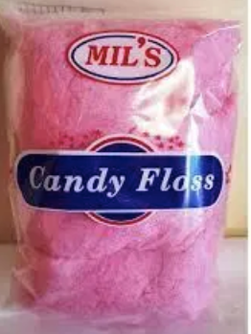
Driven by design or default?
It is like candy floss – all taste, but no substance.

Slide 14
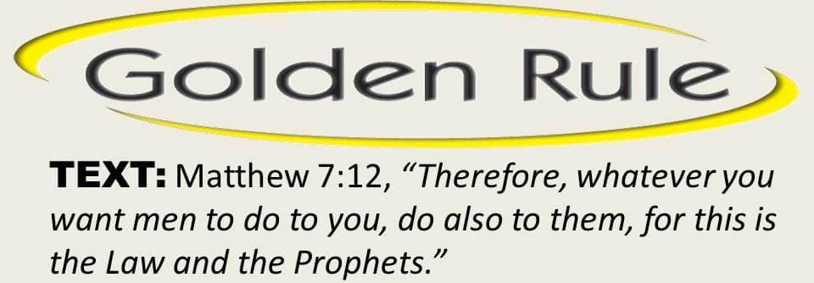
Some quote this a God’s total PURPOSE for them.
This is an attribute of the Christian—not your life’s purpose.
Also expressed as…

Slide 15


Slide 16
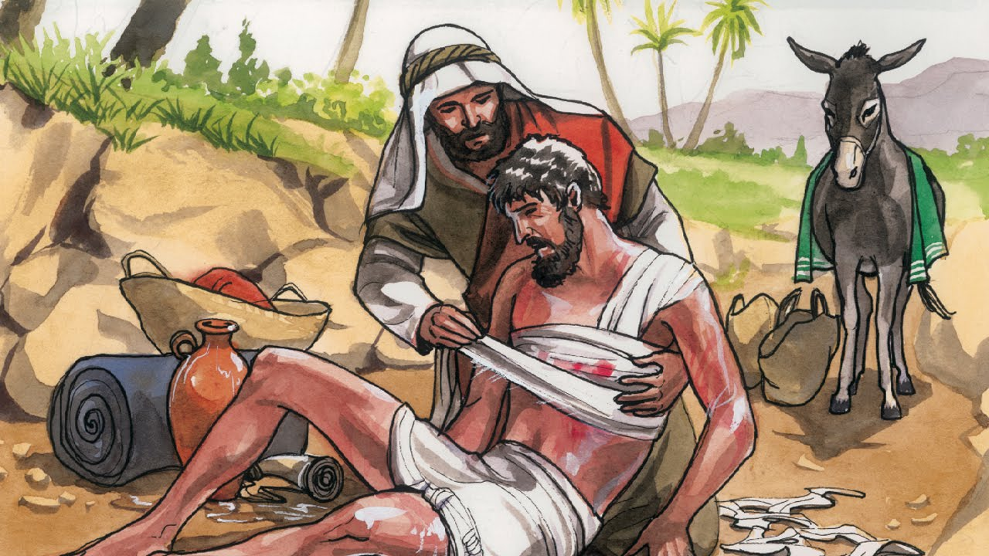
Jesus illustrates…

Slide 17

1 Corinthians 2:2
²For I resolved to know nothing while I was with you except Jesus Christ and him crucified.
This is the core of our belief system.
Sets up everyday life…

Slide 18





Colossians 3:17—
¹⁷Whatever you do in word or deed, do all in the name of the Lord Jesus, giving thanks through Him to God the Father. (NASB95)

Slide 19
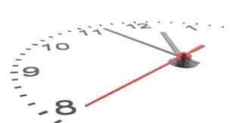
Time is ticking…
Ephesians 5:15-16—
¹⁵Therefore be careful
how you walk,
not as unwise men
but as wise,
¹⁶making the most of
your time,
because the days are evil.
(NASB95)
You don’t have time to do everything.
Everything is not even worth doing.
So, today…

Slide 20
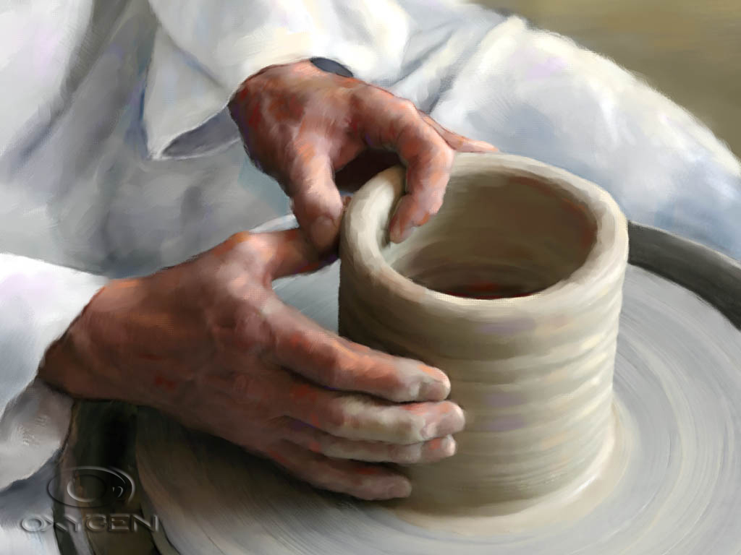
Purpose of Words, Deeds—Good Works…
Ephesians 2:10—
For we are His workmanship, created in Christ Jesus for good works, which God prepared beforehand so that we would walk in them. (NASB95)

Slide 21
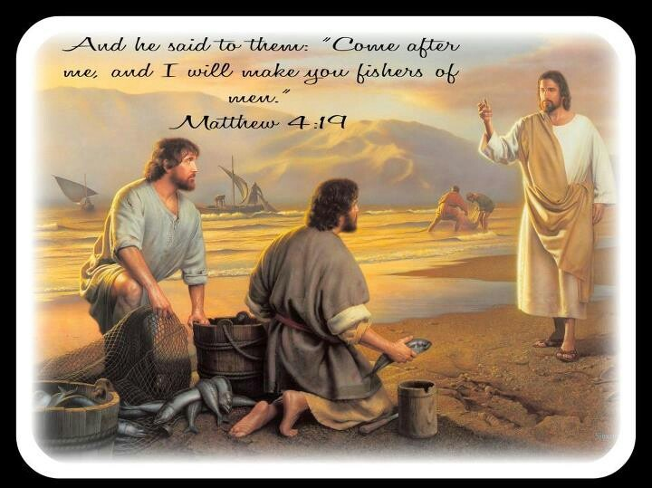

Slide 22

Always Ready…!
1 Peter 3:15— But sanctify Christ as Lord in your hearts, always being ready to make a defense to everyone who asks you to give an account for the hope that is in you, yet with gentleness and reverence.” (NASB95)

Slide 23

Always Ready…!
Purpose—Reaching out for Jesus
Keep Fishing…Keep Sowing.

Slide 24
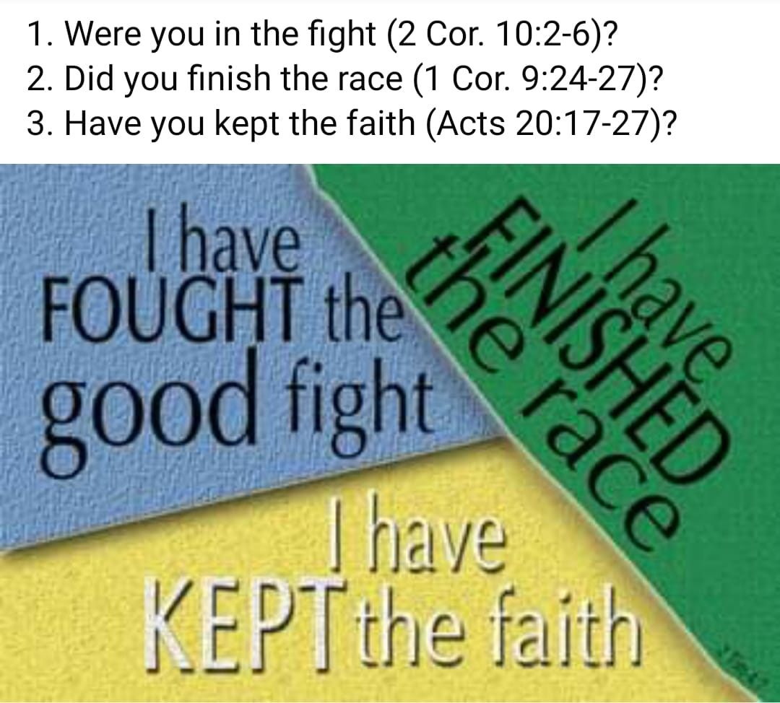
2 Timothy 4:7
⁸in the future there is laid up for me the crown of righteousness, which the Lord, the righteous Judge, will award to me on that day; and not only to me, but also to all who have loved His appearing. (NASB95)

Slide 25

Acts 2:38—
³⁸Peter said to them, “Repent, and each of you be baptized in the name of Jesus Christ for the forgiveness of your sins; and you will receive the gift of the Holy Spirit. (NASB95)
Starting to Begin…

