Slide 2

Purpose
Part 3.
What is my Purpose—Specifically?

Slide 3

Good Question…?
Asking:
What is my
SPECIFIC PURPOSE as a Christian?
Will drive you crazy if you are not careful.
It is loaded with potential frustrations…

Slide 4
Good Question…?
Asking:
What is my
SPECIFIC PURPOSE as a Christian?
Sounds like a good question…until!

Slide 5
Good Question…?
Asking:
What is my
SPECIFIC PURPOSE as a Christian?
Sounds like a good question…until!
Somebody gets the answer wrong.

Slide 6
Good Question…?
Asking:
What is my
SPECIFIC PURPOSE as a Christian?
Sounds like a good question…until!
Somebody gets the answer wrong.
Frustrating…

Slide 7

Asking the wrong Question
It is loaded with potential frustrations:

Slide 8
Asking the wrong Question
It is loaded with potential frustrations:
It is common for Christians to restrict
Purpose
to
Talents.

Slide 9
Asking the wrong Question
It is loaded with potential frustrations:
Problem:
  If your purpose is restricted to your talents, what happens when your talents are not needed or wanted?

Slide 10
Asking the wrong Question
It is loaded with potential frustrations:
Problem:
  What happens when God calls you beyond your known range of talents?

Slide 11
Asking the wrong Question
It is loaded with potential frustrations:
Problem:
  Things change:
Sickness.
War.
Accident.
Disappointment.
Disillusionment.
Failure.
Faith crisis.

Slide 12
Asking the wrong Question
It is loaded with potential frustrations:
Problem:
  You change:
  Marriage.
  Kids.
  New country.
  New friends.
  New interests.

Slide 13
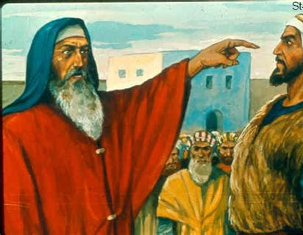
I was busy minding my own business
One day Amos the farmer had his life turned upside down…

Slide 14
I was busy minding my own business
One day Amos the farmer had his life turned upside down.
God called him to be a prophet…

Slide 15
I was busy minding my own business
One day Amos the farmer had his life turned upside down.
God called him to be a prophet.
It was in the early part of 8th century BC…

Slide 16
I was busy minding my own business
One day Amos the farmer had his life turned upside down.
God called him to be a prophet.
It was in the early part of 8th century BC.
Israel was a very prosperous place…

Slide 17
I was busy minding my own business
One day Amos the farmer had his life turned upside down.
God called him to be a prophet.
It was in the early part of 8th century BC.
Israel was a very prosperous place.
Amos’ mission…

Slide 18
I was busy minding my own business
One day Amos the farmer had his life turned upside down.
God called him to be a prophet.
It was in the early part of 8th century BC.
Israel was a very prosperous place.
Amos’ mission:
Preach wrath and doom!

Slide 19
I was busy minding my own business
In Bethel he meets the local priest, Amaziah…

Slide 20
I was busy minding my own business
In Bethel he meets the local priest, Amaziah.
He is:
  Reported to the king,

Slide 21
I was busy minding my own business
In Bethel he meets the local priest, Amaziah.
He is:
  Reported to the king,
  Accused of peddling his preaching for profit,

Slide 22
I was busy minding my own business
In Bethel he meets the local priest, Amaziah.
He is:
  Reported to the king,
  Accused of peddling his preaching for profit,
  Told to go back to where he came from.

Slide 23
I was busy minding my own business
Amos’ response…?

Slide 24
I was busy minding my own business
Amos 7:14-15—
“I am not a prophet, nor am I the son of a prophet; for I am a herdsman and a grower of sycamore figs. But the LORD took me from following the flock and the LORD said to me, ‘Go prophesy to My people Israel.’”

Slide 25
I was busy minding my own business
Going about his farm duties.
Called to do a job that he believed was reserved for anyone else but himself.
He was not a ‘Prophet.’
Never thought of enrolling himself in a Prophet Training School.
Agreed to God’s call.
God put His Spirit upon him.
He went forth and prophesied…

Slide 26
I was busy minding my own business
I have my doubts, given the grave nature of the messages that he proclaimed, that Amos had one single moment of joy.

Slide 27

God knows what He is doing
Jesus’ purpose was to reconcile us to God.
(Make us friends.)
Jesus came to save, so we can go to share…!
Luke 19:10—
For the Son of Man has come to seek and to save that which was lost.” (NASB95)

Slide 28
God knows what He is doing
Jesus’ purpose was to reconcile us to God
(Make us friends.)
Jesus came to save, so we can go to share…!
John 3:16—¹⁶ “For God so loved the world, that He gave His only begotten Son, that whoever believes in Him shall not perish, but have eternal life. (NASB95)

Slide 29
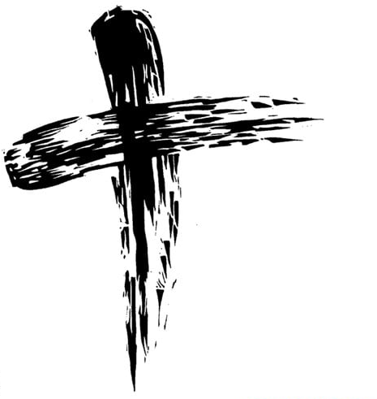
Be what you are, wherever you are, whatever you are doing.
Your purpose is ‘our’ purpose…

Slide 30
Be what you are, wherever you are, whatever you are doing.
1 Peter 2:9—
But you are a chosen race, a royal priesthood, a holy nation, a people for God’s own possession, so that you may proclaim the excellencies of Him who has called you out of darkness into His marvellous light; (NASB95)

Slide 31
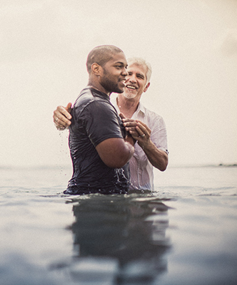
Acts 2:38—
³⁸Peter said to them, “Repent, and each of you be baptized in the name of Jesus Christ for the forgiveness of your sins; and you will receive the gift of the Holy Spirit. (NASB95)
Starting to Begin…

