Slide 2


HEBREWS XI

Slide 3
Hebrews 12:1
Therefore, since we are surrounded by so great a cloud of witnesses, let us also lay aside every weight, and sin which clings so closely, and let us run with endurance the race that is set before us
Notes:
Not going to do every character in Hebrews 11
Pick a few

Slide 4
Uploading progress
. . .
Abel: A Sacrificial Faith
Enoch: A Moving Faith
Noah: A Reverent Faith
Abraham: A Seeking Faith
Moses: A Courageous Faith
Notes:
We have looked at 5
Abel: offering what God wanted Him to offer (more acceptable sacrifice)
Enoch: went where God wanted Him to go (walked with God)
Noah: built what God wanted Him to build (an ark)
Abraham: sought what God wanted Him to seek (a homeland)
Moses: stood where God wanted him to stand (as prophet, before Pharaoh and the people)

Slide 5

HEBREWS XI

Slide 6
All the faithful
Hebrews 11:13
These all died in faith, not having received the things promised, but having seen them and greeted them from afar, and having acknowledged that they were strangers and exiles on the earth.
Hebrews 11:39
And all these, though commended through their faith, did not receive what was promised
Notes:
“These all” → “whoever believes”
Jn 3:16 16 “For God so loved the world, that he gave his only Son, that whoever believes in him should not perish but have eternal life.
“promise” (ἐπαγγελία, epangelia)
14x in Hebrews total
6x in chapter 11
8x in chapters 1-10

Slide 7
all the promise
Hebrews 9:15
Therefore He is the mediator of a new covenant, so that those who are called may receive the promised eternal inheritance, since a death has occurred that redeems them from the transgressions committed under the first covenant.
Notes:
All the faithful will receive all the promise
Eternal – how long? all the time
No half measures for God’s people

Slide 8
Uploading
. . .
We (3)
Abel (4)
Enoch (5)
Noah (7)
Abraham (8)
Isaac (20)
Jacob (21)
Joseph (22)
Moses (23)
The people (29-30)
Rahab (31)
Gideon (32)
Barak (32)
Samson (32)
Jephthah (32)
David (32)
Samuel (32)
prophets (32)
women (35)
Notes:
Numbers 1-11 are all introduced with the phrase, “By faith…”
Less obvious or well known
“We” – believe in the Creator, referring to the readers of the letter who were Jews before they became Christians
“The people” – of the exodus from Egypt
“Barak” – the guy who helped Deborah (Judges 4-5)
“Jephthah” – another judge, the guy who sacrificed his daughter! (Judges 11-12)
“women” – perhaps the two incidents involving the widow and Elijah, and the Shunammite woman and Elisha
Note: in the Greek, “by” is not there explicitly, but implicitly in the dative of pistis (“faith”)
it is the dative of means, i.e., the means of action, “a thing (and occasionally a person) brings about or enters into an action with respect to something else” (Porter, Idioms of the Greek New Testament)
and so faith enters into action with Abel, Enoch, etc., it brings about what we see in their examples

Slide 9
Uploading
. . .
Suffered by torture, mocking, flogging, imprisonment (35-36)
Killed by stoning, sawing, sword (37)
Wandered about without proper clothes, destitute, afflicted, mistreated (37)
Notes:
By my count…
15 individuals mentioned by name (we only covered 5 in detail)
4 groups (we, people of the exodus, prophets, women)
3 general categories (suffered, killed, wandered)
22 in chapter 11 (might be easy to remember), although I realise some will count differently

Slide 10
through faith, better than the world
Hebrews 11:33-34
who through faith conquered kingdoms, enforced justice, obtained promises, stopped the mouths of lions, quenched the power of fire, escaped the edge of the sword, were made strong out of weakness, became mighty in war, put foreign armies to flight.
Hebrews 11:38
of whom the world was not worthy
Notes:
“by faith” Numbers 1-11
“through faith” Numbers 12-18
“not worthy” numbers 19-22
they were better than the world
consistent theme of Hebrews – something better
“strong” and “mighty” reminds us of what faith does for us…

Slide 11
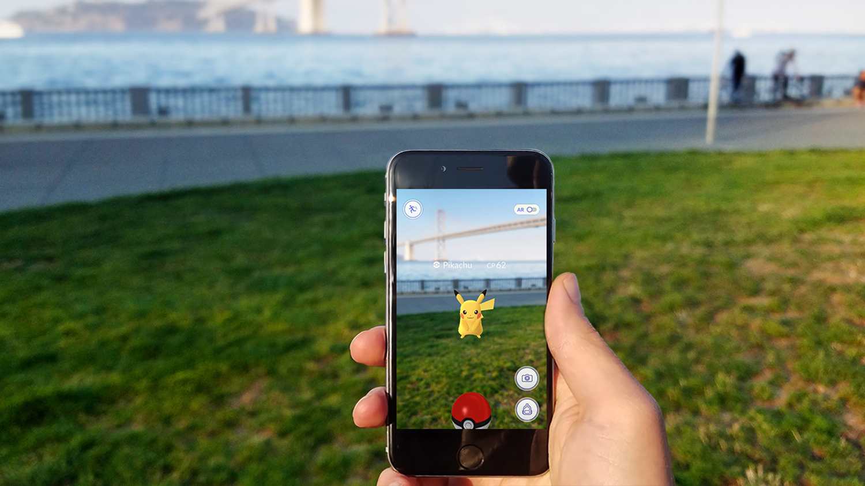
Notes:
Pokemon GO, augmented reality
Driving through Melbourne’s Botanic Gardens on the day it was released, just about running over people who were glued to their phones trying to catch them all
“to augment” =df. to make something greater by adding to it

Slide 12
FAITH: AUGMENTED REALITY
Our faith makes our hope real (11:1)
All these faithful people can strengthen us – we can “download” their faith and bring it into our world
In the end, we need to be strong to endure…
Notes:
Pokemon GO

Slide 13
Strength to endure
Hebrews 12:1-2
Therefore, since we are surrounded by so great a cloud of witnesses, let us also lay aside every weight, and sin which clings so closely, and let us run with endurance the race that is set before us, looking to Jesus, the founder and perfecter of our faith, who for the joy that was set before him endured the cross, despising the shame, and is seated at the right hand of the throne of God.

