Slide 2
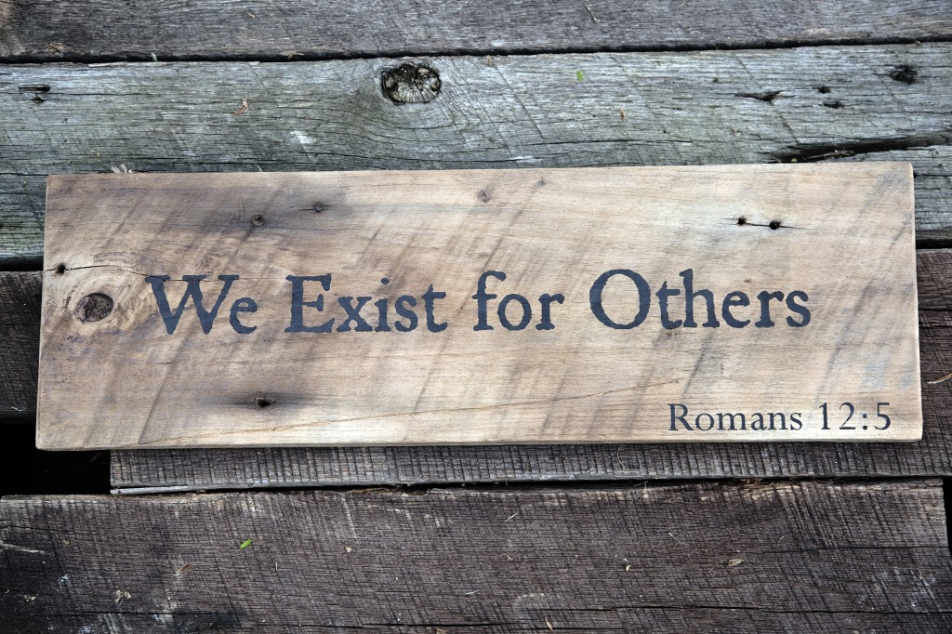

Slide 3
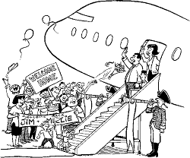
Having been on Holiday
Being a new-comer to a culture is always fascinating—
We step off the plane:
  How cute.
  How quaint.
  How interesting.
  Everything is wonderful.

Slide 4
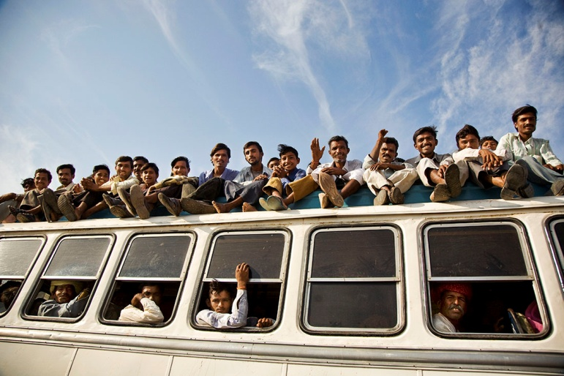
At first it is:
“Isn’t it fascinating how everyone crams into the buses like that?”

Slide 5
Later it is:
“Can’t I even take a bus without people hanging all over me?”

Slide 6
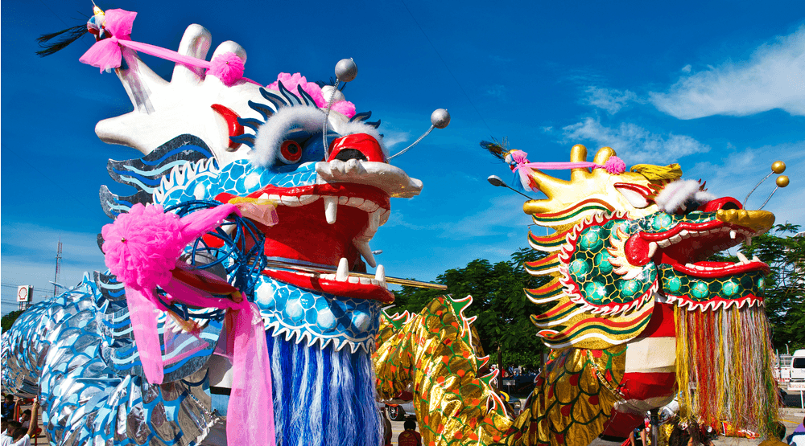
At first it is:
“I so enjoy hearing their beautiful culture.”

Slide 7
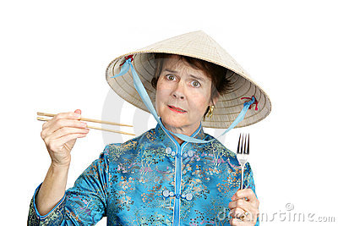
Later it is:
“Doesn’t anybody here speak English?”

Slide 8

The Joy of the New
All relationships go through a Honeymoon period:
Holidays
Marriage
Friendships
Church
Job
Neighbours
Home / Cars

Slide 9

A Period of Adjustment
The New must become Normal.
Differences must be accepted or rejected.
Its great when we have so much in common, but life is more than two people.
We take on:
  Electricity bills / In-laws / Friends / Different tastes in people / music /politics /décor / Kids /school
  Church
  Jobs

Slide 10

Isolated Luxury

Slide 11
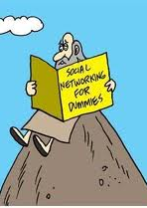
There’s no such thing as a happy hermit.
Psalm 68:6—
  “God sets the lonely in families, he leads out the prisoners with singing; but the rebellious live in a sun-scorched land.”

Slide 12
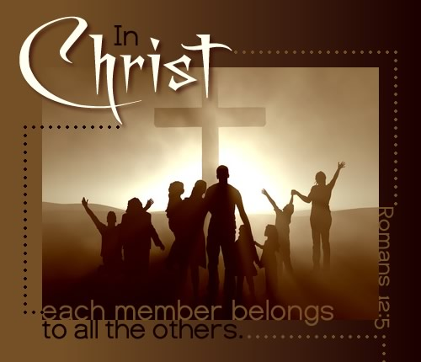
It’s all about getting along in that family
Romans 12:5
⁵ so in Christ we, though many, form one body, and each member belongs to all the others.

Slide 13
It’s all about getting along in that family
Romans 12
⁹ Love must be sincere.
¹⁰ Be devoted to one another in love.
Honour one another above yourselves.
¹³ Share with the Lord’s people who are in need.
Practice hospitality.
¹⁴ Bless those who persecute you; bless and do not curse.
¹⁵ Rejoice with those who rejoice; mourn with those who mourn.
¹⁶ Live in harmony with one another.
Do not be proud, but be willing to associate with people of low position. Do not be conceited.
¹⁷ Do not repay anyone evil for evil.
Be careful to do what is right in the eyes of everyone.
¹⁸ If it is possible, as far as it depends on you, live at peace with everyone.
¹⁹ Do not take revenge

Slide 14
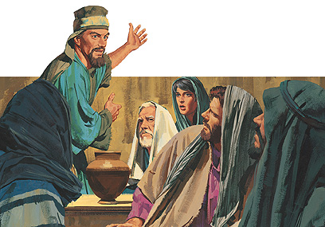
First Family Problem:
Acts 6:1-4—In those days when the number of disciples was increasing, the Hellenistic Jews among them complained against the Hebraic Jews because their widows were being overlooked in the daily distribution of food. ²So the Twelve gathered all the disciples together and said, “It would not be right for us to neglect the ministry of the word of God in order to wait on tables. ³Brothers and sisters, choose seven men from among you who are known to be full of the Spirit and wisdom. We will turn this responsibility over to them ⁴and will give our attention to prayer and the ministry of the word.”

Slide 15
First Family Problem:
Acts 6
Before
  Different People
  Different Culture
  Separate lives
Now
  New Family
  New Culture
  Same life

Slide 16
First Family Problem:
Acts 6
Before
  Different People
  Different Culture
  Separate lives
Now
  New Family
  New Culture
  Same life

Slide 17
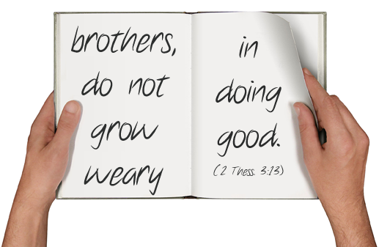
Never Stop Doing Good…
Galatians 6:10
So then, while we have opportunity, let us do good to all people, and especially to those who are of the household of the faith.

Slide 18

Ephesians 5:32—³²This is a profound mystery—but I am talking about Christ and the church.

Slide 19
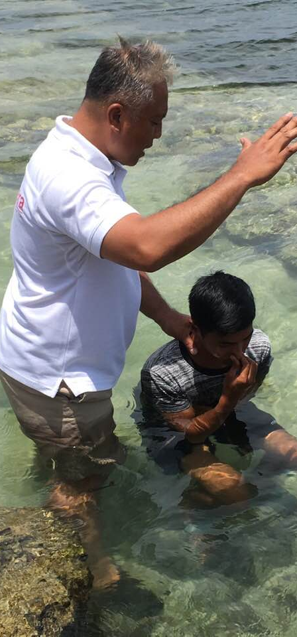
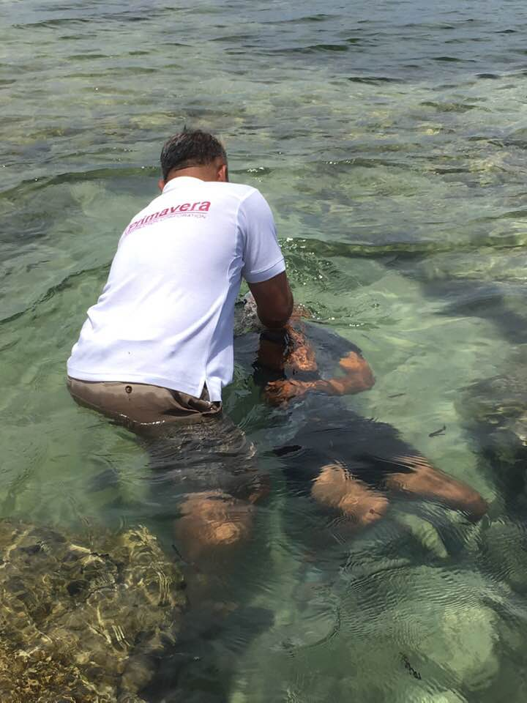
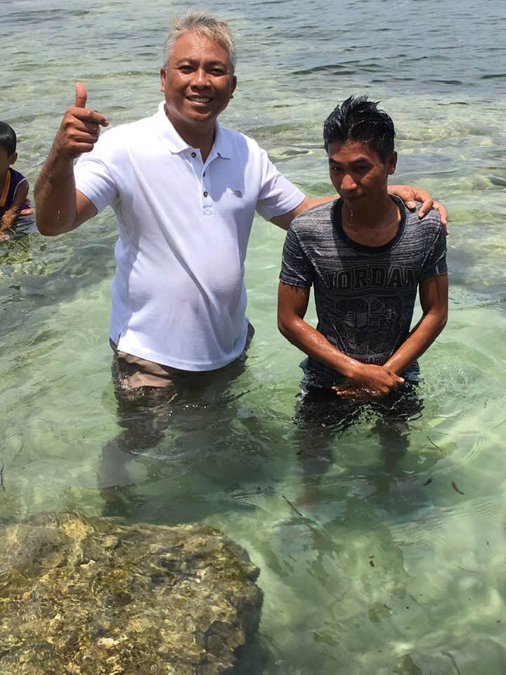
1 Peter 3:21—²¹Corresponding to that, baptism now saves you—not the removal of dirt from the flesh, but an appeal to God for a good conscience—through the resurrection of Jesus Christ, (NASB95)

