Slide 1
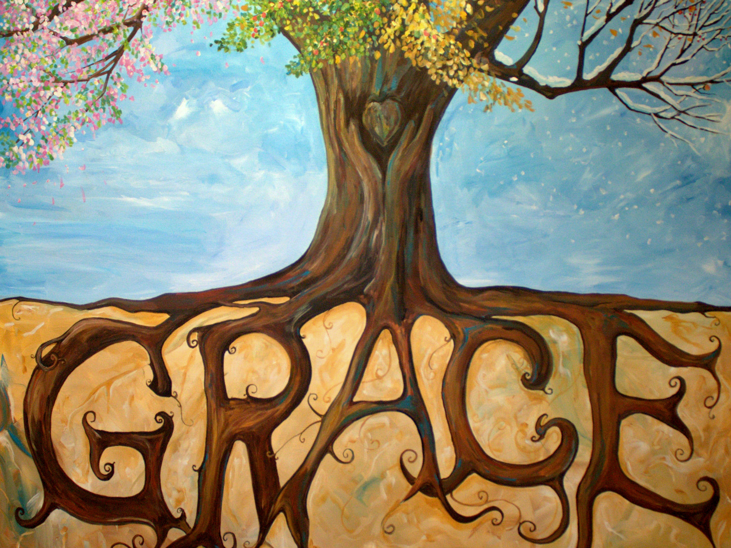
Words to live by
1. Grace

Slide 2

By Grace you have been saved
Ephesians 2:8-9—
⁸For by grace you have been saved through faith; and that not of yourselves, it is the gift of God; ⁹not as a result of works, so that no one may boast. (NASB95)

Slide 3
By Grace you have been saved
The gift is
“Grace,”
not
“Faith.”

Slide 4
By Grace you have been saved
“Faith’s”
response to .
“Grace”
is…

Slide 5
By Grace you have been saved
Ephesians 2:10
¹⁰ For we are His workmanship, created in Christ Jesus for good works, which God prepared beforehand so that we would walk in them.

Slide 6
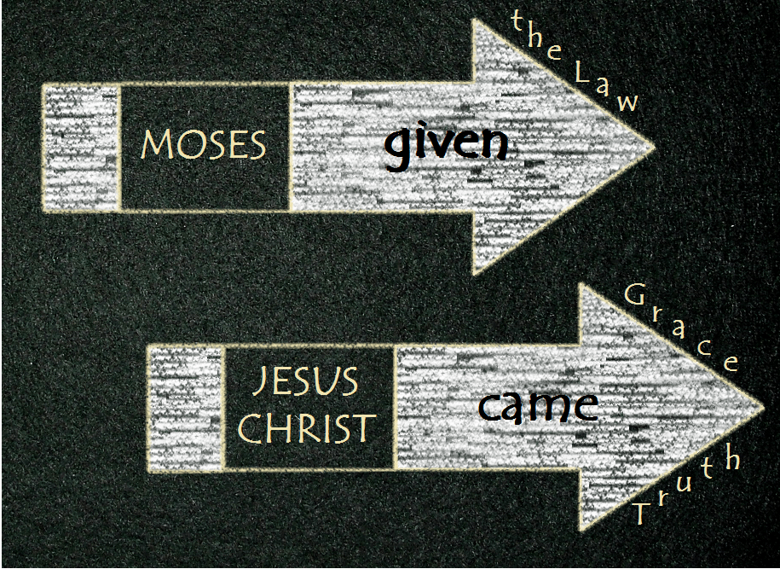
Grace upon Grace
John 1:16-17
¹⁶For of His fullness we have all received, and grace upon grace. ¹⁷For the Law was given through Moses; grace and truth were realized through Jesus Christ. (NASB95)

Slide 7
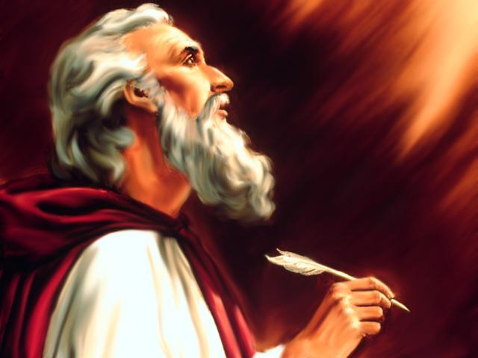
By Grace I am what I am.
1 Corinthians 15:9-10—
⁹For I am the least of the apostles, and not fit to be called an apostle, because I persecuted the church of God…. (NASB95)

Slide 8
By Grace I am what I am.
1 Corinthians 15:9-10—
⁹For I am the least of the apostles, and not fit to be called an apostle, because I persecuted the church of God. ¹⁰But by the grace of God I am what I am, and His grace toward me did not prove vain; but I laboured even more than all of them, yet not I, but the grace of God with me. (NASB95)

Slide 9
By Grace I am what I am.
Paul’s self-appraisal:
  “For I am the least of the apostles.”
  “Not fit to be called an apostle.”
  “Because I persecuted the church of God.” God.

Slide 10
By Grace I am what I am.
Paul’s self-appraisal:
  “But by the grace of God.”
  “I am what I am.”
  “His grace toward me did not prove vain.”
  But I laboured even more than all of them.”
  “Yet not I.”
  “But the grace of God with me.”

Slide 11
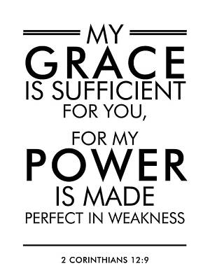
God’s Grace is Enough
2 Corinthians 12:9—
⁹And He has said to me, “My grace is sufficient for you, for power is perfected in weakness.”
Most gladly, therefore, I will rather boast about my weaknesses, so that the power of Christ may dwell in me. (NASB95)

Slide 12
God’s Grace is Enough
“My grace is sufficient for you.”
“Power is perfected in weakness.”
“Most gladly.”
“I will rather boast about my weaknesses.”
“So that the power of Christ may dwell in me.”

Slide 13

Grow in grace and knowledge
2 Peter 3:18—
¹⁸but grow in the grace and knowledge of our Lord and Saviour Jesus Christ. To Him be the glory, both now and to the day of eternity. Amen. (NASB95)

Slide 14
Grow in grace and knowledge
Christianity is represented as “grace.”
Every part of it is the result of grace.
“Unmerited favour.”
To “grow in grace” is to increase in that which constitutes true religion.
It must be cultivated.
To grow in us as any other virtue of the soul.

Slide 15
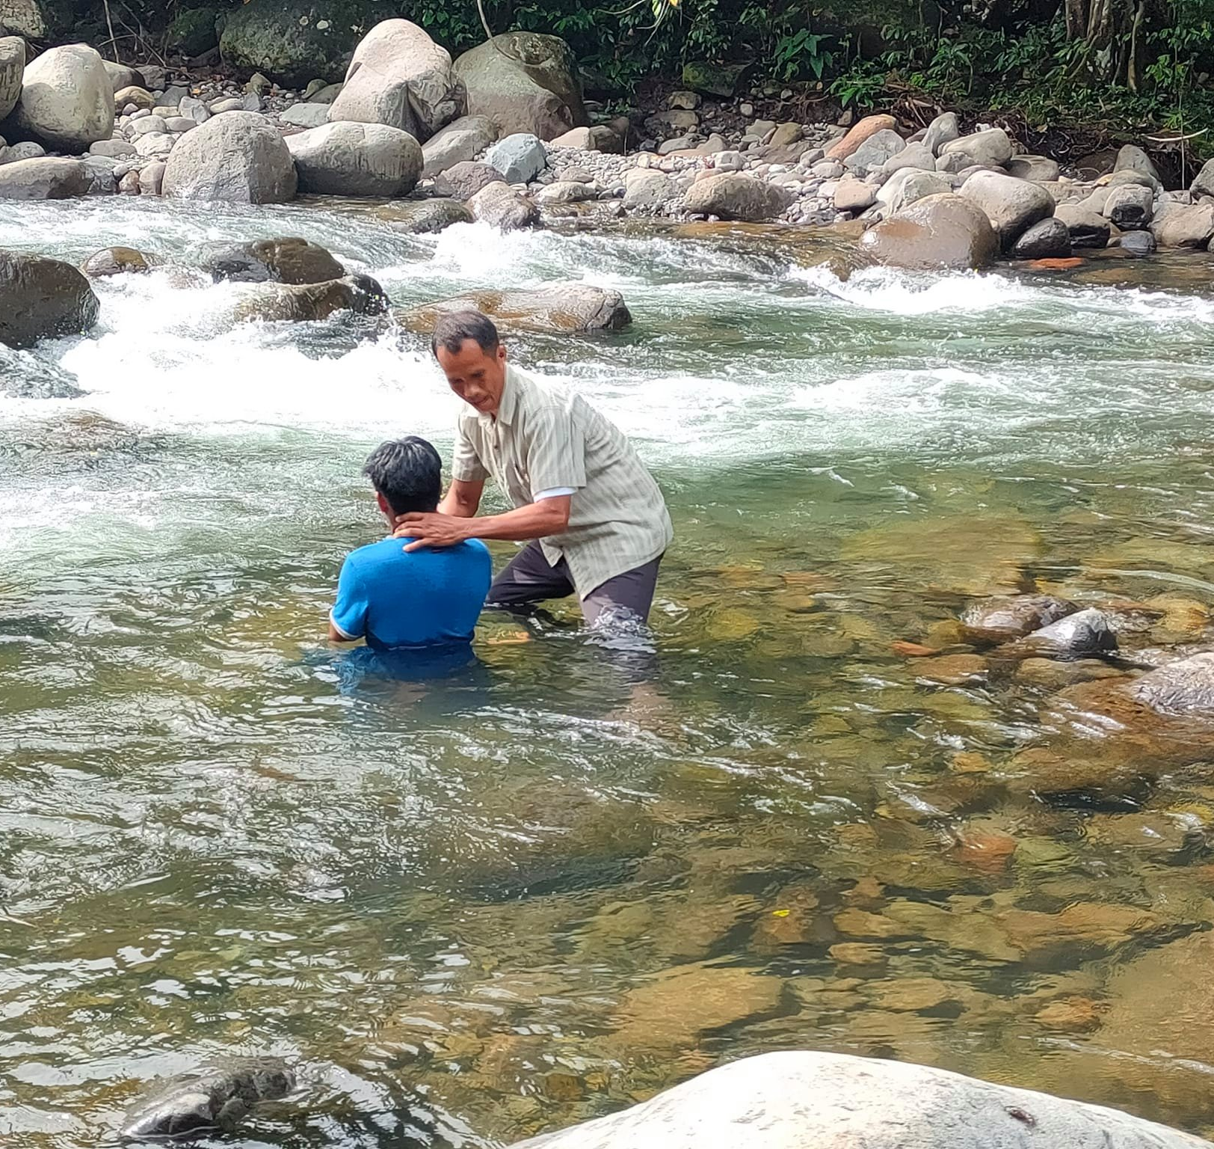
“Baptism now saves you” (1Pet.3:21).
Matthew 28:19-20—¹⁹Go therefore and make disciples of all the nations, baptizing them in the name of the Father and the Son and the Holy Spirit, ²⁰teaching them to observe all that I commanded you; and lo, I am with you always, even to the end of the age.” (NASB95)

