Slide 1
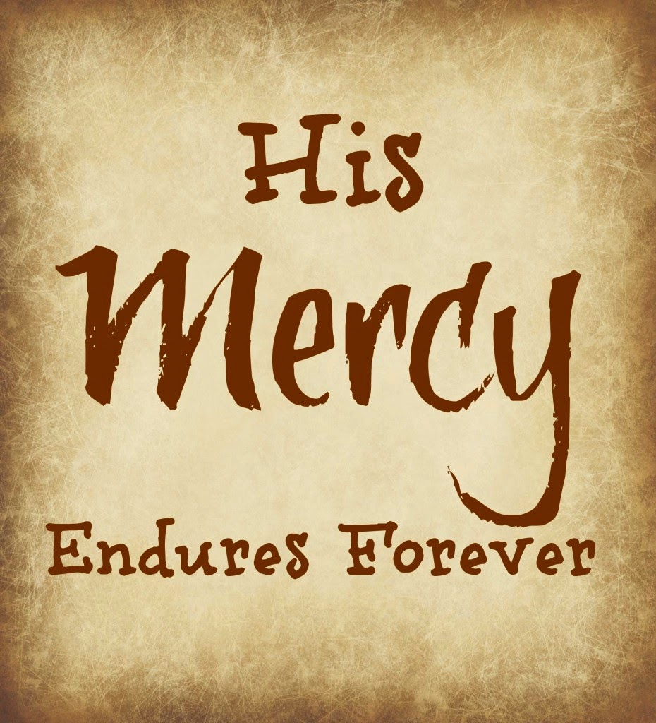
Words to live by
2. Mercy

Slide 2
Matthew 15:21-28—
The Syrophoenician Woman
²¹ Jesus went away from there, and withdrew into the district of Tyre and Sidon. ²²And a Canaanite woman from that region came out and began to cry out, saying, “Have mercy on me, Lord, Son of David; my daughter is cruelly demon-possessed.” ²³But He did not answer her a word. And His disciples came and implored Him, saying, “Send her away, because she keeps shouting at us.” ²⁴But He answered and said, “I was sent only to the lost sheep of the house of Israel.” ²⁵ But she came and began to bow down before Him, saying, “Lord, help me!” ²⁶And He answered and said, “It is not good to take the children’s bread and throw it to the dogs.” ²⁷But she said, “Yes, Lord; but even the dogs feed on the crumbs which fall from their masters’ table.” ²⁸Then Jesus said to her, “O woman, your faith is great; it shall be done for you as you wish.” And her daughter was healed at once. (NASB95)

Slide 3
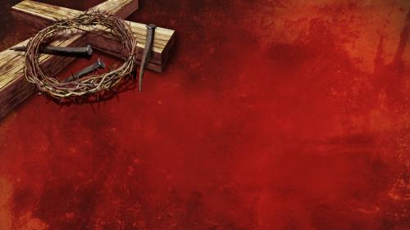
Romans 5:6-10
⁶For while we were still helpless, at the right time Christ died for the ungodly.
While we were still helpless.

Slide 4
Romans 5:6-10
⁶For while we were still helpless, at the right time Christ died for the ungodly.
⁸But God demonstrates His own love toward us, in that while we were yet sinners, Christ died for us.
While we were still helpless
While we were yet sinners

Slide 5
Romans 5:6-10
⁶For while we were still helpless, at the right time Christ died for the ungodly.
⁸But God demonstrates His own love toward us, in that while we were yet sinners, Christ died for us.
¹⁰ For if while we were enemies we were reconciled to God through the death of His Son, much more, having been reconciled, we shall be saved by His life.
While we were still helpless
While we were yet sinners
While we were enemies

Slide 6
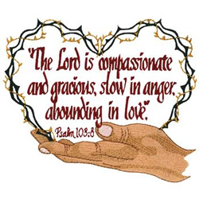
Psalm 103

Slide 7
Psalm 103
Psalm 103:10-12—
¹⁰He has not dealt with us according to our sins,
Nor rewarded us according to our iniquities. (NASB95)
Just deserts…?—Not so!
  Justice demanded punishment—Death.
  Romans 3:26—
  for the demonstration, I say, of His righteousness at the present time, so that He would be just and the justifier of the one who has faith in Jesus.

Slide 8
Psalm 103
Psalm 103:10-12—
¹¹For as high as the heavens are above the earth,
So great is His lovingkindness toward those who fear Him. (NASB95)
God’s Lovingkindness toward man:
  Beyond our reach.
  Beyond our vision.
  Beyond our imagination.

Slide 9
Psalm 103
Psalm 103:10-12—
¹²As far as the east is from the west,
So far has He removed our transgressions from us. (NASB95)
Forgiven!
  Sins are Forgotten.
  Life replaced death.
  No need for guilt.
  No dwelling on regrets.
  A time to share.

Slide 10
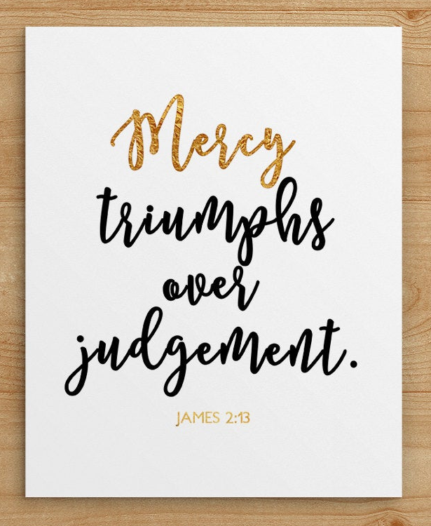
James 2:13
James 2:12-13
¹²So speak and so act as those who are to be judged by the law of liberty. ¹³For judgment will be merciless to one who has shown no mercy; mercy triumphs over judgment. (NASB95)
Abandon the judge act.
Glory in the victory of:
  The Law that brings freedom.
  God’s response to mercy.

Slide 11
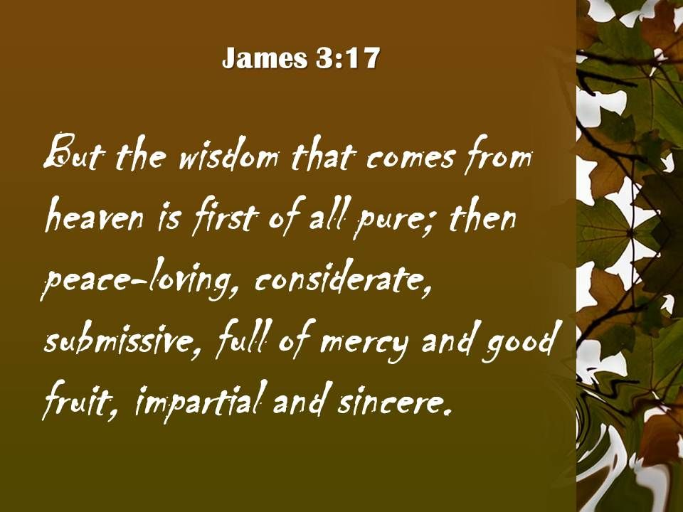
Matthew 9:13
Matthew 9:13—
¹³Go and learn what this means: ‘I desire mercy, and not sacrifice.’ For I came not to call the righteous, but sinners.” (ESV)
Teachers needed to be taught.
That is the ‘Self-righteous.’
Sacrifice loses its meaning.
The ‘sinners’ sees his unworthiness.
“Blessed are the merciful, for they shall receive mercy” (Mt.5:7).

Slide 12
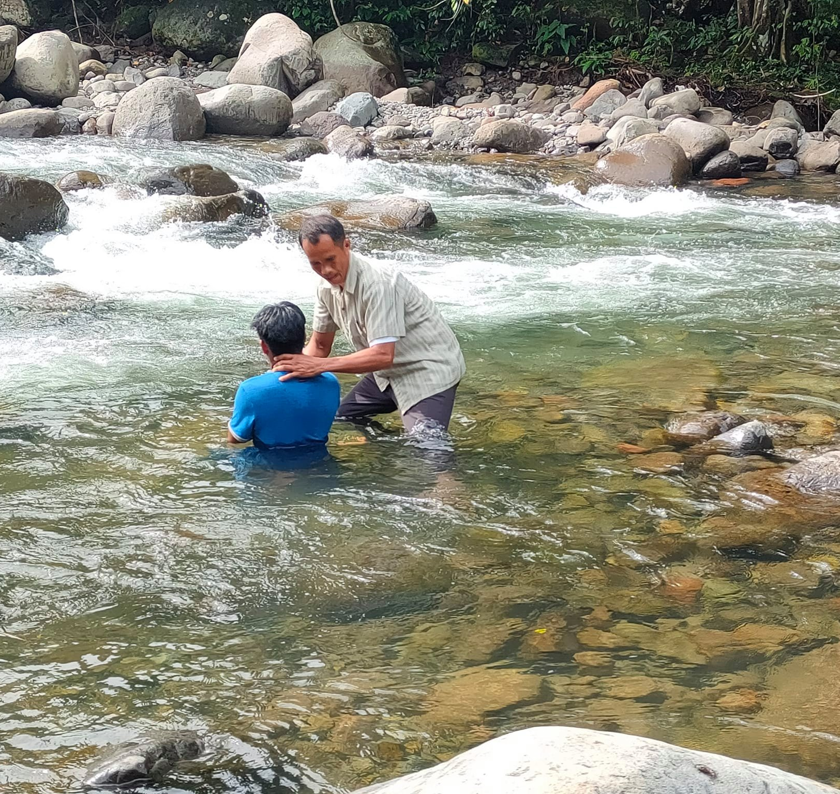
“Baptism now saves you” (1Pet.3:21).
Matthew 28:19-20—¹⁹Go therefore and make disciples of all the nations, baptizing them in the name of the Father and the Son and the Holy Spirit, ²⁰teaching them to observe all that I commanded you; and lo, I am with you always, even to the end of the age.” (NASB95)

