Slide 1
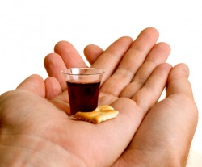
“Do this in remembrance of Me…”

Slide 2
Series: Words to Live By.
Part 4. “Be Courageous!”
John Staiger
Morningside Church of Christ
Sunday 29 August 2021
AM Sermon
Broadcast on Facebook Live from
Massey, Auckland, NZ.

Slide 3
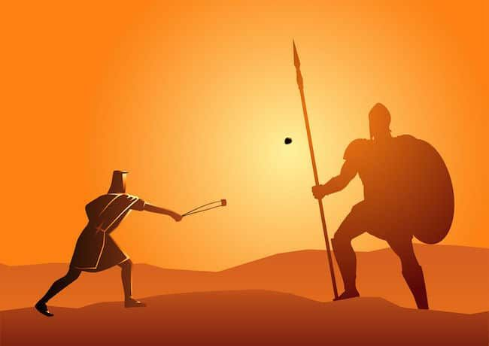
Words to live by
3. Be Courageous

Slide 4
The Times we Live in…
Sickness.
Death.
Lockdowns.
People trying to get out of Afghanistan as we speak.
Suspicion over information.
Questioning motives.

Slide 5
Wise words…
The first action to be taken is to pull ourselves together. If we are all going to be destroyed by an atomic bomb, let that bomb when it comes find us doing sensible and human things—praying, working, teaching, reading, listening to music, bathing the children, playing tennis, chatting to our friends over a game of darts—not huddled together like frightened sheep and thinking about death. They may break our bodies (a microbe can do that) but they need not dominate our minds.” (C.S.Lewis)

Slide 6

Enough for today…
When the fears of today are added to the fears of yesterday and tomorrow, we become overwhelmed.

Slide 7
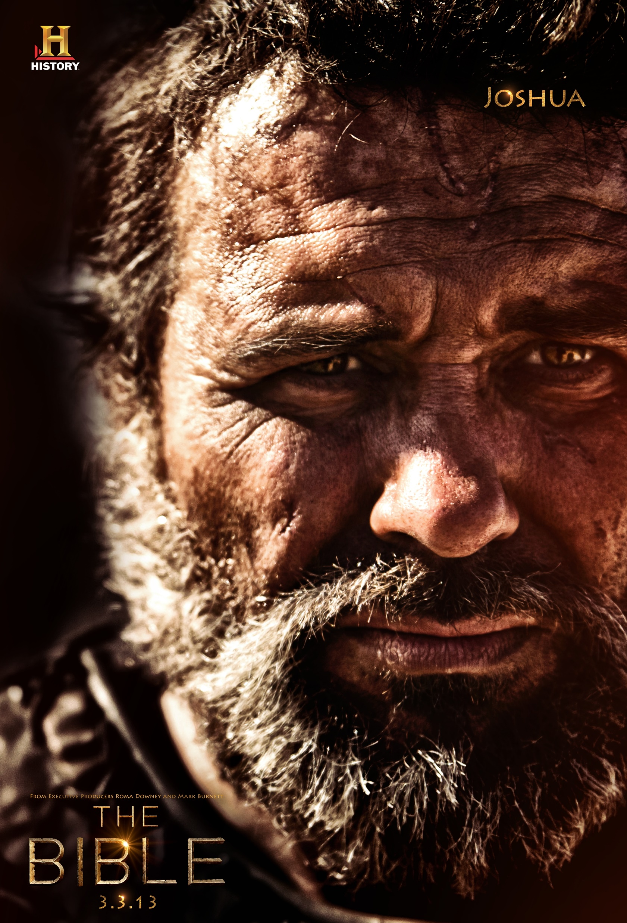
Be strong and courageous!
Joshua 1:9—
⁹Have I not commanded you? Be strong and courageous! Do not tremble or be dismayed, for the Lord your God is with you wherever you go.” (NASB95)

Slide 8
Courage comes in groups…
Proverbs 27:17—
¹⁷Iron sharpens iron, and one man sharpens another. (ESV)
We need to be around courageous Christians.
Learn their ways.
Enjoy their strength.

Slide 9

Be Courageous—NOW!
1 Timothy 4:12—
¹²Let no one despise you for your youth, but set the believers an example in speech, in conduct, in love, in faith, in purity. (ESV)

Slide 10

Courage Demands Patience
Psalm 27:14—
Wait for the Lord;
Be strong and let your heart take courage;
Yes, wait for the Lord. (NASB95)

Slide 11
Courage Demands Patience
God’s timing is eternally perfect.
Ours is limited by location.
Courage discerns all things for eternity.

Slide 12
Courage Demands Patience
God’s timing is eternally perfect.
Ours is limited by location.
Courage discerns all things for eternity.

Slide 13
Courage Demands Patience
God’s timing is eternally perfect.
Ours is limited by location.
Courage discerns all things for eternity.

Slide 14


John 16:33—
These things I have spoken to you,
so that in Me you may have peace.
In the world You have tribulation,
but take courage;
I have overcome the world.”

Slide 15
1 John 5:4—
⁴For whatever is born of God overcomes the world; and this is the victory that has overcome the world—our faith.

Slide 16
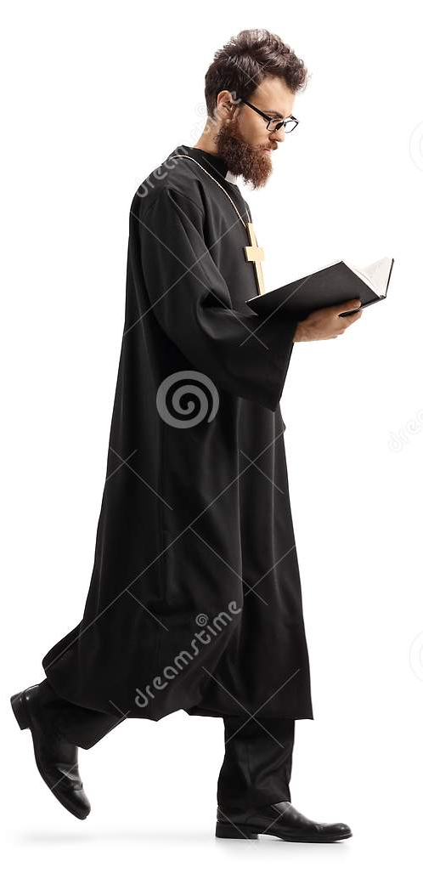
2 Corinthians 2:7—
For we walk by faith, not by sight.
Psalm 119:105—
¹⁰⁵Your word is a lamp to my feet
And a light to my path.

Slide 17
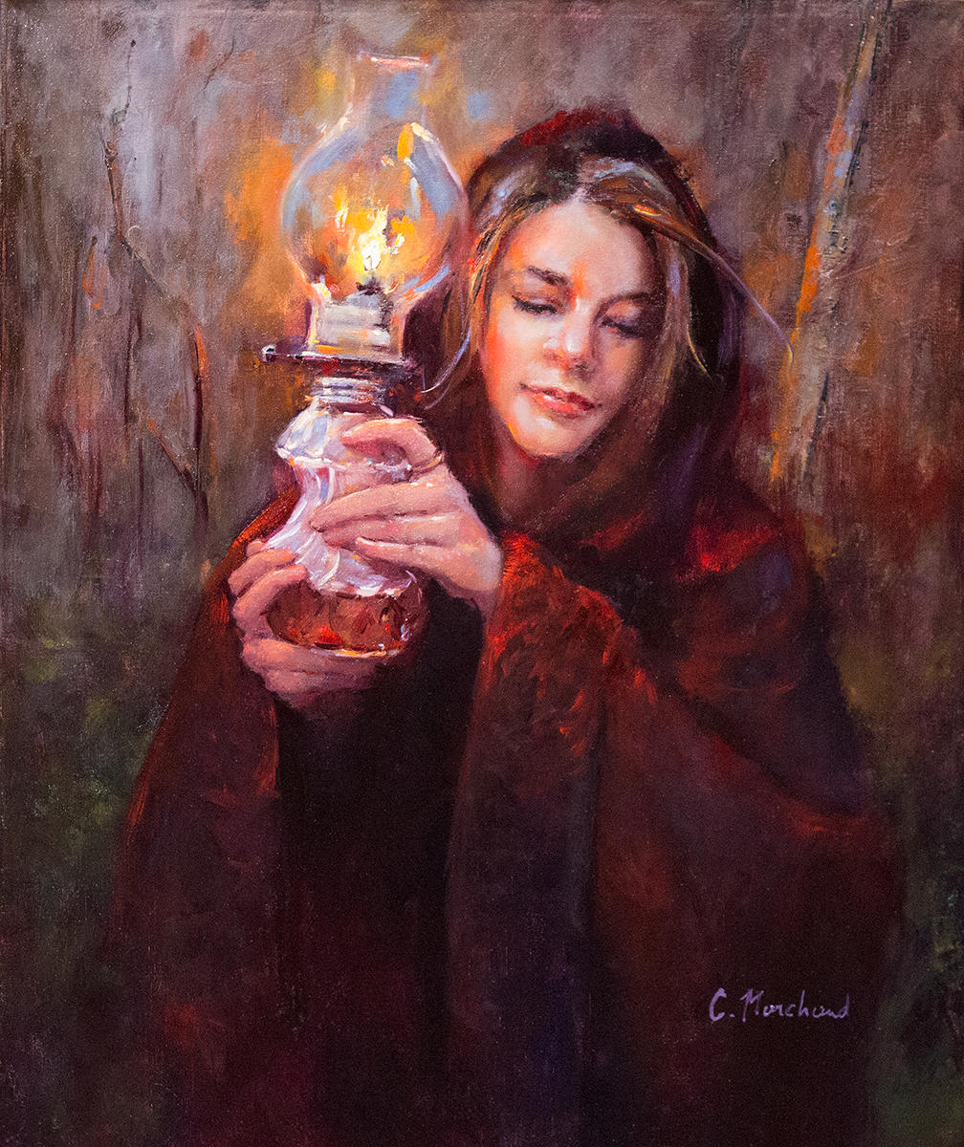
Psalm 119:105—
¹⁰⁵Your word is a lamp to my feet
And a light to my path.

Slide 18
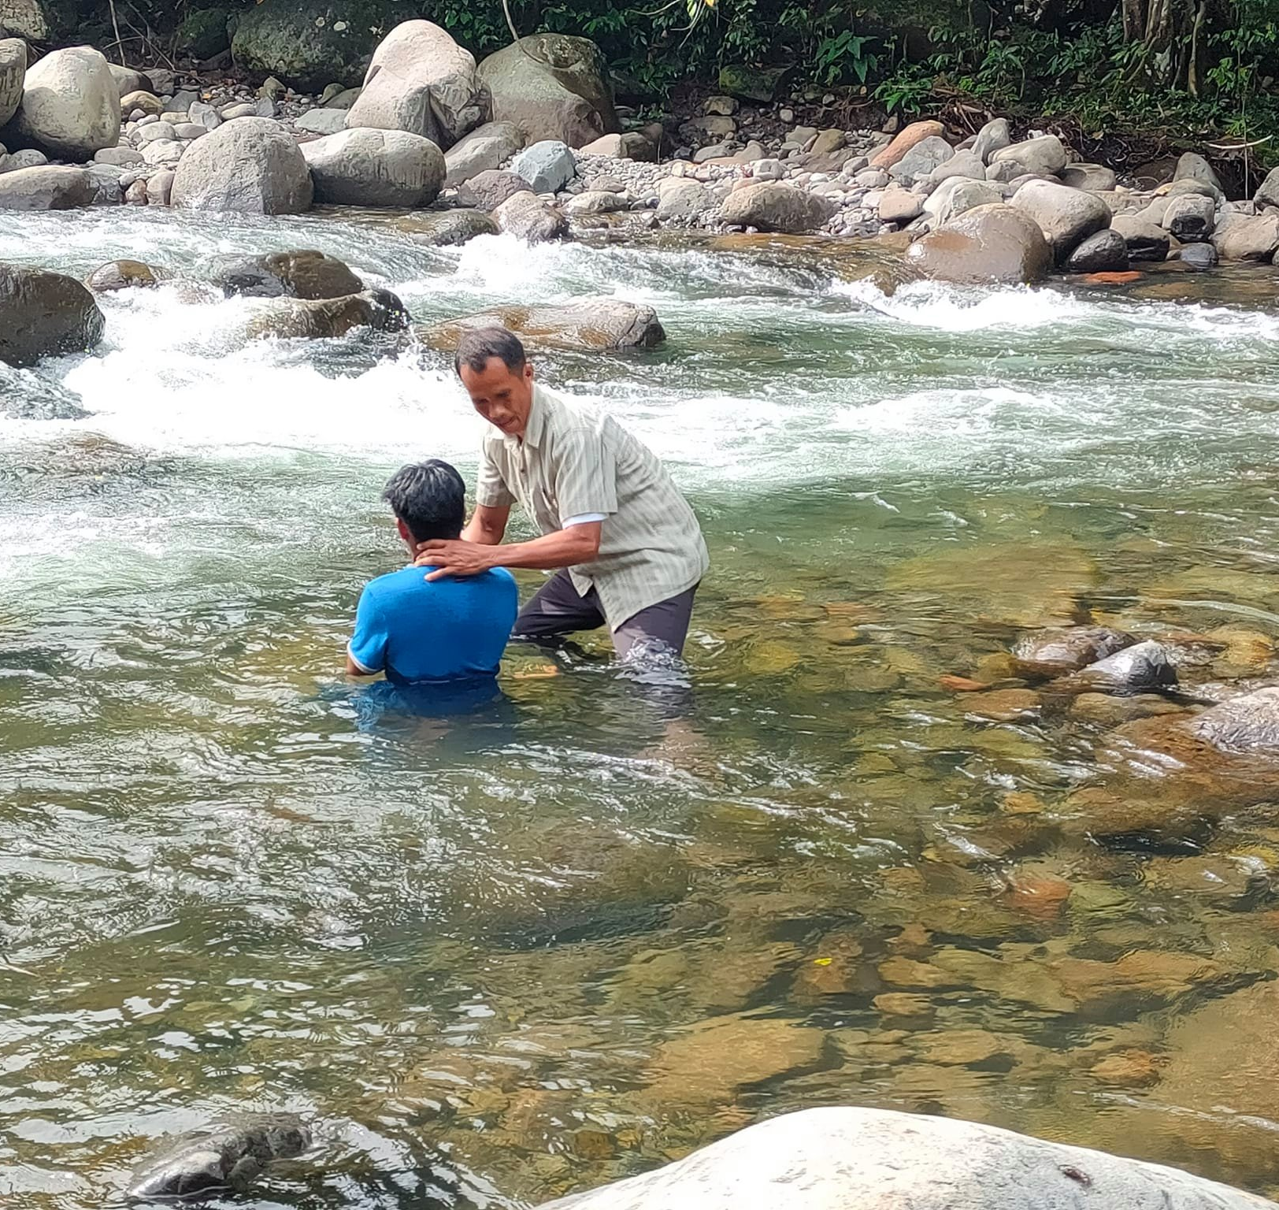
“Baptism now saves you” (1Pet.3:21).
Matthew 28:19-20—¹⁹Go therefore and make disciples of all the nations, baptizing them in the name of the Father and the Son and the Holy Spirit, ²⁰teaching them to observe all that I commanded you; and lo, I am with you always, even to the end of the age.” (NASB95)

