Slide 1
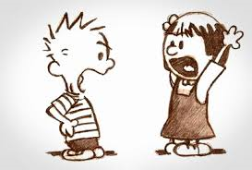
Getting Along
Principles
that apply in
every
Relationship
Ephesians 4:25-29.

Slide 2
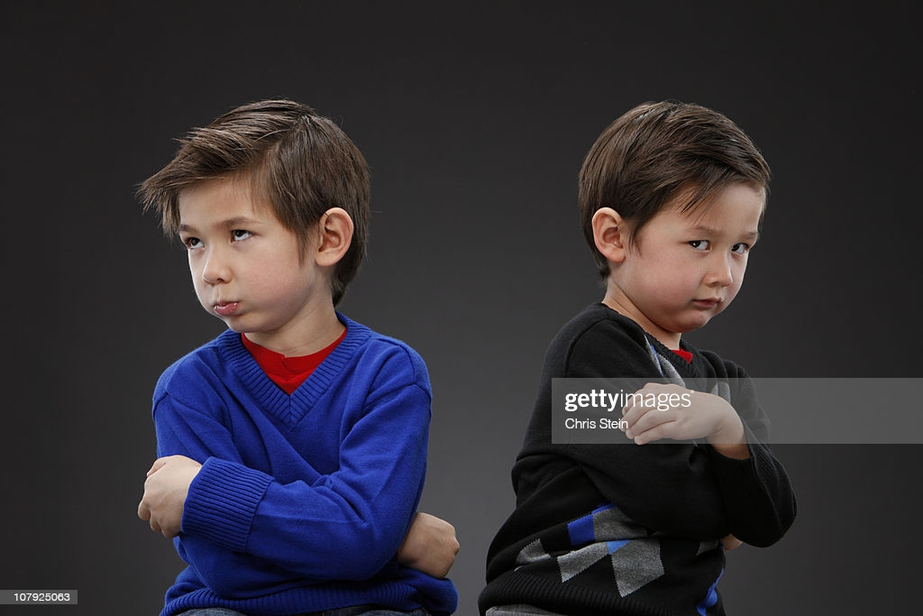
All Relationship apply:
  Marriage
  Parenting
  Friends
  Workplace

Slide 3

  2000 Years Later…
  Win-Win
  (as much as it depends on you)
  Add
  “MUTUAL”
  and it will work:
  Any relationship → Anytime

Slide 4
  2000 Years Later…
  Win-Win
  (as much as it depends on you)
  A new generation
  will ignore these
  principles
  to their peril.

Slide 5
  2000 Years Later…
  Win-Win
  (as much as it depends on you)
  Not so fast!
  It’s not that easy…

Slide 6
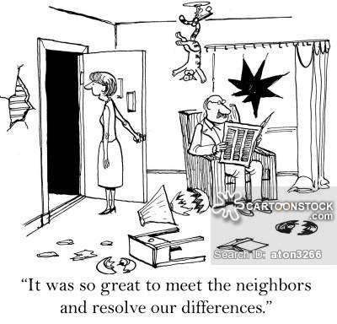

Slide 7

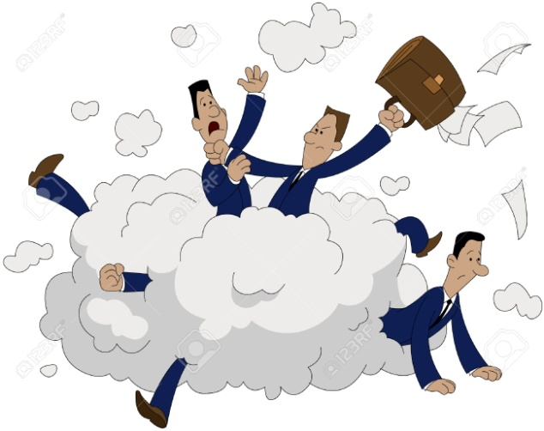

Slide 8
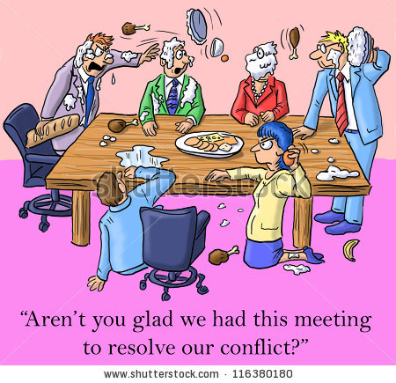

Slide 9

Pick one
relationship
in your
life that
needs
repair.

Slide 10
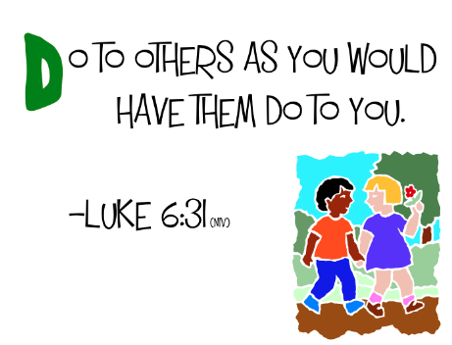
“Fail” Starting Points:
“If only he would change!”
“If only she would treat me better.”
“He ought to do...!”

Slide 11
“Success starts here…”
Choose one thing you can do to make things better.
Expect the best.

Slide 12
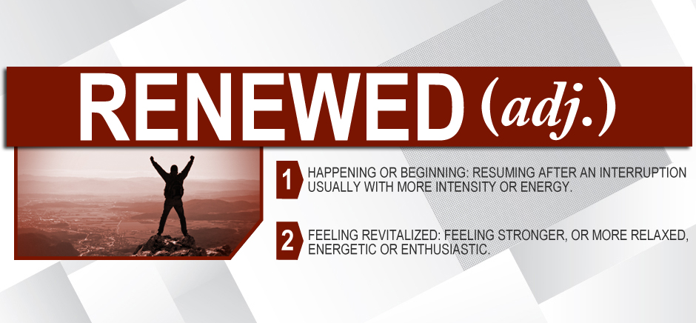
Become the kind of person you would like to know.
Ephesians 4:22-24—²² You were taught, with regard to your former way of life, to put off your old self, which is being corrupted by its deceitful desires; ²³ to be made new in the attitude of your minds; ²⁴ and to put on the new self, created to be like God in true righteousness and holiness.

Slide 13
Become the kind of person you would like to know.
You would like your child to hang around with.
You would like your boss to be.
You would want for a father / mother / wife / husband…
We act intending to be a blessing.
Imagine if the roles were reversed.
What changes would the other person want to see in you.

Slide 14
Become the kind of person you would like to know.
Who acts intending to be a blessing.
Who imagines if the roles were reversed.
Who looks through the other person’s eyes.

Slide 15
Become the kind of person you would like to know.
Who has integrity:
  Is honest
    Tells the truth
      Can be relied upon
        Doesn’t have hidden motives
          Has everything out in the open

Slide 16
Become the kind of person you would like to know.
All you have to be is a Christian:
  It makes you the kind of person that you would like to know
    Reliable
      Forgiving
        Honest
          Kind

Slide 17

Tell the truth and tell it on time
Ephesians 4:25-27—
²⁵Therefore, laying aside falsehood, speak truth each one of you with his neighbour, for we are members of one another. ²⁶Be angry, and yet do not sin; do not let the sun go down on your anger, ²⁷and do not give the devil an opportunity. (NASB95)

Slide 18
Tell the truth and tell it on time
The (hidden) truths that angers you…
Bad strategy—avoid talking about the obstacles in your relationship.
Anger will turn to resentment if allowed to sit and cook.
The volcano effect…

Slide 19

Resentment allowed to fester will sooner or later explode!
Anger will be out of proportion to the cause the outburst.

Slide 20

Respect other’s property
Ephesians 4:28 He who has been stealing must steal no longer, but must work, doing something useful with his own hands, that he may have something to share with those in need.

Slide 21
Respect other’s property
“If you steal a man’s tools you are stealing the food from his family table.”
Respect for their things is respect for them.
We are givers, not takers

Slide 22
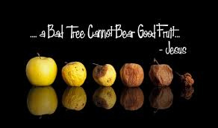
Keep those conversations fresh
Ephesians 4:29—Do not let any unwholesome talk come out of your mouths, but only what is helpful for building others up according to their needs, that it may benefit those who listen.
Matthew 7:17

Slide 23
Keep those conversations fresh
The most disobeyed verse in the Bible.
“Unwholesome” means “Rotten.”
Words that destroy, degrade or harm your relationship.
We make paths to better things.
Matthew 7:17

Slide 24
Keep those conversations fresh
Not a good idea to tell the truth when you’re first angry.
“Take a deep breath and count to ten.”—taste your own words before you share them.
Matthew 7:17

Slide 25

Don’t let the past infect the present
Ephesians 4:31—Get rid of all bitterness, rage and anger, brawling and slander, along with every form of malice.

Slide 26
Don’t let the past infect the present
Everyone can find something bad to hold against someone if we keep looking.
These are the fruits of resentment.

Slide 27

Missing no opportunity to be the kind and forgiving
Ephesians 4:32—Be kind and compassionate to one another, forgiving each other, just as in Christ God forgave you.

Slide 28
Missing no opportunity to be the kind and forgiving
We become the kind of person that we want to be like.

Slide 29
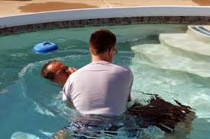
Galatians 3:27—for all of you who were baptized into Christ have clothed yourselves with Christ.

