Slide 1
Series: Life in the Son.
Part 1. “Abundant by Design.”
John Staiger
Morningside Church of Christ
Sunday 26 September 2021
AM Sermon
Broadcast on Facebook Live from
Massey, Auckland, NZ.

Slide 2
Life in the Son.
1. Abundant by design.

Slide 3

Psalm 23
¹The Lord is my shepherd,
I shall not want.
² He makes me lie down in green pastures;
He leads me beside quiet waters.

Slide 4
Psalm 23
³He restores my soul;
He guides me in the paths of righteousness
For His name’s sake.

Slide 5
Psalm 23
⁴Even though I walk through the valley of the shadow of death,
I fear no evil, for You are with me;
Your rod and Your staff, they comfort me.

Slide 6
Psalm 23
⁵You prepare a table before me in the presence of my enemies;
You have anointed my head with oil;
My cup overflows.

Slide 7
Psalm 23
⁶Surely goodness and lovingkindness will follow me all the days of my life,
And I will dwell in the house of the Lord forever.

Slide 8
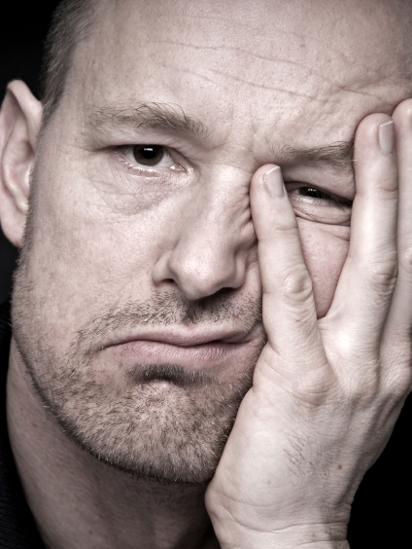
A normal life for God’s children.
Why is Christianity portrayed as a negative life-style…?

Slide 9
A normal life for God’s children.
As if God is holding out on us.
They say…

Slide 10
A normal life for God’s children.
You will lose so much.
You live a life full of don’ts...

Slide 11
A normal life for God’s children.
Boredom and Drudgery
No fun.

Slide 12
A normal life for God’s children.
Yes, that can happen, if…

Slide 13
A normal life for God’s children.
If you want just enough religion to get you to heaven.

Slide 14
A normal life for God’s children.
There is no abundance in that!

Slide 15

Skewed view of Abundant Living
The world system thinks happiness is in "stuff."

Slide 16

Skewed view of Abundant Living
Happiness
Possessions.

Slide 17
Skewed view of Abundant Living
Happiness is a condition of the heart and soul.

Slide 18
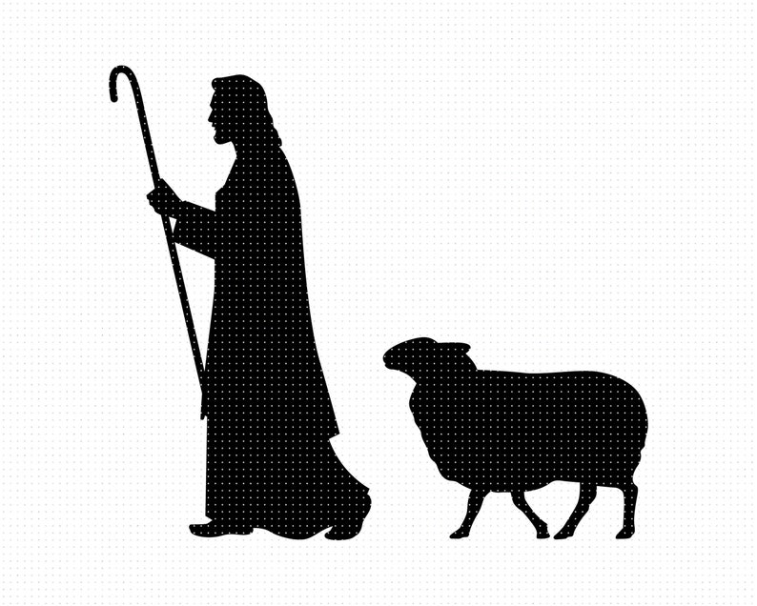
Knowing who to listen to.
It begins by hearing the Shepherd’s voice…

Slide 19
Knowing who to listen to.
John 10:4—
⁴ When he puts forth all his own, he goes ahead of them, and the sheep follow him because they know his voice.

Slide 20
Knowing who to listen to.
John 10:10—
¹⁰The thief comes only to steal and kill and destroy; I came that they may have life, and have it abundantly.

Slide 21

This abundant life is to be enjoyed now.
John 14:27—
²⁷Peace I leave with you; My peace I give to you; not as the world gives do I give to you. Do not let your heart be troubled, nor let it be fearful.

Slide 22
This abundant life is to be enjoyed now.
Attitudes in Christianity have shifted…

Slide 23
This abundant life is to be enjoyed now.
From a life of
sacrificial giving
to
selfish getting!

Slide 24
This abundant life is to be enjoyed now.
Giving of yourself to God and others is what fills the heart with joy!

Slide 25
This abundant life is to be enjoyed now.
Luke 6:38—
³⁸Give, and it will be given to you. They will pour into your lap a good measure—pressed down, shaken together, and running over. For by your standard of measure it will be measured to you in return.”

Slide 26
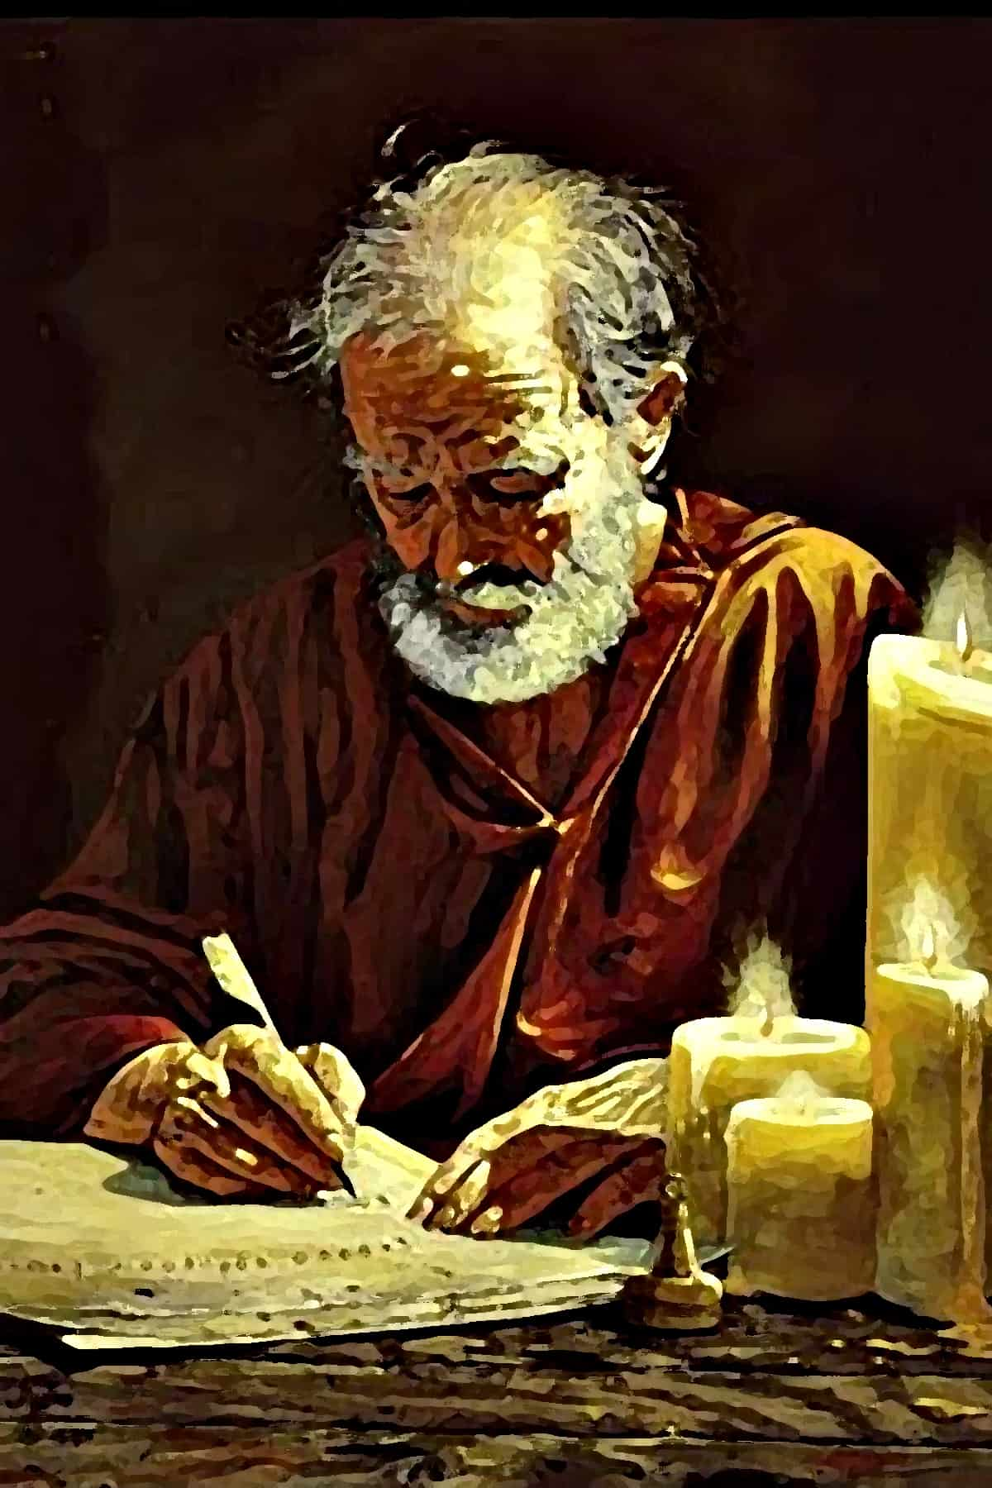
Eyes on the goal.
Acts 21:13—
¹³ Then Paul answered, “What are you doing, weeping and breaking my heart? For I am ready not only to be bound, but even to die at Jerusalem for the name of the Lord Jesus.”

Slide 27
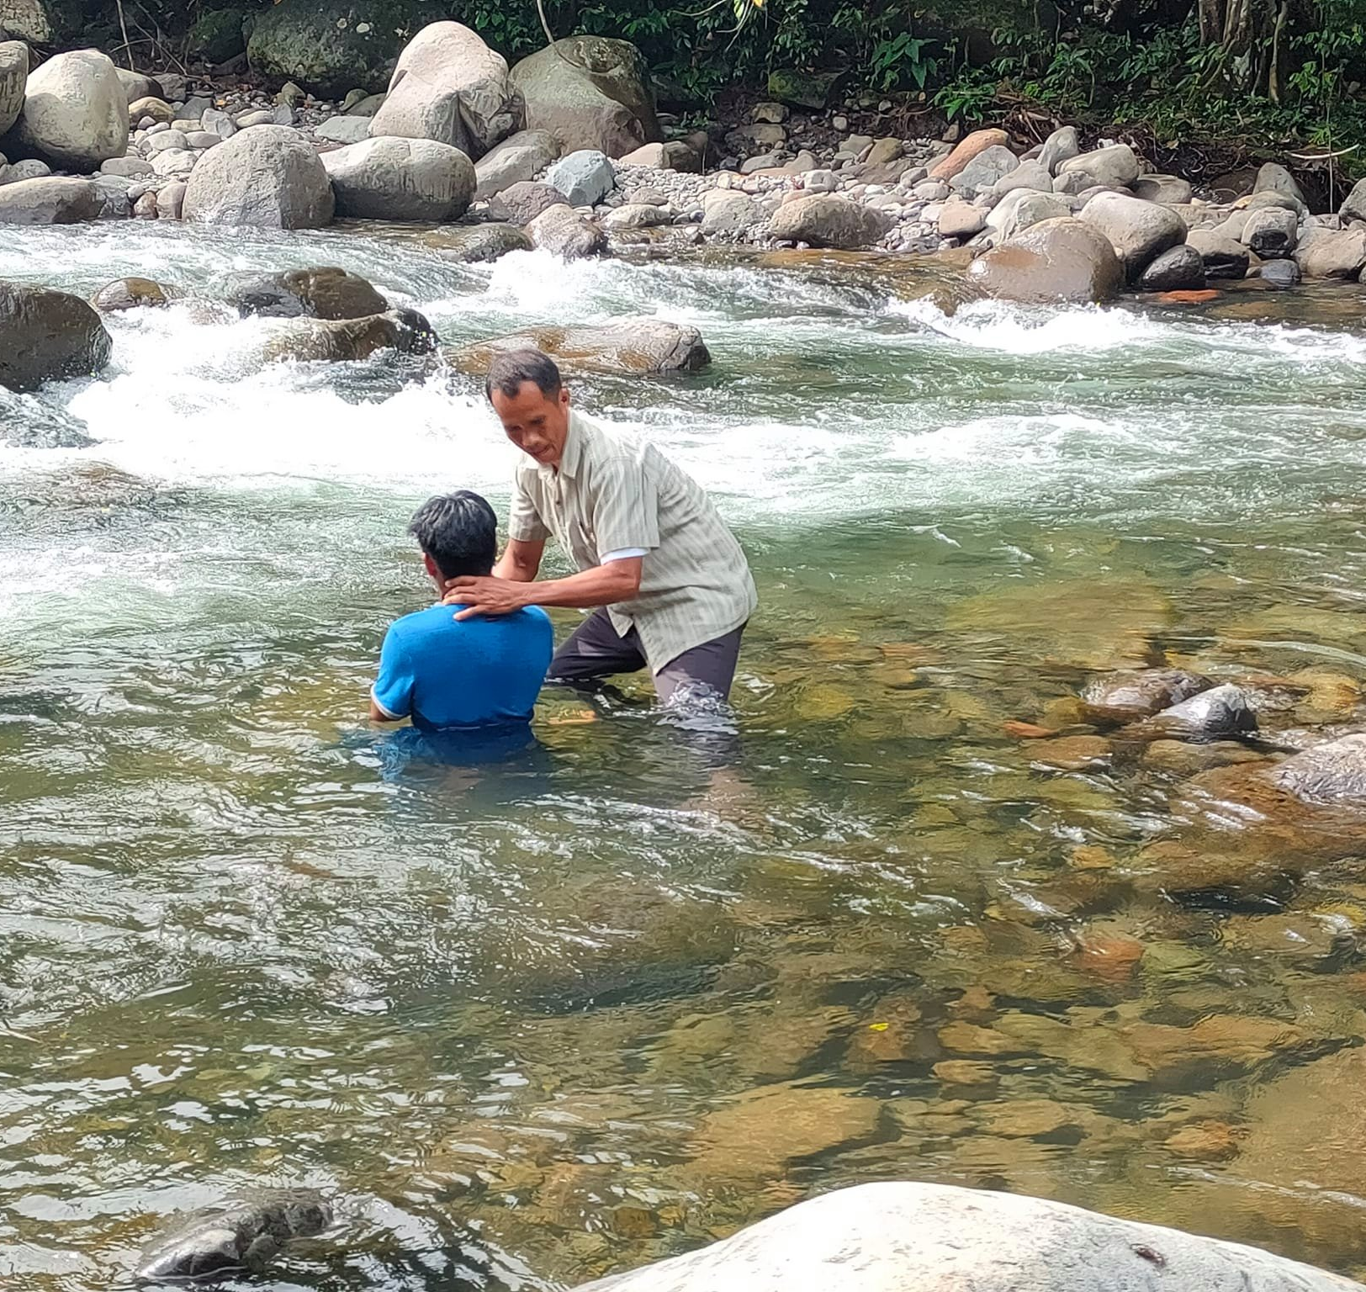
“Baptism now saves you” (1Pet.3:21).
Matthew 28:19-20—¹⁹Go therefore and make disciples of all the nations, baptizing them in the name of the Father and the Son and the Holy Spirit, ²⁰teaching them to observe all that I commanded you; and lo, I am with you always, even to the end of the age.” (NASB95)

