Slide 1
“The Soul’s Anchor—Hope!”

Slide 2

Hope
That heartfelt, joyful conviction that this temporary life has an eternal future.

Slide 3
Hope
Glorying in an all-knowing, and all caring God.

Slide 4
Hope
Confident that needs of our body and soul will be satisfied, here and in eternity.

Slide 5
Hebrews 6:19—This hope we have as an anchor of the soul, a hope both sure and steadfast and one which enters within the veil, (NASB95)

Slide 6
1 Peter 1:13—Therefore, prepare your minds for action, keep sober in spirit, fix your hope completely on the grace to be brought to you at the revelation of Jesus Christ. (NASB95)

Slide 7
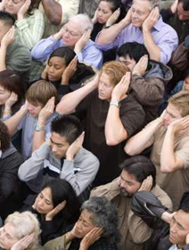
A hope that the world will want to know about:
Some will reject it…

Slide 8
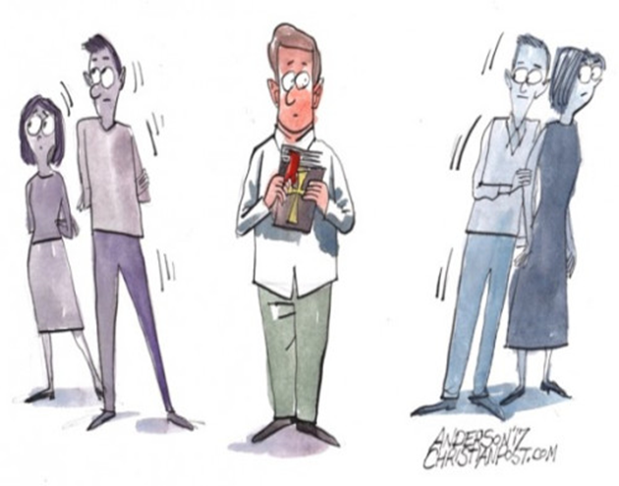
A hope that the world will want to know about:
Some will avoid you…

Slide 9

A hope that the world will want to know about:
They cannot avoid its impact!

Slide 10

A hope that the world will want to know about:
1 Peter 3:15—
¹⁵but sanctify Christ as Lord in your hearts, always being ready to make a defense to everyone who asks you to give an account for the hope that is in you, yet with gentleness and reverence; (NASB95)

Slide 11

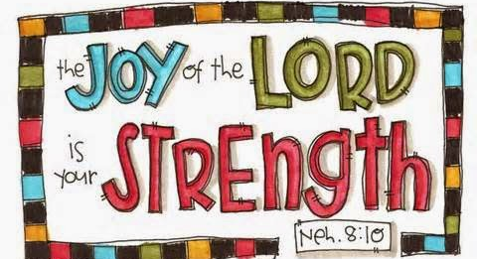
Hope Bears Fruit…
Vibrant spirit
Generous heart
Confident outlook
Unshakable faith
Perfect peace

Slide 12
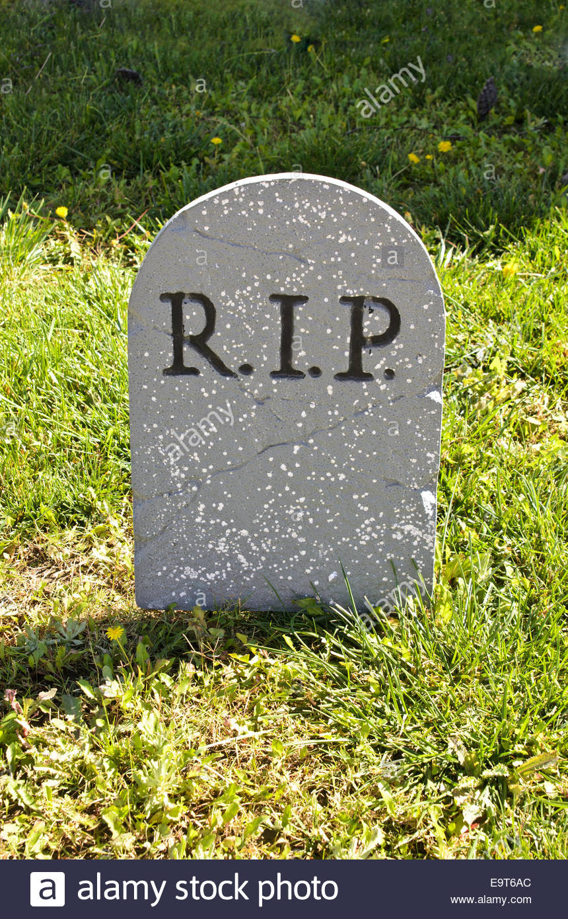
Hopelessness Bears Fruit too…
Here and now—That’s it!
When crushed by life—
Nothing but discouragement.
Depression and despair.
In a word, hopelessness.

Slide 13
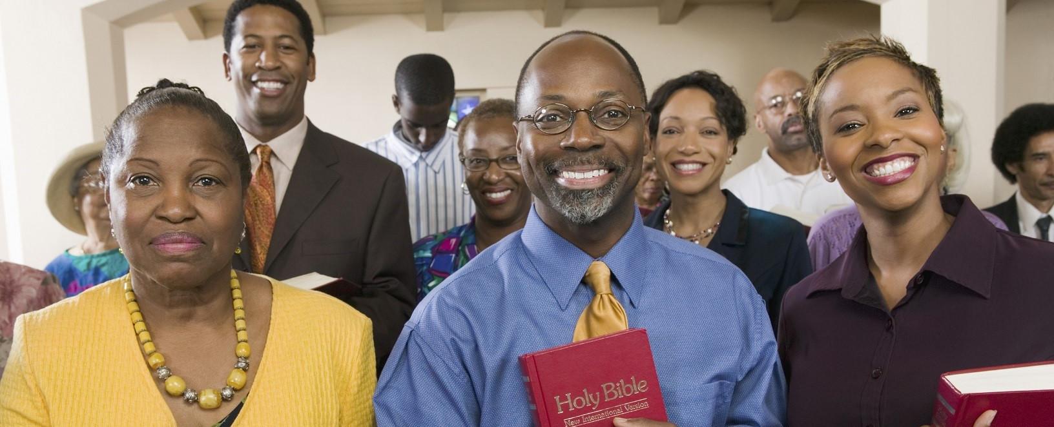
It is impossible to be a Christian and believe that your eternity will be bleak.

Slide 14
Hebrews 10:23-25—
²³ Let us hold fast the confession of our hope without wavering, for He who promised is faithful; (NASB95)

Slide 15
Hebrews 10:23-25—
²⁴ and let us consider how to stimulate one another to love and good deeds, (NASB95)

Slide 16
Hebrews 10:23-25—
²⁵ not forsaking our own assembling together, as is the habit of some, but encouraging one another; and all the more as you see the day drawing near. (NASB95)

Slide 17
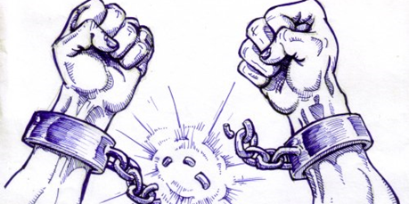
Galatians 5:1—It was for freedom that Christ set us free; therefore keep standing firm and do not be subject again to a yoke of slavery.

Slide 18
Romans 8:2—For the law of the Spirit of life in Christ Jesus has set you free from the law of sin and of death.

Slide 19
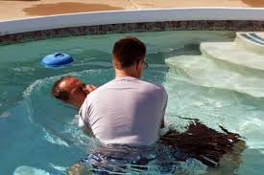
Galatians 3:27—for all of you who were baptized into Christ have clothed yourselves with Christ.

