Slide 1

Words to live by
5. Be Equipped

Slide 2

Not left to our own devices…

Slide 3
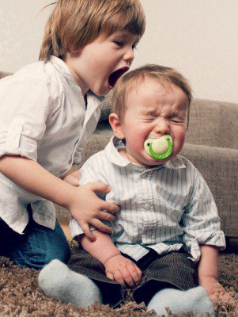
Not left to our own devices
For good reason:
Babies are helpless
Kids are cute, but they need constant monitoring.

Slide 4

Not left to our own devices
For good reason:
Teenagers are smart and resourceful, but they need help and security.

Slide 5

Ready or not…
Citizens
Friends
Neighbours
Employees
Parents

Slide 6
The Equippers…
Who got you this far?

Slide 7

The Equippers…
Who got you this far?
Mum and dad.

Slide 8

The Equippers…
Who got you this far?
Teachers

Slide 9
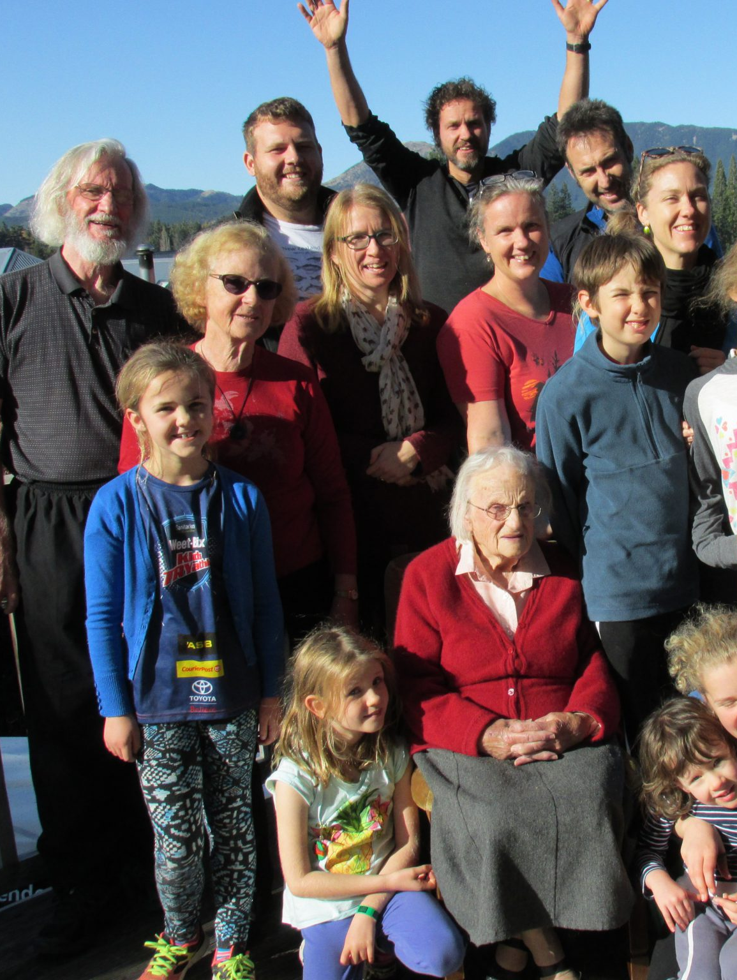
The Equippers…
Who got you this far?
Friends and family

Slide 10
The world awaits…

Slide 11
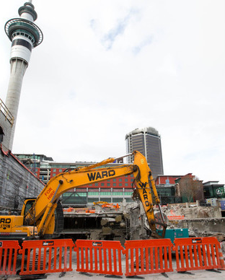



The world awaits…
World’s priorities:
Laws / Peace
Trade
Taxes
Infrastructure
Education
Health
Consumables

Slide 12

This world is NOT my Home…
This world
has a
USE-BY DATE
for all of us.

Slide 13


Slide 14

This world is NOT my Home…
This is where God has put us until Judgement.

Slide 15
This world is NOT my Home…
We must be Equipped for the journey to Heaven.

Slide 16
This world is NOT my Home…
The greatest of society builders.

Slide 17
This world is NOT my Home…
Hardworking
Honest
Moral
Caring

Slide 18
This world is NOT my Home…
John 17:15—¹⁵I do not ask You to take them out of the world, but to keep them from the evil one. (NASB95)

Slide 19
Equipping the saints
Ephesians 4:11-13—¹¹And He gave some as apostles, and some as prophets, and some as evangelists, and some as pastors and teachers, ¹²for the equipping of the saints for the work of service, to the building up of the body of Christ; ¹³until we all attain to the unity of the faith, and of the knowledge of the Son of God, to a mature man, to the measure of the stature which belongs to the fullness of Christ. (NASB95)

Slide 20

Equipped for every Good work
The church:
Elders, Preachers and Teachers.

Slide 21

2 Timothy 3:16-17—¹⁶All Scripture is inspired by God and profitable for teaching, for reproof, for correction, for training in righteousness; ¹⁷so that the man of God may be adequate, equipped for every good work. (NASB95)

Slide 22
Hebrews 13:20-21—²⁰Now the God of peace,…²¹equip you in every good thing to do His will, working in us that which is pleasing in His sight…(NASB95)

Slide 23
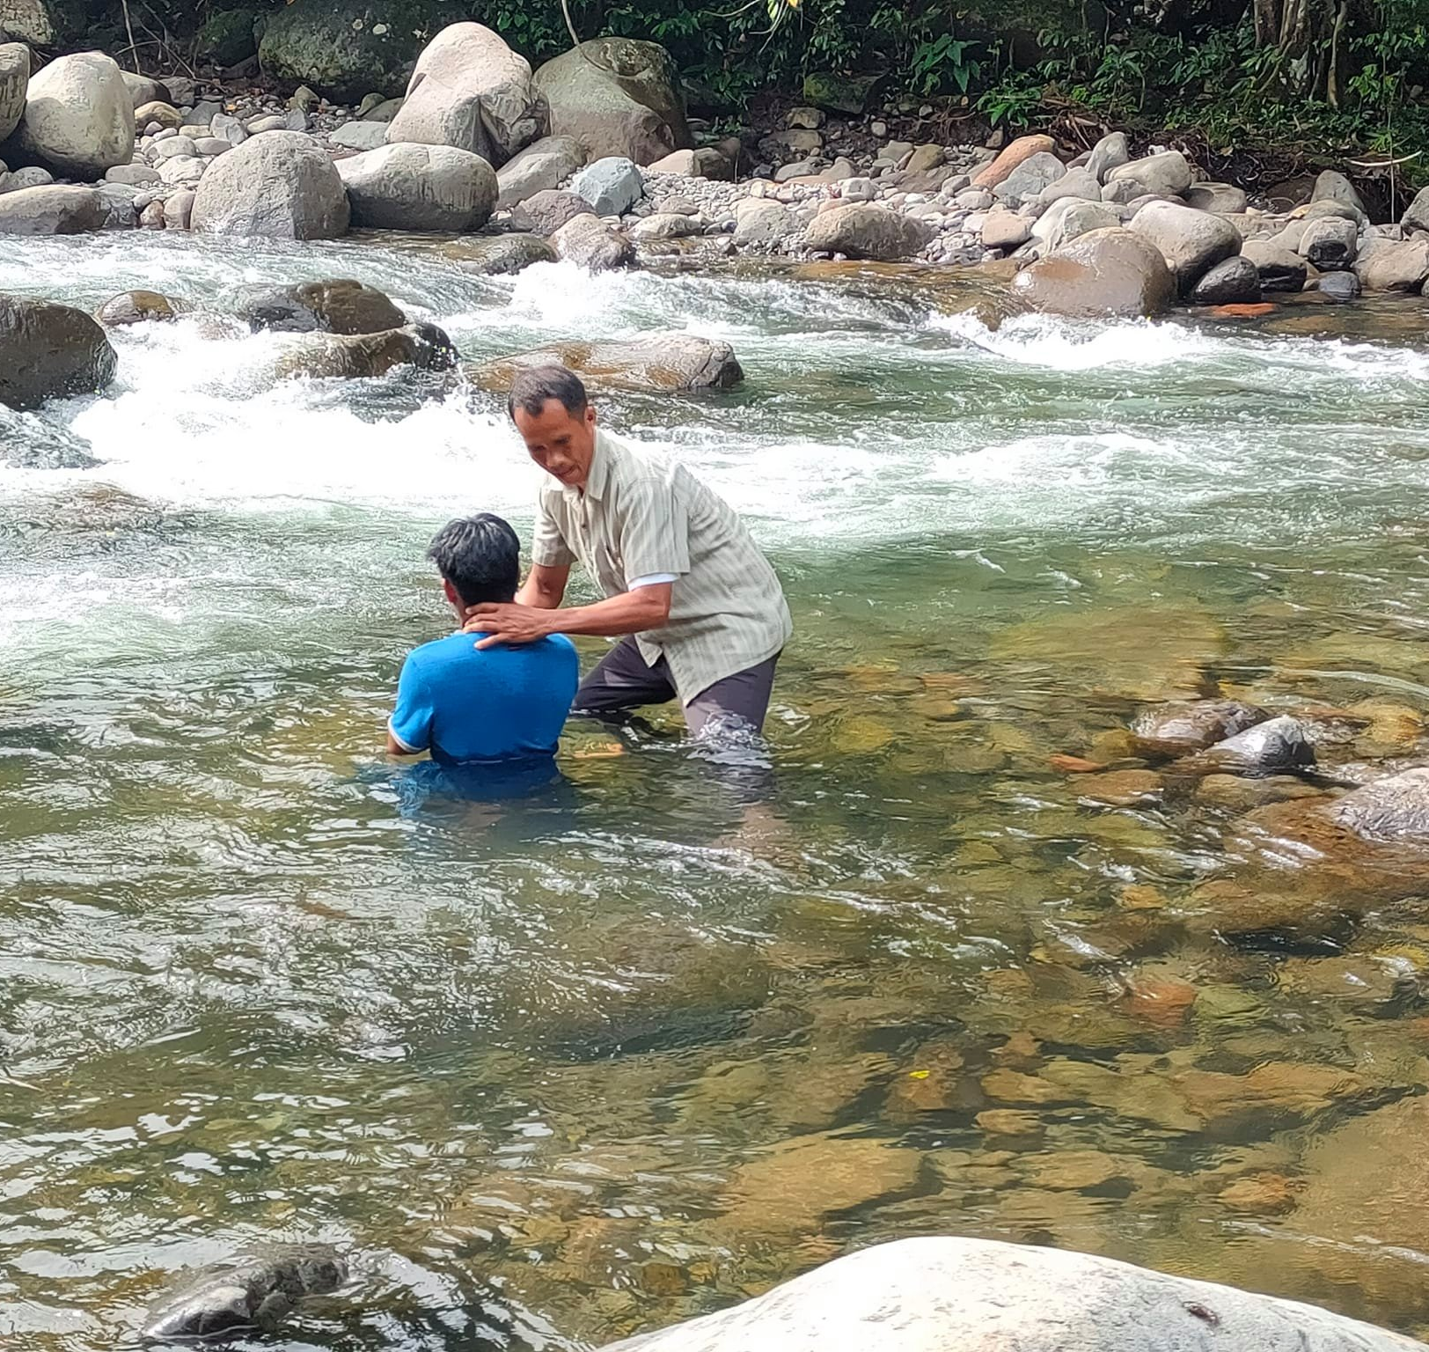
“Baptism now saves you” (1Pet.3:21).
Matthew 28:19-20—¹⁹Go therefore and make disciples of all the nations, baptizing them in the name of the Father and the Son and the Holy Spirit, ²⁰teaching them to observe all that I commanded you; and lo, I am with you always, even to the end of the age.” (NASB95)

