Slide 1

Words to live by…
7. Be
Holy!

Slide 2
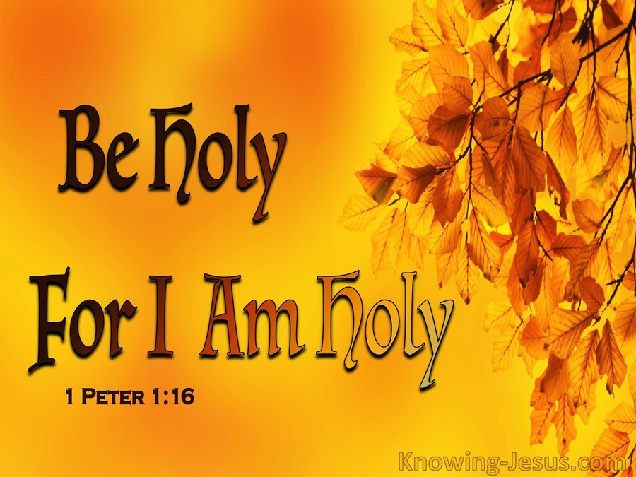
The Holiness of God
“Holy,
Holy,
Holy!”

Slide 3
The Holiness of God
Isaiah 6:3—
And one called to another and said: “Holy, holy, holy is the Lord of hosts; the whole earth is full of his glory!”

Slide 4
The Holiness of God
Revelation 4:8—
And the four living creatures, each of them with six wings, are full of eyes all around and within, and day and night they never cease to say, “Holy, holy, holy, is the Lord God Almighty, who was and is and is to come!”

Slide 5
The Holiness of God
Refers to
God
being
"set apart"

Slide 6
The Holiness of God
Distinct from all of creation.

Slide 7
The Holiness of God
He is
separate
from
sin, corruption,
and
impurity.

Slide 8
The Holiness of God
He is
perfect
in all ways.

Slide 9
The Holiness of God
He is exceptional, in a category all by Himself.

Slide 10
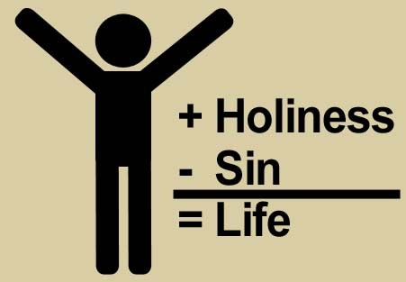
Personal Holiness:
You and me?

Slide 11
Personal Holiness:
Not something that we talk a lot about in the church.

Slide 12
Personal Holiness:
We talk a
lot about
salvation,
forgiveness,
God’s promises.

Slide 13
Personal Holiness:
Things that make people nervous are avoided.

Slide 14
Personal Holiness:
We’re afraid that we don’t meet that standard.

Slide 15

Vital to our salvation
Hebrews 12:14—
Make every effort to live in peace with everyone and to be holy; without holiness no one will see the Lord.

Slide 16
Vital to our salvation
Hebrews 12:14—
Make every effort to live in peace with everyone and to be holy; without holiness no one will see the Lord.

Slide 17
A Life Set Apart to God…
1 Peter 2:9-10—
⁹But you are a
chosen race,
a royal priesthood,
a holy nation,
a people for his own possession,
that you may proclaim the excellencies of him
who called you out of darkness
into his marvellous light…

Slide 18
A Life Set Apart to God…
1 Peter 2:9-10—
…¹⁰Once you were not a people,
but now you are God's people;
once you had not received mercy,
but now you have received mercy. (ESV)

Slide 19
A Life Set Apart to God…
1 Peter 1:13-16—
¹³ Therefore, preparing your minds for action,
and being sober-minded,
set your hope fully on the grace that will be
brought to you at the revelation of Jesus
Christ…

Slide 20
A Life Set Apart to God…
1 Peter 1:13-16—
…¹⁴ As obedient children,
do not be conformed to the passions of your former ignorance,
¹⁵ but as he who called you is holy,
you also be holy in all your conduct,
¹⁶since it is written, “You shall be holy, for I am holy.” (ESV)

Slide 21


Slide 22
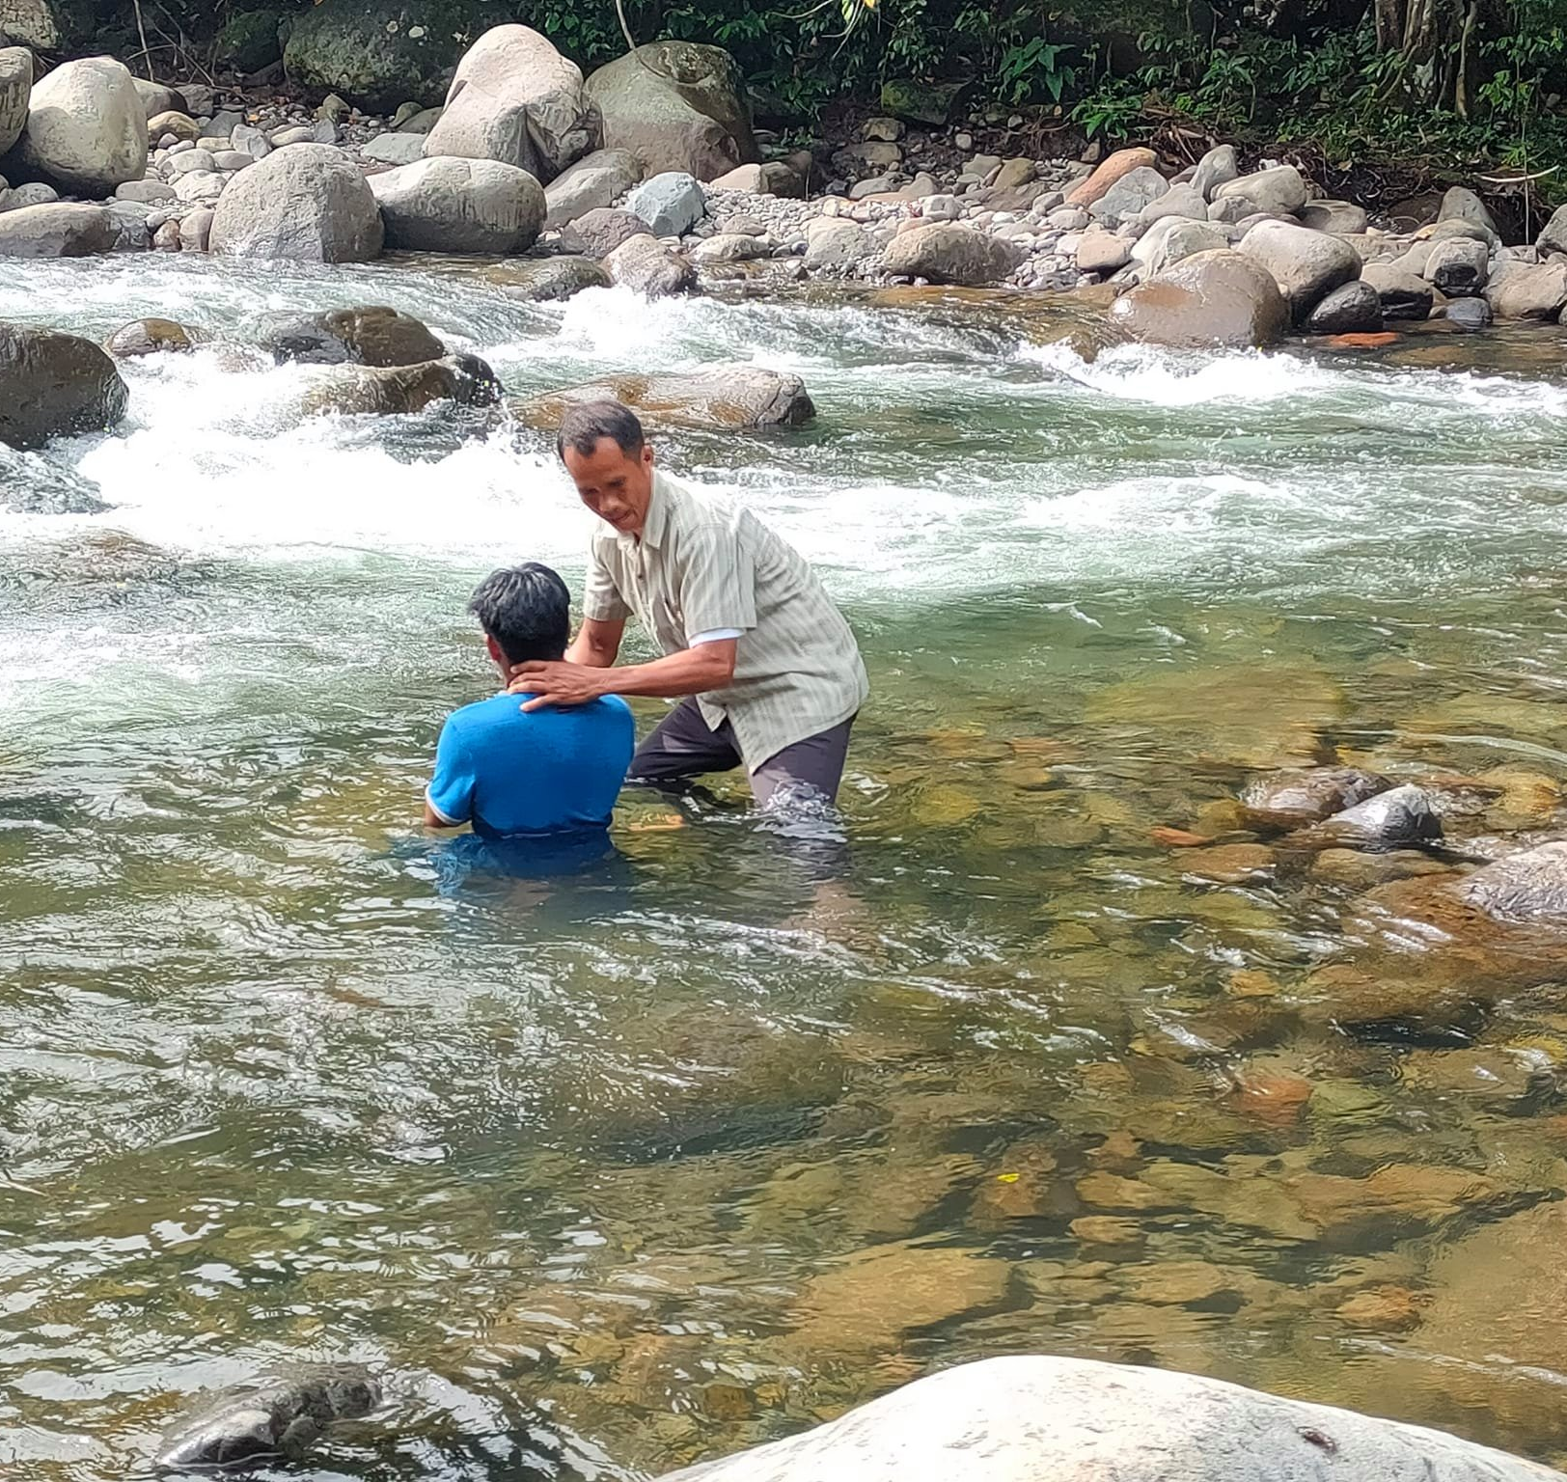
“Baptism now saves you” (1Pet.3:21).
Matthew 28:19-20—¹⁹Go therefore and make disciples of all the nations, baptizing them in the name of the Father and the Son and the Holy Spirit, ²⁰teaching them to observe all that I commanded you; and lo, I am with you always, even to the end of the age.” (NASB95)

