Slide 1
“A Gospel Tough Enough!”
John Staiger
Morningside Church of Christ
Sunday 24 October 2021
PM Sermon
Broadcast on Facebook Live from Massey, Auckland, Aotearoa/NZ.
www.morningsidechurchofchrist.org.nz

Slide 2
A Gospel Tough Enough

Slide 3
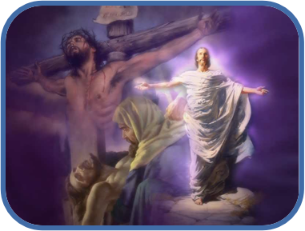
A Gospel Tough Enough—
1. The Gospel Defined

Slide 4
A Gospel Tough Enough—
1. The Gospel Defined
1Cor.15:1-4—
Now I make known to you, brethren, the gospel which I preached to you, which also you received, in which also you stand…

Slide 5
A Gospel Tough Enough—
1. The Gospel Defined
1Cor.15:1-4—
²by which also you are saved, if you hold fast the word which I preached to you, unless you believed in vain…

Slide 6
A Gospel Tough Enough—
1. The Gospel Defined
1Cor.15:1-4—
³ For I delivered to you as of first importance what I also received, that Christ died for our sins according to the Scriptures,…

Slide 7
A Gospel Tough Enough—
1. The Gospel Defined
1Cor.15:1-4—
⁴and that He was buried, and that He was raised on the third day according to the Scriptures, (NASB)

Slide 8

A Gospel Tough Enough—
2. Laid back Gospel

Slide 9
A Gospel Tough Enough—
2. Laid back Gospel
Domesticated religion.

Slide 10
A Gospel Tough Enough—
2. Laid back Gospel
Domesticated religion.
Something I can feel at home with.

Slide 11
A Gospel Tough Enough—
2. Laid back Gospel
Domesticated religion.
Something I can feel at home with.
No need to get too carried away.

Slide 12
A Gospel Tough Enough—
2. Laid back Gospel
Domesticated religion.
Something I can feel at home with.
No need to get too carried away.
Traditions…

Slide 13
A Gospel Tough Enough—
2. Laid back Gospel
The Christmas story teaches children to share.

Slide 14
A Gospel Tough Enough—
2. Laid back Gospel
The Christmas story teaches children to share.
Family Bible story time.

Slide 15
A Gospel Tough Enough—
2. Laid back Gospel
The Christmas story teaches children to share.
Family Bible story time.
Sunday School is good for the kids.

Slide 16
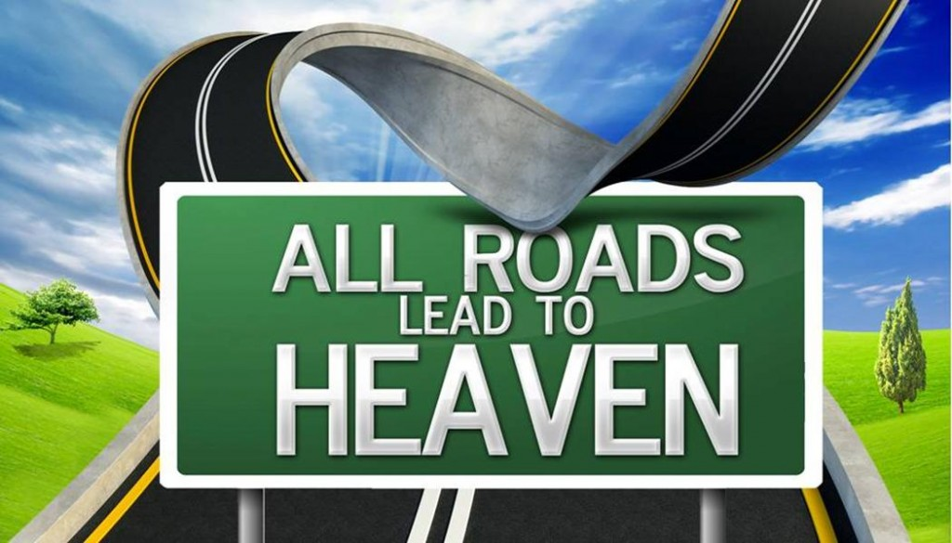
A Gospel Tough Enough—
3. Inclusive Gospel

Slide 17
A Gospel Tough Enough—
3. Inclusive Gospel
All religions lead to heaven.

Slide 18
A Gospel Tough Enough—
3. Inclusive Gospel
All religions lead to heaven.
Jesus was “one” of the great philosophers.

Slide 19
A Gospel Tough Enough—
3. Inclusive Gospel
All religions lead to heaven.
Jesus was “one” of the great philosophers.
All faiths do a lot of good.

Slide 20
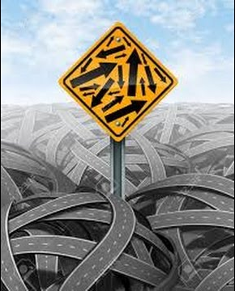

A Gospel Tough Enough—
4. Can the Gospel Stand?

Slide 21
A Gospel Tough Enough—
4. Can the Gospel Stand?
Things that terrify
  ISIS
  Murder.
  War.
  Unsafe streets.

Slide 22
A Gospel Tough Enough—
4. Can the Gospel Stand?
Things that keep you awake—
  Tension.
  Hate.
  Meanness .
  Bullying…

Slide 23
A Gospel Tough Enough—
4. Can the Gospel Stand?
Everyday evils—
  Lies.
  Theft.
  Moodiness.
  Prejudice…

Slide 24
A Gospel Tough Enough—
4. Can the Gospel Stand?
Persecution—
  Terrorized.
  Murdered.
  Kidnapped.
  Beaten…

Slide 25
A Gospel Tough Enough—
4. Can the Gospel Stand?
Hopelessness of—
  Bad politics.
  Unemployment.
  Family breakup.
  Earthquakes.
  Terminal illness.
  Disease…

Slide 26
A Gospel Tough Enough—
4. Can the Gospel Stand?
You
never can
quite
get your balance
and
feel stable.

Slide 27

A Gospel Tough Enough—
5. On the Contrary—It is standing!

Slide 28
A Gospel Tough Enough—
5. On the Contrary—It is standing!
the more horrible

Slide 29
A Gospel Tough Enough—
5. On the Contrary—It is standing!
the more horrible
the more fearful

Slide 30
A Gospel Tough Enough—
5. On the Contrary—It is standing!
the more horrible
the more fearful
the more uncertain

Slide 31
A Gospel Tough Enough—
5. On the Contrary—It is standing!
the more horrible
the more fearful
the more uncertain
the more unstable

Slide 32
A Gospel Tough Enough—
5. On the Contrary—It is standing!
the more horrible
the more fearful
the more uncertain
the more unstable
the more stomach-turning

Slide 33
A Gospel Tough Enough—
5. On the Contrary—It is standing!
the more horrible
the more fearful
the more uncertain
the more unstable
the more stomach-turning
the more relevant the gospel of Jesus Christ is!

Slide 34
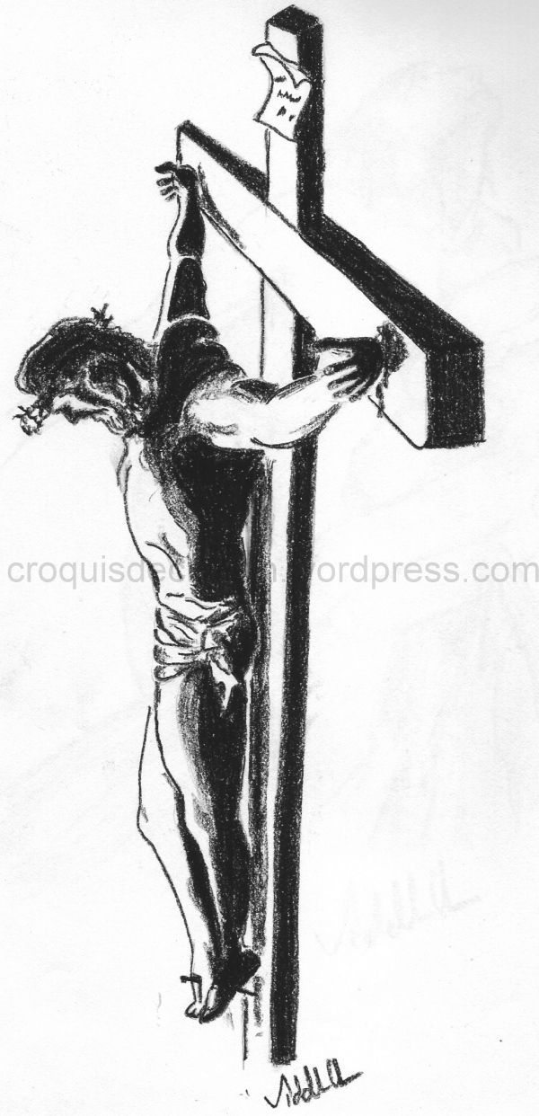
A Gospel Tough Enough—
6. HOPE in a hopeless world.

Slide 35
A Gospel Tough Enough—
6. HOPE in a hopeless world.
Jesus didn’t die for you
because it was fun
He hung there for love,
because it had to be done.
But in spite of the anguish,
his word was fulfilled.
Because love is not a feeling,
it’s an act of your will.
(Don Francisco)

Slide 36
A Gospel Tough Enough—
6. HOPE in a hopeless world.
Jesus has changed the world.

Slide 37
A Gospel Tough Enough—
6. HOPE in a hopeless world.
Jesus has changed the world.
He transforms the repentant.

Slide 38
A Gospel Tough Enough—
6. HOPE in a hopeless world.
Jesus has changed the world.
He transforms the repentant.
Makes our lives tools in His hands.

Slide 39
A Gospel Tough Enough—
6. HOPE in a hopeless world.
Jesus has changed the world.
He transforms the repentant.
Makes our lives tools in His hands.
Gives wisdom to those who ask.

Slide 40
A Gospel Tough Enough—
6. HOPE in a hopeless world.
Jesus has changed the world.
He transforms the repentant.
Makes our lives tools in His hands.
Gives wisdom to those who ask.
Guidance for those who seek Him.

Slide 41
A Gospel Tough Enough—
6. HOPE in a hopeless world.
Jesus has changed the world.
He transforms the repentant.
Makes our lives tools in His hands.
Gives wisdom to those who ask.
Guidance for those who seek Him.
Christians take the Bible, truth, congregations, generosity, morals, unity, peace, health, education, law, order,…

Slide 42
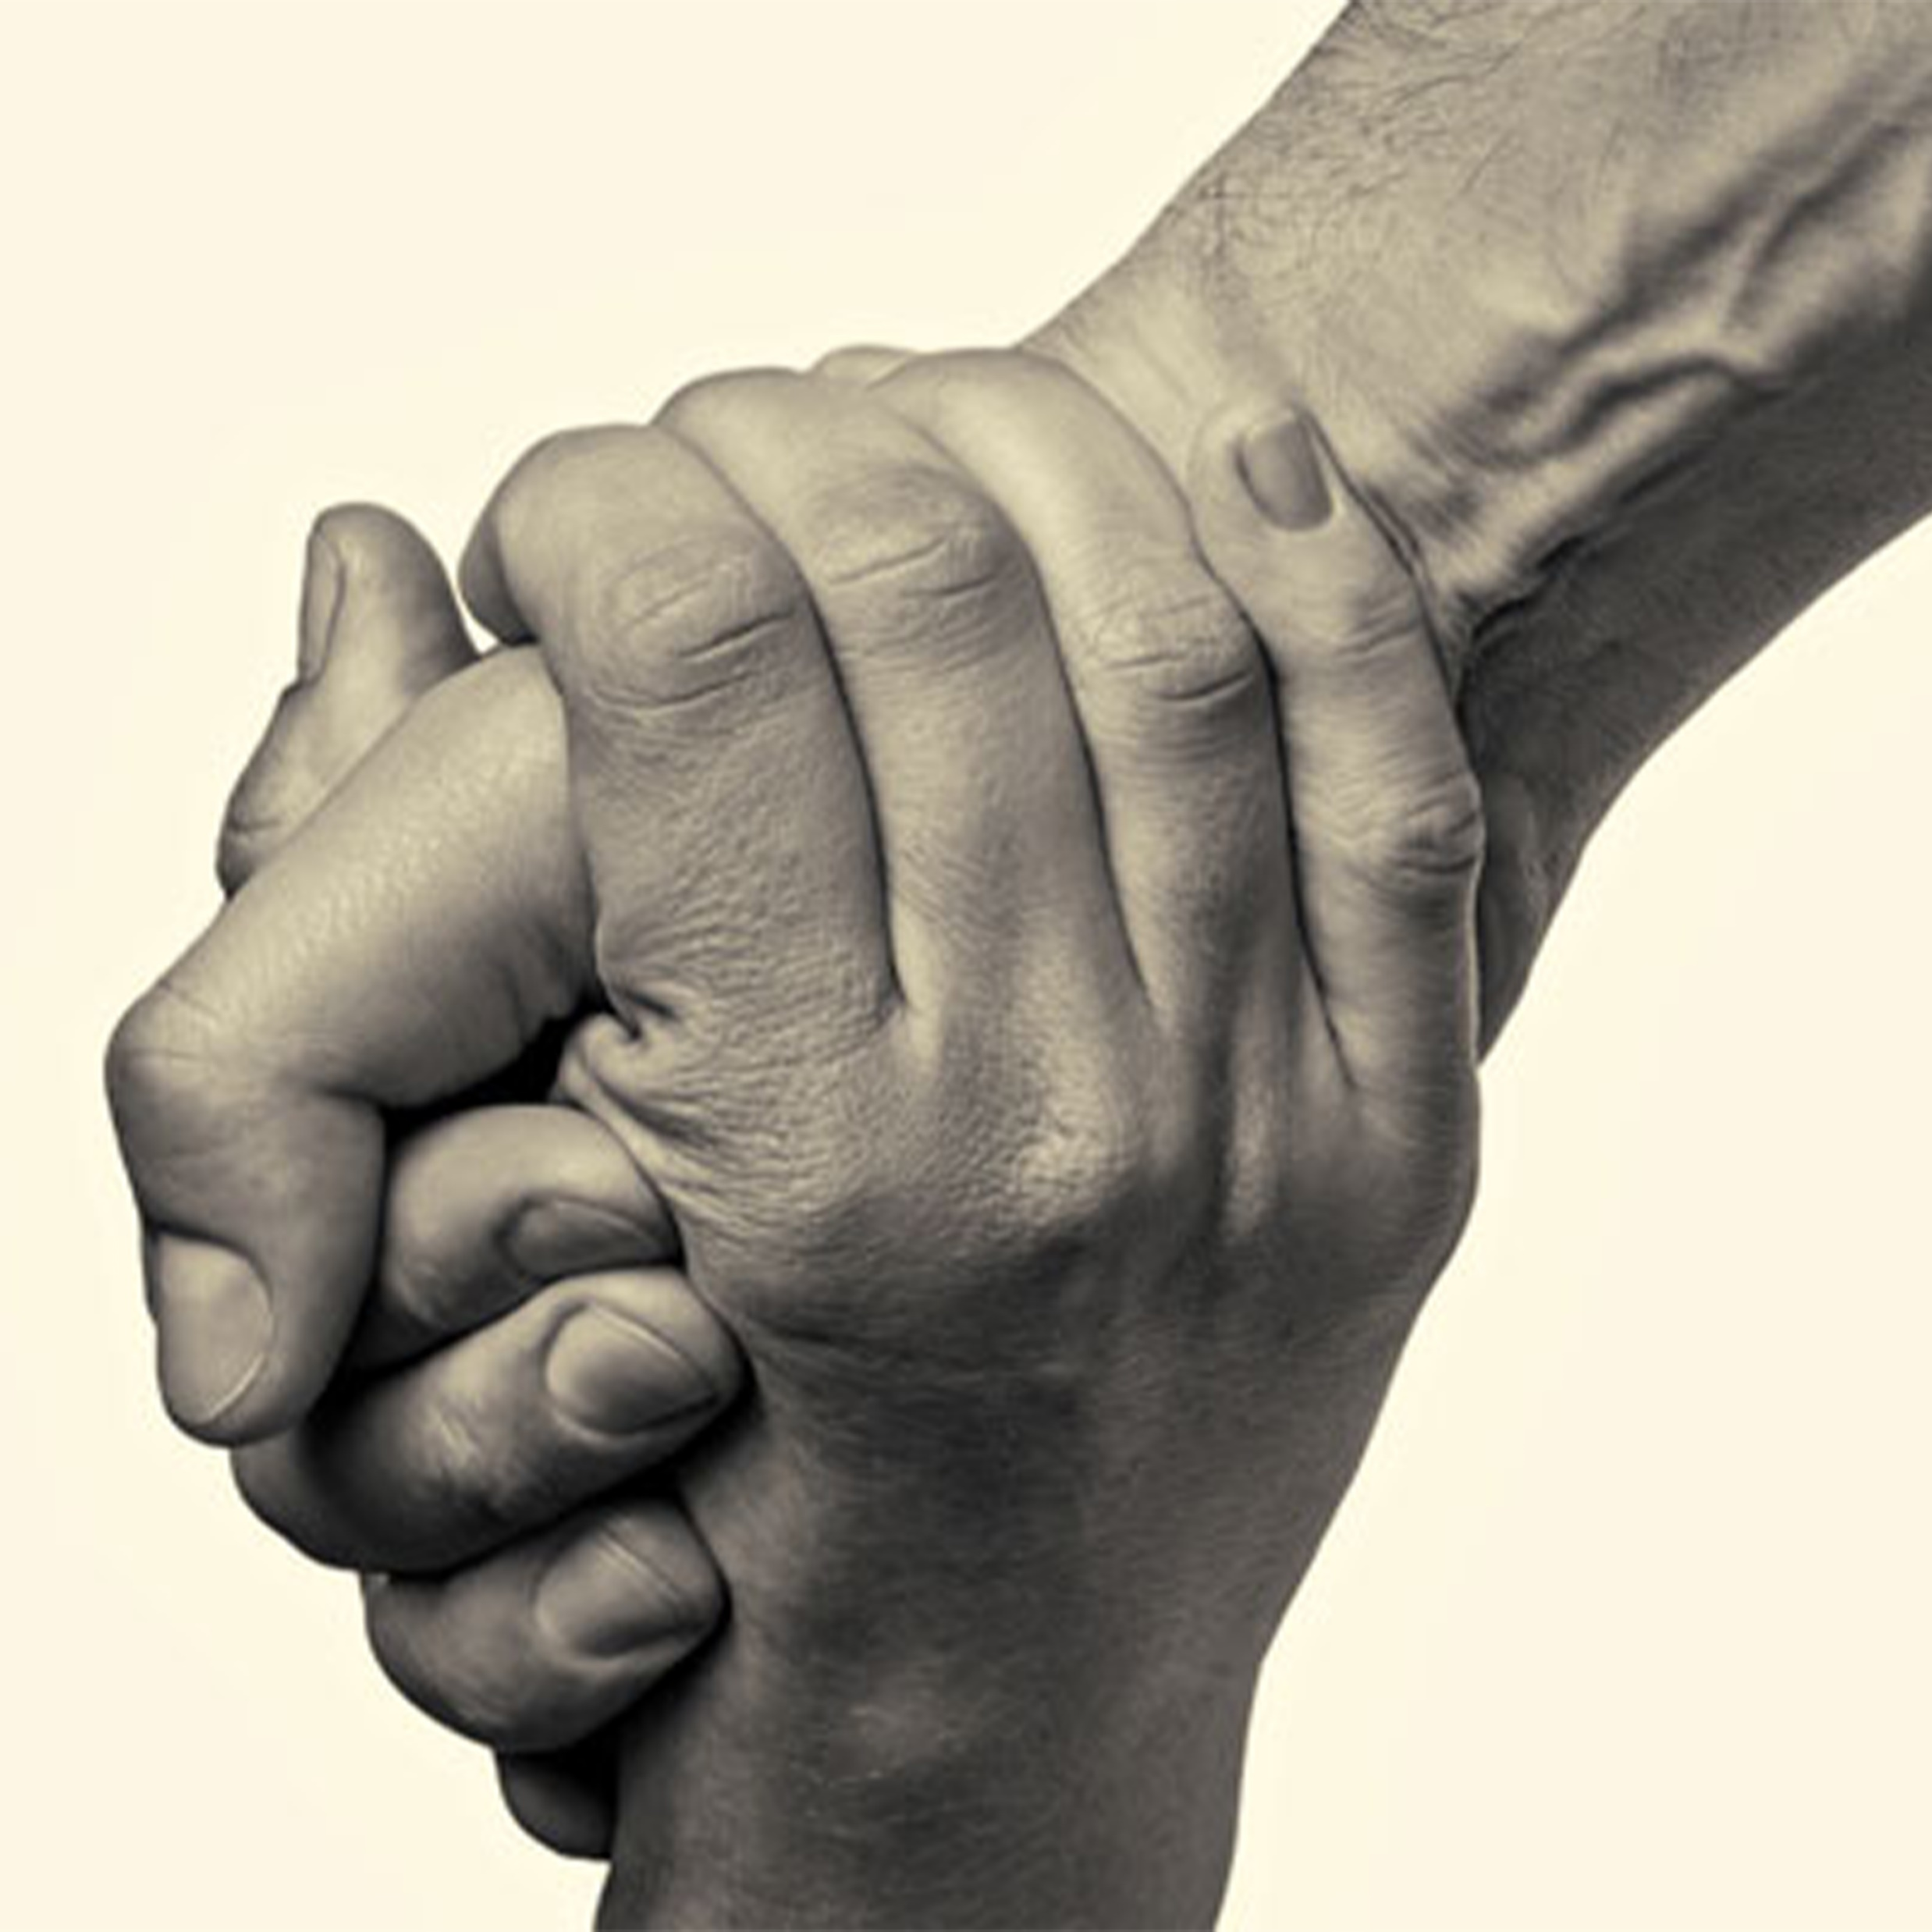
A Gospel Tough Enough—
7. Strength for the Journey…

Slide 43

A Gospel Tough Enough—
7. Strength for the Journey…
2Cor.4:7-9—
⁷But we have this treasure in earthen vessels, so that the surpassing greatness of the power will be of God and not from ourselves;…

Slide 44
A Gospel Tough Enough—
7. Strength for the Journey…
2Cor.4:7-9—
⁸ we are afflicted in every way,

Slide 45
A Gospel Tough Enough—
7. Strength for the Journey…
2Cor.4:7-9—
⁸ we are afflicted in every way, but not crushed;

Slide 46
A Gospel Tough Enough—
7. Strength for the Journey…
2Cor.4:7-9—
⁸ we are afflicted in every way, but not crushed;
perplexed,

Slide 47
A Gospel Tough Enough—
7. Strength for the Journey…
2Cor.4:7-9—
⁸ we are afflicted in every way, but not crushed;
perplexed,
but not despairing;

Slide 48
A Gospel Tough Enough—
7. Strength for the Journey…
2Cor.4:7-9—
⁸ we are afflicted in every way, but not crushed;
perplexed,
but not despairing;
⁹persecuted,

Slide 49
A Gospel Tough Enough—
7. Strength for the Journey…
2Cor.4:7-9—
⁸ we are afflicted in every way, but not crushed;
perplexed,
but not despairing;
⁹persecuted,
but not forsaken;

Slide 50
A Gospel Tough Enough—
7. Strength for the Journey…
2Cor.4:7-9—
⁸ we are afflicted in every way, but not crushed;
perplexed,
but not despairing;
⁹persecuted,
but not forsaken;
struck down,

Slide 51
A Gospel Tough Enough—
7. Strength for the Journey…
2Cor.4:7-9—
⁸ we are afflicted in every way, but not crushed;
perplexed,
but not despairing;
⁹persecuted,
but not forsaken;
struck down,
but not destroyed;

Slide 52
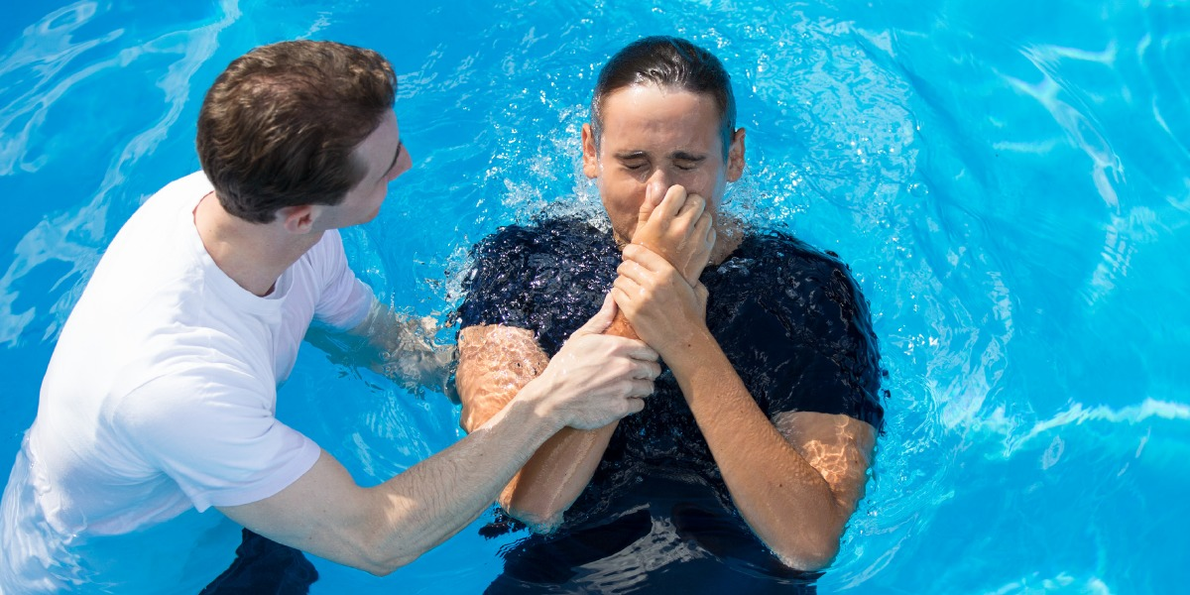
A Gospel Tough Enough—
8. Starts here…
Acts 22:16—¹⁶Now why do you delay? Get up and be baptized, and wash away your sins, calling on His name.’ (NASB95)

