Slide 1
Series: Heavenward Bound.
Part 1. “On a Mission.”
John Staiger
Morningside Church of Christ
Sunday 24 October 2021
AM Sermon
Broadcast on Facebook Live from
Massey, Auckland, Aotearoa/NZ.

Slide 2

Heavenward Bound.
1. On a Mission…

Slide 3
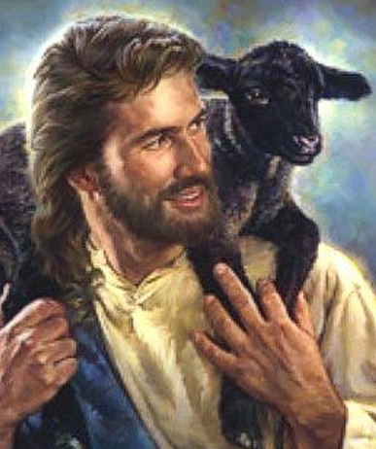
On a Mission—
1. The Way is our Good Shepherd.
Luke 19:10—
¹⁰For the Son of Man has come to seek and to save that which was lost.” (NASB95)

Slide 4
On a Mission—
1. The Way is our Good Shepherd…
The way of:
  Love for all
  Self-sacrifice
  Peace
  Unity

Slide 5

On a Mission—
2. Go and do Likewise…
Matthew 9:37-38—
³⁷ Then He *said to His disciples, “The harvest is plentiful, but the workers are few. ³⁸Therefore beseech the Lord of the harvest to send out workers into His harvest.” (NASB95)

Slide 6
On a Mission—
2. Go and do Likewise…
Think: Missionary Journeys…
Go yourself and Send others:
  Plant congregations.
  Foreign lands.

Slide 7

On a Mission—
3. Ready to Go…
Isaiah 6:8—

Slide 8
On a Mission—
3. Ready to Go…
Isaiah 6:8—
  Send me to:
    Family
    Work
    School

Slide 9

On a Mission—
4. Eyes on the Prize…
Hebrews 12:2—
²fixing our eyes on Jesus, the author and perfecter of faith, who for the joy set before Him endured the cross, despising the shame, and has sat down at the right hand of the throne of God. (NASB95)

Slide 10
On a Mission—
4. Eyes on the Prize…
Hebrews 12:2—
Too many distractions:
  This world is not my home.
  I must stop setting up as if it is.
  Entertainment must be limited.
  Relationships controlled.

Slide 11
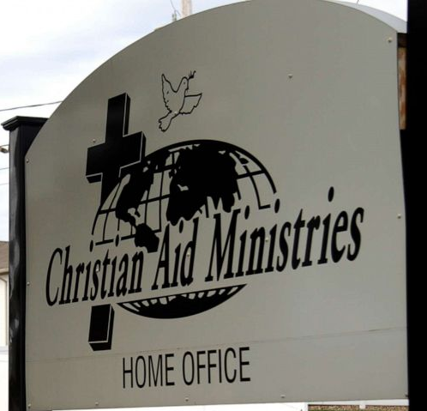
On a Mission—
5. Troubled Waters…
Romans 12:14—
¹⁴Bless those who persecute you; bless and do not curse.(NASB95)
The last thing we feel we should do is to bless the gang who kidnapped the 17 missionaries in Haiti.

Slide 12
On a Mission—
5. Troubled Waters…
Christians must expect persecution.
Churches will have problems.
Wolves in sheep’s clothing will kill and devour.
The last thing we feel we should do is to bless the gang who kidnapped the 17 missionaries in Haiti.

Slide 13

On a Mission—
7. Never let a chance go by…
Colossians 4:5
⁵Conduct yourselves with wisdom toward outsiders, making the most of the opportunity.(NASB95)

Slide 14
On a Mission—
7. Never let a chance go by…
See every person as a “Christian to be.”
“Lead me to some soul today…”
As they appear.
The ones you know.
Make new friends
Make a list.

Slide 15

On a Mission—
8. Get ready…
1 Peter 3:15—
¹⁵…always being ready to make a defense to everyone who asks you to give an account for the hope that is in you,… (NASB95)

Slide 16
On a Mission—
8. Get ready…
Crack that Bible often.
Listen on the internet.
Debates
Sermons
Read, read, read…

Slide 17

On a Mission—
9. Fear not…!
1 John 4:18—
¹⁸There is no fear in love; but perfect love casts out fear, because fear involves punishment, and the one who fears is not perfected in love. (NASB95)

Slide 18
On a Mission—
9. Fear not…!
“Lo, I am with you…”
Fear will cripple you.
Satan weaponizes fear in all its forms.
“Fear not…I go to prepare a place for you…” (Jn.14:1-3).

Slide 19
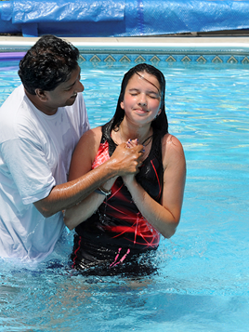
“Baptism now saves you” (1Pet.3:21).
²¹Corresponding to that, baptism now saves you—not the removal of dirt from the flesh, but an appeal to God for a good conscience— through the resurrection of Jesus Christ, (NASB95)

