Slide 1
Series: Heavenward Bound.
Part 2. “Everybody wants to go hear their name…”
John Staiger
Morningside Church of Christ
Sunday 31 October 2021
AM Sermon
Broadcast on Facebook Live from
Massey, Auckland, Aotearoa/NZ.

Slide 2

Heavenward Bound.
Part 2. Everybody wants to hear their name…

Slide 3
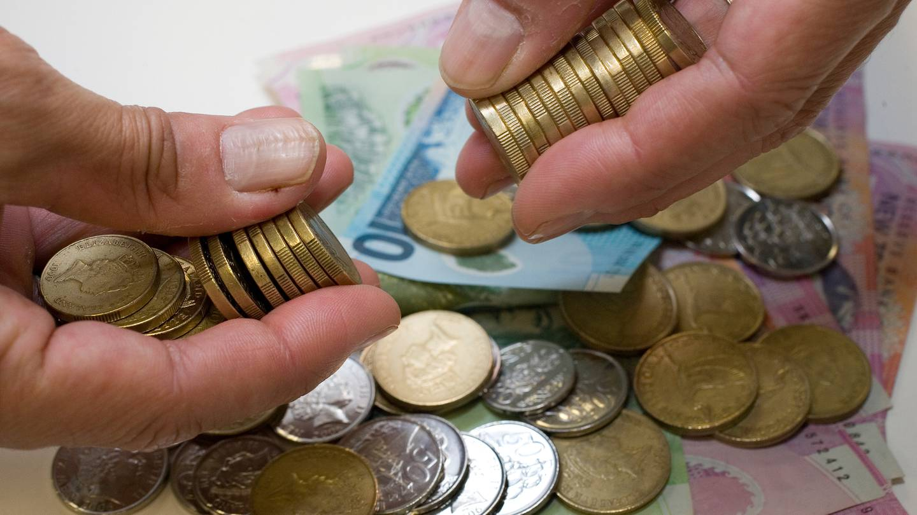
Everybody wants to hear their name—
Not the stuff of life…

Slide 4

Everybody wants to hear their name—
Life has twists and turns…Some for the better, some for the worse…!

Slide 5

Everybody wants to hear their name—
Halyna Hutchins.
A wife and mother
Sudden death by accidental shooting on Thursday 21 October 2021.
The last thing she would have woken up thinking was that it was going to be her last day on earth.

Slide 6
Everybody wants to hear their name—
Halyna Hutchins.
A wife and mother.
Sudden death by accidental shooting on Thursday 21 October 2021.
The last thing she would have woken up thinking was that it was going to be her last day on earth.

Slide 7
Everybody wants to hear their name—
Halyna Hutchins.
A wife and mother
Sudden death by accidental shooting on Thursday 21 October 2021.
The last thing she would have woken up thinking was that it was going to be her last day on earth.

Slide 8
Everybody wants to hear their name—
Halyna Hutchins.
A wife and mother
Sudden death by accidental shooting on Thursday 21 October 2021.
The last thing she would have woken up thinking was that it was going to be her last day on earth.

Slide 9

Everybody wants to hear their name—
1. Are you on the List?

Slide 10
Everybody wants to hear their name—
1. Are you on the List?
a. On this list
Together…
(i.) Philippians 4:3—

Slide 11
Everybody wants to hear their name—
1. Are you on the List?
(i.) Philippians 4:3—
³Indeed, true companion, I ask you also to help these women who have shared my struggle in the cause of the gospel, together with Clement also and the rest of my fellow workers, whose names are in the book of life. (NASB95)

Slide 12
Everybody wants to hear their name—
1. Are you on the List?
b. Christians will see the power of God in action against the forces of evil…
(1.) Luke 10:20—

Slide 13
Everybody wants to hear their name—
1. Are you on the List?
(i.) Luke 10:20—
²⁰Nevertheless do not rejoice in this, that the spirits are subject to you, but rejoice that your names are recorded in heaven.” (NASB95)

Slide 14

Everybody wants to hear their name—
2. Stay on the List?

Slide 15
Everybody wants to hear their name—
2. Stay on the List?
a. Endurance is vital…
(i.) Matthew 24:13—
Philippians 3:14

Slide 16
Everybody wants to hear their name—
2. Stay on the List?
(i.) Matthew 24:13—
¹³But the one who endures to the end, he will be saved. (NASB95)
Philippians 3:14

Slide 17
Everybody wants to hear their name—
2. Stay on the List?
b. Take extreme care, you can lose your salvation—
If you allow it!
(i.) 2 Peter 2:20—
(ii.) Revelation 21:27—
(iii.)1 Corinthians 6:9-11—
Philippians 3:14

Slide 18
Everybody wants to hear their name—
2. Stay on the List?
(i.) 2 Peter 2:20—
²⁰For if, after they have escaped the defilements of the world by the knowledge of the Lord and Saviour Jesus Christ, they are again entangled in them and are overcome, the last state has become worse for them than the first. (NASB95)
Philippians 3:14

Slide 19
Everybody wants to hear their name—
2. Stay on the List?
(ii.) Revelation 21:27
²⁷and nothing unclean, and no one who practices abomination and lying, shall ever come into it, but only those whose names are written in the Lamb’s book of life. (NASB95)
Philippians 3:14

Slide 20
Everybody wants to hear their name—
2. Stay on the List?
(iii.) 1 Corinthians 6:9-11
⁹Or do you not know that the unrighteous will not inherit the kingdom of God? Do not be deceived; neither fornicators, nor idolaters, nor adulterers, nor effeminate, nor homosexuals,…
Philippians 3:14

Slide 21
Everybody wants to hear their name—
2. Stay on the List?
(iii.) 1 Corinthians 6:9-11
…¹⁰nor thieves, nor the covetous, nor drunkards, nor revilers, nor swindlers, will inherit the kingdom of God…
Philippians 3:14

Slide 22
Everybody wants to hear their name—
2. Stay on the List?
(iii.) 1 Corinthians 6:9-11
…¹¹Such were some of you; but you were washed, but you were sanctified, but you were justified in the name of the Lord Jesus Christ and in the Spirit of our God. (NASB95)
Philippians 3:14

Slide 23

Everybody wants to hear their name—
3. Before the Throne…

Slide 24
Everybody wants to hear their name—
3. Before the Throne…
a. The first thing on the schedule…
(i.) 2 Corinthians 5:10

Slide 25
Everybody wants to hear their name—
3. Before the Throne…
2 Corinthians 5:10—
¹⁰For we must all appear before the judgment seat of Christ, so that each one may be recompensed for his deeds in the body, according to what he has done, whether good or bad. (NASB95)

Slide 26

Everybody wants to hear their name—
4. Well done!

Slide 27
Everybody wants to hear their name—
4. Well done!
a. In the Joy of His Presence…
(i.) Matthew 25:21—

Slide 28
Everybody wants to hear their name—
4. Well done!
(i.) Matthew 25:21—
²¹His master said to him, ‘Well done, good and faithful slave. You were faithful with a few things, I will put you in charge of many things; enter into the joy of your master.’ (NASB95)

Slide 29
Everybody wants to hear their name—
4. Well done!
b. The cares of this world will have ended…
(i.) Revelation 21:4—

Slide 30
Everybody wants to hear their name—
4. Well done!
(i.) Revelation 21:4—
and He will wipe away every tear from their eyes; and there will no longer be any death; there will no longer be any mourning, or crying, or pain; the first things have passed away.” (NASB95)

Slide 31
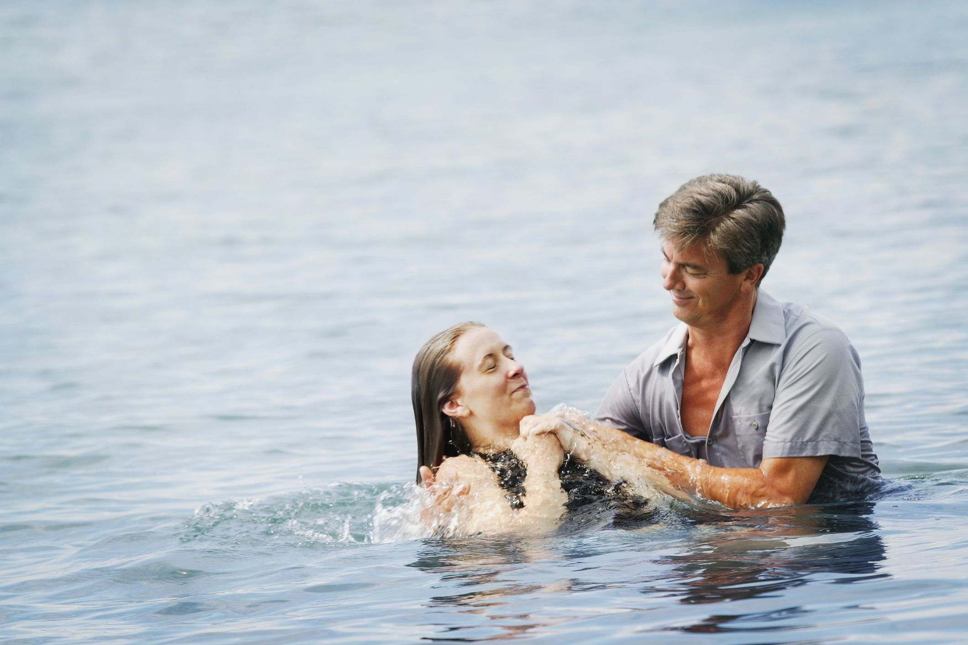
Acts 22:16—
Now why do you delay? Get up and be baptized, and wash away your sins, calling on His name.’

