Slide 1
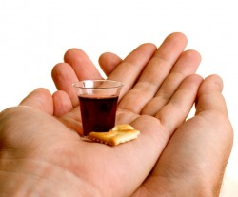
“Do this in remembrance of Me…”

Slide 2
Series: Life in the Son.
Part 2. “This is Eternal Life.”
John Staiger
Morningside Church of Christ
Sunday 3 October 2021
AM Sermon
Broadcast on Facebook Live from
Massey, Auckland, Aotearoa/NZ.

Slide 3
Life in the Son.
2. This is Eternal Life…

Slide 4
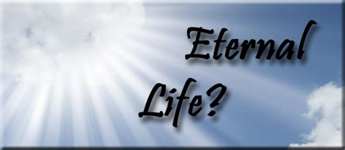
John 17:3—
³This is eternal life,
that they may know You,
the only true God,
and Jesus Christ
whom You have sent. (NASB95)

Slide 5
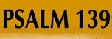

Psalm 139:1-4
O Lord, You have searched me and known me.
²You know when I sit down and when I rise up;
You understand my thought from afar.
³You scrutinize my path and my lying down,
And are intimately acquainted with all my ways.
⁴Even before there is a word on my tongue,
Behold, O Lord, You know it all.
(NASB95)

Slide 6
But whilst God knows us
perfectly,
we can only know him
imperfectly.

Slide 7
Ironically,
neither
educational enlightenment,
nor technological improvement,
nor medical advancement
has added to the furtherance
of hope.

Slide 8

John 14:8-9
⁸Philip said to Him, “Lord, show us the Father, and it is enough for us.”
⁹Jesus said to him, “Have I been so long with you, and yet you have not come to know Me, Philip?
He who has seen Me has seen the Father; how can you say, ‘Show us the Father’?

Slide 9
John 1:14
¹⁴And the Word became flesh,
and dwelt among us, and we saw His glory,
glory as of the only begotten from the
Father,
full of grace and truth.

Slide 10
John 1:18
¹⁸No one has seen God at any time;
the only begotten God
who is in the bosom of the Father,
He has explained Him.

Slide 11

Christians are realists:

Slide 12
Christians are realists:
They see this life as it is:
  Transitory.
    Unreliable.
      Frail.

Slide 13
Christians are realists:
They see this life as it is:
  Transitory.
    Unreliable.
      Frail.

Slide 14
Christians are realists:
They see this life as it is:
  Transitory.
    Unreliable.
      Frail.

Slide 15
Christians are realists:
They see this life as it is:
  Transitory.
    Unreliable.
      Frail.

Slide 16
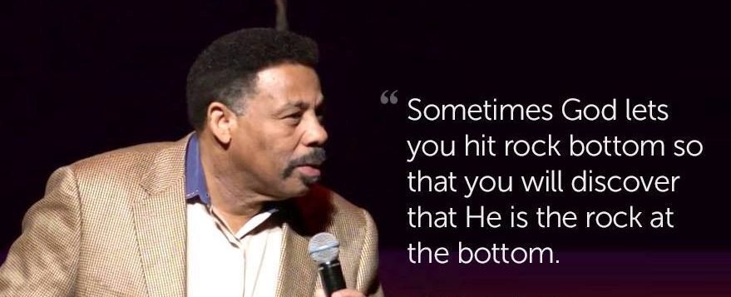
When everything else decays, what is it that is imperishable?

Slide 17
Jesus says it is the knowledge of God and of Himself.

Slide 18
So that to know Christ and God is to know Him in love and service.

Slide 19
The permanent part of our life is the part which has to do with God.

Slide 20

Adjusting to a new Reality:
Eternal Life brings hope and meaning.

Slide 21
Adjusting to a new Reality:
A purposeful investment of our days.

Slide 22
Adjusting to a new Reality:
Its everlasting and indestructible.

Slide 23
Adjusting to a new Reality:
Immortality restores us.

Slide 24
Adjusting to a new Reality:
Puts courage into frightened hearts.

Slide 25
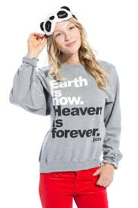
Simple test:

Slide 26
Simple test:
What is there in this world that will last?

Slide 27
Simple test:
What is there in this world that will last?
Not flesh or things…

Slide 28
Simple test:
What is there in this world that will last?
Not flesh or things…
Only that which has to do with God!

Slide 29
Make it count:
Your relationships have a promise of permanence in Christ.

Slide 30
Make it count:
Your words have the promise of eternal blessing.

Slide 31
Make it count:
Your example has the promise of Eternal Light.

Slide 32
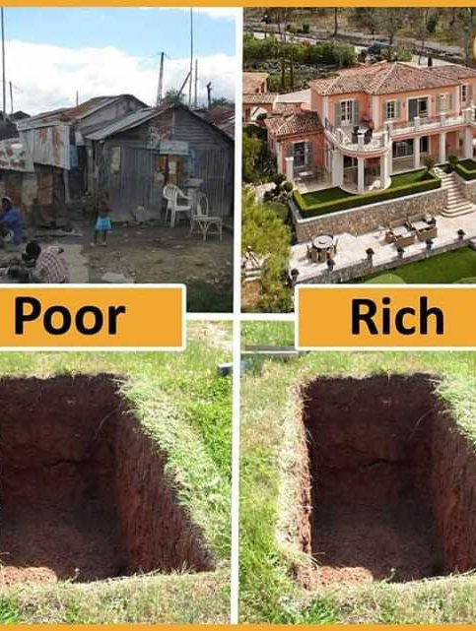
The great equalizer
In death you can keep that which has to do with God.

Slide 33
The great equalizer
To have Jesus is to have everything worth having.

Slide 34

Living abundantly in the Son:

Slide 35
Living abundantly in the Son:
Renewed enthusiasm.

Slide 36
Living abundantly in the Son:
Renewed enthusiasm.
Fired up for a principle.

Slide 37
Living abundantly in the Son:
Renewed enthusiasm.
Fired up for a principle.
Push back temptation.

Slide 38
Living abundantly in the Son:
Renewed enthusiasm.
Fired up for a principle.
Push back temptation.
Delight in the church’s success.

Slide 39
Too much gets us down in this life.

Slide 40
Too much gets us down in this life.
Too many live at a low level of joy.

Slide 41
Too much gets us down in this life.
Too many live at a low level of joy.
There is a littleness that wearies us.

Slide 42
Too much gets us down in this life.
Too many live at a low level of joy.
There is a littleness that wearies us.
It makes us ask:

Slide 43
Too much gets us down in this life.
Too many live at a low level of joy.
There is a littleness that wearies us.
It makes us ask:
"Is it worth while?"

Slide 44
Know Christ’s redemption:

Slide 45
Know Christ’s redemption:
The renewed soul sees hope in the mundane.

Slide 46
Know Christ’s redemption:
The renewed soul sees hope in the mundane.
Opportunities in the difficulties.

Slide 47
Know Christ’s redemption:
The renewed soul sees hope in the mundane.
Opportunities in the difficulties.
God’s help and wisdom for the asking.

Slide 48
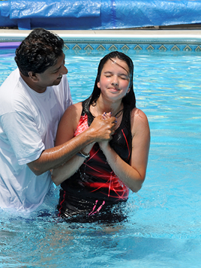
“Baptism now saves you” (1Pet.3:21).
²¹Corresponding to that, baptism now saves you—not the removal of dirt from the flesh, but an appeal to God for a good conscience—through the resurrection of Jesus Christ, (NASB95)

